Slide 1
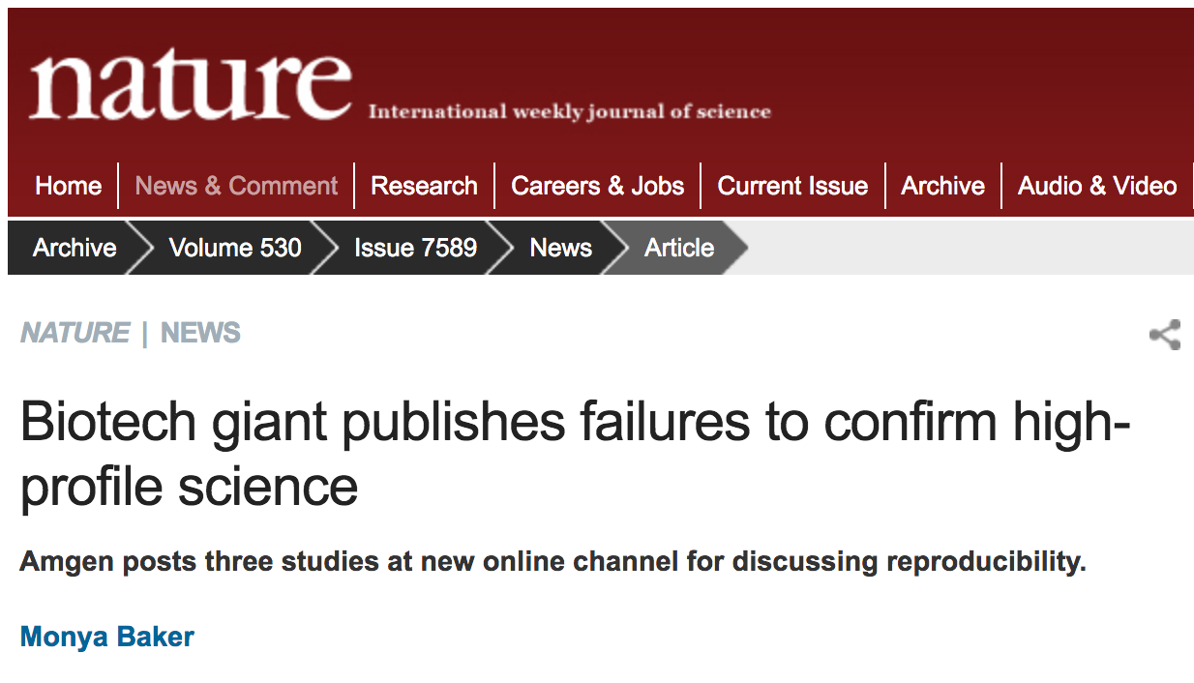
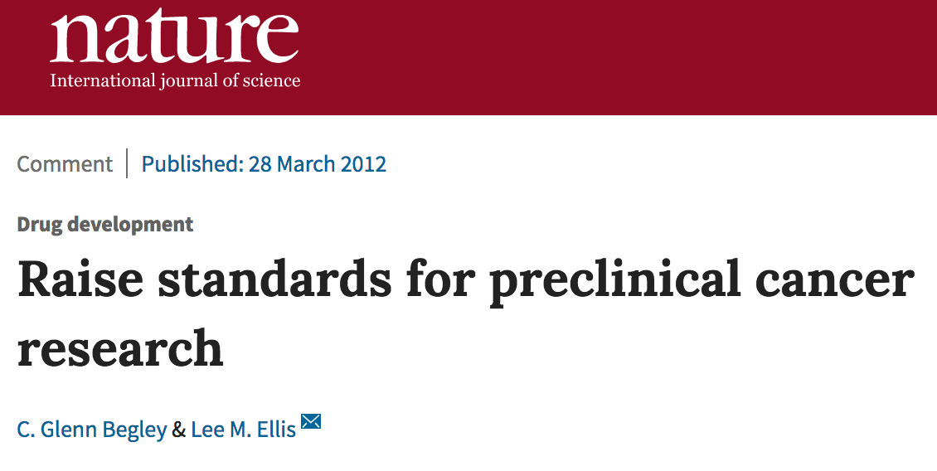
Rigor and Reproducibility
Amgen study
• 53 landmark papers
• results were attempted to be duplicated
• only 6 were reproducible
Bayer study
• 25% of studies in pre-clinical cancer research could be duplicated to point where the company would pursue further development
Are investigators cheating?

Slide 2
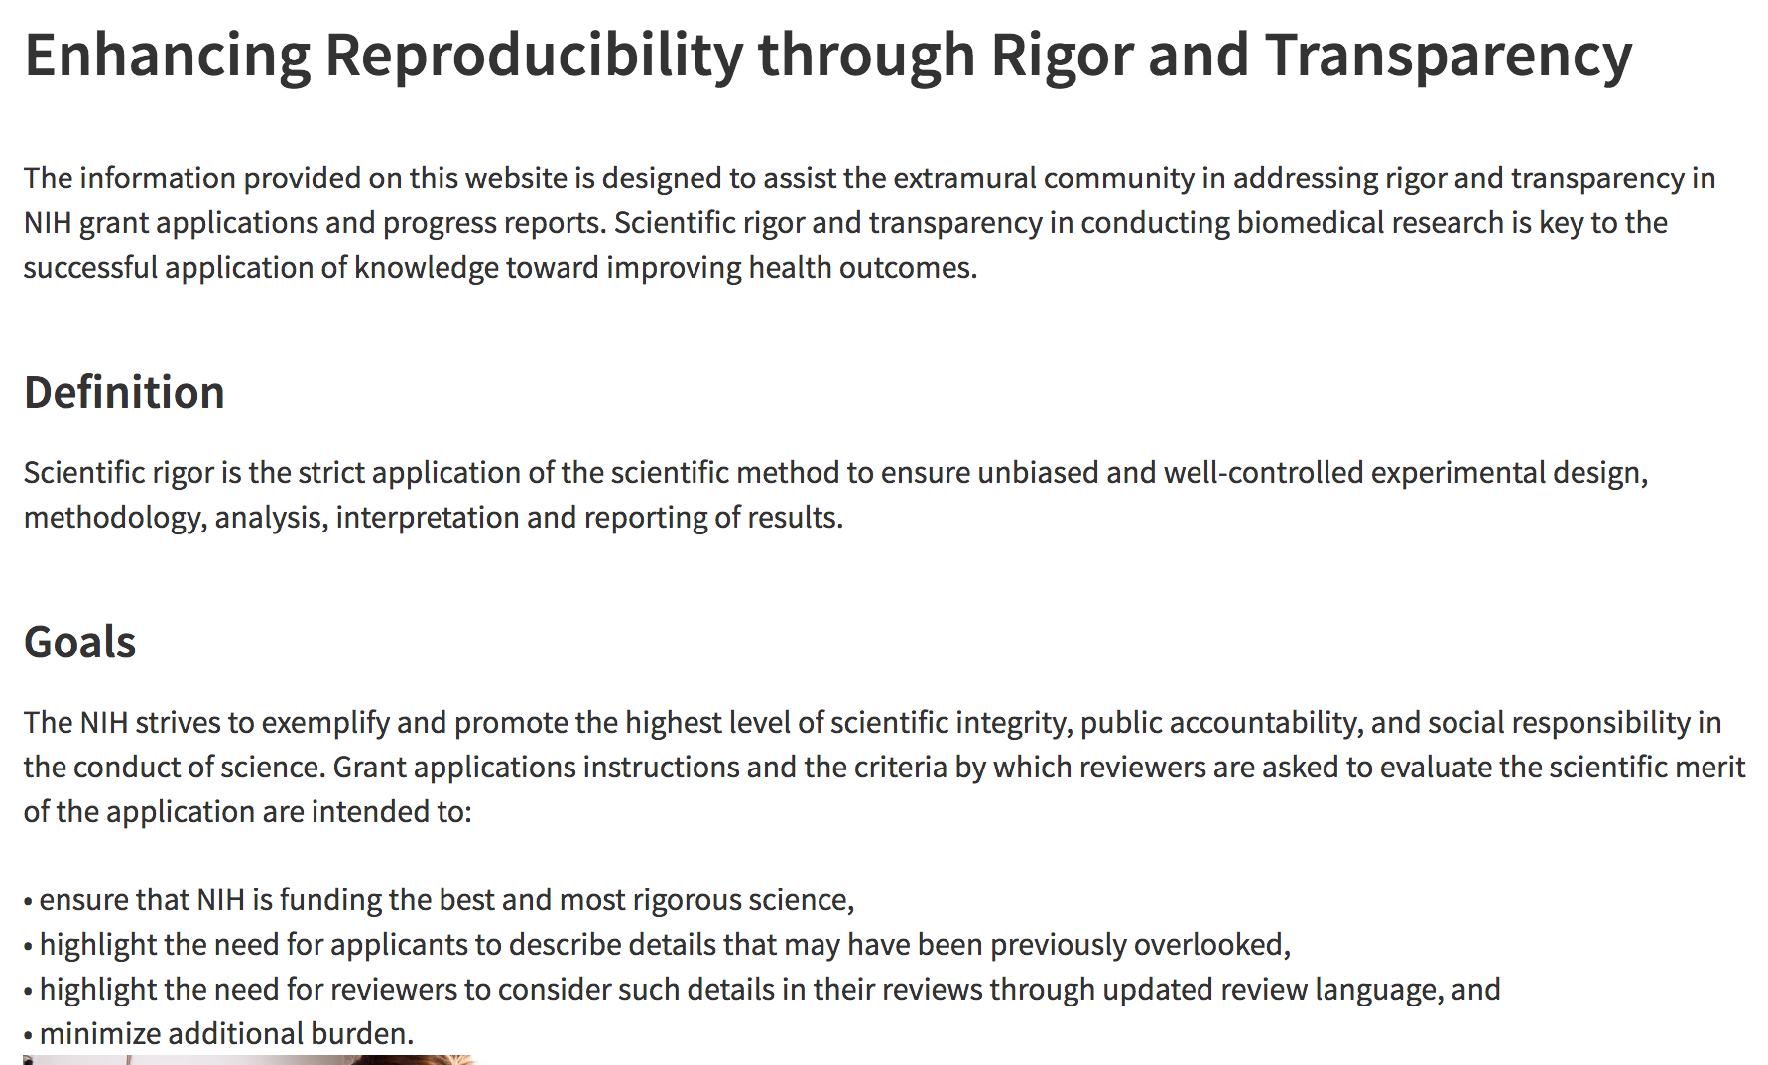
Rigor and Reproducibility
NIH

Slide 4

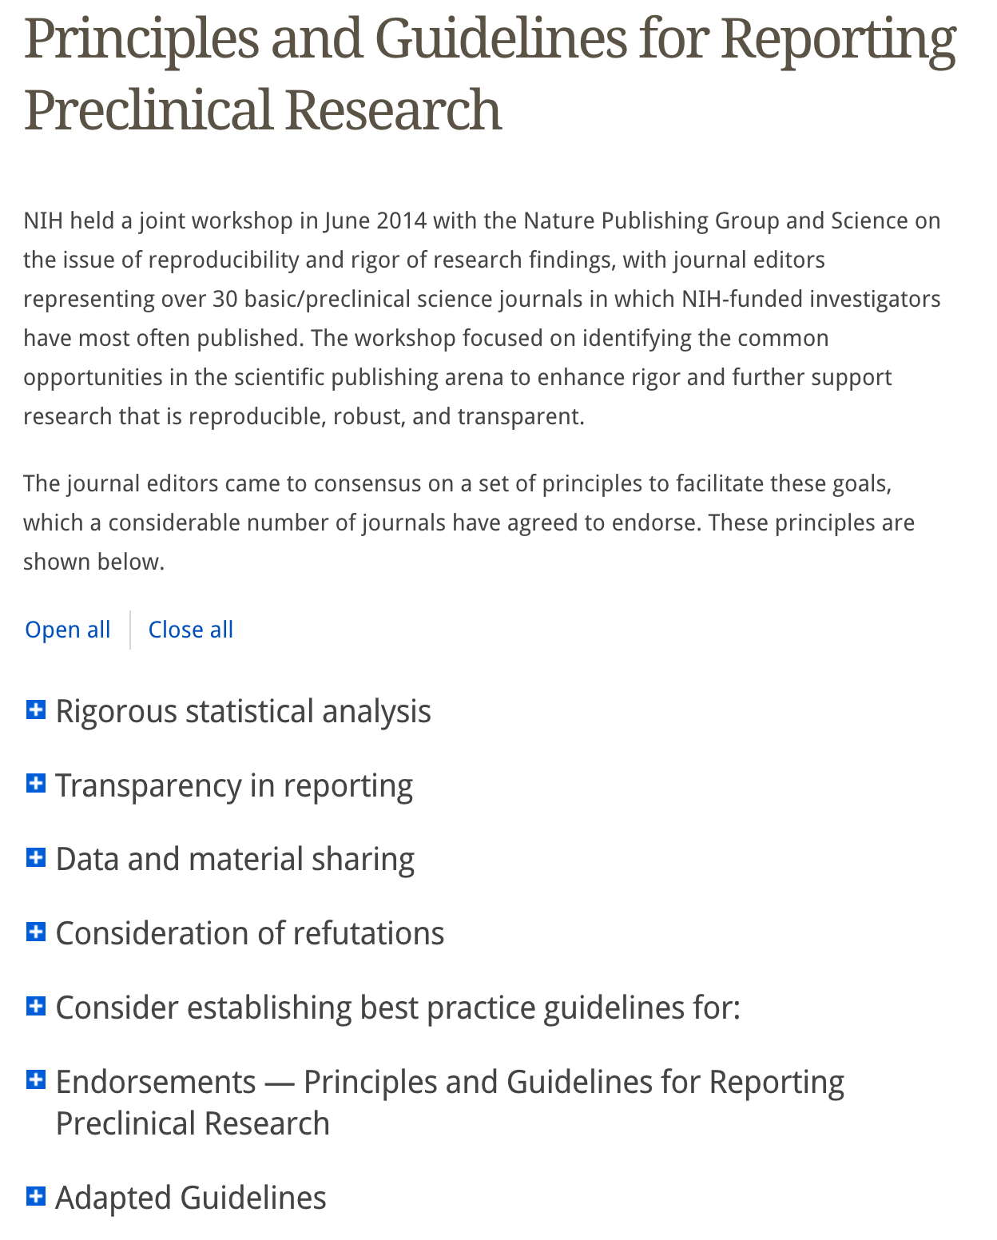
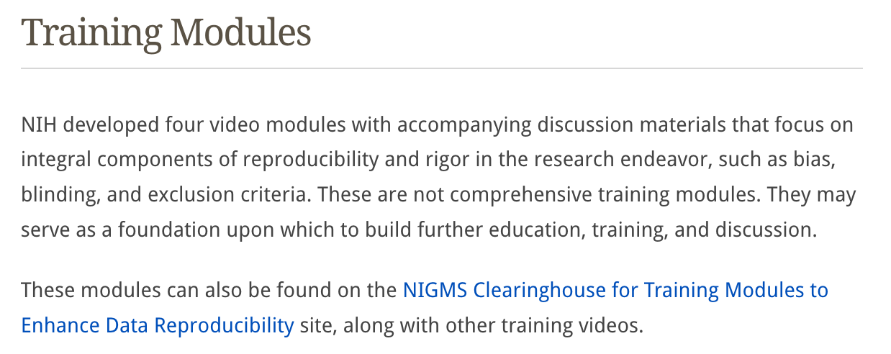

Slide 5
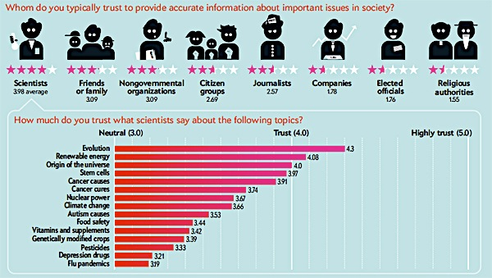
Do people trust science and scientists?
In Science We Trust: Poll Results on How You Feel about Science. Scientific American

Slide 6

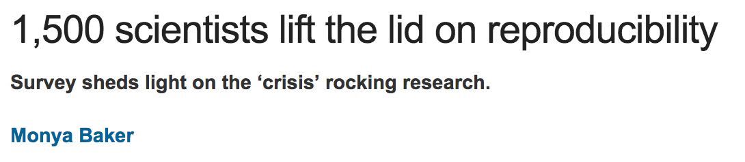
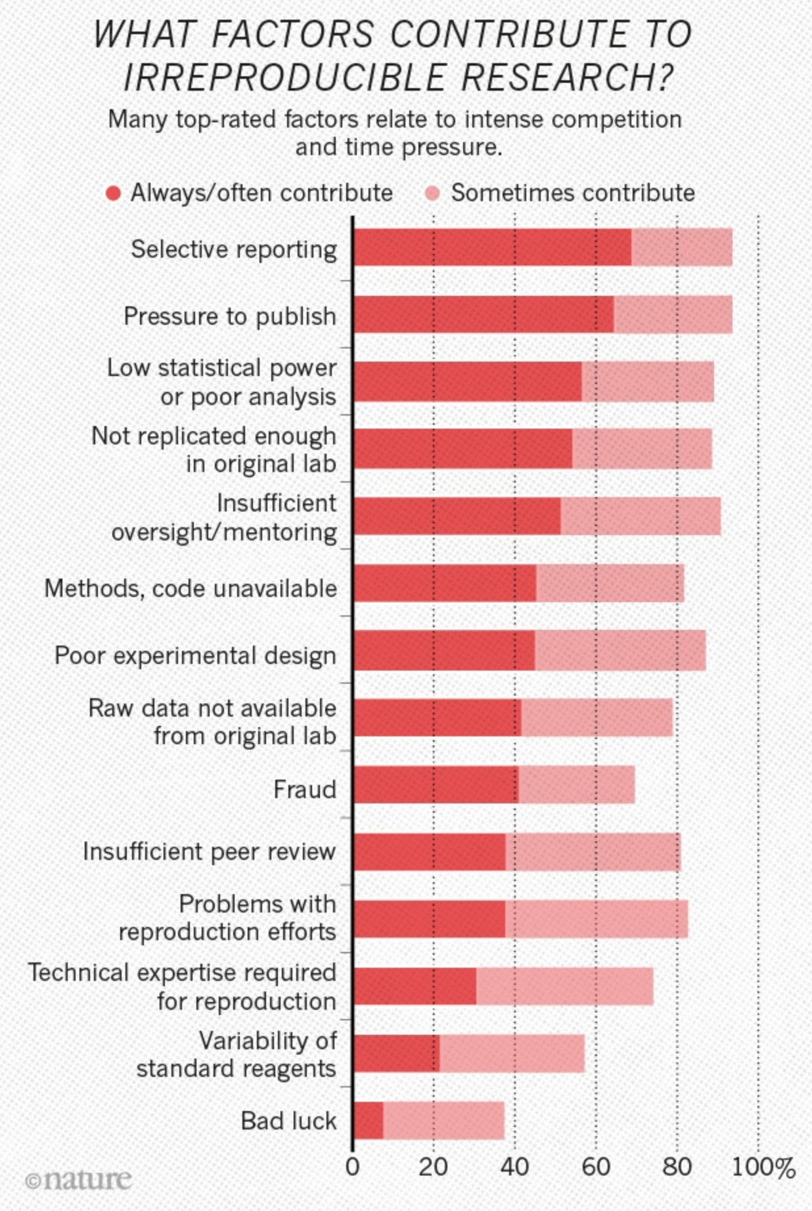
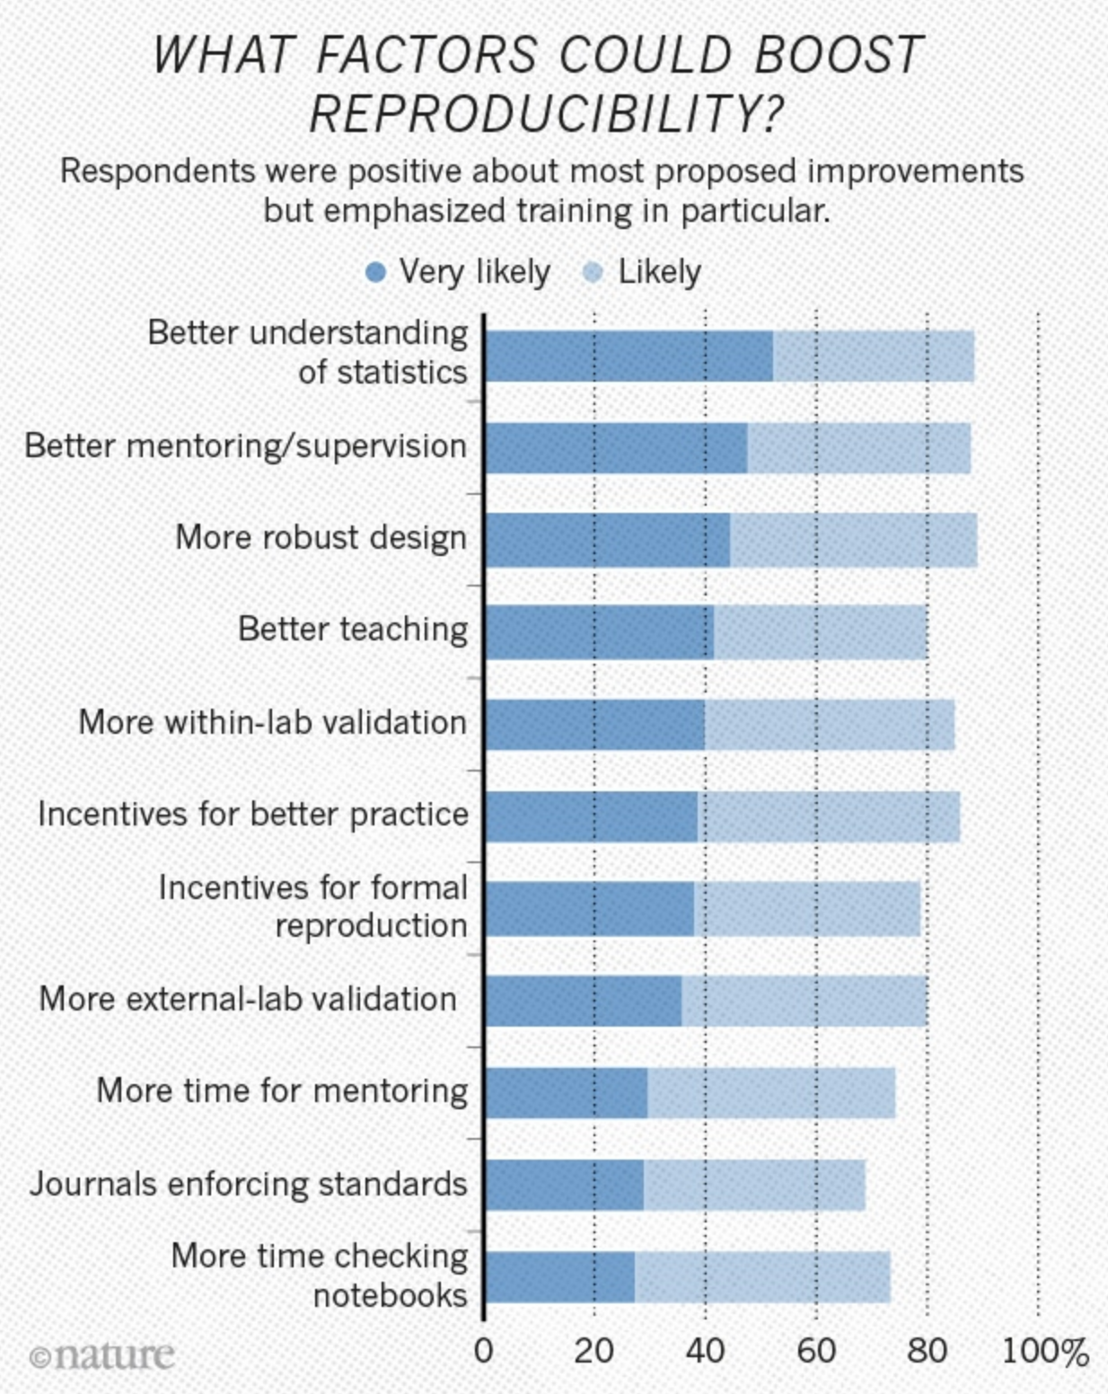

Slide 7
PNAS 110:1137, 2013
USA
USA
Other
USA
China
Other
India
India
China

Slide 8
The Journal Makes a Difference
N = 889 in 324 journals: r2 = 0.08664: p < 0.0001

Slide 9
The Pressures Facing Us
Adapted from: Sidney Harris

Slide 10
A personal story….
What Does it Mean to Have Committed Research Misconduct?
50.101 Applicability.
This subpart applies to each entity which applies for a research, research-training, or research-related grant or cooperative agreement under the Public Health Service (PHS) Act. It requires each such entity to establish uniform policies and procedures for investigating and reporting instances of alleged or apparent misconduct involving research or research training, applications for support of research or research training, or related research activities that are supported with funds made available under the PHS Act. This subpart does not supersede and is not intended to set up an alternative to established procedures for resolving fiscal improprieties, issues concerning the ethical treatment of human or animal subjects, or criminal matters.
§50.102 Definitions.
Inquiry means information gathering and initial factfinding to determine whether an allegation or apparent instance of misconduct warrants an investigation.
Institution means the public or private entity or organization (including federal, state, and other agencies) that is applying for financial assistance from the PHS, e.g., grant or cooperative agreements, including continuation awards, whether competing or noncompeting. The organization assumes legal and financial accountability for the awarded funds and for the performance of the supported activities.
Investigation means the formal examination and evaluation of all relevant facts to determine if misconduct has occurred.
Misconduct or Misconduct in Science means fabrication, falsification, plagiarism, or other practices that seriously deviate from those that are commonly accepted within the scientific community for proposing, conducting, or reporting research. It does not include honest error or honest differences in interpretations or judgments of data.

Slide 11
§ 50.103 Assurance - Responsibilities of PHS awardee and applicant institutions.
(a) Assurances. Each institution that applies for or receives assistance under the Act for any project or program which involves the conduct of biomedical or behavioral research must have an assurance satisfactory to the Secretary that the applicant:
(1) Has established an administrative process, that meets the requirements of this Subpart, for reviewing, investigating, and reporting allegations of misconduct in science in connection with PHS-sponsored biomedical and behavioral research conducted at the applicant institution or sponsored by the applicant; and
(2) Will comply with its own administrative process and the requirements of this Subpart.
•
•
•
(3) Takes immediate and appropriate action as soon as misconduct on the part of employees or persons within the organization's control is suspected or alleged.
•
•
•
(1) Inquiring immediately into an allegation or other evidence of possible misconduct. An inquiry must be completed within 60 calendar days of its initiation unless circumstances clearly warrant a longer period. A written report shall be prepared that states what evidence was reviewed, summarizes relevant interviews, and includes the conclusions of the inquiry. The individual(s) against whom the allegation was made shall be given a copy of the report of inquiry. If they comment on that report, their comments may be made part of the record. If the inquiry takes longer than 60 days to complete, the record of the inquiry shall include documentation of the reasons for exceeding the 60-day period.
•
•
•
9) Taking precautions against real or apparent conflicts of interest on the part of those involved in the inquiry or investigation.

Slide 12

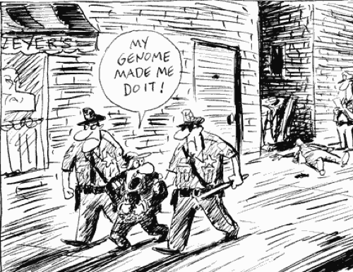
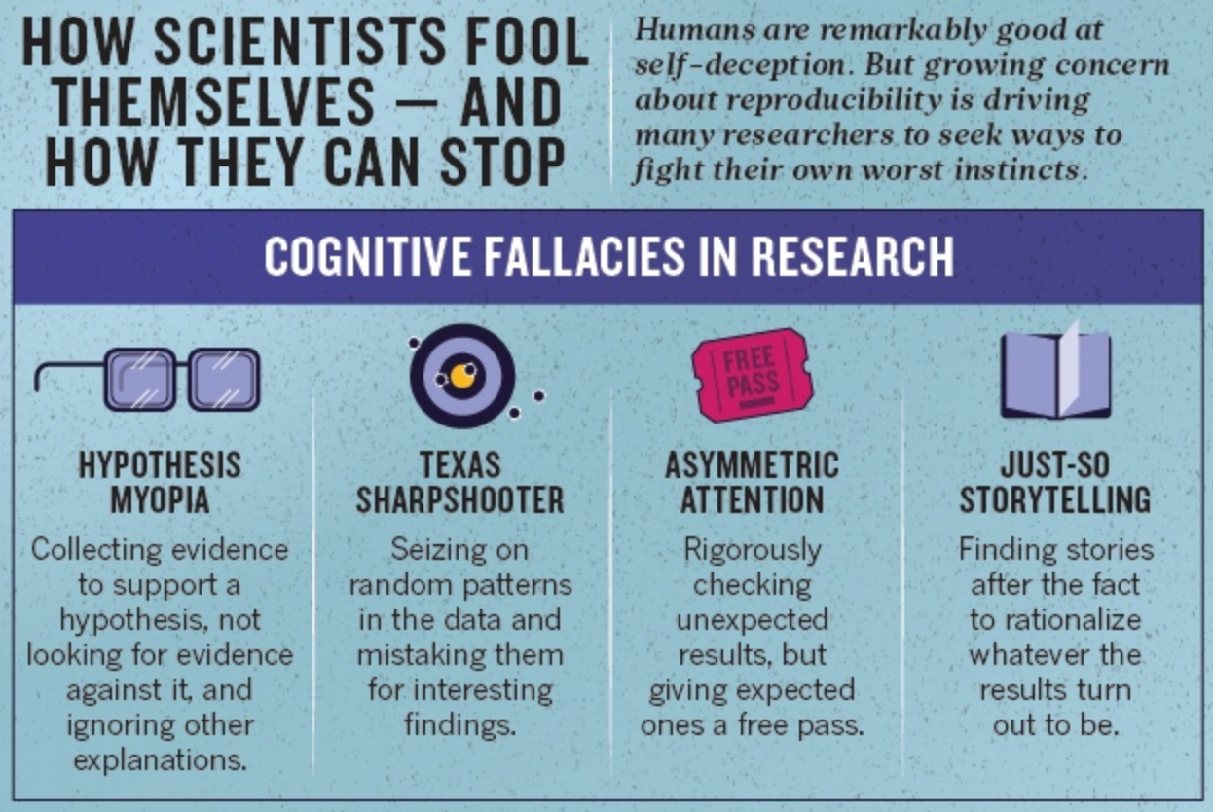
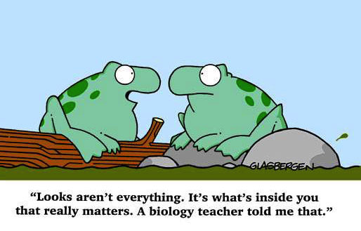
Dishonesty…
• Unfortunately, it is easy to “cheat”
• Pressure to hit it big in science
• Pressure for funding
• Until your accused, nobody checks up on you
• Increase in deception practices
….or an Honest Mistake?

Slide 13
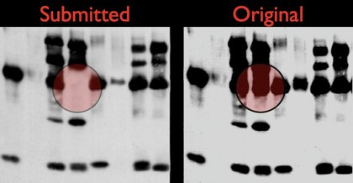
How Do We Cheat?
For Example, look what some journals are doing now
1. Pay attention to the overall quality of the Western Blot (WB). The bands should be well-marked. Do not accept a WB with fuzzy or smearing bands.
2. Do not accept a WB with over-loaded or over-exposed bands because they are impossible to quantify.
3. Request that the WBs be quantified and statistically analyzed.
4. Do not accept a WB where the samples to compare have been loaded on more than one gel.
5. Do not accept a WB without the proper loading controls:
6. Pay attention to the fraudulent use of the same loading controls in several different WBs.
7. Primary and secondary antibodies must be described in the Materials and Methods section. If the antibodies are not of commercial origin, their characterization must be described.
8. If there are doubts about a WB, do not hesitate to ask the authors to provide an image of the full WB.
ORI’s forensic image tools
Forensic tools: First posted on the ORI website: FotoForensics
4 Free Fake Image Detector
Adobe AI
• Find out whether an image’s light or dark areas have been adjusted
• Evaluate whether two images may have been obtained from a single source
• Compare two images

Slide 14

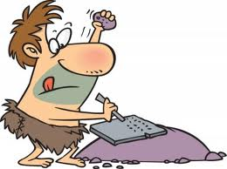
The Publishing World Is Not Helping!
vs.
Open access vs. print
Pro’s for Open Access
• easier access for all scientists and the community
• help libraries with the “serials crisis of cost”
Con’s for Open Access
• pay per ms may set up COI and affect peer review (Journals will publish more)(after all they are a business)
• peer review is not as rigorous
• reputation is still highest in subscription journals

Slide 15
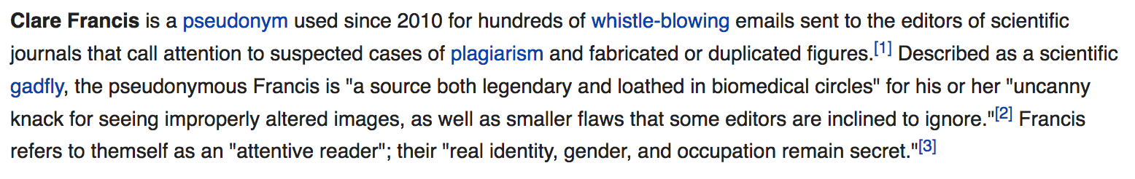
Lessons Learned
Whistleblowers: There are two sides to this coin

Slide 16
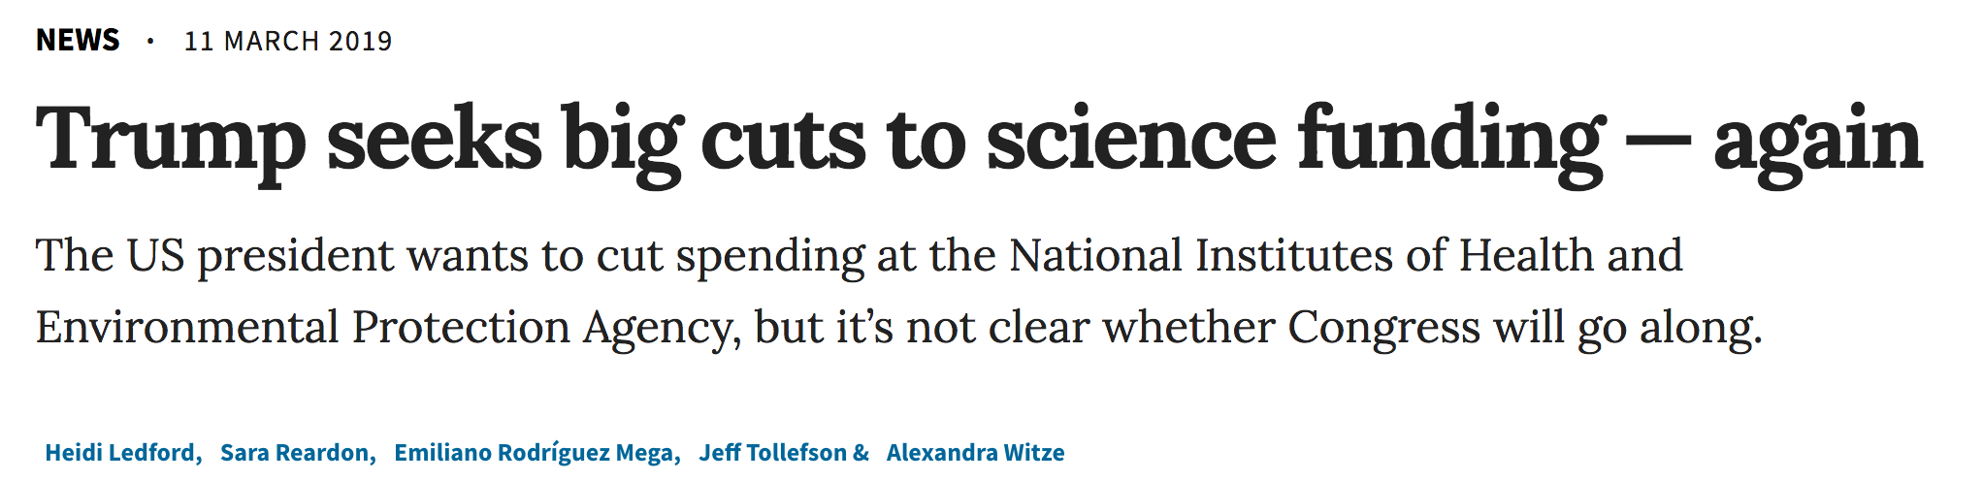
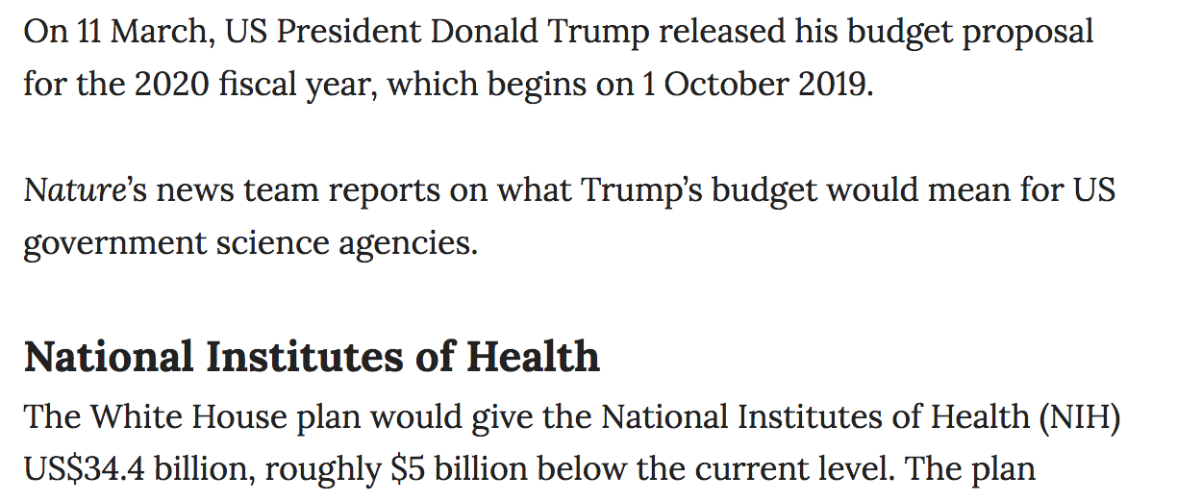
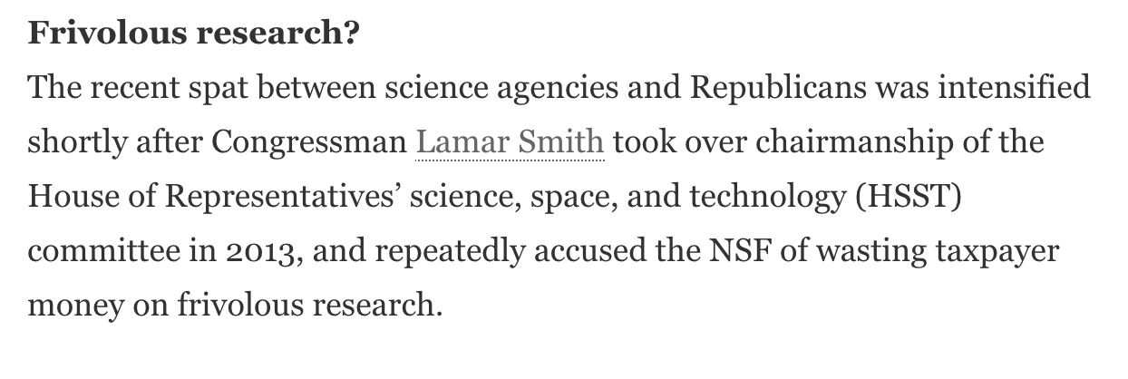
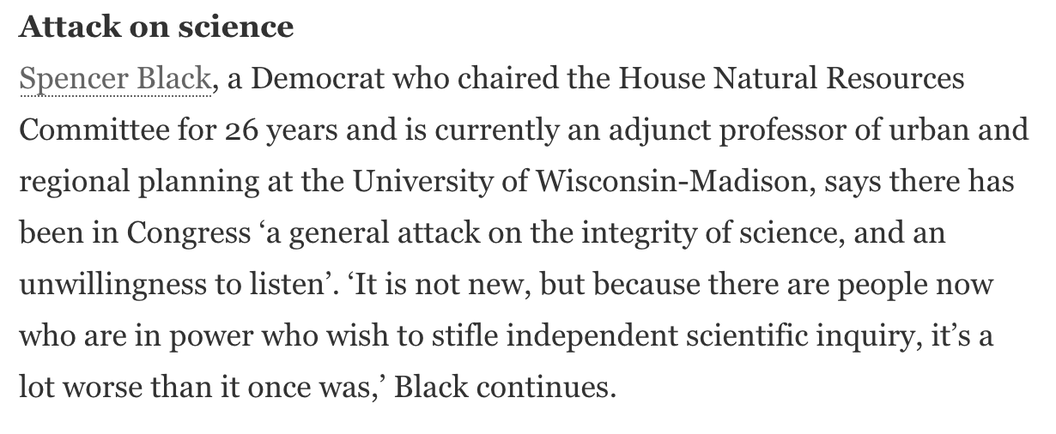
3rd time trying to cut budget
former

Slide 17
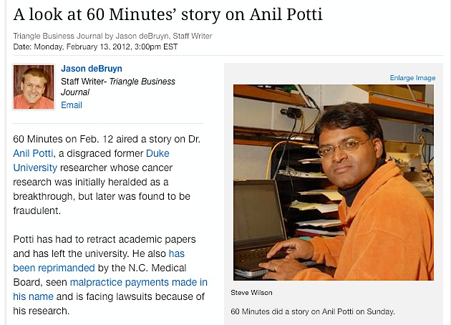
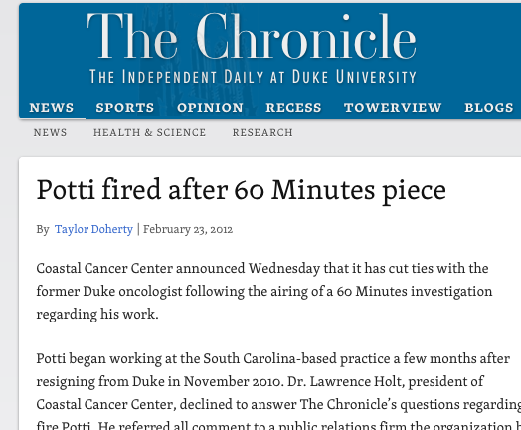
Price Paid
Public Distrust
November 15, 2013

Slide 18
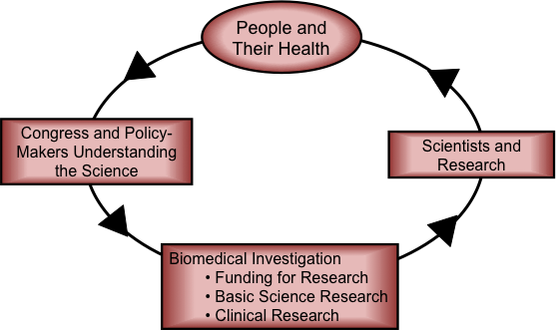
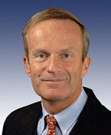

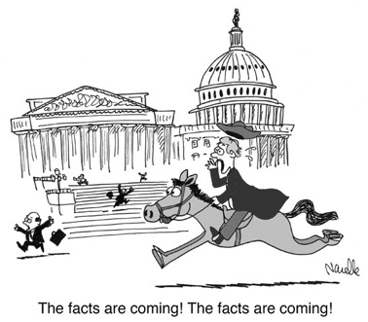
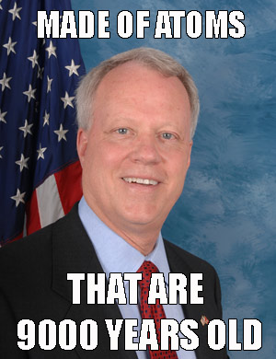
Take Home Message:
We Can’t Afford to Lose the Confidence of the Public and our Policy Makers!
Rep. Todd Akin (former R-MO) “First of all, from what I understand from doctors [pregnancy from rape] is really rare… If it’s a legitimate rape, the female body has ways to try to shut that whole thing down.”
Conservative alternative to Wikipedia
Rep. Paul Broun (R-GA): “All that stuff I was taught about evolution and embryology and the Big Bang Theory, all that is lies straight from the pit of Hell. You see, there are a lot of scientific data that actually show that this is really a young Earth. I don’t believe that the Earth’s but about 9,000 years old.”
Current and former members of the House Committee on Science, Space and Technology

Slide 19


