Slide 1


Pediatric Oral Health in Cancer Therapy
“…because of the immunosuppression the patients experience, any existing or potential sources of oral/ dental infections and or soft tissue trauma can compromise the medical treatment, leading to morbidity, mortality, and higher hospitalization costs.” - AAPD Guidelines
Goldie Razban, DMD
Erin Shope, DMD, MS

Slide 2
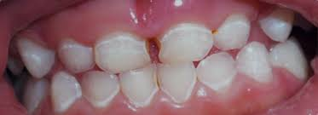
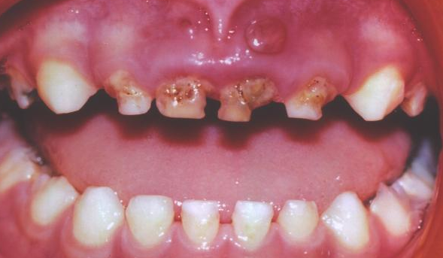
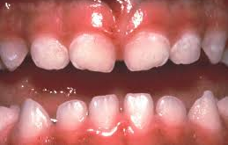
What is the current strategy for assessing oral health of children with new cancer diagnoses?
B
A
C
Would you handle these three cases similarly? Differently?
Notes:
Short pause – these all should be handled the same

Slide 3
Effects on the mouth from immunosuppression, chemo, and/or radiation
Mucositis
Candidiasis
Mouth pain
Oral ulcerations
Gingival hypertrophy
Gram negative oral flora transformation
Sepsis
Bleeding
Taste dysfunction
Xerostomia
Neurotoxicity
Osteonecrosis
Trismus
Oral Graft Versus Host Disease
Increased caries risk
Impact on dental development
Notes:
Oral flora radically changes - - becomes gram negative – and over the course of the mucositis, there are modifications that may have to be made

Slide 4
Oral mucositis definition
Oral mucositis (OM) is defined as erythema and/or ulcerations of the oral mucosa secondary to chemotherapy, radiation, or hematopoietic stem cell transplantation
It is one of the most common complications following cancer treatment in children, occurring in approximately 52 to 80% of patients
The mucosal damage can present with a range of mild atrophy to severe ulcerations
Patients with mucositis can experience severe pain causing pain while eating, drinking, and swallowing affecting the overall quality of life

Slide 5
Good oral hygiene can decrease rates of mucositis
MASCC/ISOO clinical practice guidelines for the management of mucositis secondary to cancer therapy (2020)

Slide 6
Dental clearances
1
2
3
Dental examination
Treatment
Education
Completed in the hospital or at Eastman Dental
Treat all dental needs prior to cancer treatment
Routine care along with education

Slide 7
Compromised oral health : prior to during following cancer therapy
Dramatically affects:
  Clinical outcomes
  Quality of life outcomes
Dental Oncology Education Program’s: “Oral Health in Cancer Therapy: A Guide for Health Care Professionals”

Slide 8
Early, pre-induction, dental intervention:
  Assures immunosupression is not initiated in the presence of an acute or emerging oral infection
  Minimizes oral acute infections during treatment cycles and associated immunosupression
  Educates child and caregiver as to potential oral complications with cancer therapy
  Educates child and caregiver importance of and adaptive techniques for oral hygiene during therapy and techniques to maintain hygiene in presence of mucositis / candidiasis
Dental Oncology Education Program’s: “Oral Health in Cancer Therapy: A Guide for Health Care Professionals”

Slide 9
New Cancer Diagnosis
INPATIENT:
OUTPATIENT:
Page Pediatric Dentist on Call
Daily In-Pt
rounds w/ team when acute dental issue present
Assist mucositis / candidiasis / oral pain management
Hygienist: as needed
Request Pediatric Dentistry Consult in Epic
Referral to Pediatric Dentistry in Epic
Inpatient Pre-treatment Oral Health Assessment & Radiographs w/in 24 hours
Pre-treatment Oral Health Assessment & Radiographs w/in 72 hours at Pediatric Dentistry Clinic
Non-urgent carious lesions/dental issues
+ Potential Dental Sources of Infection/Irritation
Non-urgent carious lesions/dental issues
No Potential Dental Sources of Infection/Irritation
No Potential Dental Sources of Infection/Irritation
Coordinate Dental Care in Future
Coordinate Dental Care in Future
Urgent Dental Treatment (OR) (w/in 24hr)
Clearance Letter & Document in Epic

Slide 10
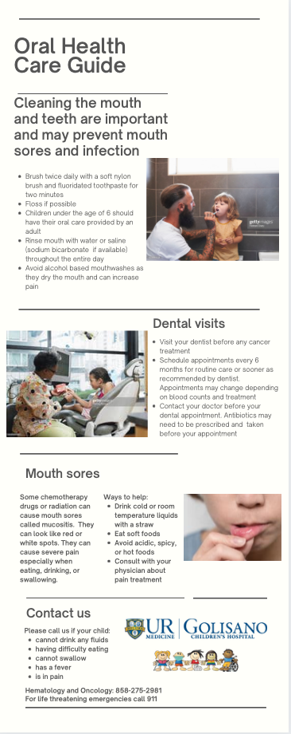
Education
Mucositis informational guide
  Given to families when they are first diagnosed
Mucositis informational video (7 minute long presentation)
  Families will watch in the hospital room
Oral health education
  Hands-on demonstrations with dentist and family at the hospital

Slide 11
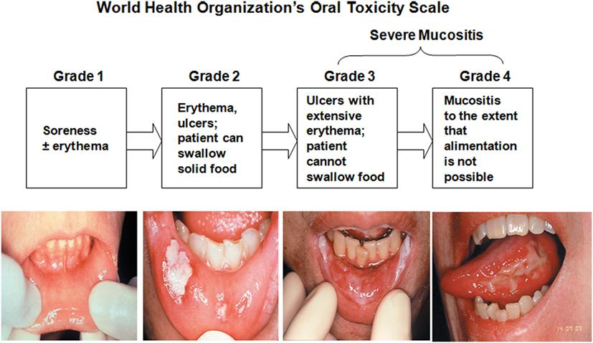
Inpatient monitoring
Daily oral hygiene
WHO mucositis scale

Slide 12
Daily oral care
PROTECTION
BRUSH
Apply lanolin based lubrication on lips
Twice daily with a soft nylon brush and fluoridated toothpaste for two minutes
(If patient cannot tolerate a soft nylon toothbrush, foam brushes can be used as a replacement soaked in chlorhexidine)
Mouth
cleaning
FLOSS
MOUTHWASH
Only recommended if the patient is skilled at flossing without causing trauma to the gingival tissues
0.9% saline or sodium bicarbonate mouth rinses four to six times/day

Slide 13
What are your thoughts…?

