Slide 1
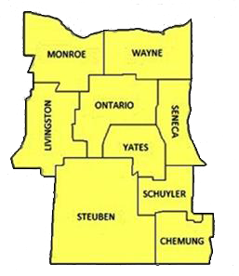
Brief Office-Based Smoking Cessation Intervention
Scott McIntosh, PhD
Center for a Tobacco-Free Finger Lakes
University of Rochester School of Medicine & Dentistry
Department of Public Health Sciences

Slide 2
Introduction to Center For a Tobacco-Free Finger Lakes
Center For A Tobacco-Free Finger Lakes (formerly GRATCC) uses evidence-based resources and programs to assist organizations in the design and implementation of policy and office based systems to identify and effectively treat tobacco dependence, according to the Department of Health and Human Services Clinical Practice Guidelines.
Notes:
Smoking is responsible for nearly a half million deaths each year. Tobacco use costs the nation an estimated $100 billion a year, mainly in direct and indirect health care costs

Slide 3
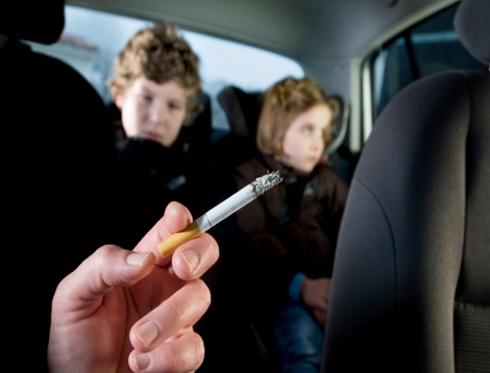
Environmental Smoke
Secondhand smoke is an environmental toxin
Third-hand smoke is the left-over contamination in a room/car/clothing that persists after the cigarette is extinguished (Winikoff, 2011)
There is no risk free level of exposure to tobacco smoke and there is no safe tobacco product

Slide 4
Don’t be Silent About Smoking
70% of smokers want to quit.
7% of smokers achieve long-term abstinence on their own.
With physician assistance - every patient, every visit - this increases to > 30%.
Notes:
75% of NYS smokers want to quit

Slide 5
Goals: Take Home Messages
Very Brief Advice
  1 to 3 minutes is EFFECTIVE (40% increase)
  Clinician advice alone is EFFECTIVE
More counseling is even more effective
    e.g., 30 minutes can be 90% increase
    SO: Time spent at point of care - PLUS -
    Multiple providers - PLUS -
    Telephone Quitline Counselors
5
Notes:
We are here today to introduce a variety of smoking cessation strategies to help you quit smoking.
Research has shown that there is not one quit strategy that is best for everyone. Quitting smoking is a very personal process. For some, a smoking cessation support group provides the social interaction and motivation that one needs to quit. But others might not feel comfortable sharing in an open group forum, and instead seeks one-on-one telephonic counseling. There are many options available for you.
We will review a concept called “stages of change”, which will help you determine where you are personally on the continuum of quitting smoking. Then, I’ll share with you the different strategies that might fit best for you at the stage you’re currently in.
treatment plan typically includes four contacts (by phone or in person) with our tobacco dependence counselors and two visits with our medical staff.

Slide 6
Tobacco Dependence / Chronic Care Model
Tobacco dependence demonstrates features of a chronic disease
  Long term disorder (addiction, tobacco)
  Periods of relapse and remission
  Requires a Chronic Care model, rather than an acute care approach
Notes:
**

Slide 7
Chemicals in Tobacco Smoke
Butane – lighter fluid
Cadmium – batteries
Toluene – solvent
Ammonia – cleaner
Acetic acid – vinegar
Methane – sewer gas
Arsenic - Poison
Carbon Monoxide – poisonous gas
Methanol – rocket fuel
Formaldehyde – embalming fluid

Slide 8
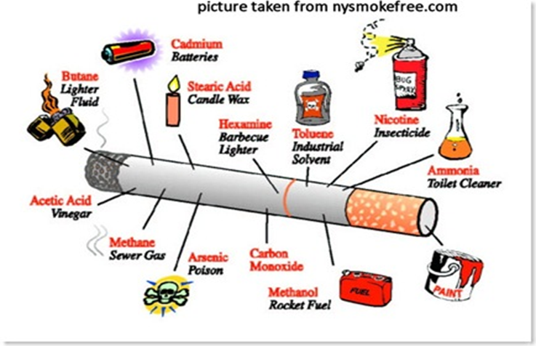
Chemicals in Tobacco Smoke
Butane – lighter fluid
Cadmium – batteries
Toluene – solvent
Ammonia – cleaner
Acetic acid – vinegar
Methane – sewer gas
Arsenic – Poison
Carbon Monoxide – poisonous gas
Methanol – rocket fuel
Formaldehyde – embalming fluid
                Click
  http://www.nysmokefree.com/subpage.aspx?p=40&p1=4020 for additional information.

Slide 9
5A’s TREATMENT MODEL
The Public Health Service Clinical Practice Guideline recommends that providers:
    Ask clients about their tobacco use
    Advise them to Quit
    Assess for their willingness to quit
    Assist in a quit attempt
    Arrange for follow-up

Slide 10
In-Office Cessation Interventions
At all patient / client contacts
    Ask whether client smokes
    Advise client to stop
    Assess whether client wants to take action
    Assist client in developing plan
    Arrange follow-up

Slide 11
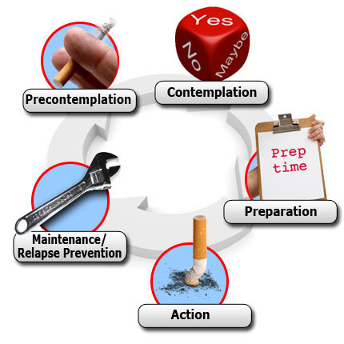
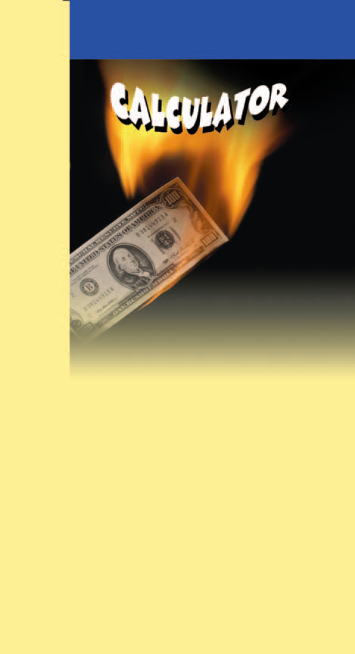
6 Stages of Change Model
(Prochaska and DiClemente)
Pre-contemplation
  (“5R’s”)
Contemplation
  Yes, but not now
Preparation
  Set a Quit Date
Action
  Quit Date / vulnerable to relapse
Maintenance
Relapse / Recycle
  Emphasize successes and “re-trying”

Slide 12
Promoting Motivation to Quit for Patients Not Ready for Action
The Five Rs
      Relevance (to their health)
      Risks (short- and long-term)
      Rewards
      Roadblocks (to success)
      Repetition

Slide 13
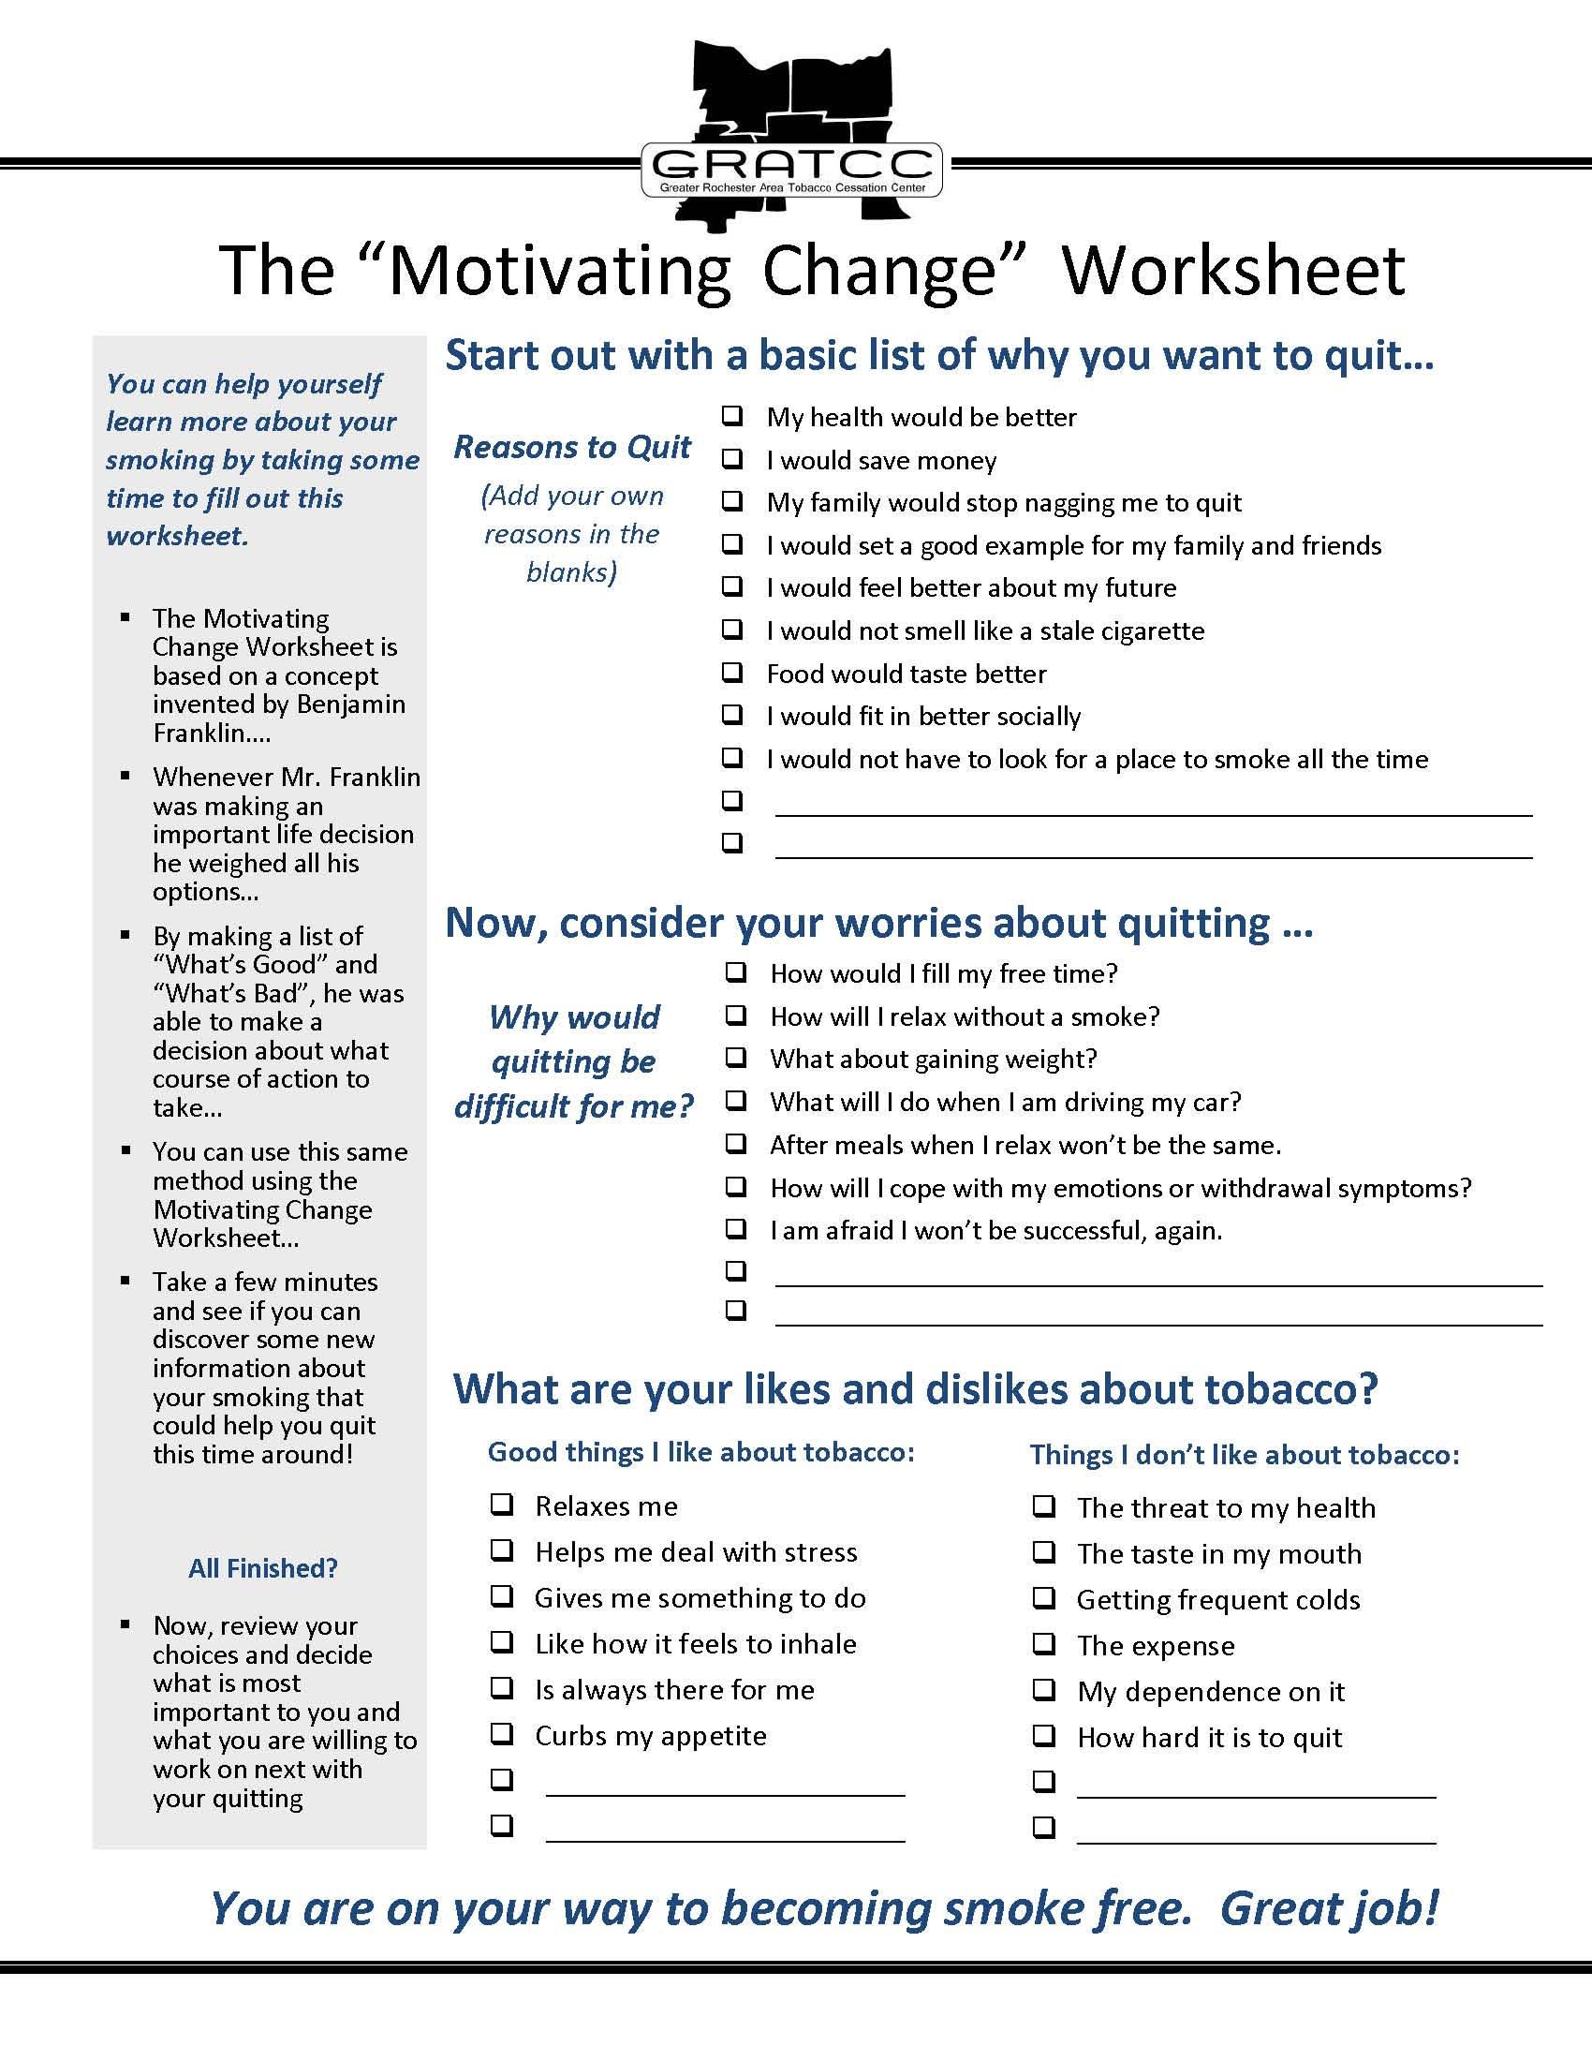
Motivational Interviewing

Slide 14
Timing of Health Benefits
20 minutes
Blood pressure, heart rate return to normal
2 to 12 weeks
Circulation improves
8 hours
O₂ level returns to normal; nicotine and CO levels reduced by half
3 to 9 months
Lung function increases by up to 10%; coughing, wheezing, breathing problems reduced
24 hours
CO is eliminated from body; lungs begin to eliminate mucus, debris
1 year
Heart attack risk halved
48 hours
Nicotine eliminated from body; taste and smell improve
10 years
Lung cancer risk halved
72 hours
Breathing is easier; bronchial tubes relax; energy levels increase
15 years
Heart attack risk same as for someone who never smoked
1990 Surgeon General’s Report
Notes:
Patients who smoke may be unaware that the benefits of quitting smoking begin within minutes.
1990 Surgeon General’s Report

Slide 15
Safety Issue: How are medications affected by smoking?
Many commonly used medications interact with chemicals in tobacco smoke (Nicotine, additives, toxins, etc.)
This results in a change of blood levels of these medications
Participants who quit smoking may need increases or decreases in medication dosing to ensure safety and effectiveness
  Use of NRT (clean Nicotine) should also be taken into consideration with medication adjustments
  That is why it is important for staff to inform prescribers when participants make a quit attempt!

Slide 16
The More Immediate Damage
Early cardiovascular damage is seen in most young smokers
Smoking reduces lung function and retards lung growth. The lungs of teens who smoke may never grow to full capacity
Nicotine addiction sensitivity- youth feel dependent earlier than adults. The younger they are when they start, the more likely they’ll be addicted

Slide 17
Quit Attempt Success
Either alone is effective, but the combination of counseling and medication is most effective for smoking cessation .

Slide 18
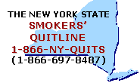
New York State Smokers’ Quitline
Free and confidential program provides evidence-based tobacco cessation services to New York State residents who want to stop cigarette smoking or other forms of tobacco
www.nysmokefree.com

Slide 19
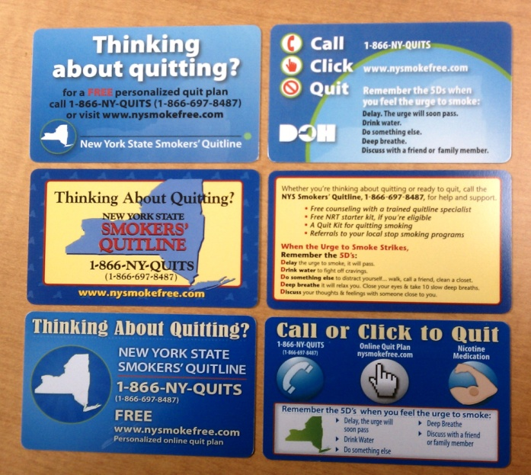
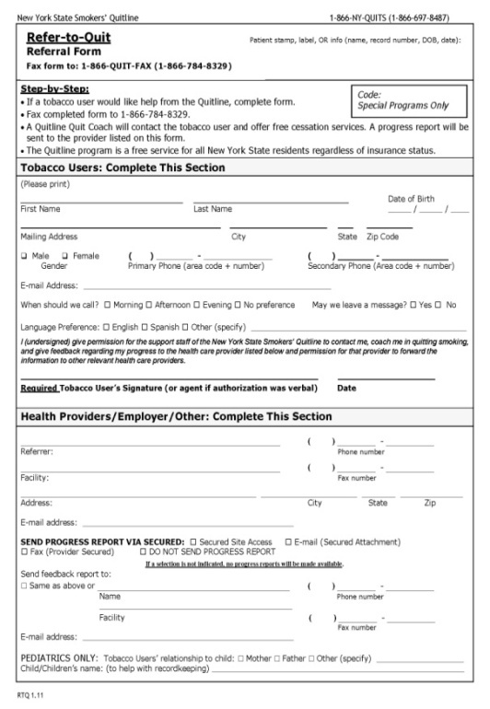
How to Refer Patients
New York State Smokers’ Quitline and Quitsite
Palm cards (passive referral)
Refer-to-Quit (active referral)

Slide 20
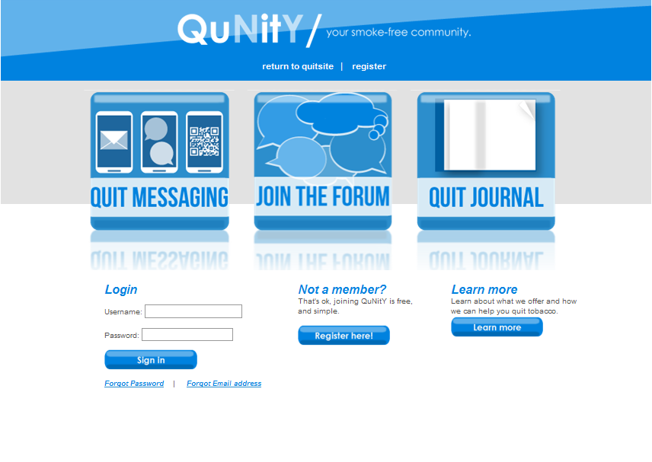
New York State Smokers’ Quitsite “QuNity” Smoke-Free Community
NYS Quitline’s smoke-free community where members talk with other members and quit coaches about smoke-free experiences, or just to socialize.
https://qunity.nysmokefree.com/
Notes:
Telephonic counseling, have spanish speaking counselors. If other language they offer phone translation.
Stress Management- Deep breathing Exercise, Muscle relaxation exercises, Offer other relaxation techniques, Think positively, Encourage.

Slide 21
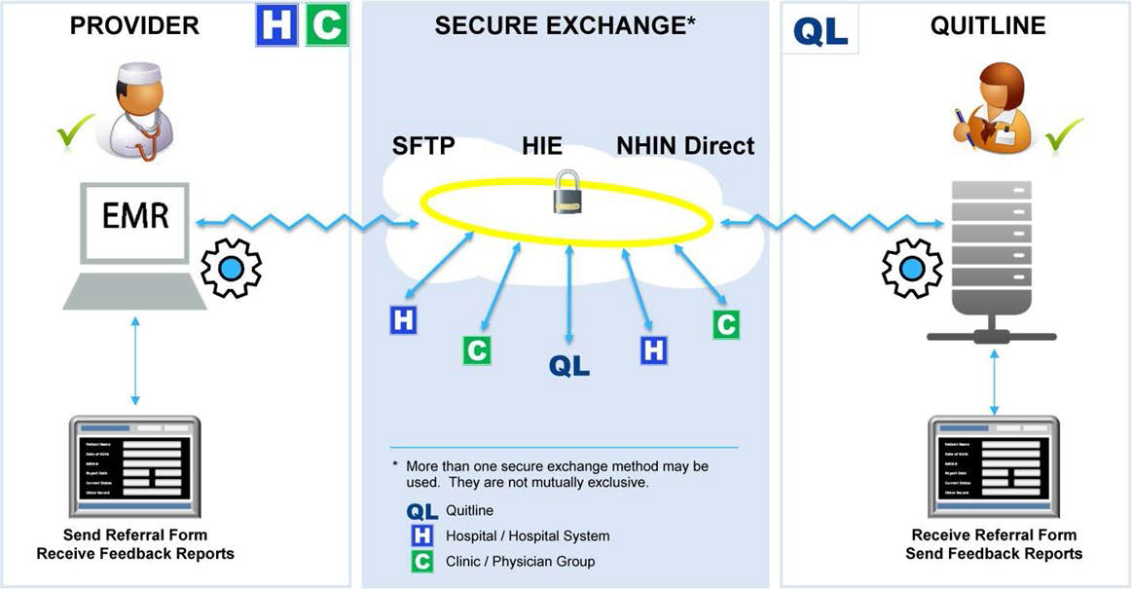
Quitline e-Referral
Source:
http://www.naquitline.org
NAQC. (2013). Quitline Referral Systems. (A. Wendling, MD, MPH and R. Daigh, MBA). Phoenix, AZ.

Slide 22

New York State Smokers’ Quitline
Services for the Clinician
Provide patient progress report via fax or e-mail
For most EMR systems, Refer-to-Quit/ Opt-to-Quit Forms can be sent electronically
NY State educational Collaborative Conference Calls on tobacco use cessation
Notes:
Telephonic counseling, have spanish speaking counselors. If other language they offer phone translation.
Stress Management- Deep breathing Exercise, Muscle relaxation exercises, Offer other relaxation techniques, Think positively, Encourage.

Slide 23
Advantages of faxing referrals to NY State Smokers’ Quitline
Patients will receive a follow-up call from a Quit Coach who will provide a stop-smoking or stop-smokeless-tobacco
coaching session.
Patients will receive a Stop-Smoking or Stop-Smokeless-Tobacco packet in the mail with information tailored to their specific situation and a listing of local stop-smoking programs.
A sample progress report (feedback form) with information about the patient’s tobacco-use status will be faxed back to the health care provider from the Quitline.

Slide 24
Advantages of faxing referrals to NY State Smokers’ Quitline
Patients can be referred to the New York State Smokers’ Quitline as often as needed.
Patients can call the New York State Smokers’ Quitline and use the Quitsite as often as needed.
Patients can be referred via “Fax to Quit” or online at:
http://www.nysmokefree.com/subpage.aspx?p=70&p1=70220&curcat=7022020

Slide 25
Face to Face Counseling
“Healthy Living Program” is based in Rochester. Considered “Intensive” counseling.
Face to Face Counseling – “Fax to Intensive”
Screened for NRT eligibility.
Patient can also be referred to the State Quitline.

Slide 26
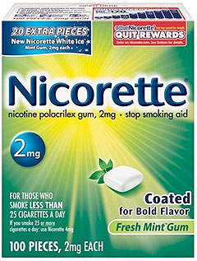
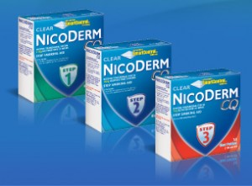
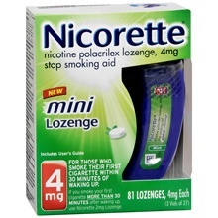
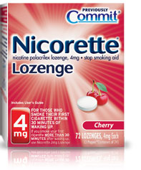
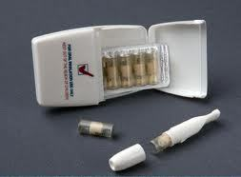
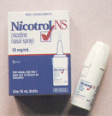
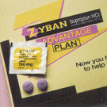
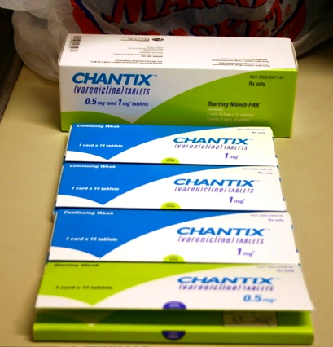
Pharmacotherapy
These are the brand names, but there are emerging NRT products and “store brand” alternatives of the nicotine containing products (e.g., CVS, Rite Aid) which have the same levels of nicotine . Although Chantix is not yet available in any other form, Zyban has two other forms: as Wellbutrin (for Depression) and generically as “Bupropion SR”. Alternatives are often cheaper for clients/patients.
Notes:
Combination therapy: The Public Health Service Guidelines in 2008 recommend that combinations of these medications should be considered. We recommend additional training or consultation with experienced clinicians for this.
Zyban can be combined with NRT. Chantix “blocks nicotine receptors”, so it is used alone. The Patch can be combined with an “intermittently used” product, like the gum or lozenge, inhaler or nasal spray.
But if the Gum, Lozenge, Inhaler or Nasal spray are used alone – they should be used regularly throughout the day to keep a steady level of nicotine in the system.

Slide 27
Nicotine Replacement Therapies (NRT)
Over the Counter
  Nicotine Patch, Gum, Lozenge
Prescription
  Nicotine Inhaler
  Nicotine Nasal Spray
  Bupropion (Zyban, Wellbutrin)
  Varenicline (Chantix)

Slide 28
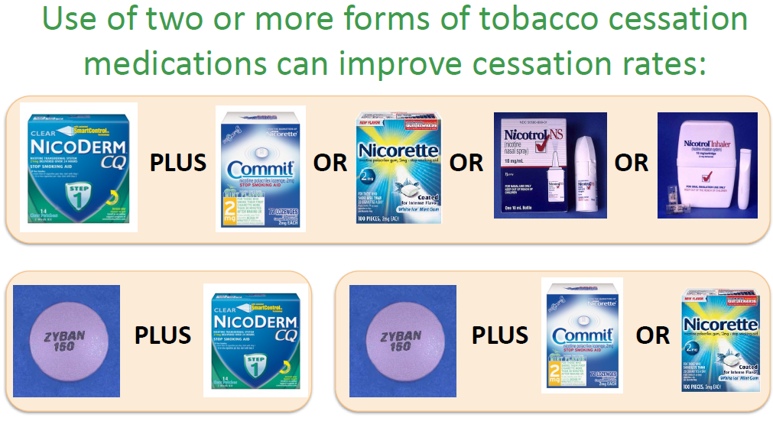
Combination Therapy

Slide 29
Myth Busting About Nicotine Replacement Therapies (“NRTs”): The Reality Is…
Nicotine medications are safe when used as directed
Patients tend to self dose
Scheduled dosing is better than PRN (as needed)
Period of treatment - may be a crucial factor in SMI
OK to combine with bupropion (Zyban, Wellbutrin)
Currently not recommended to combine with varenicline (Chantix)
OK to combine NRTs with each other
Very few contraindications
Little to no drug-on-drug interactions
Adapted from Jill Williams: “Tobacco Dependence in Mental Health Settings”

Slide 30
More Myth Busting Regarding NRT
Nicotine and patients with MI / Cardiac Disease
  This is a listed contraindication on NRT packaging
  However, some experts take the position that:
    No reason not to use
    Not introducing a “new drug”
    Safer nicotine delivery vs. smoking
    Source: Jill Williams, MD: Tobacco Dependence Treatment in Mental Health Settings

Slide 31
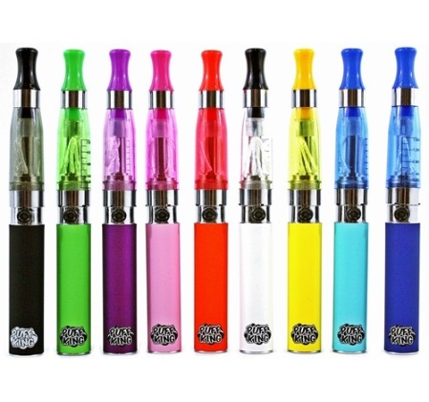

Electronic Cigarettes
AKA, “E-Cigs”, “Electronic Nicotine Delivery Systems” (ENDS), vaping, etc.
Nicotine, flavorings, and other components are heated and inhaled as vapor.
466 brands, 7764 flavors and growing.
There is no regulation in place, but proposed FDA regulation is in progress.
Targeting includes adolescents and young adults (candy, fruit flavors; CDC, 2013).
All 3 major cigarette companies now produce E-Cigs.
Notes:
Citation: O’Connor. Tob Control 2012;21:181-190

Slide 32
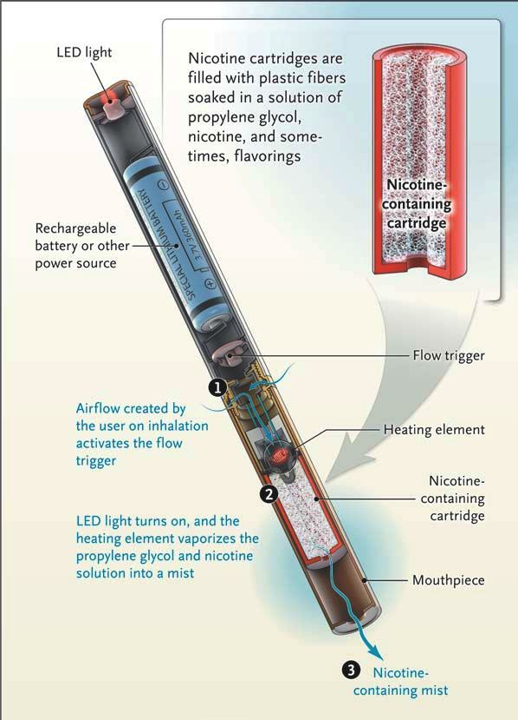
E-Cigarettes
(Un-Regulated, Under-Studied)
  Delivers nicotine in a mist of hot gas made up of chemicals – mimics the “feel” of tobacco smoke.
  A battery powered heating device vaporizes liquid nicotine contained in a cartridge.
  Emerging evidence of carcinogens, oxidants, heavy metals, and other toxins.

Slide 33
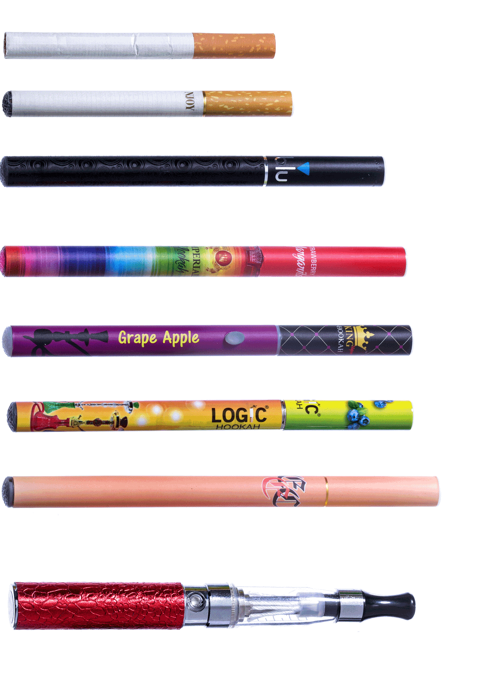
The Many Looks of E-Cigarettes

Slide 34

It is Not Just Water Vapor
E-cigs contain toxicants including nicotine, volatile organic compounds (e.g. formaldehyde), tobacco specific nitrosamines (e.g., NNK), metals (e.g., cadmium, lead, copper), propylene glycol, ultrafine particles (Goniewicz et al. 2014; Lerner et al., 2015a; Lerner et al., 2015b)
E-cigs generate secondhand vapor (exhaled by user; Flouris, et al. 2013) and thirdhand vapor (Goniewicz 2014).

Slide 35
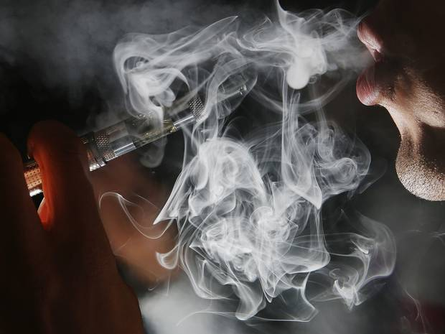
Second Generation e-Cigs (“Vaping”)
Example of E-Cigarette Starter Kit
http://www.independent.co.uk/news/world/americas/first-ecigarette-child-death-new-york-baby-dies-after-drinking-liquid-nicotine-9924229.html

Slide 36
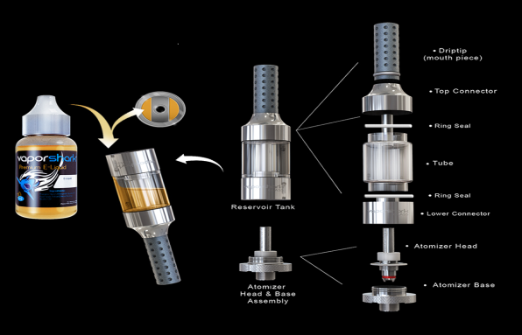
Anatomy of a “Vaping” Device

Slide 37
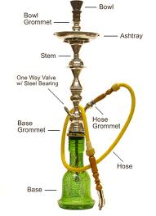
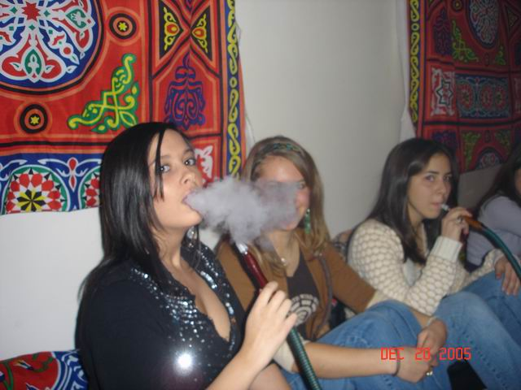

Hookahs
Hookah use has the potential of becoming a global epidemic (Maziak, 2013)
  Increasing particularly among adolescents and young adults (Global Youth Tobacco Survey 1999-2008; Warren et al 2009)
One hookah session=10 cigarettes for smokers
Secondhand hookah smoke = as if they had been smoking
Thirdhand hookah smoke
Notes:
Hookah cafes are spreading globally

Slide 38
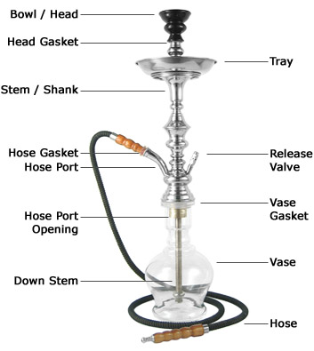
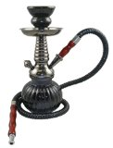
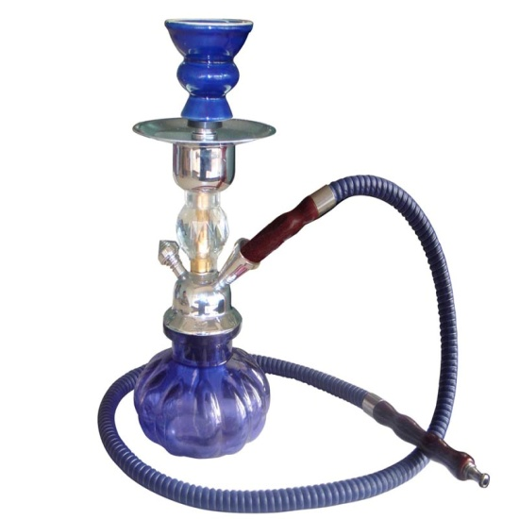
Hookahs ≠ Safe
Hookahs— a.k.a. water pipes use specially made tobacco available in a variety of flavors (e.g., apple, mint, cherry, chocolate, coconut, licorice, cappuccino, and watermelon) Water pipe smoking delivers nicotine and is at least as toxic as cigarette smoke.
Due to the mode of smoking—including frequency of puffing, depth of inhalation, and length of the smoking session—hookah smokers may absorb higher concentrations of the toxins found in cigarette smoke. A typical 1-hour-long hookah smoking session involves inhaling 100–200 times the volume of smoke inhaled from a single cigarette.

Slide 39
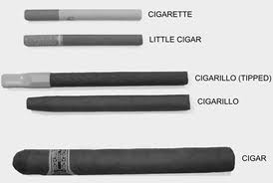
Multiple forms of Tobacco
Cigars, for example Black & Milds, are popular with youth. One out of 5 male high school students smokes cigars
Use of multiple tobacco products, including cigarettes, cigars, and smokeless tobacco is common among young people.
Neither bidis and kreteks (clove cigarettes) are safe alternatives to conventional cigarettes (CDC.gov)
2012 Surgeon General’s Report: Tobacco Use Among Young People

Slide 40
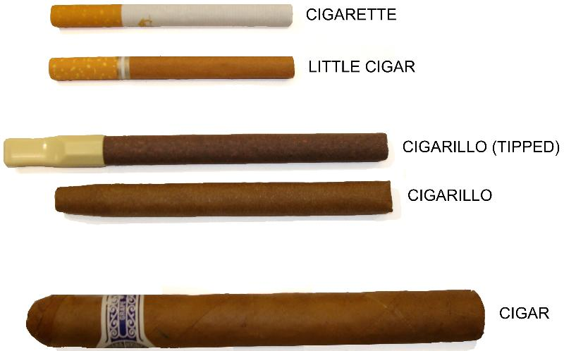
Little Cigars ≠ Safe
Traditional Cigars (pictured at the bottom in the above picture) contain 7 times the amount of tobacco as traditional cigarettes.
Little Cigars / Flavored Cigars, often redesigned to be smaller and to be marketed in order to avoid cigarette taxes, can be very similar to cigarettes in size, shape, etc.
The main health risks of cigars are head and neck cancers
followed by lung cancer and heart disease.
Source: nysmokefree.com

Slide 41
Cigars

Slide 42
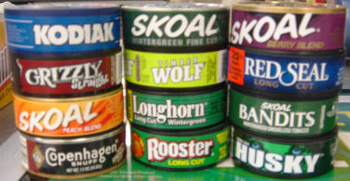
Smokeless ≠ Safe
8 – 10 chews/dips per day [2 cans per week] is equivalent [in nicotine content] to 30 – 40 cigarettes per day
Smokeless tobacco use can lead to nicotine addiction and dependence.
Adolescents who use smokeless tobacco are more likely to become cigarette smokers.
Contains more than 3000 chemicals, about 28 known carcinogens; more addictive than cigarettes because it contains higher levels of nicotine
U.S. Dept. of Health and Human Services, National Institutes of Health, NIH Publication No. 03-3270, July 2003

Slide 43
Smokeless ≠ Safe
Placed inside of the user’s mouth [‘wad’] for a continuous high from the nicotine
  CHEW/ CHEWING TOBACCO: a leafy form of tobacco sold in pouches. Users keep the chew between the cheek and gums for several hours at a time.
  PLUG: chewing tobacco that has been pressed into a brick.
  SNUFF: a powdered, moist form of tobacco sold in tins. Users put the snuff between the lower lip or cheek and the gum. As well, some users will sniff it.
    Using some forms of smokeless tobacco is also called “dipping.”

Slide 44

Smokeless ≠ Safe
  SNUS: a newer powdered, moist form of tobacco, typically in pouches and sold in tins. Users put the pouch behind the upper lip or between the cheek and the gum. It is steam pasteurized, not fermented like traditional chewing tobacco (with the idea this results in fewer carcinogens). Unlike traditional chewing tobacco, users typically do not spit. Some say it is “safer” than traditional chewing tobacco, but there is no completely safe level of exposure to tobacco.

Slide 45

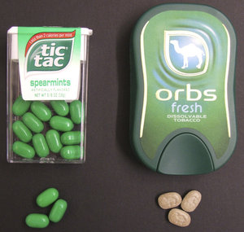
Dissolvable Tobacco Products
“Orbs” are small pellets resembling breath mints that last just a few minutes before melting away. Orbs come in “Mellow” and “Fresh” flavors. Mellow is a sweet tobacco flavor, while Fresh is minty. Dissolvable Tobacco Products entered mainstream use in the later half of the 2000s. The product consists of finely processed tobacco which is developed in such a way as to allow the substance to dissolve on the tongue or in the mouth. Camel tobacco is the major purveyor of dissolvable tobacco products, with three varieties, including strips, sticks and orbs.

Slide 46
Additional Resources
Online CME / treatment information
  www.nysmokefree.com (Click to Quit)
  www.smokefree.gov (includes chat)
  www.Talktoyourpatients.org (clinician resources)
Treating Tobacco Dependence - Clinical Practice Guidelines
  www.surgeongeneral.gov/

Slide 47
Additional Resources
References
Lerner et al. (2015). Electronic Cigarettes …. Environmental Pollution.
Lerner et al. (2015). Vapor …. Mouse Lung. PLoS ONE.

Slide 48
Wrap Up
Please sign in using the CME form
Please fill out evaluation
Questions?
Thank you!
For more information:
Center for A Tobacco-Free Finger Lakes Project Manager:
Thomas Della Porta, MS
email: Thomas_DellaPorta@URMC.Rochester.edu
phone: (585) 275-0598

Slide 49
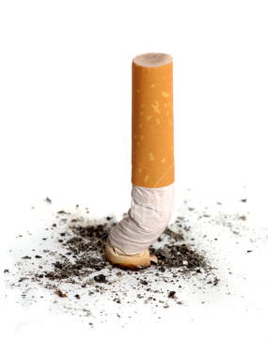
Erectile Dysfunction
Erections require the proper functioning of both the neurologic and the circulatory system
Smoking damages the circulatory system
Smokers have twice the rate of erectile dysfunction of non-smokers
The more you smoke, the higher the risk of becoming impotent

Slide 50
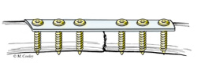
NON-UNIONS
Most broken bones heal without any problems.
After a fracture, new bone tissue forms to connect the broken pieces.
When the broken bone fails to heal it is called a
“nonunion”.
A “delayed union” is when a fracture takes longer than usual to heal.
For bone healing, bones need adequate stability and blood supply.

Slide 51
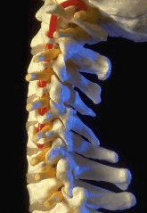
Non-unions and Tobacco
Use of tobacco is among the factors that can increase the risk of nonunion:
“Use of tobacco or nicotine in any form Smoking, chewing tobacco, and use of nicotine gum or patches significantly inhibit bone healing and increase the chance of a nonunion”
© American Academy of Orthopedic Surgeons

Slide 52

The Effects of Tobacco on Bone Healing
Weakened spinal ligaments
Reduced production of bone cells
Faster bone loss in postmenopausal women
Fractures take longer to heal
Rotator cuff surgery is less successful
Longer healing time for surgical incisions
More post-surgery complications
Delayed spinal fusion
Smoking lowers bone mineral density due to
decreased calcium absorption associated with secondary hyperparathyroidism and increased bone resorption
Toxins contained in cigarette smoke can undermine fracture and ligament repair following injury
Fracture healing problems and bone infections and smoking have been shown to impair soft tissue wound healing
Use of tobacco is among the factors that can increase the risk of nonunion

Slide 53
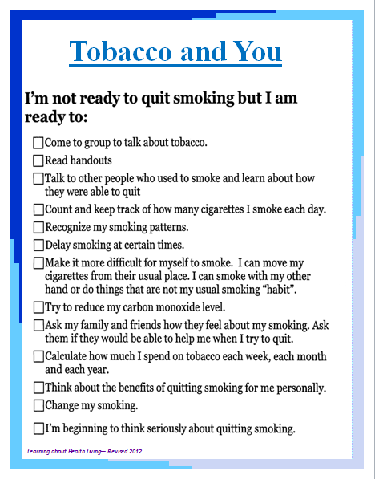
Encouraging Change

Slide 54

MOTIVATIONAL INTERVIEWING STRATEGIES
Express Empathy
Develop Discrepancy
Roll with Resistance
Support Self-Efficacy

Slide 55
TECHNIQUES:
EXPRESS EMPATHY
Use Open-ended questions to explore
Use reflective listening to seek shared understanding
Normalize feelings and concerns
Support the patient’s autonomy and right to choose or reject change.
“What might happen if you quit?”
“What I heard so far is that your enjoy smoking but you’re concerned it will lead to a serious disease.”
“Many people worry about managing without cigarettes.”
“I’m here to help you when you’re ready.”

Slide 56
TECHNIQUES:
DEVELOP DISCREPANCY
Highlight discrepancy between current behavior and expressed values
Reinforce/Support using “Change Language”
Build & deepen commitment to change
“It sounds like you’re very devoted to your family. How do you think your smoking is affecting them?”
“So you realize how smoking is affecting your breathing and making it hard to keep up with your kids.”
“There are effective treatments to ease the pain of quitting, such as medication options and counseling.”

Slide 57

TECHNIQUES:
ROLL WITH RESISTANCE
Use reflection when you meet resistance
Express empathy
Ask permission to provide information
“Sounds like you’re feeling pressured about your tobacco use.”
“You are worried about how you would manage with withdrawal symptoms.”
“Would you like to hear about some strategies that can help you address your concerns?”

Slide 58

TECHNIQUES:
SUPPORT SELF-EFFICACY
Help patient to identify & build on past successes
Offer options for achievable, small steps toward change
“So you were fairly successful the last time you tried to quit.”
“You can call the NYS Smoker’s Quitline Toll Free Number (866) 697- 8487 for support. I can even fax over a referral form to them if you like and they will call you.”
“Change smoking patterns (e.g., no smoking in the car or inside the house) can help you practice not smoking. Do you have any other ideas?”

Slide 59
TECHNIQUES:
Reflection
ROLL WITH RESISTANCE
Reflecting back to the client/patient is useful when being met with resistance
“Sounds like you’re feeling pressured about your tobacco use.”

Slide 60

TECHNIQUES:
Past Success
SUPPORT SELF-EFFICACY
Help patient to identify & build on past successes
“So you were fairly successful the last time you tried to quit.”

Slide 61
SUPPORT SELF-EFFICACY
TECHNIQUES:
Smaller Steps
Offer options for achievable, small steps toward change
Read about quitting benefits and strategies.
Change smoking patterns.
Ask patient to share his/her ideas about quitting strategies.
Call the quitline (1-866-697-8487) for advise and information.

Slide 62
Why Individuals with Mental Health and Addictions (MHA) May Have Higher Rates of Smoking
The nature of these disorders increases vulnerability to initiation and maintenance of smoking behaviors.
Individuals with MHA are self-medicating affective and cognitive symptoms.
There are social factors common to both MHA and smoking (e.g., peer modeling, poverty, stress, availability)
Kalman, Morissete and George, 2005. Am. J. Addictions. 14: 106-123
Tony P. George, M.D., FRCPC
Tobacco Treatment in People with Serious Mental Illness:
The Devil is in the Details!

Slide 63
Is it Safe to Get MHA Patients to Quit Smoking?
Short Answer: Yes! But few studies have been conducted, and more research needs to be done.
In schizophrenia, smoking cessation does not exacerbate psychotic or depressive symptoms (e.g. George et al., 2000; Evins et al., 2001; George et al., 2002; Evins et al., 2005).
In major depression, some longitudinal studies do suggest some increased risk of depression with smoking cessation, but several other studies have not supported this conclusion (Glassman et al., 1988; 1990), (Niaura et al., 2001; Thorsteinsson et al., 2001).
In anxiety disorders, little evidence that cessation can exacerbate PTSD or GAD, and in fact severity and frequency of panic attacks in Panic Disorder may be higher in smokers versus non-smokers (Breslau and Klein, 1999).
Tony P. George, M.D., FRCPC
Tobacco Treatment in People with Serious Mental Illness:
The Devil is in the Details!

Slide 64
Treatment of Tobacco Dependence in People with SPMIs
Cessation rates in SPMI (e.g. schizophrenia, bipolar, PTSD) are 1/2 to 1/3 of those in the general population.
Need to exploit pathophysiological relationships between the mental illness and tobacco dependence – this could improve treatment outcomes.
Need to combine medications with behavioral therapies
Need to integrate tobacco dependence treatments into psychiatric settings
Hitsman, B et al., 2009. Can. J. Psychiatry
Tony P. George, M.D., FRCPC
Tobacco Treatment in People with Serious Mental Illness:
The Devil is in the Details!

Slide 65
New York High School Students in Every Grade Show Significant
Declines in Cigarette Smoking
Smoking rates of high school students are monitored using the New York Youth Tobacco
Survey (NY YTS). This school-based survey is conducted in public and private schools in
New York every other year, in even-numbered years. The standard definition of current
smoking among youth is “having smoked on one or more of the past 30 days.”
Current smoking rates among 9th, 10th, 11th, and 12th grade high school students in New
York exhibited a strong downward trend between 2000 and 2010. All declines are
statistically significant.
Percentage declines in current cigarette smoking between 2000 and 2010 were 58%,
50%, 57%, and 54% for grades 9 through 12, respectively.
Significant reductions in youth smoking support New York’s approach of graphic and
emotionally evocative media, high excise taxes, and a well-funded tobacco control
program.

Slide 66
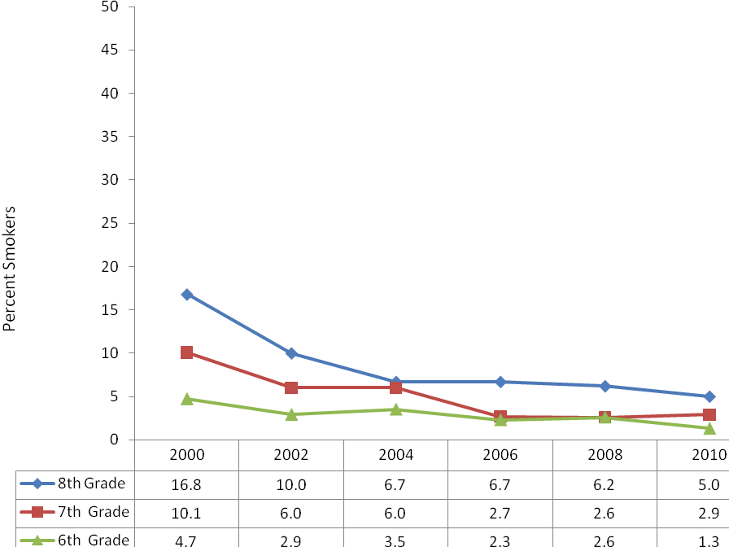
Percentage of Current Smoking among students by Grade Level,
New York State Youth Tobacco Survey 2000-2010
Source: New York State Youth Tobacco Survey, 2000-2010. Contact the Bureau of Chronic Disease Epidemiology and
Surveillance, New York State Department of Health at (518) 473-0673 or type ‘StatShot’ in the subject line of an e-mail and send it
to tcp@health.state.ny.us.

Slide 67
FDA’s Safety Review Update of Chantix
October 24th, 2011: FDA has announced that a review of results from two FDA-sponsored epidemiological studies has been completed
  it evaluated the risk of neuropsychiatric adverse events associated with Chantix
Neither study found a difference in risk of neuropsychiatric hospitalizations between Chantix and NRT
The Agency continues to believe that the drug’s benefits outweigh the risks
  the current warnings in the Chantix drug label are still considered appropriate
www.fda.gov/Drugs/DrugSafety

Slide 68
Childhood Obesity and Smoking
10% of youth (10-22 yoa) with type 1 diabetes and 16% of youth with type 2 diabetes were currently using some form of tobacco products in 2008
Less than half of the youth reported that they had been counseled by their health care provider to not smoke or stop smoking
This substantial proportion of youth with diabetes that are smokers adds greatly to their already elevated risk for heart disease
Findings based on analysis of data from the SEARCH for Diabetes in Youth Study and study funded by the CDC and National Institute of Diabetes

Slide 69

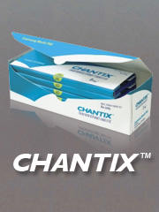
MVP Healthcare and Chantix
Effective March 1, 2011 Chantix has now been added MVP Healthcare’s Formulary as a tier 2 prescription for smoking cessation.
Prior notification must be received from a provider before claims for smoking cessation medications will
adjudicate at the pharmacy. Prior notification requests should be submitted to MVP. Members* that participate in smoking cessation counseling will be reimbursed in full for smoking cessation
medications. For reimbursement, members must present a prescription to their pharmacy and pay-out-of pocket
for over-the-counter products or their prescription co-pay when applicable. Members should then
submit the claim to MVP by following the member claim submission process available on the MVP website at https://www.mvphealthcare.com/pharmacy/documents/health-care-reform-guidelines.pdf.
*Not all members are eligible for the above coverage. ASO grandfathered plans do not have this coverage. In addition, select groups may have chosen to modify this coverage.

Slide 70
Performance Improvement Project
Earn 21 CME Credits with 3 easy steps
Stage A: 60 Chart Baseline: Ask √ Advise √ Assist √ 5 CME’s
Stage B ( Training and Implementation): 6 CME’s
Stage C
60 charts for documentation of tobacco use assessment and counseling
Meet with Cessation Center Staff to complete a short questionnaire, Stage C Checklist, and PIP Evaluation
Receive 10 CMEs
TOTAL: 21 CME’s
To schedule your PIP, or for more information:
Scott McIntosh, PhD
GRATCC Director
Sc0tt_mcintosh@urmc.rochester.edu
585.275.0511

Slide 71
Expansion of Smoking Cessation Counseling to ALL Medicaid Beneficiaries (Effective 4/1/11)
Medicaid expanded coverage of smoking cessation counseling (SCC) to ALL Medicaid beneficiaries.
Allows 6 face-to-face sessions during any 12 months
Cessation products are also covered by Medicaid
Counseling reimbursable when provided by the following:
Office-based practitioners (physicians, registered nurse
practitioners [RNP],and licensed midwives [LM]) Article 28 hospital outpatient departments (OPD)
Free-standing diagnostic and treatment centers (D&TC)
Federally qualified health centers (FQHC)
including FQHC school based health centers (SBHC)
that bill using Ambulatory Patient Groups (APGs)

Slide 72
Chantix (varenicline): label update
Now includes information about the efficacy and safety of the drug in two patient populations who may benefit greatly from giving up smoking:
a. those with cardiovascular disease
- clinical trial showed that Chantix was effective in helping patients with cardiovascular disease quit smoking; more than doubled the chance that patients remain abstinent from smoking for as long as one year compared to patients treated with placebo
b. those with chronic obstructive pulmonary disease (COPD)
- Chantix was more effective in helping COPD patients quit smoking and remain abstinent from smoking for as long as one year compared to placebo
II. Updated Warnings and Precautions section and the patient Medication Guide:
- use of varenicline may be associated with a small, increased risk of certain cardiovascular adverse events in patients who have cardiovascular disease
-These include: angina pectoris, nonfatal myocardial infarction, need for coronary revascularization, and new diagnosis of peripheral vascular disease or admission for a procedure for the treatment of peripheral vascular disease
III. Updated alternative directions for patients to select a quit smoking date after they have already started taking Chantix:
-label now states that patients should start taking Chantix 7 days before their quit date or alternatively, begin Chantix dosing and then quit smoking between Days 8 and 35 of treatment.

Slide 73
Components of Smoking Cessation Group Therapy Program for SPMI Smokers
Example:
  10 weekly sessions of manualized group smoking cessation counseling (Ziedonis and George, 1997; George et al, 2000; 2002; 2008)
  Flexibility in setting a target quit date if unsuccessful on initial attempt
  Emphasis on motivational interviewing (MI) and psychoeducation pre-Quit Date
  Modified cognitive behavioral therapy (CBT) emphasizing small amounts of material at each session with frequent repetition, to compensate for cognitive deficits of subjects
  Focus on building social skills and emphasis on relapse prevention.
Tony P. George, M.D., FRCPC
Tobacco Treatment in People with Serious Mental Illness:
The Devil is in the Details!

Slide 74
Tobacco Smoking and Persons with Psychiatric Disorders
A major cause of death of people with SPMI and addictions is tobacco-related illness (Hurt et al., 1996; Hennekens et al., 2005; George and Ziedonis, 2009)
While nicotine-dependent mentally ill smokers make up 7.1% of the population of smokers, they consume 34.7% of all cigarettes (Grant et al., 2004)
Up to 25% of disability income may be spent by heavily-dependent mentally ill smokers on tobacco products each month (Ziedonis et al., 2005)
Tony P. George, M.D., FRCPC
Tobacco Treatment in People with Serious Mental Illness:
The Devil is in the Details!

Slide 75
More Health Care Organizations Have Systems in Place for Tobacco Use Identification and Treatment
Provider reminder systems are effective tools in increasing health care provider use of
smoking cessation interventions. The Public Health Service Guideline, Treating
Tobacco Use and Dependence: 2008 Update, recommends a systems strategy of
implementing a tobacco user identification system in every clinic. The Cessation
Centers funded by the New York Tobacco Control Program are charged with working
with health care organizations to provide technical assistance and implement these
systems changes.
All hospitals in New York State documented patients’ smoking status in 2009.
In 2009, 94% of hospitals reported documenting interventions with patients, a 17%
increase from 78% in 2005.
There was a significant increase in the number of group practices that document
patient smoking status from 84% in 2005 to 94% in 2009.
There was a significant increase in group practices that documented interventions
from 49% in 2005 to 84% in 2009.

Slide 76
Percentage of Health Care Organizations in New York with Systems in Place for Tobacco Use Identification and Treatment
Health Care Organization | Activity | 2005 | 2007 | 2009
Hospitals | Cue “ask” | 96.20% | 94.70% | 98.20%
 | Cue “advise” | 69.80% | 71.70% | 68.10%
 | Document status | 96.40% | 97.00% | 100.00%
 | Document intervention | 77.50% | 79.80% | 93.50%
Group Practices | Cue “ask” | 79.80% | N/A | 90.70%
 | Cue “advise” | 36.60% | N/A | 52.30%
 | Document status | 83.60% | N/A | 93.50%
 | Document intervention | 48.60% | N/A | 84.20%
Note: Cue “ask” = Providers are cued to ask about tobacco use status; Cue “advise” = Providers are cued to advise tobacco users to quit; Document status = a system is in place to document patient’s tobacco use status; Document intervention = a system is in place to document tobacco-related intervention
Source: Health Care Organization and Provider Study, 2005–2009; N/A = not available that year. Data analysis conducted by RTI, International. Contact the Bureau of Chronic Disease Epidemiology and Surveillance, New York State Department of Health at (518) 473-0673 or type ‘StatShot’ in the subject line of an e-mail and send it to tcp@health.state.ny.us.

Slide 77
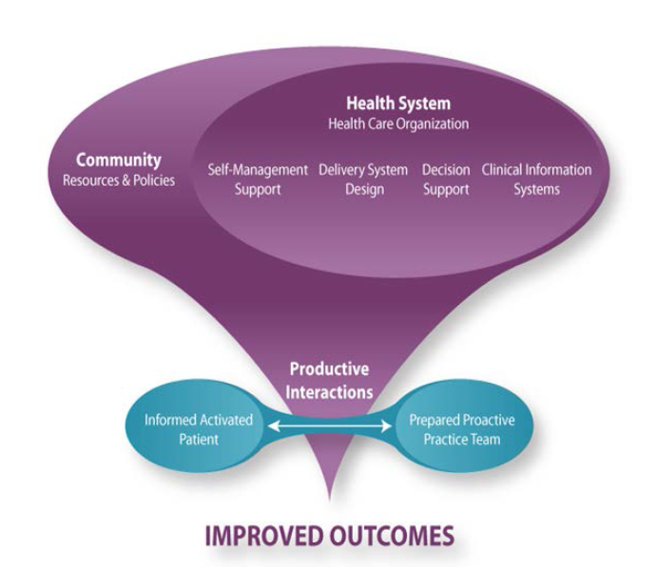
Chronic Care Model

Slide 78
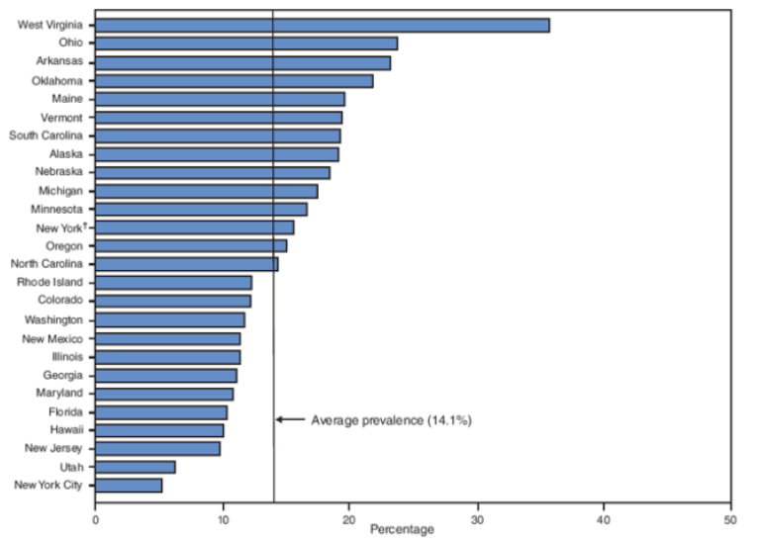

Prevalence of Smoking during Pregnancy
MMWR, 2009: 58(SS04); 1-29

Slide 79
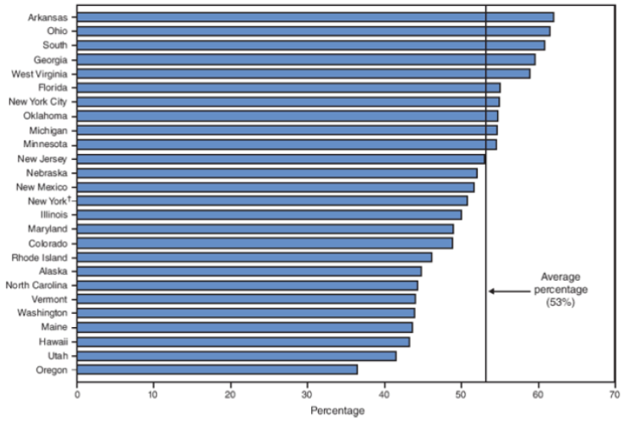
Percentage of Women Relapsing* Post-Partum after Quitting during Pregnancy
MMWR, 2009: 58(SS04); 1-29
* Assessed 4 months after delivery

Slide 80
Categories of Maternal Smoking Status
Pregnancy Quitters= quit because they are trying to get pregnant.
Spontaneous quitters= quit because they find out they are pregnant.
  25% of pregnant smokers become spontaneous quitters.
Pregnant smokers= smoke through pregnancy
  more psychological and emotional problems, less support.
  22% of women smoke throughout pregnancy.
More than 70% of spontaneous quitters relapse within 6 months post partum.

Slide 81
What’s Slowing You Down?
Your Age OR Your Smoking?
During the past year have you experienced….
Problems sleeping or falling asleep
Fatigue
Sores in the mouth, bad gums
Memory problems
Frequent coughing or heavy chest colds
High blood pressure
Wheezing
Tingling in hands & feet
Heart trouble or heart attack
Circulation problems
Pin or tightness in the chest
Emphysema, chronic bronchitis or asthma

Slide 82
Countering Typical Excuses for Not Quitting by Older Adults
Excuse
The fact is…
Smoking hasn’t killed me yet…
****
Smoking relaxes me….
Smoking harms nearly every organ in the body, and is esp. harmful to older adults. Quitting tobacco can add 2 -3 years of quality life.
****
The relaxation feeling that smokers cite may be due to deep breathing from inhaling and taking a break. Try taking a break and deep breathing without a cigarette.

Slide 83
Countering Typical Excuses for Not Quitting by Older Adults
Excuse…
The fact is….
It’s too late, the damage has been done.
Quitting at any age has immediate and long term benefits.
Quitting markedly reduces the risk of recurrent heart attack & cardiovascular death.
For those with cancer, continuing to smoke can decrease the effectiveness of treatment and the prognosis for survival.

Slide 84
Countering Typical Excuses for Not Quitting by Older Adults
Excuse…
The fact is….
I’m about to go into the hospital for surgery so I can’t deal with quitting now…
Smokers have a lower survival rate after surgery because smoking alters the body’s defenses and immune response.
Smoking slows bone and wound healing as well as recovery from surgery.

Slide 85
Countering Typical Excuses for Not Quitting by Older Adults
Excuse….
The fact is….
Been there, done that….
Most smokers have to try many times to quit for good.
Older smokers can succeed if they take advantage of the cessation counseling and medications now available.
Older adults may be less likely to try quitting, but if they do try, they are more likely to be successful.

Slide 86
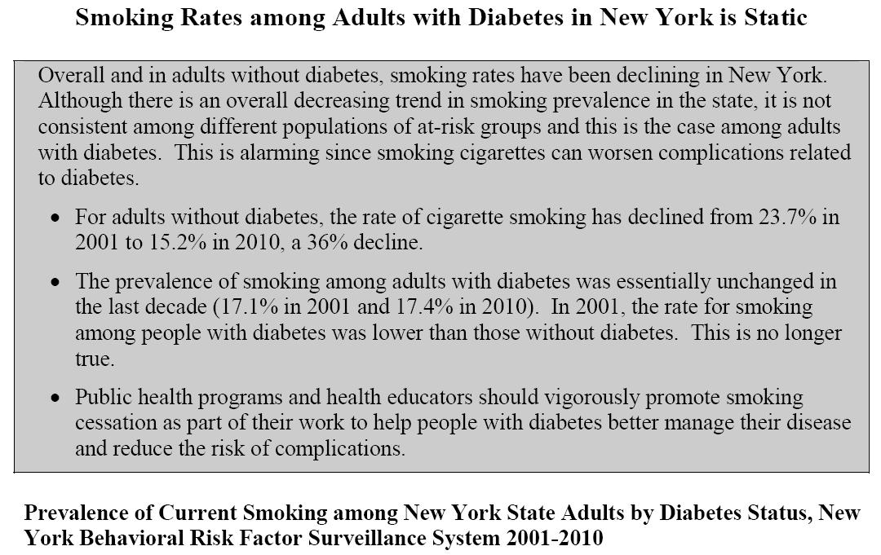
NYS Smoking Rates among Adults with Diabetes

Slide 87
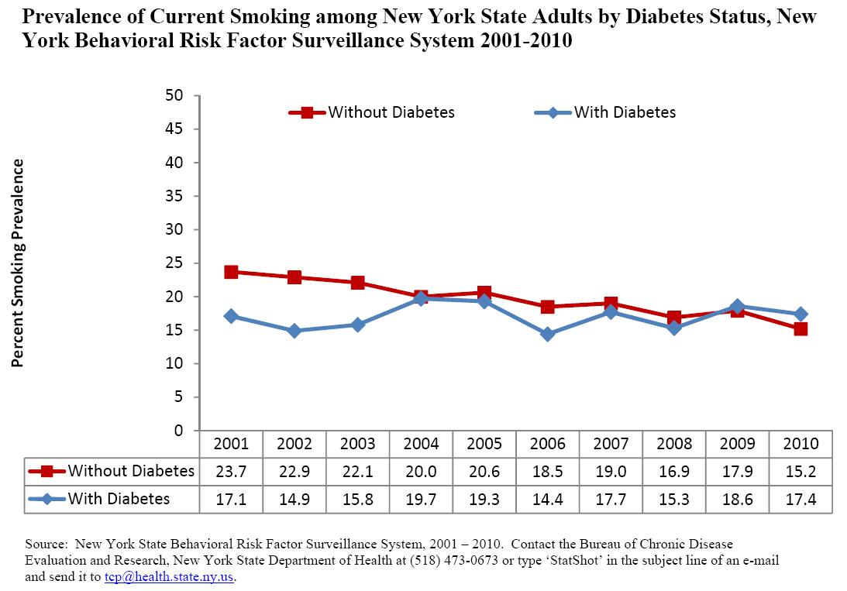
Current Smoking NYS Adults by Diabetes Status

Slide 88
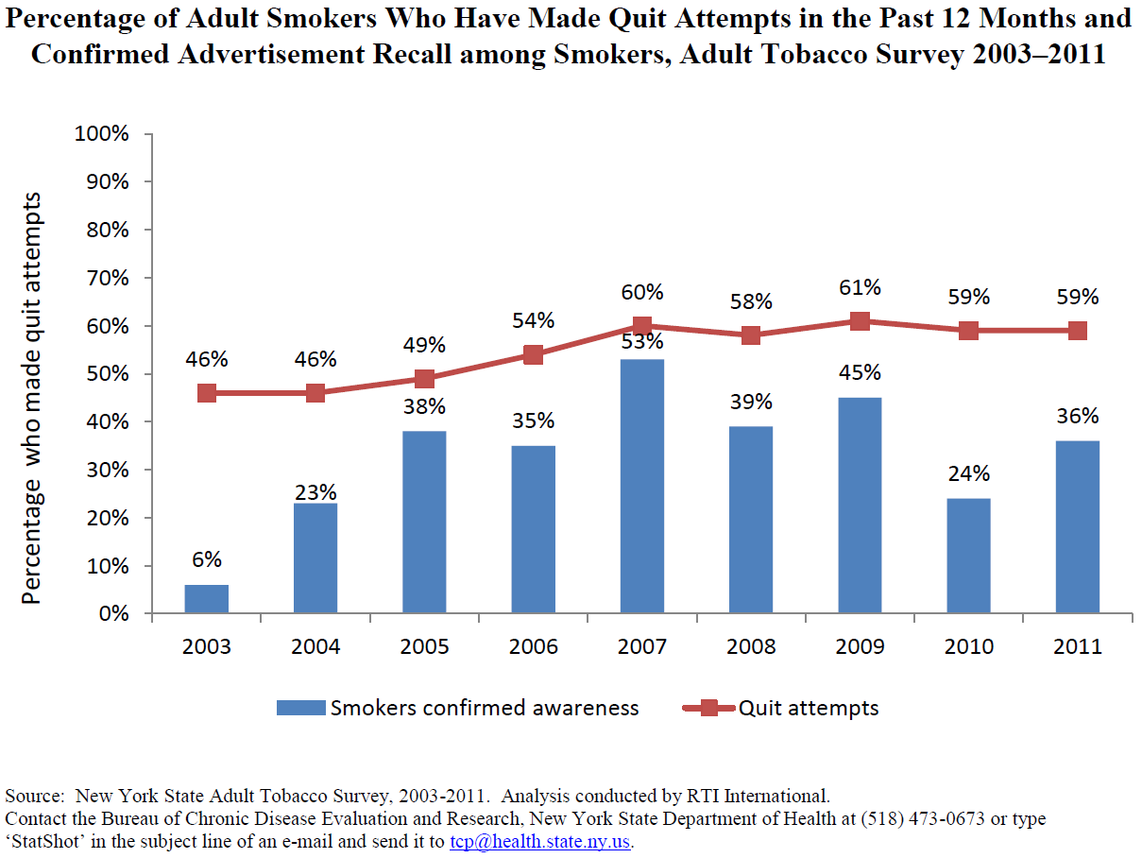
Percentage of Adult Smokers who have made Quit Attempts in the Past 12 Months

Slide 89
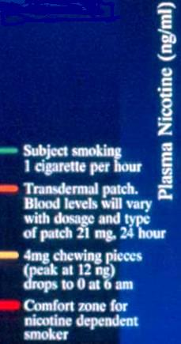
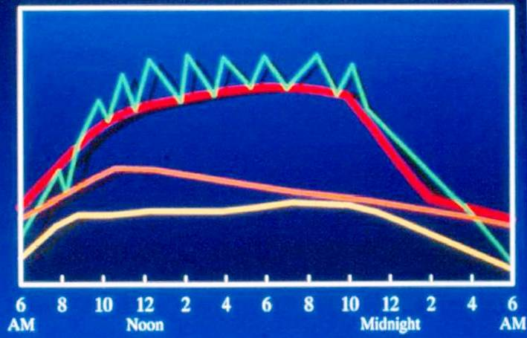
A Day in the Life of Blood Nicotine

Slide 90
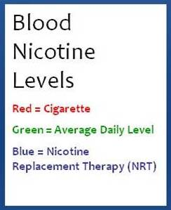
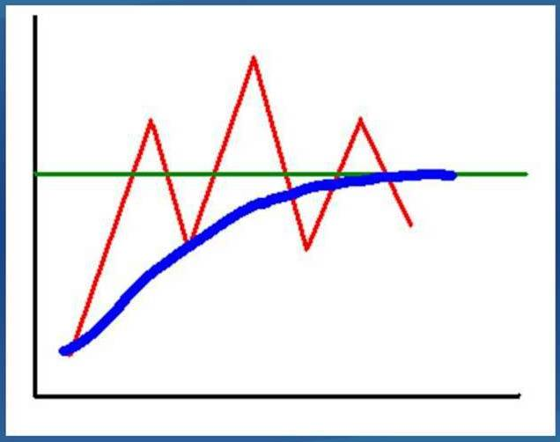
NRT Strategy:
“Maintain the Addiction” while “Changing the Behavior”
Withdrawal Symptoms
The red line represents the blood nicotine levels from a cigarette. The green line is any given person’s daily average. The blue line is blood nicotine levels that rise per NRT. As long as these levels are 2/3 that of daily average, the person is less likely to have have withdrawal symptoms. If they do, consider adding a 2nd NRT as a rescue strategy. For example, if on the patch – add gum or lozenge intermittently to handle breakthrough cravings.

Slide 91
Dissolvable Tobacco Products
“Orbs” are small pellets resembling breath mints that last just a few minutes before melting away. Orbs come in “Mellow” and “Fresh” flavors. Mellow is a sweet tobacco flavor, while Fresh is minty. Dissolvable Tobacco Products entered mainstream use in the later half of the 2000s. The product consists of finely processed tobacco which is developed in such a way as to allow the substance to dissolve on the tongue or in the mouth. Camel tobacco is the major purveyor of dissolvable tobacco products, with three varieties, including strips, sticks and orbs.

Slide 92
Evidence-based Practices / Comprehensive approach:
Strategies that Work in Tobacco Control
Increases price of tobacco
Clean Indoor Air (Smoking bans & restrictions, policies)
Mass Media campaigns with interventions (i.e., part of comprehensive tobacco control programs)
Reducing patient costs for treatment
Availability of treatment for tobacco dependence
Provider reminder systems
Telephone counseling and support
Source: Guide to Community Preventive Services, Systematic Reviews & recommendations
Notes:
The largest impact come when we increase tobacco prices, ban smoking in public places , offer affordable and accessible cessation treatments and services and combine media campaigns with other initiatives.
2009 FDA received statutory authority to regulate tobacco products.

Slide 93
Smoking Prevalence
What is the prevalence of smoking in New York State (adults)?
Notes:
Decline in percentage of population who smoke. Continues to decline.

Slide 94
Smoking Prevalence Declines in New York Overall but Disparities Exist among Different Socio-Demographic Groups
The New York Tobacco Control Program’s mission is to reduce tobacco-related morbidity and mortality and the social and economic burden caused by tobacco use
Smoking prevalence broken down by gender, race/ethnicity, education, income and mental health shows disparities in smoking prevalence among these different groups
The groups who benefitted the least included individuals with less than high school educations and those earning less than $15,000 per year
Source: Data are from the New York State Behavioral Risk Factor Surveillance System (BRFSS), 2000 and 2010 except for mental health, which is from the New York Adult Tobacco Survey (ATS), 2003 and 2010. Analysis conducted by RTI, International and abstracted from the report “Who’s Quitting in New York” available at: http://www.nyhealth.gov/prevention/tobacco_control/reports_brochures_fact-sheets.htm. For more information, contact the Bureau of Chronic Disease Evaluation and Research, New York State Department of Health at (518) 473-0673 or type ‘StatShot’ in the subject line of an e-mail and send it to tcp@health.state.ny.us.

Slide 95

Two changes were recently made to the New York State Behavioral Risk Factor Surveillance System (BRFSS) methods that affect smoking prevalence and other indicators, and are reported for the first time in 2011.
Data from individuals who live in households with only cell-phones were included and a new weighting method was adopted.
Weighting is the process by which survey data are adjusted to ensure representativeness and proper coverage of the population, and maintain validity.
New weighting methods (called raking) take into account more socioeconomic variables and are being applied to BRFSS nationally. As a result of these changes, prevalence estimates for current cigarette smoking are higher than previously indicated, but likely more accurate.
For more information on raking see http://www.cdc.gov/mmwr/preview/mmwrhtml/mm6122a3.htm

Slide 96

Percentage of Adults Who Currently Smoke in New York by Demographic Groups
Notes:
Decline in percentage of population who smoke. Continues to decline.

Slide 97
Face to Face Counseling
“Healthy Living Program” is based in Rochester- Considered “Intensive” counseling
  Face to Face Counseling – “Fax to Intensive”
  Assessed for cessation medications/ insurance eligibility
  Patient can also be referred to the State Quitline

Slide 98

FDA Label Modifications
On April 1st, 2013, the FDA announced that the previous statements regarding their approved labels of over-the-counter (OTC) nicotine replacement therapy (NRT) products are no longer believed to be necessary in their existing form and considering the current available evidence, the present labels will be modified as follows:
Published literature the FDA relied on to make the determinations contained in the notice can be found at www.regulations.gov by searching “over-the-counter nicotine replacement therapy products”

Slide 99

Motivational Interviewing Role Playing Practice
Please Break into Groups of four
Select one individual to be the clinician and one to be patient/parent

Slide 100

Article published by the Times of Roanoke, Virginia September 20 2004
True Story!

Slide 101

Center for Tobacco Free Finger-Lakes
Tobacco Cessation and Quality Cancer Care
As part of its effort to build awareness and encourage cessation counseling, in 2006, ASCO began integrating smoking-related measures into the ASCO Quality Oncology Practice Initiative (QOPI), an oncologist-led, outpatient practice–based quality assessment and improvement program.
Hanna N, Mulshine J, Wollins DS, Tyne C & Dresler C (2013). Tobacco Cessation and Control a Decade Later: American Society of Clinical Oncology Policy Statement Update. Journal of Clinical Oncology, 48; 8932.

Slide 102

Tobacco Free Policy: A Parallel Process
Client, visitor, and staff policy
Client and staff resources
Facilities
Incentives
Medications
Peer support

Slide 103
NYS Medicaid covers meds (even OTC) and cessation counseling
ICD9 Codes: 630-677, V22, V23, V28
Cessation Counseling (SCC) CPT procedure codes:
99406 – Smoking Cessation Counseling 3-10 minutes ($10)
99407 – Smoking Cessation Counseling greater than 10 min ($19)
Medicare now covers counseling for tobacco dependence without a co-morbidity
ICD9 Code: 305.1
99406 – Smoke/Tobacco Counseling 3-10 minutes payment ($12.19 natl avg)
99407 – Smoke/Tobacco Counseling greater than 10 minutes ($23.99 natl avg)
Many private plans now cover medications and some reimburse for cessation counseling
Billing Codes
Notes:
Counseling your patients to quit smoking is important. The codes listed can be used for reimbursement. Private payer benefits are subject to plan policies. According to the US Public Health Service, the combination of counseling and medication is more effective than either alone.

Slide 104
Upcoming ICD-10 Codes
ICD-10 Codes: F17.2 Nicotine Dependence
      F17.20 Nicotine dependence, unspecified,
      F17.21 Nicotine dependence, cigarettes;
      F17.22 Nicotine dependence, chewing tobacco,
      F17.29 Nicotine dependence, other tobacco product

Slide 105

Billing Diagnosis and Codes

Slide 106

New ICD-10 Codes

Slide 107

Kidney Cancer
In the US, approximately 58,000 people will be diagnosed with kidney cancer this year
13,000 people will die of kidney cancer this year
The risk of developing kidney cancer is higher in smokers
The risk of kidney cancer is higher in those who smoke more cigarette or in those who have smoked for many years

Slide 108
Bladder Cancer
Over 14,000 people in the US will die of bladder cancer this year
Smoking is a major risk factor for the development of bladder cancer
Smokers are 4x more likely to develop bladder cancer than non-smokers
Quitting smoking will decrease the risk of developing bladder cancer and of cancer recurrence

Slide 109

Surgical Complications
Increased complications from general anesthesia
Increased risk of pulmonary complications (pneumonia, reintubation, bronchospasms)
Detrimental effects on wound healing
  Compromised capillary blood flow
  Increased vasoconstriction
  Increased risk of wound infection
Quitting smoking at least one month prior to surgery is most beneficial
Source: Jamie Ostroff, PhD Director, MSKCC Tobacco Cessation Program Chief, Behavioral Sciences Service Memorial Sloan-Kettering Cancer Center

Slide 110

Radiation Complications
Lower treatment response rates
Lower overall survival
Greater need for hospitalization
More frequent treatment complications (e.g.,
Osteoradionecrosis, Mucositis, poor pain control, need
for feeding tube, pharyngeal stricture)
Impaired resumption of voice quality post-radiation
Source: Jamie Ostroff, PhD Director, MSKCC Tobacco Cessation Program Chief, Behavioral Sciences Service Memorial Sloan-Kettering Cancer Center

Slide 111

Chemotherapy Complications
Diminished treatment response
Increased side effects (e.g., immune suppression, weight loss, fatigue, pulmonary cardiac toxicity)
Increases drug toxicity
Increases infection
Source: Jamie Ostroff, PhD Director, MSKCC Tobacco Cessation Program Chief, Behavioral Sciences Service Memorial Sloan-Kettering Cancer Center

Slide 112

Health Benefits of Smoking Cessation:
Cancer-Specific
Fewer treatment complications
  Lower risk of peri- and post-operative complications
  Improved pulmonary health and less need for pulmonary rehabilitation
  Improved surgical wound healing and less risk of infection
  Greater likelihood of shorter hospitalization and surgical time
  Less dry mouth, mucositis, tissue and bone necrosis
Improved treatment efficacy
Reduced risk of disease recurrence
Reduced risk second primary cancer
Improved mastery and control
Better quality of life
Improved survival
Source: Jamie Ostroff, PhD Director, MSKCC Tobacco Cessation Program Chief, Behavioral Sciences Service Memorial Sloan-Kettering Cancer Center

Slide 113
Center for a Tobacco-Free Finger Lakes
Tobacco Cessation and Quality Cancer Care
It is “incumbent on the cancer care community to incorporate effective tobacco cessation as an integral component of quality cancer care” (ASCO, 2009)
Smoking status recommended as core clinical and research data element
Tobacco cessation counseling recommended as standard of quality care
ASCO, 2009

Slide 114


Break Loose

Slide 115

American Lung Association. June 2013 Report Taking Her Breath Away: The Rise of COPD in Women

Slide 116





TOBACCO SMOKING AND YOUTH
More than 6.3 million children under age 18 alive today will eventually die from smoking-related disease, unless current [smoking] rates are reversed.
Source: CDC
Nearly 90 percent of adult smokers began at or before age 18.
Source: Calculated based on data in National Survey
on Drug Use and Health, 2009.
More than a third of all kids who ever try smoking a cigarette become regular, daily smokers before leaving high school.
Source: CDC
More than 2.8 million kids under the age of 18 are current tobacco users.
Source: 2009 National Survey on Drug Use and Health data

Slide 117
Special Considerations in Using Cessation
Pharmacotherapy with Cancer Patients
Medication recommendations should consider potential contraindications and side effects
Nausea and vomiting are common side effects of chemotherapy
Insomnia and sleep impairment are common
Dry mouth and oral mucositis may preclude use of NRT lozenge/gum
Patients scheduled for reconstructive surgery (breast, head and neck) are advised to refrain from peri-operative NRT
Source: Jamie Ostroff, PhD Director, MSKCC Tobacco Cessation Program Chief, Behavioral Sciences Service Memorial Sloan-Kettering Cancer Center

Slide 118
Special Considerations in Using Cessation
Pharmacotherapy with Cancer Patients
Patients with brain tumors and brain metastases may be at-risk for seizures (may preclude Zyban)
Patients with kidney cancer may have impaired renal function (may preclude Chantix)
Standard dosage recommendations are dependent upon smoking rate/patterns and patient’s prior medication use
Source: Jamie Ostroff, PhD Director, MSKCC Tobacco Cessation Program Chief, Behavioral Sciences Service Memorial Sloan-Kettering Cancer Center

Slide 119

It’s never too late to quit!
85-90% of lung cancer cases are related to tobacco use
Smokers benefit from quitting smoking even after the development of smoking-related morbidity
  CVD
  COPD
  Cancer
Smoking cessation is associated with decreased all-cause mortality, even for smokers with airway obstruction (Anthonisen et al., 2005)
Smoking cessation can slow or partially reverse the accelerated bone loss caused by years of smoking (Ward et al., 2001)
Older smokers are less likely to make an initial quit attempt, but are more successful than younger smokers when they do (Ossip-Klein et al., 1999)

Slide 120
Impact of Nurses and Dentists
A Cochrane review of clinical trials that covered 42 studies with over 15,000 participants that advice and support from nursing staff could increase people’s success in quitting smoking, especially in a hospital setting¹
Evidence suggests that tobacco cessation counseling conducted by oral health professionals, who incorporate an oral examination component in the dental office or community setting, can increase tobacco abstinence rates among both cigarette smokers and smokeless tobacco users²
¹ Nursing interventions for smoking cessation (Review) Copyright © 2009 The
Cochrane Collaboration. Published by JohnWiley & Sons, Ltd.
² Carr, A.B., & Ebbert, J.O. (2012). Interventions for tobacco cessation in the dental
setting. Cochrane Database of Systematic Reviews, 2012(6), Art. No.: CD005084.

Slide 121
5A Model/CME
Using the 5As: The 5As model is a structured intervention designed to facilitate an evidence-based, effective intervention in a short period of time with patients. The 5As are Ask, Advise, Assess, Assist and Arrange.
http://www.nysmokefree.com/CME/PageView.aspx?P=50&P1=5018#

Slide 122
Prescription Drug Use/CME
Smoking Cessation & Concomitant Prescription Drug Use: Smoking changes how the body reacts to many medications. The efficacy of certain medications is decreased with concomitant smoking, and therefore, certain medications must be given in higher doses in the smoking patient. Also, when a patient stops smoking, the levels of these medications in the body may change. This link shows, in chart form, medications and considerations for use with patients who smoke or have quit smoking.
http://www.nysmokefree.com/CME/PageView.aspx?P=50&P1=5017

Slide 123
CME Pharmacotherapy
Pharmacotherapy: Reviews both nicotine replacement and non-nicotine medications that can be used to help smokers with withdrawal systems. Clinical research studies show that using pharmacotherapy, along with counseling, can double a smoker’s chances of success. The link below also discusses dosage, how to use each product, adverse reactions, contraindications and potential precautions for each product.
http://www.nysmokefree.com/CME/PageView.aspx?P=50&P1=5008

Slide 124
Please complete the following by the end of the presentation.
Sign in
  Note: Birthdate (At least Day and Month) and e-mail address is required to receive CME credit.
Evaluation Form (in folder) By End Of Presentation, Please.

Slide 125
5Rs/CME
5Rs Model (Motivational Intervention): This section discusses each of the 5Rs in detail (Relevance, Risks, Rewards, Roadblocks and Repetition). Discussing these with smokers who may be unwilling to quit provides a consistent message that smoking cessation is a process and it is the best thing anyone can do to improve their health. It allows for patient-centered discussions that can help clear up misconceptions about smoking and address their feelings of failure in past quit attempts.
http://www.nysmokefree.com/CME/PageView.aspx?P=50&P1=5027

Slide 126
Stages of Change /CME
Stages of Change: This section discusses the 5 stages of change in detail. For most people change is a gradual process and understanding each stage will help providers open discussions about smoking cession with their patients.
http://www.nysmokefree.com/CME/PageView.aspx?P=50&P1=5025

Slide 127
Motivating Change/CME
Motivating Change: This section contains a downloadable “Motivating Change Worksheet” to help open discussions with patients about smoking cessation and to help them move from one stage to the next. The work sheet allows patients who smoke the opportunity to think about what they like and what their concerns are about smoking. This tool can provide an opening for honest review and discussion.
http://www.nysmokefree.com/CME/PageView.aspx?P=50&P1=5026#

Slide 128
5A’s Treatment Model
The 5As model is a structured intervention designed to facilitate an evidence-based, effective intervention in a short period of time with patients.
Visit the NY State Smokers’ Quitline link below for more in-depth information:
http://www.nysmokefree.com/CME/PageView.aspx?P=50&P1=5018#

Slide 129

E-Cigarettes ≠ Safe
Example of E-Cigarette Starter Kit

Slide 130

NRT Patch Dosages
NicoDerm CQ
Patch strength Duration
21 mg/day 6-8 weeks
14 mg/day 2-4 weeks
7 mg/day 2-4 weeks
Nicotrol:
Patch strength Duration
15 mg/16 hours 8 weeks
Possible Side Effects:
local skin reaction, insomnia

Slide 131
Chantix (Varenicline) U.S. Food and Drug Administration (FDA) 2015 Warning
The U.S. Food and Drug Administration (FDA) is warning that the prescription smoking cessation medicine Chantix (Varenicline) can change the way people react to alcohol. In addition, rare accounts of seizures in patients treated with Chantix have been reported.
The FDA has approved changes to the Chantix label to warn about these risks. Until patients know how Chantix affects their ability to tolerate alcohol, they should decrease the amount of alcohol they drink. Patients who have a seizure while taking Chantix should stop the medicine and seek medical attention immediately.
Source: 3/9/2015 http://www.fda.gov/downloads/Drugs/DrugSafety/UCM436960.pdf

Slide 132
Chantix (Varenicline) U.S. Food and Drug Administration (FDA) 2015 Warning
Some patients experienced decreased tolerance to alcohol, including increased drunkenness, unusual or aggressive behavior, or they had no memory of things that happened
Identified cases in which the patients who had seizures while taking Chantix either had no history of seizures or had a seizure disorder that had been well-controlled. In most of these cases, the seizures occurred within the first month of starting Chantix.
Source: 3/9/2015 http://www.fda.gov/downloads/Drugs/DrugSafety/UCM436960.pdf

Slide 133
Chantix (Varenicline) U.S. Food and Drug Administration (FDA) 2016 Removal of Boxed Warning and Labeling Revisions
The Chantix (Varenicline) boxed warning regarding serious neuropsychiatric events was removed by US FDA and labeling updates made to corresponding warning regarding neuropsychiatric safety.
Clinical Data from the EAGLES study suggested superior efficacy of Chantix compared to Bupropion or Nicotine Patch.
EAGLES (Evaluating Adverse Events in a Global Smoking Cessation Study) is the largest smoking cessation clinical trial in patients with and without a history of psychiatric disorder and consistent with the recent recommendation of the FDA Psychopharmacologic Drugs and Drug Safety and Risk Management Advisory Committee.
Source: http://www.businesswire.com/news/home/20161216005682/en/FDA- Approves-Removal-Boxed-Warning-Neuropsychiatric-Events

