Slide 1

Tobacco Cessation for Behavioral Health Settings
Scott McIntosh, PhD
Holly Widanka, MS
Naz Baecher, MD
Jessica Rosman, MPH, CTTS
Ryan Mulhern, BS, CTTS
Center For a Tobacco-Free Finger Lakes
Notes:
Intro

Slide 2

Center for a Tobacco-Free Finger Lakes
Serving:
Cayuga
Chemung
Livingston
Monroe
Ontario
Schuyler
Seneca
Steuben
Tompkins
Wayne
Yates
Uses evidence-based resources and programs to assist organizations in the design and implementation of policy and office-based systems to address nicotine dependence
Our education and resources can help to identify and effectively treat nicotine dependence
Notes:
CTFFL is funded by a grant through the NY State Dept. of Health & the Bureau of Tobacco Control.
All of our educational services and resources are free of charge.
The basis of our training is taken from evidence-based resources and program. Our main source of info is the Department of Health & Human Services Clinical Practice Guidelines.

Slide 3
Summary and Objectives
Understand Tobacco Dependence and its Impact on Physical and Mental Health
Recommendations for Screenings, Research, and Treatment
Provide an Overview of Medication-Assisted Treatment, FDA-Approved Pharmacotherapies, and Combination Therapy
Combining Medication with Counseling
Refer Patients to Quitline and Resources For Cessation
Counseling Methods for Clients/Patients
Improve Tobacco Policy for your Healthcare Organization

Slide 4
Evidence-Based Best Practices for a Healthcare Tobacco Policy
Obtain strong administrative buy-in
Definition of tobacco & smokeless products
Tobacco-Free Culture and Tobacco-Free Environment
Definition of facilities and grounds including signage
Statement: Policy is in force at all times
Tobacco Cessation Counseling & Referral:
  For employees
  For patients - 5 As
  For visitors
Policy Evaluation and Continuous Quality Improvement

Slide 5
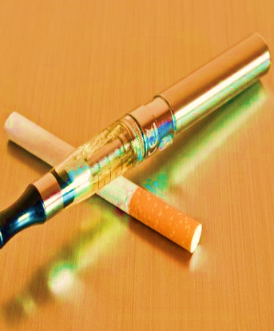
Harms of Tobacco Use
60% of lifelong cigarette users die prematurely from smoking
Smoking causes one in five deaths in USA
The leading cause of global preventable disease, disability and deaths
A major contributing factor to poverty
Vaping and smoking damages adolescent brains and leads to addiction

Slide 6

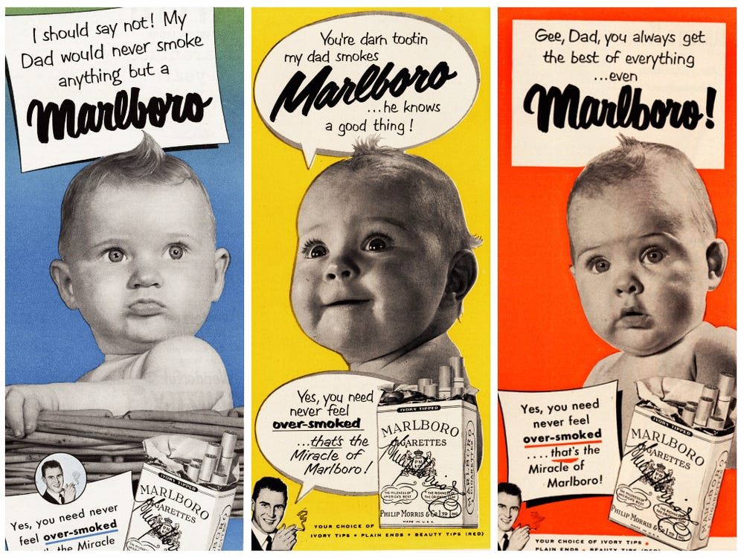




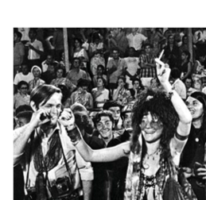
Tobacco Companies Target Vulnerable Populations
Black Communities
LGBT+
Rural
Children
Impoverished
Psychiatric illness

Slide 7
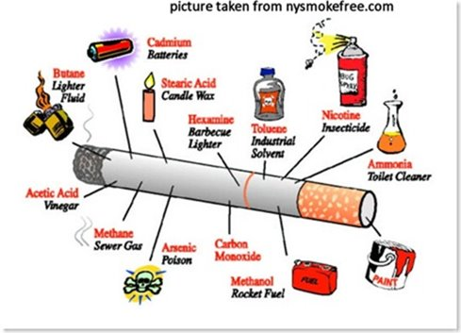
Chemicals in Tobacco Smoke
Acetone—found in nail polish remover
Acetic acid—an ingredient in hair dye
Ammonia—a common household cleaner
Arsenic—used in rat poison
Benzene—found in rubber cement and gasoline
Butane—used in lighter fluid
Cadmium—active component in battery acid
Carbon monoxide—released in car exhaust fumes
Formaldehyde—embalming fluid
Hexamine—found in barbecue lighter fluid
Lead—used in batteries
Naphthalene—an ingredient in mothball
Methanol—a main component in rocket fuel
Nicotine—used as an insecticide
Tar—material for paving roads
Toluene—used to manufacture paint
Notes:
Ammonia added to increase absorption time.
Tar added to me less harsh.

Slide 8
“Spit Tobacco” (smokeless, chew)
Amount of nicotine in 8–10 chews/dips per day = 30-40 cigarettes!
Smokeless tobacco delivers 3-4 times more nicotine than smokable tobacco
Made from a mixture of tobacco, nicotine, sweeteners, abrasives, salts and chemicals
Contains a mix of 4000 chemicals, more than 30 known carcinogens
More addictive than cigarettes because it contains higher levels of nicotine

Slide 9

E-Cigarettes/ Vapes –
Not Just Water Vapor
E-cigarettes are a category of “tobacco products​”
They contain Nicotine​ and many chemicals
Ultrafine particles are inhaled deep into the lungs​
Flavorings contain chemicals from food additives known to be directly and irreversibly harmful to the lungs (diacetyl, vanillin and cinnamaldehyde)​
Volatile organic compounds ​(vitamin-e acetate)
Heavy metals (nickel, tin, copper, & lead)

Slide 10


Second and Thirdhand Smoke and Exhaled Vape Fluid
Environmental tobacco smoke (ETS) and passive smoke/vapor
Third-hand smoke/vapor is the left-over contamination in a room/car/clothing that persists after the cigarette is extinguished
Propylene glycol (PG) & glycerol, especially hazardous to pets
There is no risk-free level of exposure to tobacco smoke, and vapor, and there is no safe tobacco product

Slide 11
Chronic Disease Model
Chronic Disease Model
Tobacco Use Disorder, like all substance use disorders is a chronic disease
  Long term disorder
  Periods of relapse and remission
  Requires a chronic disease model approach rather than an acute care approach

Slide 12
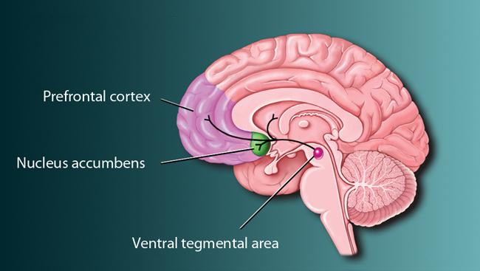
Involvement of Receptors
Nicotine binds to nicotinic receptors in the brain, augmenting the release of numerous neurotransmitters
Cigarette smoke also inhibits monoamine oxidase (the enzyme that breaks down the biogenic amine neurotransmitters norepinephrine, serotonin, and dopamine)

Slide 13

Nicotine Addiction in Youth
NO AMOUNT of nicotine is safe for youth​
Teens may not know about and don’t think about the dangers of nicotine
Nicotine harms adolescent (13-19) brain development and maturation​
Tobacco dependence leads to impotence, even in young people
Decreased activation in the pre-frontal cortex can cause problems with:​
    Learning​
    Attention​
    Memory ​
    Behavior problems​
    Leads to future addiction​

Slide 14
Pathology
Lungs
Current and former smokers: 54% have lung impairment
80% COPD deaths caused by smoking
Vaping Associated Acute Lung Injury: EVALI
Cardiovascular
Smoking increases the rate of dying from heart disease in men by 4x, in women by 5x
Stroke: smoking increases risk by 2x-4x
Smoking ages the arteries at 2x the speed, leading to peripheral vascular disease and atrial insufficiency
Reduces Wound Healing post injury or surgery
Dementia
Risk increased for Alzheimer's and vascular complications

Slide 15
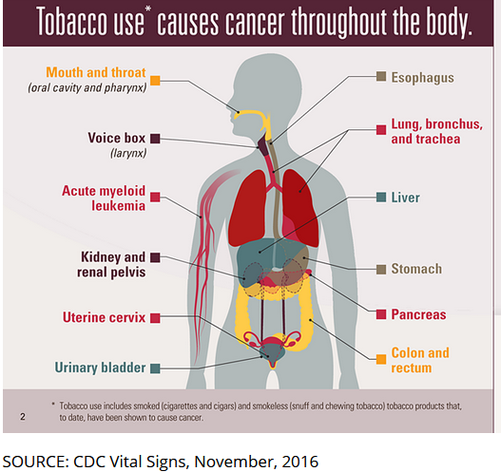
Cancers linked to Tobacco Use make up 40% of all cancers in the U.S.

Slide 16

Effects on Oral Health
Malignancies
Oral mucosal lesions
  Leukoplakia
  Nicotine Stomatitis
Periodontal diseases
  Higher levels of plaque, calculus formation (tartar)
  Gingivitis, Periodontitis, and Acute necrotizing ulcerative gingivitis (ANUG)
Dental Implants
  Damaging to both the initial and long-term success
  Delayed wound healing/less favorable treatment outcomes
Dental Caries
Salivary changes/dry mouth

Slide 17

Study: Smoking Cessation Improves Mental Health
Quitting tobacco use can improve the likelihood of long term sobriety from alcohol and other drugs by 25% if addressed at same time as alcohol/drug recovery.
A meta-analysis of 26 studies that assessed mental health, depression and psychological quality of life, concluded that:
Cessation reduces depression
Cessation reduces anxiety, lowers stress
Improved positive mood and quality of life
Effects of quitting smoking are equal to or greater than treatment with antidepressants

Slide 18
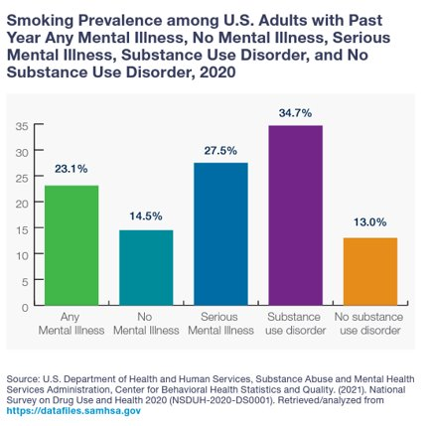
Mental Illness and Substance Use Disorder Populations
75% of smokers have a past or present problem with mental illness and substance abuse
Up to 75% of individuals with serious mental illnesses and/or substance use disorders smoke
30–35% of treatment staff smoke
Those with mental illness and substance use disorder consume almost 40% of all cigarettes smoked by adults

Slide 19
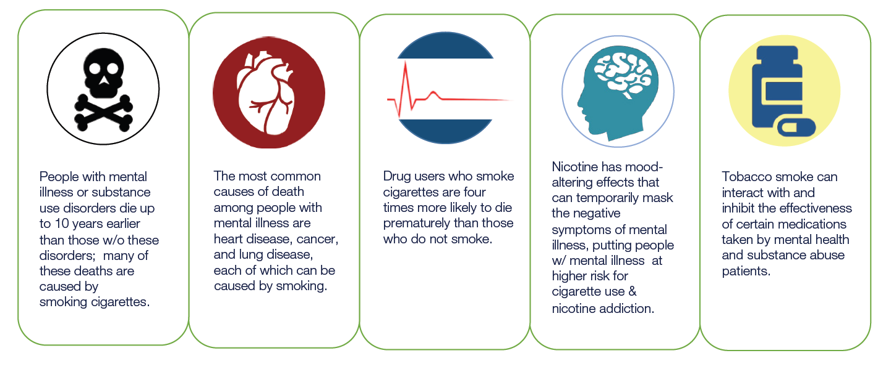
Adverse Effects of Tobacco Use for
Mental Illness and SUD Populations
Sources: CDC. Vital Signs: Current Cigarette Smoking Among Adults Aged ≥18 Years With Mental Illness—United States, 2009–2011. MMWR 2013;62(05):81-87; Druss BG, Zhao L, Von Esenwein S, Morrato EH, Marcus SC. Understanding Excess Mortality in Persons With Mental Illness: 17-Year Follow Up of a Nationally Representative US Survey. Medical Care 2011;49(6):599–604; CDC. Vital Signs Fact Sheet: Adult Smoking Focusing on People With Mental Illness, February 2013. NCCDPHP, Office on Smoking and Health, 2013; Smoking Cessation Leadership Center. Fact Sheet: The Tobacco Epidemic Among People With Behavioral Health Disorders. San Francisco: SCLC, University of California, 2015; Smoking Cessation Leadership Center. Fact Sheet: Drug Interactions With Tobacco Smoke. San Francisco: SCLC, University of California, 2015.

Slide 20

Depression and Clinical Depression
Tobacco use is linked to worsened depression outcomes
Individuals with current or past diagnosis of depression are more likely to use tobacco
Often heavy smokers are more nicotine dependent, which correlates with depression
Those with depression are more likely to relapse to smoking
Those with depression have higher morbidity and mortality from smoking-related illnesses
Image or graph

Slide 21
Nicotine Affects Mental Health Medication
Nicotine affects medication absorption
When nicotine use is reduced medication dosage adjustments may be necessary
  Tri-Cyclic anti-depressants
  Serotonin-Reuptake Inhibitors
  Specific meds – Clozapine, Alprazolam

Slide 22
Nicotine Affects Caffeine Absorption
Nicotine use will shorten the half-life of caffeine
The combination of nicotine and caffeine in the system at the same time increases the stimulation effect
Drinking Caffeine can create an associated nicotine craving
  Individuals quitting nicotine may want to limit or be more mindful of caffeine intake to avoid potential associated cravings

Slide 23
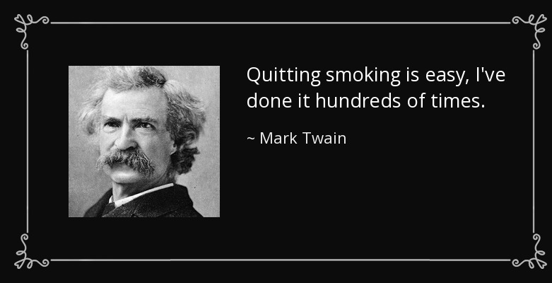
Treatment
Treatment should address the physiological and the behavioral aspects of dependence

Slide 24
Take the Extra Minute or Two
Treating tobacco dependence is “the single, most powerful, preventive intervention in clinical practice.”
  -Andrew Pipes CM MD, Ottawa Heart Institute
“Smoking cessation would prevent more deaths than any other single known intervention.”
  -Steven Woolf, JAMA 1999; 282(24):2358-2365

Slide 25

Elevator Speech
However, as your healthcare provider, it’s important for me to explain to you the options that are APPROVED by the FDA…. Including Escalators and Elevators.
Jumping out of 4th story windows is dangerous, right? How about if I just jump out of 2nd story windows?
Research reveals more and more that it’s true – jumping out of 2nd story windows is MUCH SAFER compared to 4th story windows!

Slide 26

It’s never too late!
Smokers benefit from quitting smoking even after the development of smoking-related morbidity
Smoking cessation is associated with decreased all-cause mortality, even for smokers with airway obstruction
Smoking cessation can slow or partially reverse the accelerated bone loss caused by years of smoking
Older smokers are less likely to make an initial quit attempt, but are more successful than younger smokers when they do

Slide 27
Combining Counseling with Pharmacotherapy is the Gold Standard
First-line therapy should include both Pharmacotherapy and Behavioral Support
Cessation medication is most effective when combined with counseling
Brief (or intensive) behavioral support can be delivered effectively in person or by telephone, text messages, or the internet
Combining a clinician's advice to quit with cessation medication is effective when it is routine with tobacco users in virtually all health care settings
​Rigotti NA, Kruse GR, Livingstone-Banks J, et al. Treatment of Tobacco Smoking: A Review. JAMA. 2022 Feb 8;327(6):566-577.doi: 10.1001/jama.2022.0395.

Slide 28
Medication-Assisted Treatment:
FDA-Approved Nicotine Replacement
Therapies and Cessation Medications
Over the Counter
  Nicotine Patch, Gum, Lozenge
Prescription
  Nicotine Inhaler
  Nicotine Nasal Spray
  Bupropion (Wellbutrin)
  Varenicline (Chantix)

Slide 29
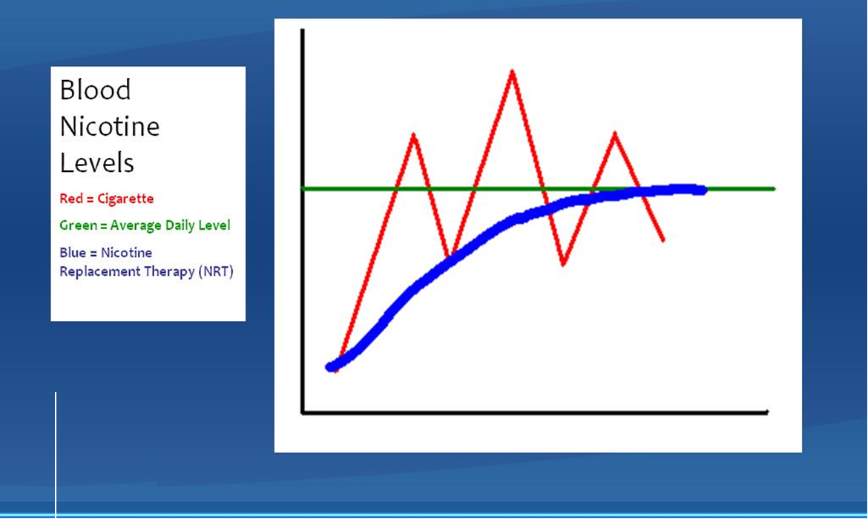

Slide 30
Varenicline (Chantix)
Screening: Screen for kidney disease and mental illness.
Mechanism: Partial agonist of 4β2 nicotinic acetylcholine receptors. Reduces cravings and prevents nicotine reward. Metabolizes in the kidney
Dose: Begin 1-2 weeks before quit date
Begin with 0.5mg OD days 1-3, 0.5mg BID days 4-7, then 1mg BID. Take after eating with full glass of water (helps avoid side effects)
Side Effects: Nausea, vivid dreams, insomnia, immediate hypersensitivity, skin reactions, neuropsychiatric illness
FDA 2015 Warning: Increases intoxication with alcohol
Notes:
Partial agonist of nicotinic acetylcholine receptor, blocking tobacco nicotine
Rewarding effects from smoking are blocked, and withdrawal symptoms lessened.
but a
retrospective cohort study in almost 165,000 patients
found no increased risk of any cardiovascular or
neuropsychiatric event with varenicline compared
to NRT or bupropion.14 Varenicline has increased
smoking cessation rates in patients with psychiatric
illnesses, with no signifi cant psychiatric adverse
effects.15,16 Recent analyses of clinical trials have
found no increase in suicidal behavior in patients
treated with varenicline compared to those treated
with NRT, bupropion, or placebo.17 (TML)

Slide 31

Treatment – Perinatal Populations,
Children and Adolescents
Pregnancy - data on varenicline use in pregnancy are lacking
Avoid Varenicline in pregnant patients.
Breastfeeding - NRT is passed in the breastmilk, however, the positive effect of breastfeeding outweighs the negative impact of both NRT and Tobacco .
We do recommend breastfeeding in these circumstances
Children and Adolescents - No smoking cessation medications are FDA approved for use in children or adolescents
For more information on lactation and medication: interactions:
https://www.ncbi.nlm.nih.gov/books/NBK501922/?msclkid=980c57a0b1c911ec97eee1ecdebcdf06
Thishoto by Unknown Author is licensed under CC BY-SA

Slide 32
Nicotine Overdose Symptoms
Muscarinic signs
  Vomiting
  Diarrhea
  Bronchorrhea
  Salivation
  Wheezing
Nicotinic effects
  Muscle fasciculations
  Paralysis
  Coma
  Seizures
These typically present rapidly after exposure and resolve in about two hours. In most patients, supportive care until resolution of toxicity is sufficient
Although uncommon, life-threatening effects such as seizures, coma, respiratory arrest, and cardiac arrest have been reported in children

Slide 33
Nicotine Withdrawal Symptoms
Symptoms | Duration | Prevalence
Urges to smoke | > 2 weeks | 70%
Increase appetite | >10 weeks | 70%
Poor concentration | < 2 weeks | 60%
Depression | < 4 weeks | 60%
Restlessness | < 4 weeks | 60%
Irritability/aggression | < 4 weeks | 50%
Mouth ulcers | > 4 weeks | 40%
Night-time awakenings | < 1 week | 25%
Constipation | > 4 weeks | 17%
Light-headedness | < 48 hours | 10%

Slide 34
Counseling, Referrals, and Policy

Slide 35
Components of Smoking Cessation
Group Therapy Program
Example:
  6-10 weekly sessions of manualized group smoking cessation counseling
  Flexibility in setting a target quit date if unsuccessful on initial attempt
  Emphasis on motivational interviewing (MI) and psychoeducation pre-Quit Date
  Modified cognitive behavioral therapy (CBT) emphasizing small amounts of material at each session with frequent repetition
  Focus on building social skills and emphasis on relapse prevention

Slide 36

Face to Face Counseling
The Healthy Living Program, based in Rochester, is located in the Center for Community Health and Prevention
  https://www.urmc.rochester.edu/community-health/programs-services/healthy-living-center/stop-smoking-program.aspx
Face to Face Counseling provided, including phone call follow-up
Individuals will be screened for NRT/medications
Individuals can also be referred to the NY State Smokers’ Quitline at the same time

Slide 37
5A’s Treatment Model
Current Practice Guidelines of the Monroe County Medical Society (recommended statewide) and based on National clinical guidelines:
    Ask patients/clients about tobacco product use
      Every patient/client, every visit
    Advise them to quit for good
    Assess their willingness to quit for good
    Assist in a quit attempt (counseling, meds, referral)
    Arrange follow-ups (notes, appointments, electronic health records)

Slide 38
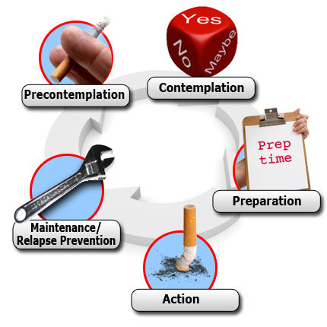
Stages of Change Model
Pre-contemplation
  Can discuss the “5R’s”
Contemplation
  Yes, but not now
Preparation
  Set a Quit Date
Action
  Quit Date/vulnerable to relapse
Maintenance
Relapse/Recycle
  Emphasize successes and “re-trying”

Slide 39
For Those Not Ready to Quit
The Five R’s (Personalize)
  Relevance (Relationship/how does it affect their life?)
  Risks (Short and long term health and economic risks)
  Rewards (Health and quality of life improvement)
  Roadblocks (Stress, other tobacco product users, boredom, lack of confidence)
  Repetition (Think “dose response”: more discussion leads to increased success)

Slide 40

Motivational Interviewing a conversation about change
Express Empathy
Develop Discrepancy
Roll with Resistance
Support Self-Efficacy

Slide 41

Decisional Balance
Motivation & Ambivalence | Advantages | Disadvantages
No Change
Change
1
2
4
3
Finish with Advantage of Quitting
Develop Discrepancy

Slide 42
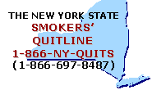
New York State Smokers’ Quitline & Quitsite
Quitline: Free and confidential telephone Quitline provides evidence-based tobacco cessation services to New York State residents who want to quit tobacco product use for good
Quitsite: www.nysmokefree.com

Slide 43
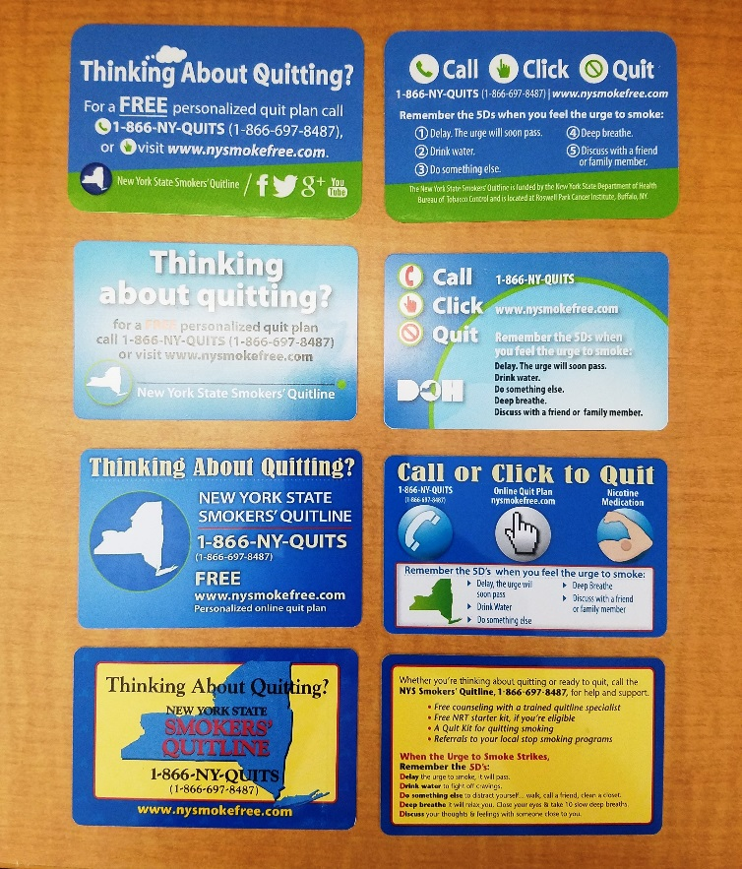
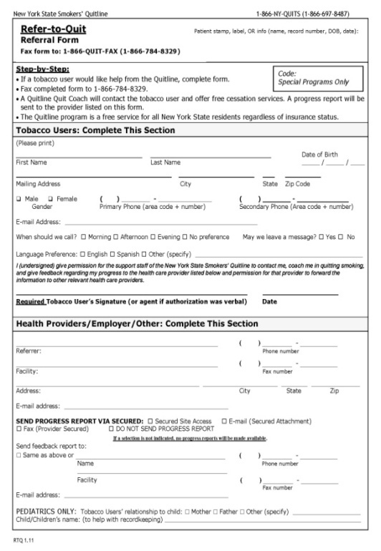
NY State Smokers’ Quitline - Resources and Referral
Palm cards (passive referral)
Refer-to-Quit (active referral)
Electronic Health Record Referral
Notes:
Passive Referral: hand client a card and say call the Quitline for help.
Active Referral: You refer the client to the Quitline and tell them they’ll receive a proactive support call from a QL coach.
I can assist you in setting up a referral account to the NY State Smokers’ Quitline.

Slide 44

New York State Smokers’ Quitsite
Resources for Clinicians, Counselors, etc.

Slide 45
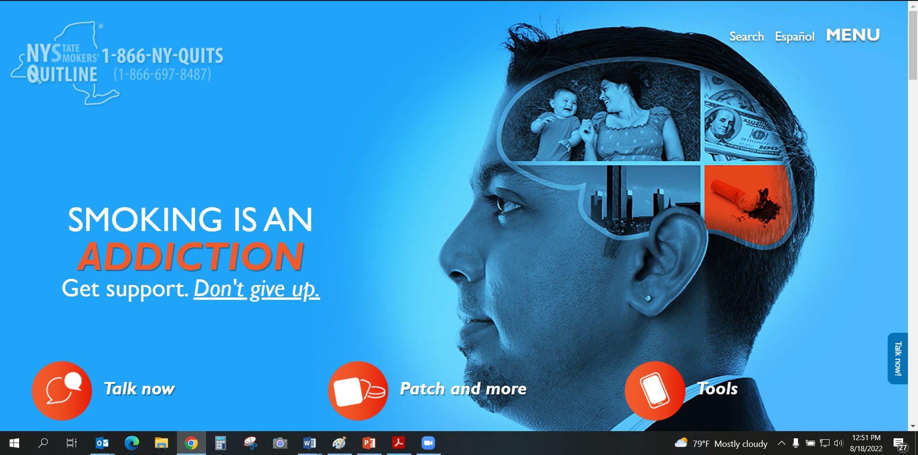
New York State Smokers’ Quitsite for tobacco product users

Slide 46
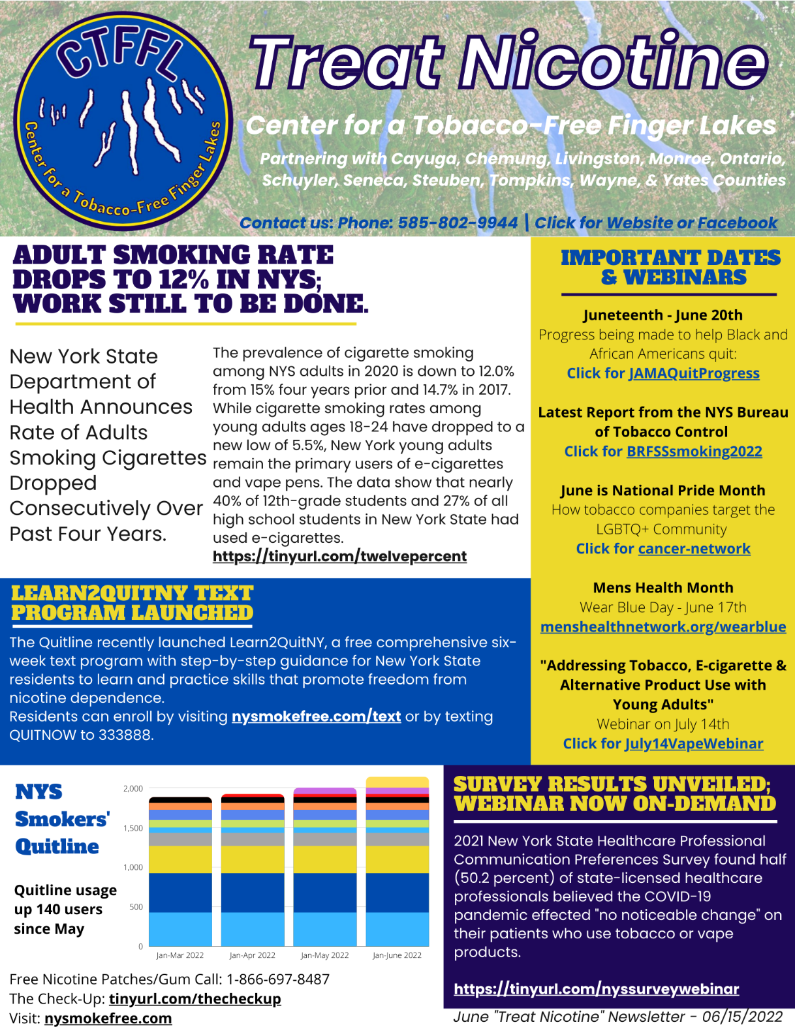
Newsletter
If you are interested in receiving our monthly newsletter,
please type your email address and name in the chat,
or send us a request at treatnicotine@URMC.Rochester.edu
(June ‘22 Newsletter Shown)

Slide 47
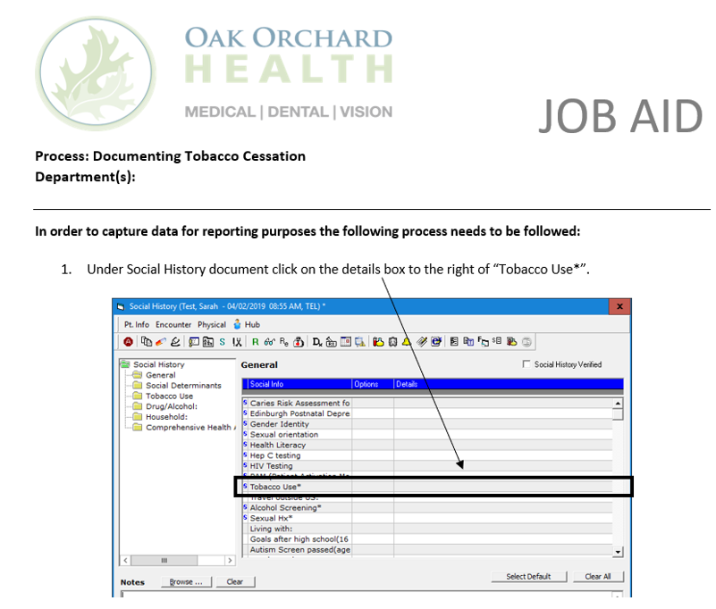

Slide 48
Questions?
Website: tinyurl.com/CTFFL-URMC
Facebook: Facebook.com/CTFFL
Email Addresses:
  Scott_mcintosh@urmc.Rochester.edu – Director
  Holly_Widanka@URMC.Rochester.edu – Senior Project Coordinator
  Jessica_Rosman@URMC.Rochester.edu – Health Project Coordinator
  Ryan_Mulhern@URMC.Rochester.edu – Health Project Coordinator

Slide 49
END

