Slide 1
Tobacco Dependence Screening and Treatment in Behavioral Health Settings
Counseling for
Tobacco- Use Disorders

Slide 2
OBJECTIVES
As a result of this training, participants will be able to:
Develop and understanding of why counseling services related to tobacco use should be provided to individuals in behavioral health treatment
Describe how a client’s stage of change with regard to tobacco use will impact the treatment strategies that a counselor employs in treating tobacco
Identify the basic skills of motivational interviewing and apply them to the treatment of tobacco use
Develop the knowledge, skills and abilities necessary to develop a tobacco quit plan
Identify relapse prevention strategies and apply them to the treatment of tobacco use

Slide 3
AGENDA
Welcome, Introductions, Goal and Objectives
Counselors Role in the Integration of Tobacco Use Disorder Treatment into Behavioral Health Settings
Trans Theoretical Model (TTM) and Counseling Strategies
Counseling Skills Practice: Strategies for Engaging Clients in Pre-contemplation and Contemplation
Creating a Quit Plan and Preventing Relapse: Providing Services to Clients in Preparation, Action and Maintenance
Case Studies: Putting It All Together
Closing

Slide 4
WELCOME & INTRODUCTIONS
Please share your:
Name
Agency
Role

Slide 5
Counselors’ Role in the Integration of Tobacco use Disorder Treatment Into Behavioral health Settings
Notes:
Open-Ended Questions Worksheet Activity
Explain the following:
Now everyone will do an activity to build skills in writing open-ended questions.
Asking open-ended questions can sound like an easy task, but before meeting with a client it is important to practice asking them.
We are passing out a worksheet. Every statement on the worksheet is phrased as a closed ended question. The task is for you to individually rewrite questions to make them open.
Ask participants to refer to the Open Ended Questions Worksheet.
Give them about 5 minutes to complete sheet individually.
Keep the PowerPoint slide with Open-Ended Question Stems up on the screen.
Call time and review as a large group.
If people have trouble writing open questions, ask another volunteer to share what they wrote.

Slide 6
Chronic Relapsing Illness
Treat as a chronic relapsing illness
Few people quit successfully without treatment
To maximize success, combine pharmacotherapy and counseling
Treat for as long as it takes
Treat to target-no withdrawal symptoms

Slide 7
BEHAVIORAL HEALTH PROVIDERS
Already have the required skill set to help clients with their tobacco use
Problem-solving
Coping with difficult situations/emotions
Avoiding high risk situations
What you fail to say sends a message

Slide 8
Overview of Transtheoretical Model: Assessing Tobacco Dependence and Clients’ Readiness & Motivation to Quit
Notes:
Open-Ended Questions Worksheet Activity
Explain the following:
Now everyone will do an activity to build skills in writing open-ended questions.
Asking open-ended questions can sound like an easy task, but before meeting with a client it is important to practice asking them.
We are passing out a worksheet. Every statement on the worksheet is phrased as a closed ended question. The task is for you to individually rewrite questions to make them open.
Ask participants to refer to the Open Ended Questions Worksheet.
Give them about 5 minutes to complete sheet individually.
Keep the PowerPoint slide with Open-Ended Question Stems up on the screen.
Call time and review as a large group.
If people have trouble writing open questions, ask another volunteer to share what they wrote.

Slide 9
Overview of Transtheoretical Model (TTM):
Assessing Tobacco Dependence & Clients Readiness and Motivation to Quit

Slide 10
STAGES OF CHANGE MODEL
Developed by Prochaska and DiClemente
Behavior change does not happen in one step, but in stages
An individual progresses through the stages at their own pace, depending on their goals and sources of motivation

Slide 11
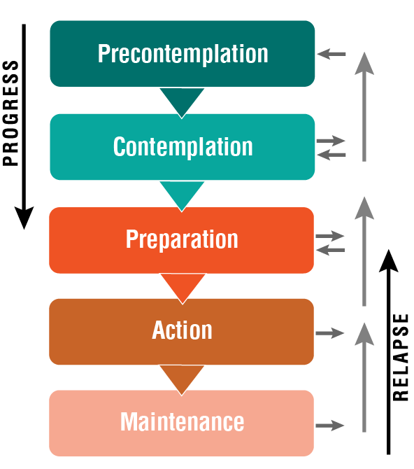
THE STAGES OF CHANGE
Notes:
Tell participants:
When it comes to changing behaviors, clients may not want to change, may be thinking about changing, may be preparing to change, or may be in process of changing.
According to the Transtheoretical Model (TTM) of Behavior Change, these different states that someone may be in are known as the “Stages of Change”.
As Counseling staff it will be important to assess which Stage of Change a client is in.
The 5 stages of change are:
Pre-contemplation
Contemplation
Preparation
Action
Maintenance
The TTM Stages of Change model helps us to better understand how people change behaviors.
TTM notes that relapse is a part of behavior change.
Harm reduction is an approach to help minimize the exposure when a person is not able or willing to stop a behavior.
Providing information around the impact of tobacco use is important in the early stages of change.
Ask participants to think about a behavior in their lives that they have tried to change.
Offer some examples:
Diet/Eating habits (drink more water, eat more vegetables, eat less junk food, etc.)
Exercise habits
Walk participants through the 5 stages of change by saying the following (use PowerPoint slides when describing each stage if possible): Next slide

Slide 12
PRECONTEMPLATION
There is no intention to change behavior in the foreseeable future:
Others are aware of problem
Unaware or under-aware
Change due to outside pressure
No plans to change (6 months)
Coerced by others to change
Notes:
Most of you are familiar with the stages of change model. Let’s pick a behavior and see how the model works. How many of you have ever tried to change the way you eat? Let’s look at changing the way you eat and the stages of change.
We’ll begin with Stage 1 (Pre-contemplation) of the Stages of Change Model. Stage 1 is when you are not considering a change at all. You are comfortable with what you are doing. In stage one:
Others may be aware or think you have a problem, you don’t
You have no in intention to change for the next 6 months
How many of you remember being at this stage? Raise your hands.
When you were at that stage, what was your reaction if people said, “You should stop?”
Highlight they likely don’t want to hear other people say that they should stop.

Slide 13
CONTEMPLATION
Aware that a problem exists and begins to think about overcoming it:
No commitment
Struggles with loss
Decisional-balancing
Can get stuck and remain so
Notes:
Now, let’s say that you’ve moved on to Stage 2 (Contemplation). Stage 2 is when you start thinking, maybe there is a problem. In other words, you’re considering making a change, but you are ambivalent and don’t feel ready to do the change right now. This is where you start becoming aware of the pros and cons of your behavior.
How many of you remember getting to that point? Raise your hands.
What moved you from Stage 1 to Stage 2? In other words, what made you go from not considering it to thinking maybe you should do something about it in sometime in the future?
Trainer’s Note
Encourage participants to tell their individual stories. Identify in each case what it was that moved the participant from not being willing to think about changing his/her behavior to actively considering it. Highlight these motivators and discuss with participants.
Usually there is something that moves you from Stage 1 to Stage 2. Also, I want you to notice that for every person the motivator for changing their behavior may be different.
What might motivate you to change may be different from what motivates me or another person?

Slide 14
PREPARATION
Making Plans for the intended change:
Intending to take action within 30 days
Taking steps/making plans
May/may not have taken unsuccessful action in past year
Notes:
Preparation (Stage 3) is the next stage, where we seriously want to change the behavior, and take concrete steps to prepare to do it. This is the stage where we intend to change within the next 30 days.
How many of you remember being at that stage? Raise your hands.
There are really two parts to this:
The first part is planning how we are going to do it, which may include taking some steps.
The second part is gearing up to make these changes. This may or may not include picking a date to start.
Who remembers being at this stage? Tell me what kind of plans you made? What were the first steps you took? How did you prepare?
Trainer’s Note
Encourage participants to describe the plans they made. Ask about concrete steps taken.
Point out:
Similar to the motivators, people have different plans. What works for one person may not work for the other.
If you are able to predict and plan for barriers, you are more likely to succeed in behavioral change.

Slide 15
ACTION
Modification of behavior, experiences, or environment in order to overcome problem behavior
Taking an action is not being in action
Runs from one day to six months
Requires Considerable Commitment
Notes:
Stage 4 (Action) is when you are doing it, but you’re not 100% confident you can keep it up without slipping. This is the stage where you are taking it one day at time. This stage requires considerable commitment. It runs from 1 day to 6 months.
How many of you remember being at this stage? Raise your hands.
Tell me what that was like?
Trainer’s Note
Allow participants to describe their experiences in detail.
Highlight that slipping is a normal occurrence when trying to change a behavior.
Just because you slip doesn’t mean you aren’t successful. It’s normal to slip, and most people do. These Stages of Change are not linear. People will remain in different stages for different lengths of time and move back and forth through the stages. And that is perfectly normal. Some people will have a brief slip and then go right back to the new behavior. Others will “relapse” and temporarily move back to a previous stage of change again. When you try again, you don’t have to start over from the beginning (Stage 1) usually, you just go back one stage.

Slide 16
MAINTENANCE
Integrated the new behavior into present lifestyle
More than six months
Stabilizing change
Avoiding relapse
Can last a lifetime
Notes:
Now we get to the final stage, Maintenance (Stage 5). This is the point where the new way of behaving becomes a regular part of your life. We consider Stage 5 (Maintenance) to be after you have maintained the behavior for at least 6 months.
How many of you remember being at that stage or are in that stage now? Raise your hands.
Tell me what that was like?
Trainer’s Note
Give participants an opportunity to describe their personal experiences.
Highlight that being in Stage 5 does not mean that there are no temptations or struggles.
Emphasize:
Being in Stage 5 is defined as successfully performing the new behavior without a relapse for six months or longer.
The longer you maintain a behavior; the less likely it is you will experience a slip. But if you do, it’s not a failure. It’s just a slip into another stage.

Slide 17
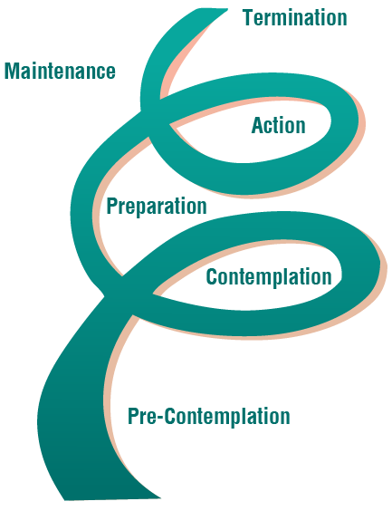
THE STAGES OF CHANGE
Notes:
Distribute a copy of “Stages of Behavior Change Overview” to each participant.
Highlight that we don’t stage people, we stage their goals.
Explain that stages are not linear and recycling through stages is common. Emphasize that relapse can occur at any time.

Slide 18
LEARNING DOMAINS FOR CHANGE
Cognitive
What a person thinks related to the change
Affective
What a person feels related to the change
Behavioral
What actions related to the change
Notes:
Tell participants that stages have different domains we can focus on to help people towards behavior change:
Cognitive - The way a person thinks. It includes perceptions, attitudes, beliefs and knowledge.
Affective - The way a person feels.
Behavioral - The way a person acts
Share Examples of Domains to Focus on to Help Clients Change
Provide the following examples of each domain:
Cognitive: If a lot of people in my support system have smoked and therefore I feel that smoking cannot be harmful to me, I am less likely to stop smoking. Addressing this will help move me towards behavior change.
Affective: If smoking is the only thing that makes me feel relaxed, I am less likely to consider not smoking. Addressing this will help move me towards behavior change.
Behavioral: If I continue to associate with people who smoke, I am more likely to not continue smoking. Addressing this will help move me towards behavior change.
Highlight that during the first three stages, participants should focus on using interventions that impact the cognitive and affective domains whereas the latter stages, they may focus on using interventions for the behavioral domain. They may also need to impact the cognitive and affective domain in later stages.

Slide 19
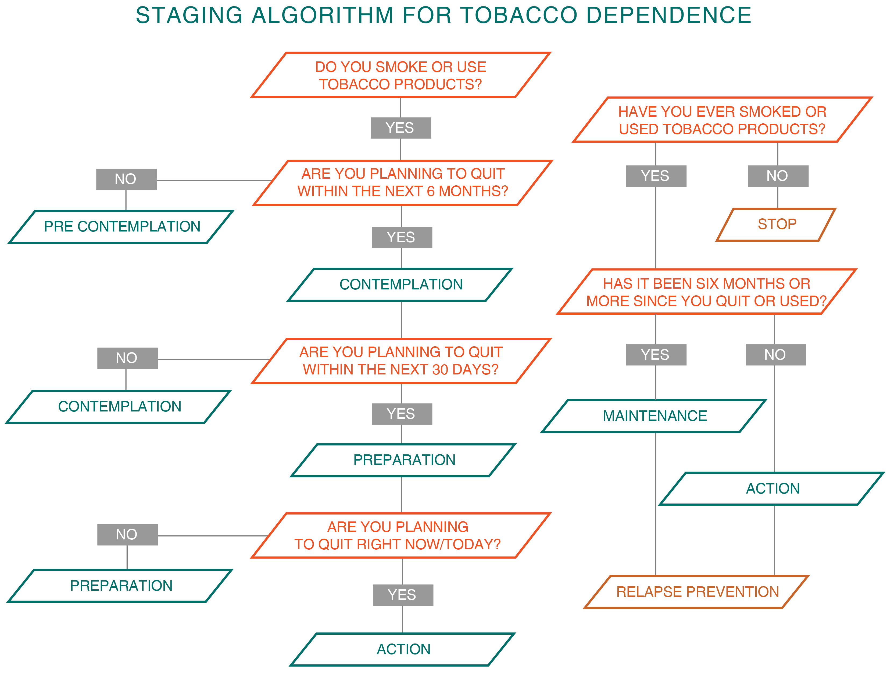
Notes:
Walk participants through the sample intervention ppt and explain to them that this conversation/intervention between a patient and a counselor takes approximately 3-5 minutes.

Slide 20
Intervention based on the Stages of Change
Pre-contemplation - Motivational Interviewing
Contemplation – Motivational Interviewing
Preparation – Motivational Interviewing
Action – Cognitive Behavioral Therapy
Maintenance – Cognitive Behavioral Therapy

Slide 21
Counseling Skills Practice Open-ended Questions and Affirmations

Slide 22
MOTIVATIONAL INTERVIEWING
Developed by Miller and Rollnick
Person-centered approach
Utilized in multiple settings
Most effective working with individuals in pre-contemplation and contemplation
Notes:
22
Ask participants how many of them are familiar with the Motivational Interviewing counseling strategy.
Highlight the following:
Developed by Miller & Rollnick
Person-centered approach
Used in multiple settings
Most effective working with individuals in pre-contemplation and contemplation
Skills to conduct Motivational Interviewing are called “OARS” (open-ended questions, affirmations, reflective listening and summarizing).
The skills used to conduct Motivational Interviewing are called “OARS” (open-ended questions, affirmations, reflective listening and summarizing).

Slide 23
O. A. R. S.
Open-ended Questions
Affirmations
Reflective Listening
Summarizing
Notes:
Explain to participants that today you will be discussing only 2 of the 4 “OARS”
Open Ended Questions
Affirmations
Emphasize the following about open-ended questions:
Open ended questions can help the session feel less like a interview and more like a conversation (which can help decrease resistance).
Using open-ended questions can help you gather a lot of information from a patient with only using two or three questions
You can use open-ended questions that will evoke change talk.
Staff can prepare themselves by developing a set of open ended questions for information they frequently seek from patients.
Define closed ended questions as:
Questions that can only be answered with a: Yes, No or specific response (e.g., date of birth).
Step 2: Twenty Questions with Closed-Ended Questions
Ask the group – “What is a reason you don’t use open ended questions?”
Possible answer: Often people do not want to use them because they think it takes too much time.
Ask for a volunteer to think of a movie and come to the front of the room.
Tell the rest of the group that they will play twenty questions. They can ask only closed-ended questions to try to figure out the movie.
Have one trainer facilitate and the other trainer count how many questions were asked before someone guessed correctly.

Slide 24
OPEN-ENDED QUESTION STEMS
How…
What…
Tell me…
In what ways…
Notes:
Using the PowerPoint slide Open-Ended Questions Stems, define frequent open ended stems.
Repeat the “20 questions” game, with a new volunteer, thinking of a new movie.
This time, tell participants that they can ask open-ended questions and the volunteer should answer fully.
Have trainer count how many questions it takes to correctly guess the movie.

Slide 25
Open-Ended Questions Activity
Notes:
Open-Ended Questions Worksheet Activity
Explain the following:
Now everyone will do an activity to build skills in writing open-ended questions.
Asking open-ended questions can sound like an easy task, but before meeting with a client it is important to practice asking them.
We are passing out a worksheet. Every statement on the worksheet is phrased as a closed ended question. The task is for you to individually rewrite questions to make them open.
Ask participants to refer to the Open Ended Questions Worksheet.
Give them about 5 minutes to complete sheet individually.
Keep the PowerPoint slide with Open-Ended Question Stems up on the screen.
Call time and review as a large group.
If people have trouble writing open questions, ask another volunteer to share what they wrote.

Slide 26
AFFIRMATIONS
Statement of understanding and appreciation for something someone has tried, done, or achieved
Genuine and honest
Positive
Encouraging
Notes:
Lead an interactive discussion on affirmations. Be sure to include the following points:
Affirmations are statements of recognition
You can affirm effort, experience, or feelings. This can include intent
Affirmations help to show that you are listening and can help build confidence
Affirmations must be genuine and honest
26

Slide 27
AFFIRMATIONS
Make someone feel good and recognized
Recognize efforts, experiences, and feelings; this can include intent
Build rapport
Notes:
Describe the impact affirmations can have – make someone feel good, build rapport, etc.
Emphasize to participants that often, affirmations is relative easy to do when someone is doing something you approve of. It might be more challenging to affirm someone when their behavior or statement is not reflective of successful behavior change.
Affirmations:
Make someone feel good & recognized
Recognize efforts
Build rapport
It is a way to give information or feedback to a client that lets him/her know that you are aware of and appreciate their efforts and is a way of validating those efforts as being something constructive or helpful or even difficult that they did.
Affirmations should be used judiciously and not overdone or used to frequently or else they will lose their effectiveness.
27

Slide 28
Affirmations Activity
Notes:
Open-Ended Questions Worksheet Activity
Explain the following:
Now everyone will do an activity to build skills in writing open-ended questions.
Asking open-ended questions can sound like an easy task, but before meeting with a client it is important to practice asking them.
We are passing out a worksheet. Every statement on the worksheet is phrased as a closed ended question. The task is for you to individually rewrite questions to make them open.
Ask participants to refer to the Open Ended Questions Worksheet.
Give them about 5 minutes to complete sheet individually.
Keep the PowerPoint slide with Open-Ended Question Stems up on the screen.
Call time and review as a large group.
If people have trouble writing open questions, ask another volunteer to share what they wrote.

Slide 29
Creating Quit Plans and Relapse Prevention Plans
Preparation, Action and Maintenance

Slide 30
QUIT PLAN
Set a quit date
Putting support systems in place
Review reasons for quitting
Discuss previous quit attempts
Plan for managing trigger
Notes:
Previous Quit Attempts
Strategies to help smokers quit

Slide 31
Tobacco Use Triggers
Internal Triggers
External Triggers
High Risk Situations

Slide 32
DEALING WITH TRIGGERS
Coping Strategies
Social Support

Slide 33
Thank You!
Notes:
Highlights
Thank everyone for their participation and hard work.
Ask if anyone wants to share one highlight they are taking away from the training. (Time permitting)
Once everyone who wants to say something has, wrap up the training by thanking participants for being a part of the training.

