Slide 1
Tobacco Dependence Screening and Treatment in Behavioral Health Settings
Screening and Assessment

Slide 2
OBJECTIVES
As a result of this training, participants will be able to:
1. Identify and utilize two reliable and valid screening tools for tobacco use
2. Utilize the substance use disorder criteria in assessing and diagnosing tobacco use disorders
3. Identify the Stages of Change and how they apply to the assessment of tobacco use

Slide 3
AGENDA
Welcome, Introductions, Goal and Objectives
Screening for Tobacco Use: Review of the Fagerström and Hooked on Nicotine Checklist
Assessing Tobacco Use: Overview of the Substance Use Disorder Criteria and Application to Assessing for Tobacco Use Disorders
Assessing Tobacco Use: Readiness and Motivation to Change
Closing

Slide 4
WELCOME & INTRODUCTIONS
Please share your:
Name
Agency
Role

Slide 5
Screening for tobacco use:
the Fagerström
and
hooked on nicotine checklist
Notes:
Open-Ended Questions Worksheet Activity
Explain the following:
Now everyone will do an activity to build skills in writing open-ended questions.
Asking open-ended questions can sound like an easy task, but before meeting with a client it is important to practice asking them.
We are passing out a worksheet. Every statement on the worksheet is phrased as a closed ended question. The task is for you to individually rewrite questions to make them open.
Ask participants to refer to the Open Ended Questions Worksheet.
Give them about 5 minutes to complete sheet individually.
Keep the PowerPoint slide with Open-Ended Question Stems up on the screen.
Call time and review as a large group.
If people have trouble writing open questions, ask another volunteer to share what they wrote.

Slide 6
Purpose of Screening
Determining appropriateness and eligibility for program admission
Gathering baseline information about client
Determining areas for further exploration with client
Screening does not give sufficient information to determine diagnosis or treatment plan goals

Slide 7
Purpose of Screening for Tobacco Use
To gather baseline data on an individual’s tobacco use
To determine if tobacco use is an area for further exploration in treatment

Slide 8
The Fagerström Test for Nicotine Dependence
Valid and reliable tool for screening for tobacco use
Easy to administer (3-5 min)
Supports integration of tobacco use and accurate treatment planning
Higher scores indicates higher intensity
Refer to handout for details of test

Slide 9
The Hooked on Nicotine Checklist
Alternative screen to Fagerström
Works well with adolescents
Stronger reliability for individuals who have lower levels of tobacco consumption

Slide 10
Real Play!
Pair up
Take out Fagerström handout
Administer Fagerström to person you are paired with
You do not need to use real answers
Score the instrument!

Slide 11
Tobacco Use Disorder Diagnostic Criteria
A problematic pattern of tobacco use leading to clinically significant impairment or distress, as manifested by at least two of the following, occurring within a twelve-month period:
Tobacco is often taken in larger amounts or over a longer period of time than was intended
2. There is a persistent desire or unsuccessful efforts to cut down or control tobacco use
3. A great deal of time is spent in activities necessary to obtain or use tobacco

Slide 12
Tobacco Use Disorder Diagnostic Criteria
4. Craving, or strong desire or urge to use tobacco.
5. Recurrent tobacco use resulting in a failure to fulfill major role obligations at work, school or home.
6. Continued tobacco use despite having persistent or recurrent social or interpersonal problems caused or exacerbated by the effects of tobacco.
7. Important social, occupational, or recreational activities are given up or reduced because of tobacco use.

Slide 13
Tobacco Use Disorder Diagnostic Criteria
8. Recurrent tobacco use in situations in which it is physically hazardous (e.g., smoking in bed).
9. Tobacco use is continued despite knowledge of having a persistent or recurrent physical or psychological problem that is likely to have been caused or exacerbated by tobacco.
10. Tolerance, as defined by either of the following:
A need for markedly increased amounts of tobacco to achieve the desired effect.
A markedly diminished effect with continued use of the same amount of tobacco.

Slide 14
Tobacco Use Disorder Diagnostic Criteria
11. Withdrawal, as manifested by either of the following:
The characteristic withdrawal syndrome for tobacco use.
Tobacco (or a closely related substance, such as nicotine) is taken to relieve or avoid withdrawal symptoms.

Slide 15
Tobacco Use Disorder Severity
Specify Severity:
Mild-2-3 Symptoms
Moderate-4-5 Symptoms
Severe-6 or more symptoms

Slide 16
Tobacco Withdrawal
A. Daily use of tobacco for at least several weeks.
B. Abrupt cessation of tobacco use, or reduction in the amount of tobacco used, followed within 24 hours by four (or more) of the following signs or symptoms:
Irritability, frustration, or anger
Anxiety
Difficulty Concentrating
Increased appetite
Restlessness
Depressed mood
Insomnia
C. The signs or symptoms in Criterion B cause clinically significant distress or impairment in social, occupation or other important areas of functioning.
D. The signs or symptoms are not attributed to another medical condition and are not better explained by another mental disorder, including intoxication or withdrawal from another substance.

Slide 17
Questions to Assess Tobacco Use
Tell me about when you started using tobacco.
How often do you use tobacco and how much do you use?
What are some of the reasons for your tobacco use/Why do you use tobacco/What are the benefits of tobacco use?

Slide 18
Questions to Assess Tobacco Use
How does your current tobacco use compare to how much you used when you started using tobacco?
Tell me about previous attempts to discontinue tobacco use? What was helpful and what was not?
What are some of the negative consequences of your tobacco use?

Slide 19
Questions to Assess Tobacco Use
If you were to stop using tobacco, what would the reasons be for your discontinued use?
On a scale of 1 to 10, how important is it for you to change your tobacco use behavior?
On a scale of 1 to 10, how confident are you in your ability to change your tobacco use behavior.
How do you feel when you are in situations when you cannot use tobacco?

Slide 20
Overview of Transtheoretical Model (TTM):
Assessing Tobacco Dependence & Clients Readiness and Motivation to Quit

Slide 21
STAGES OF CHANGE MODEL
Developed by Prochaska and DiClemente
Behavior change does not happen in one step, but in stages
An individual progresses through the stages at their own pace, depending on their goals and sources of motivation

Slide 22
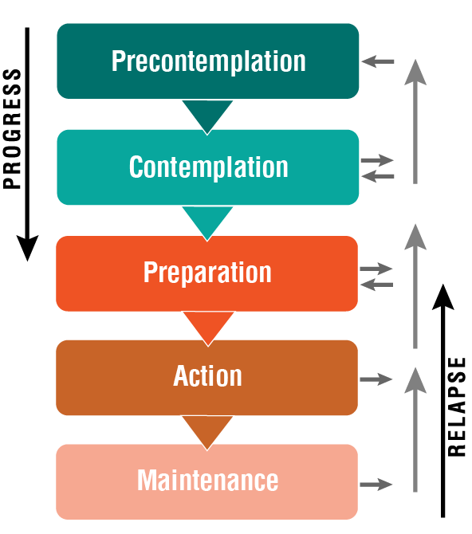
THE STAGES OF CHANGE
Notes:
Tell participants:
When it comes to changing behaviors, clients may not want to change, may be thinking about changing, may be preparing to change, or may be in process of changing.
According to the Transtheoretical Model (TTM) of Behavior Change, these different states that someone may be in are known as the “Stages of Change”.
As Counseling staff it will be important to assess which Stage of Change a client is in.
The 5 stages of change are:
Pre-contemplation
Contemplation
Preparation
Action
Maintenance
The TTM Stages of Change model helps us to better understand how people change behaviors.
TTM notes that relapse is a part of behavior change.
Harm reduction is an approach to help minimize the exposure when a person is not able or willing to stop a behavior.
Providing information around the impact of tobacco use is important in the early stages of change.
Ask participants to think about a behavior in their lives that they have tried to change.
Offer some examples:
Diet/Eating habits (drink more water, eat more vegetables, eat less junk food, etc.)
Exercise habits
Walk participants through the 5 stages of change by saying the following (use PowerPoint slides when describing each stage if possible): Next slide

Slide 23
PRECONTEMPLATION
There is no intention to change behavior in the foreseeable future:
Others are aware of problem
Unaware or under-aware
Change due to outside pressure
No plans to change (6 months)
Coerced by others to change
Notes:
Most of you are familiar with the stages of change model. Let’s pick a behavior and see how the model works. How many of you have ever tried to change the way you eat? Let’s look at changing the way you eat and the stages of change.
We’ll begin with Stage 1 (Pre-contemplation) of the Stages of Change Model. Stage 1 is when you are not considering a change at all. You are comfortable with what you are doing. In stage one:
Others may be aware or think you have a problem, you don’t
You have no in intention to change for the next 6 months
How many of you remember being at this stage? Raise your hands.
When you were at that stage, what was your reaction if people said, “You should stop?”
Highlight they likely don’t want to hear other people say that they should stop.

Slide 24
CONTEMPLATION
Aware that a problem exists and begins to think about overcoming it:
No commitment
Struggles with loss
Decisional-balancing
Can get stuck and remain so
Notes:
Now, let’s say that you’ve moved on to Stage 2 (Contemplation). Stage 2 is when you start thinking, maybe there is a problem. In other words, you’re considering making a change, but you are ambivalent and don’t feel ready to do the change right now. This is where you start becoming aware of the pros and cons of your behavior.
How many of you remember getting to that point? Raise your hands.
What moved you from Stage 1 to Stage 2? In other words, what made you go from not considering it to thinking maybe you should do something about it in sometime in the future?
Trainer’s Note
Encourage participants to tell their individual stories. Identify in each case what it was that moved the participant from not being willing to think about changing his/her behavior to actively considering it. Highlight these motivators and discuss with participants.
Usually there is something that moves you from Stage 1 to Stage 2. Also, I want you to notice that for every person the motivator for changing their behavior may be different.
What might motivate you to change may be different from what motivates me or another person?

Slide 25
PREPARATION
Making plans for the intended change:
Intending to take action within 30 days
Taking steps/making plans
May/may not have taken unsuccessful action in past year
Notes:
Preparation (Stage 3) is the next stage, where we seriously want to change the behavior, and take concrete steps to prepare to do it. This is the stage where we intend to change within the next 30 days.
How many of you remember being at that stage? Raise your hands.
There are really two parts to this:
The first part is planning how we are going to do it, which may include taking some steps.
The second part is gearing up to make these changes. This may or may not include picking a date to start.
Who remembers being at this stage? Tell me what kind of plans you made? What were the first steps you took? How did you prepare?
Trainer’s Note
Encourage participants to describe the plans they made. Ask about concrete steps taken.
Point out:
Similar to the motivators, people have different plans. What works for one person may not work for the other.
If you are able to predict and plan for barriers, you are more likely to succeed in behavioral change.

Slide 26
ACTION
Modification of behavior, experiences, or environment in order to overcome problem behavior
Taking an action is not being in action
Runs from one day to six months
Requires considerable commitment
Notes:
Stage 4 (Action) is when you are doing it, but you’re not 100% confident you can keep it up without slipping. This is the stage where you are taking it one day at time. This stage requires considerable commitment. It runs from 1 day to 6 months.
How many of you remember being at this stage? Raise your hands.
Tell me what that was like?
Trainer’s Note
Allow participants to describe their experiences in detail.
Highlight that slipping is a normal occurrence when trying to change a behavior.
Just because you slip doesn’t mean you aren’t successful. It’s normal to slip, and most people do. These Stages of Change are not linear. People will remain in different stages for different lengths of time and move back and forth through the stages. And that is perfectly normal. Some people will have a brief slip and then go right back to the new behavior. Others will “relapse” and temporarily move back to a previous stage of change again. When you try again, you don’t have to start over from the beginning (Stage 1) usually, you just go back one stage.

Slide 27
MAINTENANCE
Integrated the new behavior into present lifestyle
More than six months
Stabilizing change
Avoiding relapse
Can last a lifetime
Notes:
Now we get to the final stage, Maintenance (Stage 5). This is the point where the new way of behaving becomes a regular part of your life. We consider Stage 5 (Maintenance) to be after you have maintained the behavior for at least 6 months.
How many of you remember being at that stage or are in that stage now? Raise your hands.
Tell me what that was like?
Trainer’s Note
Give participants an opportunity to describe their personal experiences.
Highlight that being in Stage 5 does not mean that there are no temptations or struggles.
Emphasize:
Being in Stage 5 is defined as successfully performing the new behavior without a relapse for six months or longer.
The longer you maintain a behavior; the less likely it is you will experience a slip. But if you do, it’s not a failure. It’s just a slip into another stage.

Slide 28
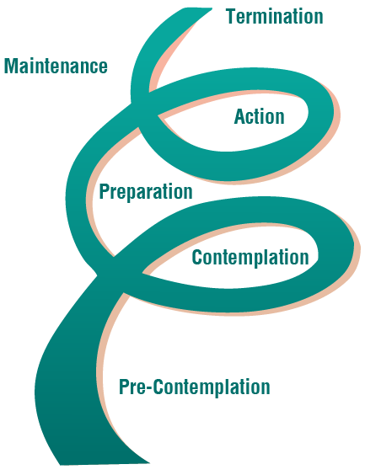
THE STAGES OF CHANGE
Notes:
Distribute a copy of “Stages of Behavior Change Overview” to each participant.
Highlight that we don’t stage people, we stage their goals.
Explain that stages are not linear and recycling through stages is common. Emphasize that relapse can occur at any time.

Slide 29
LEARNING DOMAINS FOR CHANGE
Cognitive
What a person thinks related to the change
Affective
What a person feels related to the change
Behavioral
What actions related to the change
Notes:
Tell participants that stages have different domains we can focus on to help people towards behavior change:
Cognitive - The way a person thinks. It includes perceptions, attitudes, beliefs and knowledge.
Affective - The way a person feels.
Behavioral - The way a person acts
Share Examples of Domains to Focus on to Help Clients Change
Provide the following examples of each domain:
Cognitive: If a lot of people in my support system have smoked and therefore I feel that smoking cannot be harmful to me, I am less likely to stop smoking. Addressing this will help move me towards behavior change.
Affective: If smoking is the only thing that makes me feel relaxed, I am less likely to consider not smoking. Addressing this will help move me towards behavior change.
Behavioral: If I continue to associate with people who smoke, I am more likely to not continue smoking. Addressing this will help move me towards behavior change.
Highlight that during the first three stages, participants should focus on using interventions that impact the cognitive and affective domains whereas the latter stages, they may focus on using interventions for the behavioral domain. They may also need to impact the cognitive and affective domain in later stages.

Slide 30
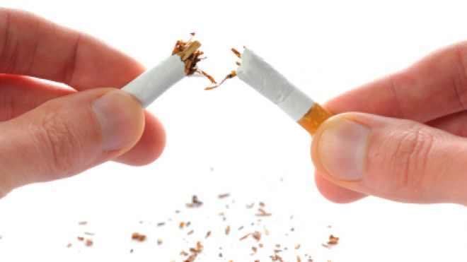
INDIVIDUAL ACTIVITY
Notes:
Distribute the “Staging Practice Worksheet” to each participant.
Explain they will use the statements on the worksheet to stage the client in regards to stopping tobacco use.
Ask participants to determine which stage the client is in based on each of the statements and the goal.
Using the answer key as a guide, discuss with participants.
Highlight that when staging, it is important to use varying questioning techniques to avoid redundant and repetitive questioning.

Slide 31
Thank You!
Notes:
Highlights
Thank everyone for their participation and hard work.
Ask if anyone wants to share one highlight they are taking away from the training. (Time permitting)
Once everyone who wants to say something has, wrap up the training by thanking participants for being a part of the training.

