Slide 1
Tobacco Dependence Screening & Treatment
Frontline Staff Training

Slide 2
GOAL
To build the capacity of frontline staff at health centers to support the integration of evidence-based tobacco dependence screening and treatment into standard delivery of care

Slide 3
OBJECTIVES
After this training, participants will be able to:
Recognize the important role that your health center has in reducing the disparity of tobacco use amongst priority populations
Describe the 5 A’s of a brief tobacco intervention
Identify pharmacotherapy

Slide 4
TRAINING AGENDA
Welcome
Warm-Up: Myths & Facts
Building a Rationale for Screening and Treatment
Basic Knowledge of 5 A’s (Ask & Advise)
Pharmacotherapy and Medicaid Coverage
Closing

Slide 5
WELCOME & INTRODUCTIONS
Please share your:
Name
Agency
Role

Slide 6
Myths & Facts About Tobacco Use

Slide 7
MYTHS
FACTS
Smoking light cigarettes will reduce one’s risk of lung cancer, stroke, heart disease, and emphysema
Once addicted to nicotine, it’s not that hard to quit
Quitting cold turkey is the only way to stop using tobacco
Nicotine products are just as unhealthy as the nicotine that’s found in cigarettes
Tobacco use is the leading cause of preventable deaths in the U.S.
Cigarette smoking accounts for more than 480,000 deaths annually in the U.S.
Tobacco use reduces a women’s fertility
Individuals who earn less than $15,000 annually and those with less than high school education use tobacco at higher rates than the general population
Nicotine is the addictive substance
Notes:
Explain to the participants:
These examples are often associated with tobacco use. Some are fact while others are fiction.
We will explore how, despite declines in tobacco use prevalence among the general population, individuals with low incomes, and those with less than a high school education continue to use tobacco at high rates.
These are the same--under-served and vulnerable populations that federally qualified health centers (FQHC), community health centers (CHC), and other safety net providers serve, making the integration of tobacco dependence screening and treatment into these settings critical.
Nicotine is the addictive substance that’s found in tobacco.
When tobacco is used as intended, it has a harmful effect on the human body (psychologically & physically).

Slide 8
Building a Rationale for Integrating Tobacco Dependence Screening & Treatment into Health Care Settings

Slide 9
BUILDING A RATIONALE: SCREENING EVERY PATIENT FOR TOBACCO USE
Through the delivery of evidence-based tobacco dependence screening and treatment, safety net providers have the ability to reduce health disparities on a statewide level
Notes:
Through the delivery of evidence-based tobacco dependence screening and treatment, safety net providers have the ability to reduce health disparities on a statewide level.

Slide 10
BUILDING A RATIONALE: SCREENING EVERY PATIENT FOR TOBACCO USE
These heath care settings serve as:
Primary care homes for all who need it, with a special focus on low-income and uninsured individuals
Community-directed health care providers located in medically underserved communities impacted by health disparities
Providers of affordable primary care and preventive services regardless of insurance status or ability to pay, including comprehensive care
Notes:
These health care settings serve as:
A primary care home for all who need it, with a special focus on low income and uninsured people.
A non-profit, community-directed health care provider located in low-income and medically underserved communities impacted by health disparities.
Provider of affordable primary care and preventive services regardless of insurance status or ability to pay, including comprehensive care.

Slide 11
BUILDING A RATIONALE: SCREENING EVERY PATIENT FOR TOBACCO USE
Safety net providers have the potential to eliminate disparities in health outcomes for:
Low-income individuals
Racial/ethnic minority populations
Medically underserved populations
Possible through the delivery of Comprehensive preventive care and promoting the proactive management of chronic conditions
Notes:
Safety net providers have the potential to eliminate disparities in health outcomes for low-income, racial/ethnic minority, and medically underserved populations by delivering comprehensive preventive care and promoting the proactive management of chronic conditions.

Slide 12
BUILDING A RATIONALE: SCREENING EVERY PATIENT FOR TOBACCO USE
The Institute of Medicine recognizes federally qualified health centers (FQHC) and Community Health Centers (CHC) as model settings for screening, diagnosing, and managing the following chronic conditions:
Diabetes
Depression
Cardiovascular disease
Cancer
Asthma
HIV
Notes:
For trainings at FQHCs/CHC: The Institute of Medicine recognizes FQHCs and CHCs as model settings for screening, diagnosing, and managing the following chronic conditions:
Diabetes
Depression
Cardiovascular Disease
Cancer
Asthma
HIV

Slide 13
BUILDING A RATIONALE: SCREENING EVERY PATIENT FOR TOBACCO USE
Safety Net Providers are able to:
Utilize electronic health records (EHR) and their existing quality improvement infrastructure to support the standardized delivery of evidence-based tobacco dependence screening and treatment in their settings
Attest to meaningful use and meaningful use provisions related to tobacco
Capitalize on opportunities created by health reform to integrate evidence-based tobacco dependence screening and treatment into standard delivery of care
Notes:
Safety Net Providers are able to:
Utilize Electronic Health Records (EHR) and the quality improvement infrastructure to support the standardized delivery of evidence-based tobacco dependence screening and treatment in their settings.
Provide an overview of meaningful use and meaningful use provisions related to tobacco
Capitalize on opportunities created by health reform for integrating evidence-based tobacco dependence screening and treatment into standard care delivery.
Integrate tobacco dependence screening and treatment into standard care delivery.

Slide 14
Basic Knowledge of 5 A’s

Slide 15
BASIC KNOWLEDGE OF THE 5 A’S
Definition of “evidence based”:
Applying the best available research results (evidence) when making decisions about health care
Health care professionals who perform evidence-based practice combine research evidence along with clinical expertise and patient preferences
Notes:
Tell participants the Definition of “evidence based”:
Applying the best available research results (evidence) when making decisions about health care. Health care professionals who perform evidence-based practice use research evidence along with clinical expertise and patient preferences

Slide 16
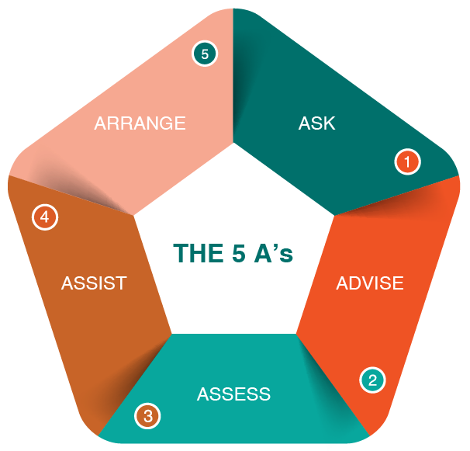
THE 5 A’S
Notes:
Tells participants that the 5 As are an evidence-based tobacco cessation intervention developed by the U.S. Public Health Service.
These are the 5 As, which assist those who want to stop using tobacco products to be successful in doing so.

Slide 17
THE 5 A’S
Ask
Each patient about his or her tobacco use status at every visit and record the patient’s response
Advise
Providing clear, non-judgmental, and personalized suggestions regarding quitting
Tell patients that you understand quitting is difficult, but can be the most important thing they do for their health and family
Notes:
Ask - Identify and document tobacco use status for every patient at every visit.
Tell participants that they may wish to develop their own vital signs sticker, based on the sample below.
Advise - In a clear, strong, and personalized manner, urge every tobacco user to quit.

Slide 18
THE 5 A’S
Assess
Each patient’s readiness and interest in quitting
The patient’s responses to your questions regarding readiness to quit will affect the next step in the process:
If he or she is willing to quit, you’ll offer resources and assistance
If not, you’ll help the patient identify the barriers to quitting
18
Notes:
Assess - Is the tobacco user willing to make a quit attempt at this time?

Slide 19
THE 5 A’S
Assist
Each patient that is ready to quit to develop a personalized quit plan
This will include providing materials, resources, pharmacotherapy (preferably on-site), and/or referrals
Patients should be encouraged to pick a quit date
Notes:
Assist - For the patient willing to make a quit attempt, and use counseling and pharmacotherapy to help him or her with overcoming this addiction. Also, refer the patient to 311 and NYS Smokers Quitline 1-866-NY-QUITS for ongoing support.
Arrange - Schedule follow-up contact, in-person or by telephone, preferably within the first week after the quit date to discuss progress and address challenges.
"Treating Tobacco Use and Dependence: Five Major Steps to Intervention (The “5A’s”)." PHS Clinical Practice Guideline. Web. 22 June 2015.

Slide 20
THE 5 A’S
Arrange
Follow-up contact, preferably within the first week after the quit date
If a patient relapses, let him or her know you and your staff will be there to help get back on track
20
Notes:
Assist - For the patient willing to make a quit attempt, and use counseling and pharmacotherapy to help him or her with overcoming this addiction. Also, refer the patient to 311 and NYS Smokers Quitline 1-866-NY-QUITS for ongoing support.
Arrange - Schedule follow-up contact, in-person or by telephone, preferably within the first week after the quit date to discuss progress and address challenges.
"Treating Tobacco Use and Dependence: Five Major Steps to Intervention (The “5A’s”)." PHS Clinical Practice Guideline. Web. 22 June 2015.

Slide 21
ASK
Ask about tobacco use:
# of Cigarettes per Day (CPD)
□ 31+ □ 21 – 30 □ 11 – 20 □ 1 – 10
Time to first Cigarette (TTFC)
.
□ within 5 min □ 6 – 30 min □ 31 – 60 min □ 61+ min
Notes:
Explain to participants that this is one method of tracking/charting a patient’s tobacco use and creating a systemic change within organization to ensure that every tobacco user is identified and advised to quit at every visit and staff encounter.
Frontline staff should capture this information during their intake assessment.

Slide 22
ADVISE
Advise tobacco users to quit
Use a clear, non-judgmental, personalized manner
“It’s important that you quit as soon as possible, and I can help you.”
“Cutting down while you are ill is not enough.”
“Occasional or light smoking is still harmful.”
“I realize that quitting is difficult. It is the most important thing you can do to protect your health now and in the future. I have training to help my clients quit, and when you are ready, I will work with you to design a specialized treatment plan.”
Notes:
Sample statements of Frontline staff:

Slide 23
SAMPLE VITAL SIGN CARD
VITAL SIGNS
Blood Pressure: __________________________________________
Pulse: ________________ Weight: ________________
Temperature: ____________________________________________
Respiratory Rate: ________________________________________
Do you use Tobacco Products (circle one) : Current Former Never
*Alternatives to expanding the vital signs are to place tobacco-use status stickers on all patient charts or to indicate tobacco use status using electronic medical records or computer reminder systems
Notes:
Explain to participants that documentation and tracking a patients tobacco use is critical to systemic change within an organization. This is one method of tracking/charting a patient’s tobacco use and creating a systemic change within organization to ensure that every tobacco user is identified and advised to quit at every visit and staff encounter.
Frontline staff would capture this information during their intake assessment.
Other alternative methods are as follows:
Place tobacco-use status stickers on all patient charts; Or
To indicate tobacco use status using electronic medical records or computer reminder systems.

Slide 24
COMMON RESPONSES
Frontline staff: “Do you mind if I talk to you about your tobacco use?”
Participant: “No, go right ahead.”
Frontline staff: “Great, what are your thoughts on quitting smoking?”
Participant: “I’ve been thinking about it.”
Notes:
Frontline staff: “Do you mind if I talk to you about your tobacco use?”
Participant: “No, go right ahead.”
Frontline staff: “Great, what are your thoughts on quitting smoking?”
Participant: “I’ve been thinking about it.”
Frontline staff: “What do you think will happen if you quit?”
Participant: “I’m really not interested in quitting.”
Frontline staff: “I’d love to give you more information in case you change your mind

Slide 25
COMMON RESPONSES
Frontline staff: “What do you think will happen if you quit?”
Participant: “I’m really not interested in quitting.”
Frontline staff: “I’d love to give you more information in case you change your mind.”
Notes:
Frontline staff: “Do you mind if I talk to you about your tobacco use?”
Participant: “No, go right ahead.”
Frontline staff: “Great, what are your thoughts on quitting smoking?”
Participant: “I’ve been thinking about it.”
Frontline staff: “What do you think will happen if you quit?”
Participant: “I’m really not interested in quitting.”
Frontline staff: “I’d love to give you more information in case you change your mind

Slide 26
COMMON RESPONSES
Participant: “Why do you keep asking?”
Frontline staff: “I ask each time you visit because I care about you and your health and want to help you when you are ready to quit.”
Participant: “I’ve tried before.”
Frontline staff: That’s great, that you have tried before. Tell me more about your experience.”
Notes:
Participant: “Why do you keep asking?”
Frontline: “I ask each time you visit because I care about you and your health and want to help you when you are ready to quit.”
Participant: “I’ve tried before.”
Frontline: That’s great, that you have tried before. Tell me more about your experience.”
Participant: “I want to, but I’m not ready.”
Frontline: Well, the best thing you can do for your health is to quit smoking. We’re here to help and support you. We have some great resources available to assist with quitting. The clinician will be in shortly and can tell you what steps you can take when you’re ready.”

Slide 27
COMMON RESPONSES
Participant: “I want to, but I’m not ready.”
Frontline staff: Well, the best thing you can do for your health is to quit smoking. We’re here to help and support you. We have some great resources available to assist with quitting smoking too. The clinician will be in shortly and can help you quit when you’re ready.”
Notes:
Participant: “Why do you keep asking?”
Frontline: “I ask each time you visit because I care about you and your health and want to help you when you are ready to quit.”
Participant: “I’ve tried before.”
Frontline: That’s great, that you have tried before. Tell me more about your experience.”
Participant: “I want to, but I’m not ready.”
Frontline: Well, the best thing you can do for your health is to quit smoking. We’re here to help and support you. We have some great resources available to assist with quitting. The clinician will be in shortly and can tell you what steps you can take when you’re ready.”

Slide 28
Individual Activity Practice Responding to Clients
Notes:
Individual Activity
Tell participants that they will receive a worksheet that has a series of patient statements on it. Their task is to develop responses to the statements on the worksheet.
Tell participants that they are to complete the worksheet individually.
Distribute the Common Responses worksheet to participants.
Give participants 3-5 minutes to complete the worksheet.
Call time and ask for a few volunteers to share their responses.
Process the Activity
Ask the following questions:
What was it like to do this activity?
What are your reaction(s) to the different ways the group responded to the statements?
What lessons are you taking away from this activity?

Slide 29
Overview of Pharmacotherapy & Insurance Coverage

Slide 30
PHARMACOTHERAPY & INS.
Nicotine Replacement Therapy (NRT) or pharmacotherapy:
Improves chances of quitting
Makes people more comfortable while quitting
Allows individuals to focus on changing their behavior
Does not have the harmful ingredients found in cigarettes and other tobacco products
Notes:
Tell participants that medication like Nicotine Replacement Therapy (NRT) or pharmacotherapy:
Improves chances of quitting.
Makes people more comfortable while quitting.
Allows consumers to focus on changing their behavior.
Does not have the harmful ingredients found in cigarettes and other tobacco products
Allows consumers to focus on changing their behavior.
Does not have the harmful ingredients found in cigarettes and other tobacco products.

Slide 31
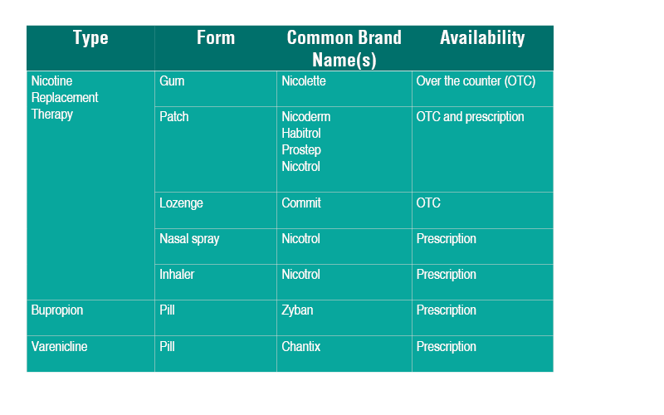
PHARMACOTHERAPY & INSURANCE
Medicaid helps pay for most pharmacotherapy, decreasing the financial barriers to quitting
* Nicoderm CQ patches (shown here) are manufactured by GlaxoSmithKline Commit lozenges (shown here) are manufactured by GlaxoSmithKline.
Zyban (above top) is manufactured by GlaxoSmithKline. Chantix (above bottom) is manufactured by Pfizer.
Notes:
Tell participants about different forms of NRT/Pharmacotherapy:
For over the over the counter NRT, no prescription is needed.
This includes the following:
Nicotine Patch
Nicotine Gum (2mg and 4mg pieces available)
Nicotine Lozenges (2mg and 4mg pieces available)
The following requires a prescription:
Nicotine Vapor Inhaler (the puffer)
Nicotine Nasal Spray
Explain that:
All NRT can be used alone or in combination.
Some common side effects are as follows: headache, nausea, dizziness.
Health care providers should determine dosing and combinations that will work best for their patients.
Trainer’s Notes:
Trainer does not have to address every bullet point but should select a few from each of the areas below.
Step 2: Lecturette on Medications
The PATCH: Key elements to share with participants.
Nicotine is absorbed through the skin
Can take up to six (6) hours to reach peak nicotine levels
Wear on upper part of the body, where there is little hair
Skin will have pink rash – it is not an allergic reaction!
Do not cut in half
Apply a new patch every 24 hours
Common side effects – headache, nausea, dizziness
Nicotine Gum:
Sugar-free chewing gum
Absorbed through the lining of the mouth
Bite and Park
Available in two strengths (2mg and 4mg)
Available flavors are:
Original, cinnamon, fruit, mint (various), and orange
Sold without a prescription as Nicorette or as a generic
May not be a good choice for people with jaw problems, braces, retainers, or significant dental work
Can irritate the mouth and throat and cause dryness
Nicotine Lozenge:
Absorbed through the lining of the mouth
Park in the cheek
Available OTC in two strengths
2mg and 4mg
Available sugar-free flavors include:
Mint
Cappuccino
Cherry
Not covered by NYS Medicaid Prescription benefit
Can irritate the mouth and throat and cause dryness
Nicotine Inhaler:
Nicotine inhalation system:
Mouthpiece
Cartridge
Absorbed through the lining of the mouth
Allows for similar hand-to-mouth ritual of smoking
Sold with a prescription as Nicotrol Inhaler
Can irritate the mouth and throat and cause dryness
Nicotine Nasal Spray:
About 100 doses per bottle
Quickly absorbed through the lining of the nose
Gives largest “spike” of nicotine
Sold with a prescription as Nicotrol NS
Side effects include sneezing, sore throat, runny nose and eyes
Oral Medications:
Bupropion SR – Available by prescription
Zyban; Wellbutrin SR or Generic
Can be used with NRTs
Effective in consumers with depressive disorders
Non-sedating, activating antidepressant
Affects NE; DA systems
Side effects – headache, insomnia
Varenicline HCl (Chantix) – Available by prescription
Use with NRTs not recommended
Some people who used varenicline have reported experiencing changes in behavior, agitation, depressed mood, suicidal thoughts or actions. Peers should talk to their doctor before taking this medication.
Also highlight:
Medicaid will pay for most tobacco dependence treatment medications when patients have a prescription from their health care provider, although Medicaid Managed Care plans sometimes have limits on this benefit (e.g., length of the course, how many courses a patient will have covered in a year, maximum dosage covered).
Helping a patient to quit using tobacco entails working with him or her to understand available insurance benefits and helping to remove as many financial barriers to quitting as possible for that patient. .
Medications covered by Medicaid are as follows:
Nicotine “Patch”, with a prescription order for over the counter
Nicotine Gum, with a prescription order for over the counter
Chantix, prescription required
Nicotine Inhalers, prescription required
Nicotine Nasal Spray, prescription required
Zyban (Bupropion), prescription required

Slide 32
Thank You!
Notes:
State the following:
We want you to draw on all the success you’ve had to date to help you in this next phase of your work.
Tell participants clients are more likely to make a behavioral change (i.e., breast feeding, family planning, lose weight, cancer screening and tobacco cessation) when they hear it from a health care provider.
Frontline staff play a critical role in promoting tobacco screening and dependence treatment. Most tobacco users who smoke want to quit and need the support of others, including resources and pharmacotherapy do so successfully.

