Slide 1
Talking to Patients about their Tobacco Dependence
February 9, 2018
Patricia Mallaber, MS, RN, ANP-BC, CTTS
Nurse Practitioner
Wilmot Cancer Institute
Tobacco Dependence Treatment Program

Slide 3
Who should be talking to patients?
Physicians
Physician Assistants
Nurse Practitioners
Nurses
Physical and Occupational Therapists
Mental Health Professionals
Dental Professionals
Pharmacists

Slide 4
The Five A’s
ASK
ADVISE
ASSESS
ASSIST
ARRANGE
ASK every patient about tobacco use at every visit and document smoking status.
In a clear, strong, and personalized manner urge every tobacco user to quit.
Is the tobacco user willing to make a quit attempt at this time?
For the patient willing to make a quit attempt, use counseling and pharmacotherapy to help him or her quit.
Schedule follow-up contact, preferably within the first week after the quit date.
Fiore MC, Jaen CR, Baker TB, et al. Treating Tobacco Use and Dependence: 2008 Update. Clinical Practice Guideline. Rockville, MD: U.S. Departmentof Health and Human Services. Public Health Service. May 2008.

Slide 5
The Five A’s
ASK
ADVISE
ASSESS
ASSIST
ARRANGE
Ask every patient about tobacco use at every visit and document smoking status.
In a clear, strong, and personalized manner urge every tobacco user to quit.
Is the tobacco user willing to make a quit attempt at this time?
For the patient willing to make a quit attempt, use counseling and pharmacotherapy to help him or her quit.
Schedule follow-up contact, preferably within the first week after the quit date.
Fiore MC, Jaen CR, Baker TB, et al. Treating Tobacco Use and Dependence: 2008 Update. Clinical Practice Guideline. Rockville, MD: U.S. Departmentof Health and Human Services. Public Health Service. May 2008.

Slide 6
What Can You Do?
Have a conversation….
Among all current U.S. adult cigarette smokers, nearly 7 out of every 10 (68.0%) reported in 2015 that they wanted to quit completely.
Centers for Disease Control and Prevention.
Quitting Smoking Among Adults—United States, 2000–2015. Morbidity and Mortality Weekly Report 2017;65(52):1457-64 [accessed 2017 Jan 24].

Slide 7
Treating Tobacco Use: An algorithm
Does patient use tobacco now?
Is patient now willing to quit?
Provide appropriate tobacco dependence treatments
Provide motivation to quit
Did patient once use tobacco?
Encourage continued abstinence
Prevent relapse
Yes
No
Yes
No
Yes
No
Fiore MC, Jaen CR, Baker TB, et al. Treating Tobacco Use and Dependence: 2008 Update. Clinical Practice Guideline. Rockville, MD: U.S. Departmentof Health and Human Services. Public Health Service. May 2008.

Slide 8
“Tobacco Status” ≠ “Smoking Status”
Tobacco status should be assessed and documented during every encounter
This is not just about smoking
This includes many different types of tobacco
Traditional “combustible” Cigarettes, e-cigarettes, vaping (standard vape or “mods”), chewing tobacco (snus, snuf), hookah, cigars, mini cigars (cigarillos), pipe
Some of these may vary by patient’s cultural background
Bidis, Betel nuts/Quid, Kreteks
Use non-judgmental approach when assessing tobacco status

Slide 9
How to Ask
Instead of
Try
Critical or Disparaging Questions
Have you quit smoking yet?
Why haven’t you quit smoking yet?
Why are you still smoking?
Open ended questions
Tell me how things are going with smoking
Have you thought about quitting?
On a scale of 1-10 how much do you want to quit smoking right now?
What do you like about smoking?
How do you feel about quitting?

Slide 10
The Five A’s
ASK
ADVISE
ASSESS
ASSIST
ARRANGE
ASK every patient about tobacco use at every visit and document smoking status.
In a clear, strong, and personalized manner urge every tobacco user to quit.
Is the tobacco user willing to make a quit attempt at this time?
For the patient willing to make a quit attempt, use counseling and pharmacotherapy to help him or her quit.
Schedule follow-up contact, preferably within the first week after the quit date.
Fiore MC, Jaen CR, Baker TB, et al. Treating Tobacco Use and Dependence: 2008 Update. Clinical Practice Guideline. Rockville, MD: U.S. Departmentof Health and Human Services. Public Health Service. May 2008.

Slide 11
Advise
Urge all smokers to quit smoking
Ensure them that you can help
Reassure them that it can take multiple quit attempts to be successful
Past results do not guarantee future outcomes!
Previous failed attempts to not mean future attempts will be the same
Be non confrontational
Be encouraging

Slide 12
Reframe
Instead of saying
Try
If you keep smoking you will get cancer (or a heart attack, a stroke, etc)
Did you know that one of the best things you can do for your health is to quit smoking?

Slide 13
The Five A’s
ASK
ADVISE
ASSESS
ASSIST
ARRANGE
ASK every patient about tobacco use at every visit and document smoking status.
In a clear, strong, and personalized manner urge every tobacco user to quit.
Is the tobacco user willing to make a quit attempt at this time?
For the patient willing to make a quit attempt, use counseling and pharmacotherapy to help him or her quit.
Schedule follow-up contact, preferably within the first week after the quit date.
Fiore MC, Jaen CR, Baker TB, et al. Treating Tobacco Use and Dependence: 2008 Update. Clinical Practice Guideline. Rockville, MD: U.S. Departmentof Health and Human Services. Public Health Service. May 2008.

Slide 14
Stages of Change
Pre-contemplation
Contemplation
Preparation
Action
Maintenance
Stage
No plans to quit in the next 6 months
No interest, lack of knowledge or awareness of potential benefits of quitting
Seriously considering a quit attempt in the next 6 months
Gathering information
Plans to quit in the next month
Taking Steps towards quitting
(Day 1-6 months)
Using Medications, Following up in clinic as well as using family/friends for support
>6 months smoke free
Patient’s Status
Discuss benefits, risks, resources available
Encouragement, Motivational Interviewing
Motivational Interviewing, Help with plan, Medication and Behavior teaching
Provide support, Medication refills, plan modification (if needed), additional resources if needed
Discuss relapse prevention, target date to stop medications
What can we do?
Prochaska & DiClemente, 1983; Prochaska, DiClemente, & Norcross, 1992

Slide 15
Self Determination Theory and Motivation
More likely to engage in
and sustain behavior change
Amotivated
External
Introjected
Identified
Integrated
Intrinsic
“I do not want to quit at all”
“My doctor says I should quit”
“I know I should quit”
“I want to quit because it is consistent with my goals”
“Being a non smoker is who I am now”
“I feel great since I have quit”
More Controlled
More Autonomous
Ryan, R. M., & Deci, E. L. (2000).
Segar & Hall (2011)

Slide 16
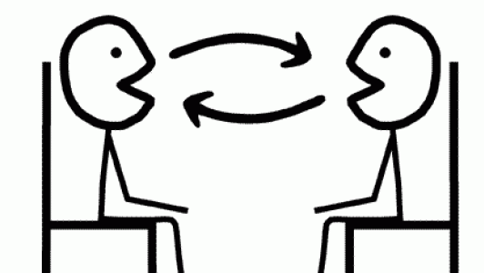
Motivational Interviewing
Patient centered counseling
Recognizing/Acknowledging patient’s current feelings about making health change
Promotes patient autonomy
Assists with exploring/resolving ambivalence
Open ended questions
Non-judgmental
Reflective listening
Miller and Rollnick

Slide 17
Motivational Interviewing and Self Determination Theory
Structure
Autonomy Support
Involvement
Present clear and neutral information about behavior and outcomes
Provide positive feedback
Develop appropriate goals
Elicit and reinforce self motivational statements
Present options
Let client make decisions
Develop discrepancy
Rolling with resistance
Express empathy
Demonstrate empathy
Demonstrate understanding
Avoid criticism and judgement
Explore client’s concerns
Competence
Autonomy
Relatedness

Slide 18
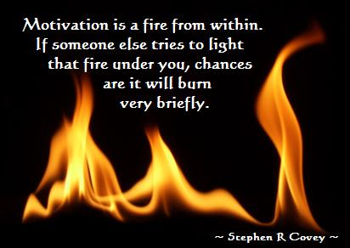

Slide 19
Questions to Consider
Consider questions that will guide your treatment and start a conversation
What are your goals?
How old were you when you started smoking?
How many per day over the past month?
What is the most you ever smoked on a regular basis?
How soon after you wake up do you have your first puff?
What is the longest you have ever gone without a cigarette?

Slide 20
Real life situations
What do you like about smoking?
What do you NOT like about smoking?
Common Answers
Helps me relax
My “me” time
Gives me an escape
Common Answers
Smells bad
Hurts my health
COPD, Cancer, etc
Costs too much
Social Stigma
Tastes bad
Can no longer smoke in public
Control it has over me

Slide 21
Real life situations
Patient
Health Care Professional
“I’ve tried a million times- I can’t do it!”
Quitting smoking can take time
This is something that has been a part of your life for XX years- it is not realistic to think you can turn it off overnight
It can take many quit attempts to quit
Sometimes our first plan doesn’t work out and we have to try a couple of different combinations of medications/behaviors etc.

Slide 22
Real life situations
Patient
Health Care Professional
“It’s not a good time right now, I have a lot going on. I want to wait until my stress level goes and then I can work on this”
“There will always be some degree of stress in your life. Let’s talk about other ways we can help you manage stress”

Slide 23
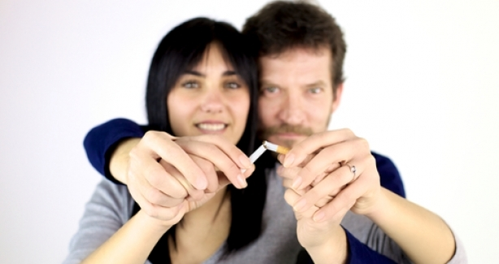
Real life situations
Patient
Health Care Professional
“I can’t quit because my spouse smokes too and doesn’t want to quit”.
“Consider having a conversation with your spouse and let him/her know quitting is important to you.”

Slide 24
Real life situations
Patient
Health Care Professional
“I feel like things are out of control- smoking is the only thing I have control of right now”
Encourage the patient to consider all of the control that cigarettes have over them in their lives (financially, emotionally, physically)

Slide 25
The Five A’s
ASK
ADVISE
ASSESS
ASSIST
ARRANGE
ASK every patient about tobacco use at every visit and document smoking status.
In a clear, strong, and personalized manner urge every tobacco user to quit.
Is the tobacco user willing to make a quit attempt at this time?
For the patient willing to make a quit attempt, use counseling and pharmacotherapy to help him or her quit.
Schedule follow-up contact, preferably within the first week after the quit date.
Fiore MC, Jaen CR, Baker TB, et al. Treating Tobacco Use and Dependence: 2008 Update. Clinical Practice Guideline. Rockville, MD: U.S. Departmentof Health and Human Services. Public Health Service. May 2008.

Slide 26
What do think are some of your triggers??
Patient
Health Care Professional
Talking on the phone |  | Think of other things to hold in hand while on phone (lollypop, toothpicks, straw)
Driving in the car |  | Consider not having cigarettes within reach in the car (put in trunk)
After meals |  | Try washing dishes/brushing teeth right after eating
When I am bored |  | Try to keep busy (puzzles, games, hobbies)
When I feel stressed |  | Learning other strategies to deal with stress (counseling, breathing exercises, yoga, meditation)

Slide 27
Real life situations
Patient
Health Care Professional
“I’ve tried all of the medicines- none of them work”
“Let’s go through what you’ve tried before”
“Did you know there are 7 FDA approved medications to help patients quit smoking?”

Slide 28
Real life situations
Patient
Health Care Professional
“I took <<medicine>> once but it didn’t work- I still smoked!”
“Unfortunately none of the medications we have available are meant to make you quit smoking- they are meant to help the process be more comfortable for you”

Slide 29
Real life situations
Patient
Health Care Professional
“I don’t want to use the patch and put chemicals in my body”
“I don’t want to get addicted to the patch”
Discuss chemical components in a cigarette smoke (one of which is nicotine)
Review rationale and safety of Nicotine Replacement

Slide 30
The Five A’s
ASK
ADVISE
ASSESS
ASSIST
ARRANGE
ASK every patient about tobacco use at every visit and document smoking status.
In a clear, strong, and personalized manner urge every tobacco user to quit.
Is the tobacco user willing to make a quit attempt at this time?
For the patient willing to make a quit attempt, use counseling and pharmacotherapy to help him or her quit.
Schedule follow-up contact, preferably within the first week after the quit date.
Fiore MC, Jaen CR, Baker TB, et al. Treating Tobacco Use and Dependence: 2008 Update. Clinical Practice Guideline. Rockville, MD: U.S. Departmentof Health and Human Services. Public Health Service. May 2008.

Slide 31
Barriers for follow ups
Patient
Health Care Professional
“I have too many visits/copays- I can’t come back for a follow up that soon”
“I don’t have a ride”
Identify other ways you can follow up
Phone
Electronically (EMR based email)

Slide 32
Common Responses at Follow Up Visits
Patient
Health Care Professional
“I failed, I am still smoking”
“I am not doing well”
Focus on positives and achievements
“You went 2 weeks without smoking!”
“You are still working on this and you haven’t given up!”

Slide 33
Approaching Slip Ups
Patient
Health Care Professional
Follow up visit:
“I quit for 2 weeks and then my friend passed away so I had one”
Acknowledge the slip, help the patient recognize and learn from it
“Let the slip slide!”
Congratulate them for not relapsing to their previous smoking pattern

Slide 34
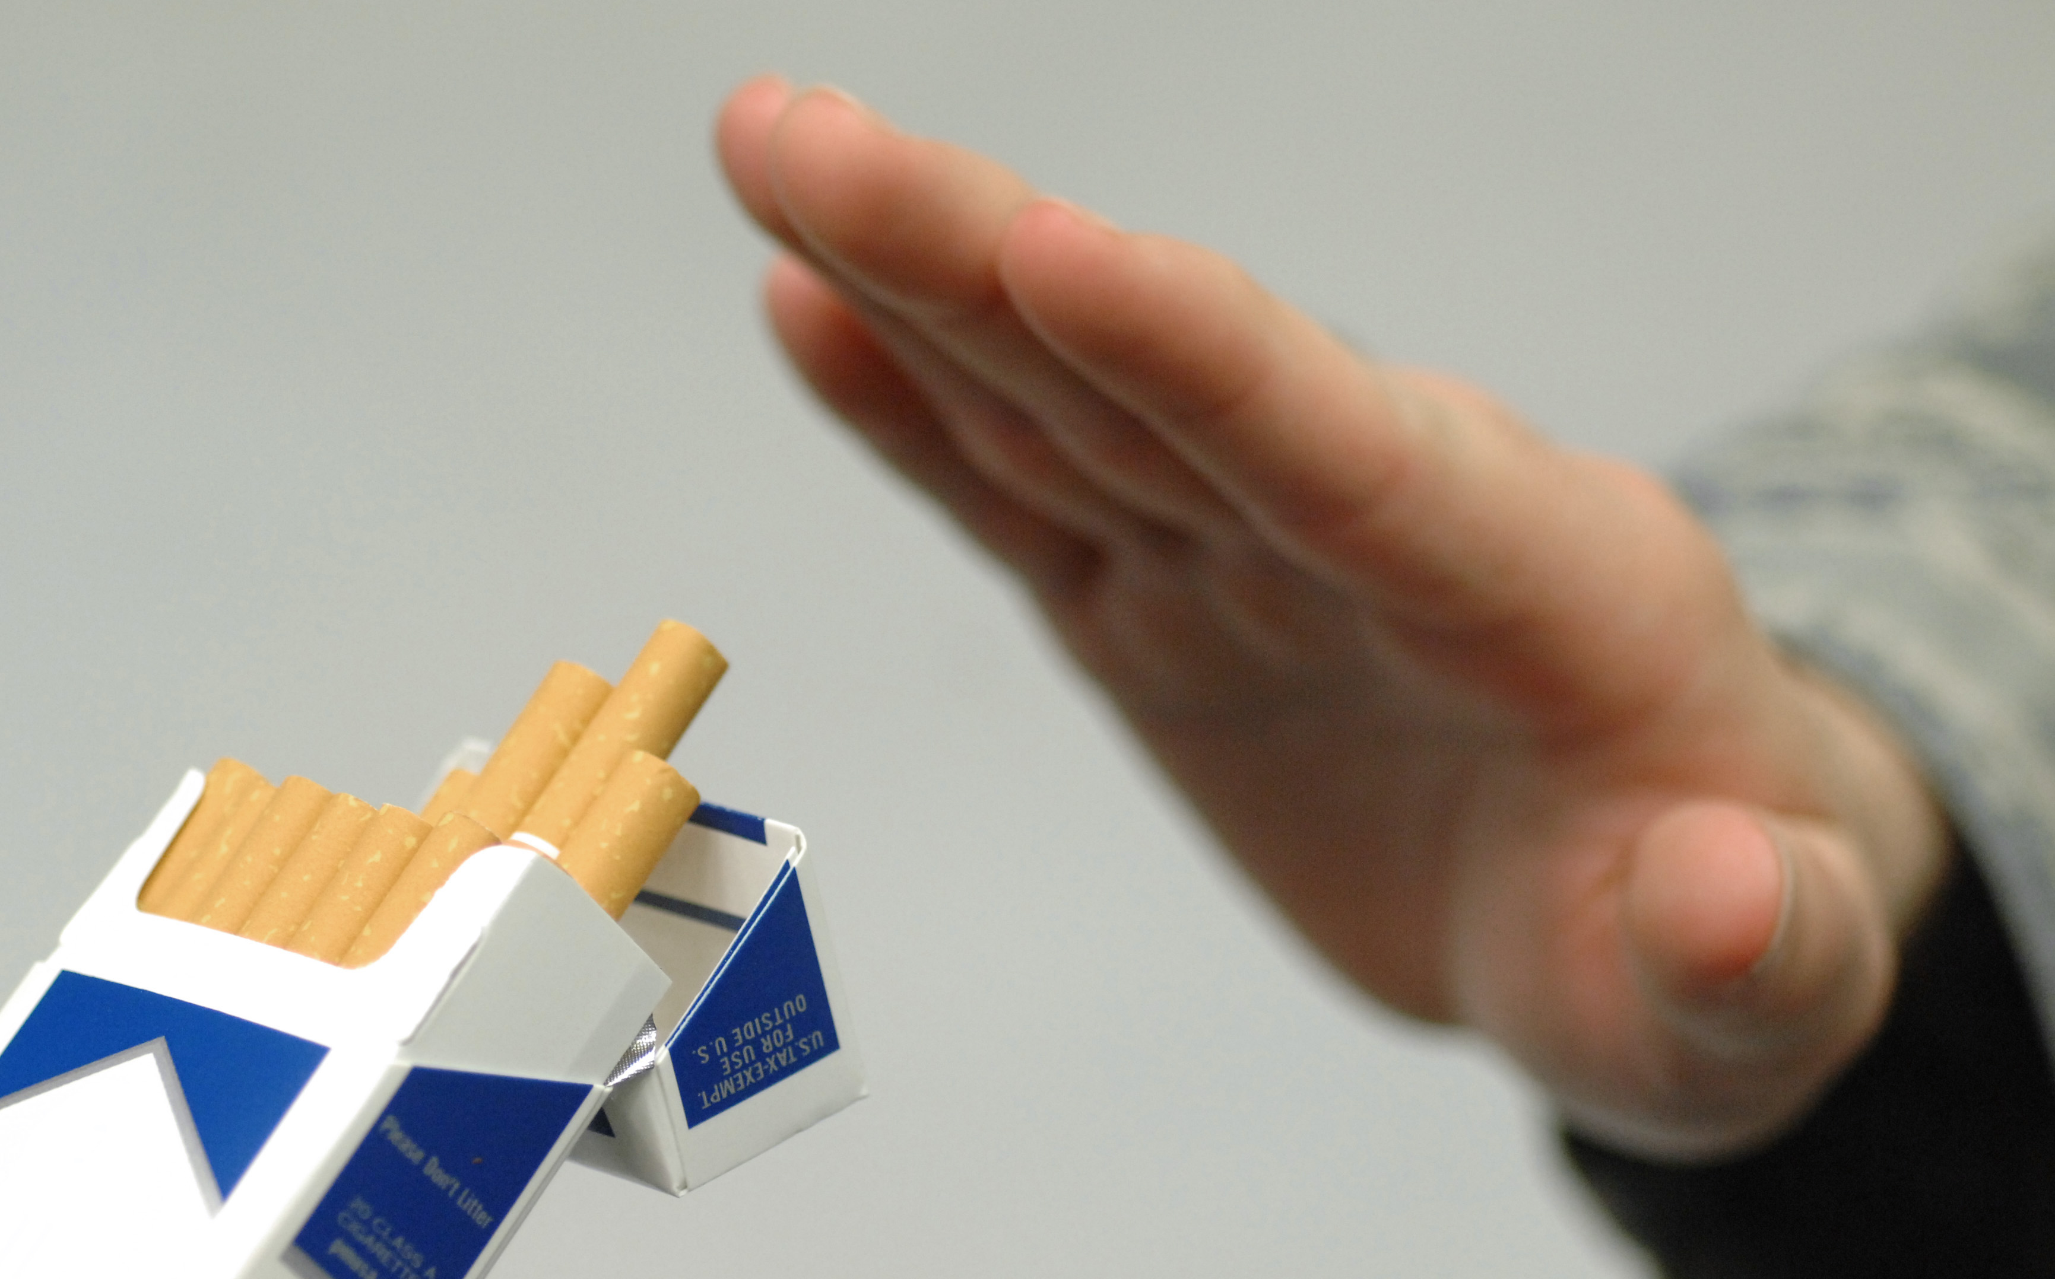
About Relapse
Prevention of relapse begins at the beginning phases of the quit journey
Anticipating triggers, strategies
Pharmacologic Support
Patients who relapse often feel negative feelings of shame, guilt and blame
Congratulate them for time they spent tobacco free
Help to focus on what they learned (both negative and positive) from this quit attempt
Assist in starting new plan

Slide 35
Offer Alternate Resources
Local Tobacco Treatment Providers/Classes/Groups
NY State Smokers’ Quitline
Employer programs
Nicotine Anonymous
American Cancer Society Quit for Life Program
American Lung Association Freedom from Smoking Program
Smart Phone/Tablet Apps/Text Programs
Websites to visit
Social Media
Pamphlets and Handouts

Slide 36
Ongoing Support
Reassurance that we are here for them no matter what
If relapse occurs we will have open line of support to offer assistance—no judgement
We can help them try again
Next week
Next month
Whenever!

Slide 37
For those who are unwilling
The 5 R’s
Relevance
Do you feel that quitting smoking is an important thing for you to do for yourself?
Risks
What effect do you think your continued smoking will have on you/others around you?
Rewards
Can you think of some potential benefits of quitting smoking for you?
Roadblocks
What are some barriers you feel to quitting?
Repetition
Repeat every time a patient visits.

Slide 38
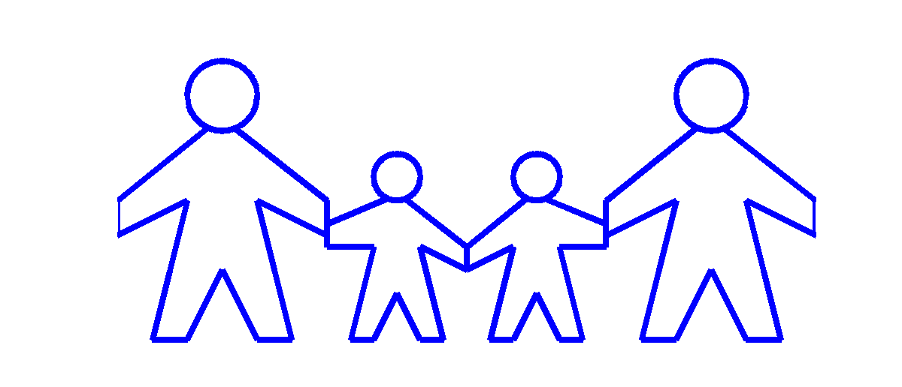
Teaching for Family/Friends
Do
Don’t
Ask how they are doing and feeling
Be supportive when they need to talk
Help distract them through cravings (“let’s go on a walk”)
Be patient and respectful-this process is done at the quitter’s pace
Be positive and encouraging
Help remind them of the reasons they want to quit
Be patient with them
Judge
Nag
Tease
Offer them any tobacco products
Smoke around them
Scold them or make them feel guilty for slip ups

Slide 40
Consider having a “Tobacco Treatment Champion”
Passionate person in clinic/work place
This person can take lead for tobacco treatment, education for staff
May be able to provide individual counseling, follow up for patients in between visits
This person may seek additional training/become certified in tobacco treatment

Slide 42
CONTACT
patricia_mallaber@urmc.rochester.edu

