Slide 1
Nicotine Dependence and Treatment
Steven J. Novak, MD
February 9, 2018

Slide 2
Treating Tobacco Use and Dependence
“ Numerous effective pharmacotherapies for smoking cessation now exist. Except in the presence of contraindications, these should be used with all patients attempting to quit smoking.”
Fiore et al, U.S. Dept of Health and Human Services, June 2000

Slide 3
Nicotine
Not a carcinogen (as opposed to Tobacco)
Addictive (when inhaled or delivered by Tobacco)
Cigarettes are a potent Nicotine Delivery System
  Approximately 1mg/ cigarette
  <10 seconds to brain
  Addictive potential similar to cocaine and heroin
Notes:
3

Slide 4
Cigarettes as Nicotine Delivery Systems
Nicotine is inhaled deep into lungs
Rapid delivery to left side of heart
Pumped into brain and body
Faster than injection into peripheral vein
Onset of CNS action-seconds
Notes:
4

Slide 5
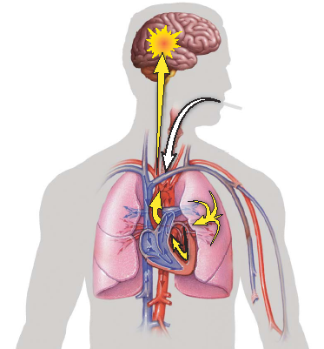
Inhaled Nicotine
Notes:
5

Slide 6
Tobacco Delivered Nicotine
Stimulates the release of dopamine in the nucleus accumbens, in the brain’s reward center.
This release of dopamine is similar to that seen for other drugs of abuse, such as heroin and cocaine, and is thought to underlie the pleasurable sensations and the addictive behaviors associated with tobacco.

Slide 7
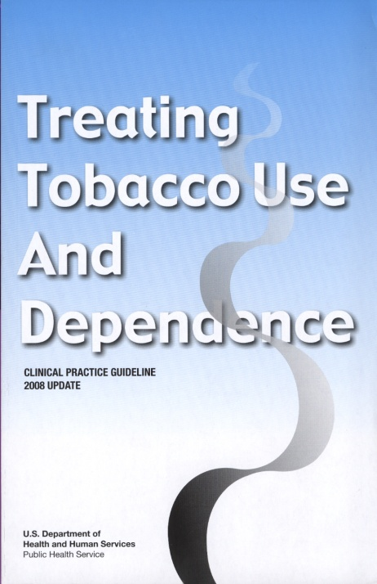
Pharmacotherapy
“Clinicians should encourage all patients attempting to quit to use effective medications for tobacco dependence treatment, except where contraindicated or for specific populations* for which there is insufficient evidence of effectiveness.”
* Includes pregnant women, smokeless tobacco users, light smokers, and adolescents.
Medications significantly improve success rates.
Fiore et al. (2008). Treating Tobacco Use and Dependence: 2008 Update.
Clinical Practice Guideline. Rockville, MD: USDHHS, PHS, May 2008.
Notes:
7

Slide 8
Medications For Tobacco Dependence
Seven first-line medications reliably increase long-term smoking abstinence rates:
Nicotine patch
  Nicoderm CQ (OTC)
  Generic (OTC)
Nicotine gum
  Nicorette (OTC)
  Generic (OTC)
Nicotine lozenge
  Commit (OTC)
  Generic (OTC)
Nicotine inhaler
  Nicotrol (Rx)
Nicotine nasal spray
  Nicotrol NS (Rx)
Bupropion SR
  Zyban (Rx)
  Generic (Rx)
Varenecline
  Chantix (Rx)
OTC = over-the-counter / no prescription needed
Rx=prescription required
These are the only medications approved by the
Food and Drug Administration (FDA) for tobacco dependence.

Slide 9
Considerations When Choosing Medications
Patient preference
Previous patient experiences with a specific agent (positive or negative)
Patient characteristics (concern about weight gain, history of depression)
Clinician familiarity with the medications
Contraindications for selected patients

Slide 10
Nicotine Replacement
Nicotine Patch
  (7-42+mg/day)
Nicotine Gum
  2 + 4 mg (10-24/day)
Nicotine Lozenge
  2 + 4mg (10-20/day)
Nicotine Inhaler
  4mg/inh (6-16/day)
Nicotine Nasal Spray
  1mg/dose (up to 40/day)
Randomized, Placebo Controlled Studies consistently show doubling of abstinence rate
Safe
Effective
4-12 weeks or longer

Slide 11
Nicotine Replacement Therapy
Reduces withdrawal symptoms
Reduces cravings
Delivers nicotine without toxins from tobacco
Allows patient to focus on changing behavior
Medications double chances of recovery

Slide 12
Nicotine Withdrawal
Irritability/frustration/anger
Anxiety
Difficulty concentrating
Restlessness/impatience
Depressed mood/depression
Insomnia
Impaired performance
Increased appetite/weight gain
Cravings
Most symptoms manifest within the first 1–2 days, peak within the first week, and subside within 2–4 weeks.
Hughes. (2007). Nicotine Tob Res 9:315–327.
Notes:
12

Slide 13
Nicotine Replacement Benefits
Decreased irritability
Decreased anxiety
Improved concentration
Improved mood
Decreased cravings

Slide 14
Address Potential NRT Concerns
Safety
Ineffectiveness
Fear of overdose
Fear of Addiction
No evidence of increased cardiac risk
No evidence of NRT causing cancer
Provide Adequate dose (approximately 1mg/cigarette)
Awareness of overdose symptoms (nausea, dizziness, headache)
Low addictive potential due to delivery system

Slide 15
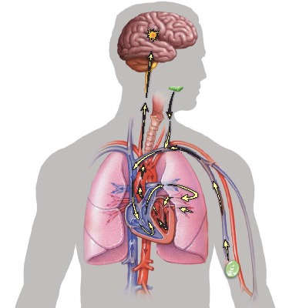
Nicotine Replacement
Notes:
15

Slide 16
Withdrawal Symptoms Over Time
Placebo
Nicotine Gum
Mean Adjusted
Withdrawal Score
Impatience
Irritability/Anger
1.5
1.0
0.5
0.0
1
2
3
4
5
6
7
8
9
10
Postcessation Weeks
Postcessation Weeks
Mean Adjusted
Withdrawal Score
Anxiety/Tension
Excessive Hunger
Postcessation Weeks
Postcessation Weeks
N = 40. Mean adjusted withdrawal scores are from an analysis of covariance with baseline cigarettes per day and baseline scores on the items shown as covariates.
Gross et al. Psychopharmacology. 1989;98:334-341.
Notes:
Key Point
Common nicotine withdrawal symptoms including impatience, irritability, and anxiety typically resolve in 5 to 6 weeks following abstinence; these withdrawal symptoms can be decreased with nicotine replacement therapy (NRT) therapy. Other withdrawal symptoms, such as excessive hunger, may last well beyond this initial 5 to 6 week period.
Background
To investigate the long-term effects of NRT on tobacco withdrawal symptoms, this community-based, double-blind, randomized study monitored 40 volunteers chewing 2 mg of NRT gum or placebo gum over the first 10 weeks after stopping smoking.
Smoking abstinence over the course of the study was verified using carbon monoxide testing.
For the first week after quitting, individuals in the NRT gum group experienced significant decreases in irritability, anxiety, impatience, restlessness, excessive hunger, difficulty concentrating, drowsiness, sleep disturbance, and tobacco craving intensity vs individuals in the placebo gum group (P<.01).
For increased appetite and excessive eating, the NRT gum group scored consistently lower throughout the study period. However, irritability, anxiety, and impatience symptoms declined over time in the placebo group so that, by week 5 or 6 through study end, there was no difference between groups for these symptoms.
Reference
Gross J, Stitzer ML. Nicotine replacement: ten-week effects on tobacco withdrawal symptoms. Psychopharmacology. 1989;98:334-341.

Slide 17
Transdermal Nicotine Patch
24 hr (21mg, 14mg, 7mg)
A new patch is applied each morning
Rotating placement site can reduce irritation
Gradual release
Plasma nicotine levels fluctuate less than with smoking
Often under-dosed (~50% replacement)

Slide 18
Nicotine Patch Side Effects
  Mild itching and tingling in first hour
    Resolves quickly
  Vivid dreams or sleep disturbances
    May remove at bedtime if needed
  Local skin reactions (redness, burning, itching)
    Usually caused by adhesive
    Up to 50% of patients experience this reaction but fewer than 5% of patients discontinue therapy
    Rotate placement site
    Hydrocortisone cream as needed
Notes:
18

Slide 19
Nicotine Patch Summary
Advantages:
  Provides consistent nicotine levels.
  Easy to use and conceal.
  Once daily dosing associated with fewer compliance problems.
Disadvantages:
  Patients cannot titrate the dose to acutely manage withdrawal symptoms.
  Often under-dosed
Notes:
19

Slide 20
Nicotine Gum
2 mg (<25cig/day) and 4 mg (>25cig/day)
Chew (release peppery taste) and “park”, continue for 30 minutes
Absorbed in a pH basic environment, avoid acidic beverages 15 minutes pre and post dose (coffee, juice, soft drinks)
Use enough pieces each day (10-15 usual)
Notes:
.

Slide 21
Nicotine Gum Summary
Advantages
  Might satisfy oral cravings.
  Delays weight gain (4-mg strength).
  Patients can titrate therapy to manage withdrawal symptoms.
  A variety of flavors are available.
Disadvantages
  Might be problematic for patients with significant dental work.
  Patients must use proper chewing technique to minimize adverse effects.
  Need for frequent dosing can compromise compliance.
  Often under-dosed.
Notes:
21
.

Slide 22
Nicotine Lozenge
2 mg (1st cig >30 minutes after waking)
4 mg (<30 minutes )
Place in mouth and allow to dissolve slowly
Do not chew or swallow lozenge
Avoid food and acidic beverages 15 minutes pre and post dose (coffee, juice, soft drinks)
Use enough each day (usually 10-20/day)

Slide 23
Nicotine Lozenge Summary
Advantages
  Might satisfy oral cravings.
  Delays weight gain (4-mg strength).
  Easy to use and conceal.
  Patients can titrate therapy to manage withdrawal symptoms.
  A variety of flavors are available.
Disadvantages
  Need for frequent dosing can compromise compliance
  Gastrointestinal side effects (nausea, hiccups, and heartburn) may be bothersome.
  Often under-dosed.
Notes:
23

Slide 24
Nicotine Inhaler
Absorbed through oral mucosa
Continuous puffing (80 puffs) over 20 minutes per dose (delivers 4 mg)
6-16 cartridges per day
Eating or drinking before and during administration should be avoided
Decreased delivery at cold temperatures

Slide 25
Nicotine Inhaler Summary
Advantages
  Patients can easily titrate therapy to manage withdrawal symptoms.
  The inhaler mimics the hand-to-mouth ritual of smoking.
Disadvantages
  Need for frequent dosing can compromise compliance.
  Initial throat or mouth irritation can be bothersome.
  Cartridges should not be stored in very warm conditions or used in very cold conditions.
  Often under-dosed.
Notes:
25

Slide 26
Nicotine Nasal Spray
Rapid delivery directly to nasal mucosa
A dose is one spray (0.5mg) to each nostril
Dosing should be 1 to 2 doses per hour, not to exceed 40 doses per day (or 5/hour)
Usual dose 12-16/day
Expect moderate to severe nasal and throat irritation early
Avoid in patients with severe reactive airway disease
Highest dependence potential of NRT’s

Slide 27
Nicotine Nasal Spray Summary
Advantages
  Patients can easily titrate therapy to rapidly manage withdrawal symptoms.
  May be more effective with more highly dependent patients.
Disadvantages
  Nasal/throat irritation may be bothersome.
  Higher dependence potential.
  Need for frequent dosing can compromise compliance.
  Patients with chronic nasal disorders or severe reactive airway disease should avoid the nasal spray.
Notes:
27

Slide 28
Bupropion
Monocyclic antidepressant
Inhibits re-uptake of Norepinephrine and Dopamine
Affects Dopaminergic activity on reward pathways
Doubles abstinence rates
Begin 1-2 weeks before quit attempt
150mg x 3 days, then 150mg bid (300mg/day) for 6-12 weeks
Up to 6 months as maintenance

Slide 29
Bupropion Summary
Advantages
  Easy to use oral formulation.
  Convenient dosing.
  Delays weight gain.
  Beneficial for patients with concurrent depression.
Disadvantages
  Seizure risk increased.
  Contraindications preclude use in some patients.
Notes:
29
.

Slide 30
Varenicline
Partial agonist at nicotinic acetylcholine receptor
>Doubles abstinence rate
0.5mg x 3 days, 0.5mg twice daily x 4 days, then 1mg twice a day
Reduce dose in severe renal impairment
Take after eating with a full glass of water
12 weeks
Up to 6 months as maintenance

Slide 31
Varenicline
Side effects:
  Nausea
  Abnormal dreams/ insomnia
Reduce dose in severe renal impairment
Patients should be advised to use caution driving or operating machinery
Monitor for changes in mood and behavior

Slide 32
Tobacco Smoke Interactions with Medications
  Clinically significant interactions result from the combustion products of tobacco smoke .
  Tobacco smoke is a potent inducer of 1A2 and 2E1 P450 isoenzymes
  Constituents in tobacco smoke (polycyclic aromatic hydrocarbons) enhance the metabolism of other drugs, resulting in a reduced pharmacologic response.
Fiore et al. (2008). Treating Tobacco Use and Dependence: 2008 Update. Clinical Practice Guideline. Rockville, MD: USDHHS, PHS, May 2008.

Slide 33
Tobacco Smoke Interactions with Medications
Tobacco use can result in a 40% reduced serum level of some medications
Abstinent Tobacco users can experience side effects from supra-therapeutic drug levels of medications such as
    Clozapine Amitriptyline
    Olanzapine Nortriptyline
    Fluvoxamine Imipramine
    Theophylline Haloperidol
    Caffeine *** Clomipramine

Slide 34
Caffeine and Smoking
Caffeine is 99% metabolized by CYP1A2
Median caffeine concentrations are 2-3x higher in non-smokers
When a patient quits smoking, their caffeine intake should be reduced by ½ to avoid excessive caffeine levels
Symptoms of caffeine toxicity can mimic those of nicotine withdrawal
Clin Pharmacokinet 1999; 36:425-38

Slide 35
Weight Gain Concerns
Medications can delay post-cessation weight gain
  Nicotine Replacement
    In particular, 4mg Nicotine Gum and Nicotine Lozenge
    Dose response relation
  Bupropion
Fiore et al. (2008). Treating Tobacco Use and Dependence: 2008 Update. Clinical Practice Guideline. Rockville, MD: USDHHS, PHS, May 2008.

Slide 36
Highly Dependent Smokers
Higher dose preparations of NRT are effective in highly dependent smokers
Combination NRT therapy is particularly effective in suppressing withdrawal symptoms
Fiore et al. (2008). Treating Tobacco Use and Dependence: 2008 Update. Clinical Practice Guideline. Rockville, MD: USDHHS, PHS, May 2008.

Slide 37
Combination Pharmacotherapy
Combination NRT
  Long-acting formulation (Nicotine Patch)
    Produces relatively constant levels of nicotine
  PLUS
  Short-acting formulation (Nicotine Gum, Inhaler, or Nasal Spray)
    Allows for acute dose titration as needed for nicotine withdrawal symptoms
Bupropion SR + Nicotine Patch
Fiore et al. (2008). Treating Tobacco Use and Dependence: 2008 Update. Clinical Practice Guideline. Rockville, MD: USDHHS, PHS, May 2008.
Notes:
37

Slide 38
Co-occurring Addiction/ Mental Illness and Tobacco Dependence Treatment
-70% expressed an interest in stopping tobacco use in the past year.
People with mental illness and chemical dependency express an interest in stopping tobacco use just as often as smokers in the general population.
-Patients with mental illness can successfully stop tobacco use
Often need more frequent and more intense treatment
Notes:
38

Slide 39
Intensive Treatment for People with
Co-occurring Addiction/ Mental Illness
A general rule regarding smoking cessation efforts for this population: more is better.
More intensive treatment frequency/ duration
More intensive pharmacotherapy
Increased dose
Increased combinations
Longer duration
Involving more than one type of provider leads to greater success.

Slide 40
NRT in patients not ready to quit
“The use of NRT more than doubled the likelihood that a smoker would be abstinent at 12 months, despite the smoker’s unwillingness to make a quit attempt at the time of initial assessment”
Fiore et al. (2008). Treating Tobacco Use and Dependence: 2008 Update.
Clinical Practice Guideline. Rockville, MD: USDHHS, PHS, May 2008.

Slide 41
Summary
Clinicians should encourage the use of effective medications by all patients attempting to quit tobacco
First-line medications reliably increase long-term tobacco abstinence rates
Use of effective combinations of medications should be considered
Notes:
41

Slide 42
Summary
Use of high dose NRT should be considered and encouraged in highly dependent tobacco users
Use of extended duration NRT should be offered and encouraged
Consider NRT prior to quit date
Treat both the physiological and behavioral components of tobacco dependence
Notes:
42

