Slide 1
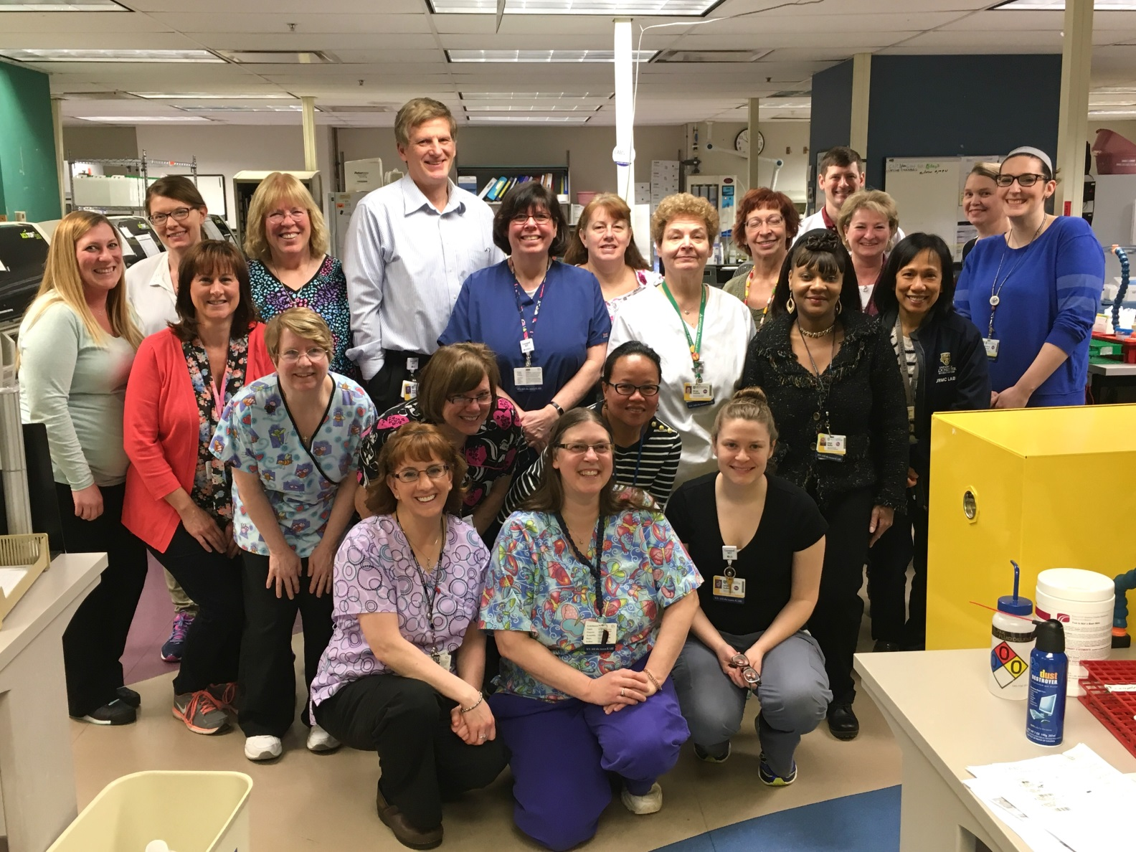
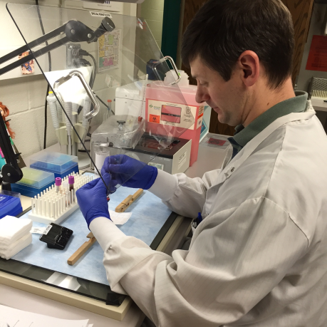
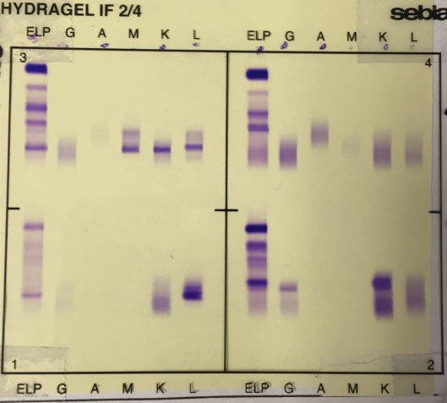
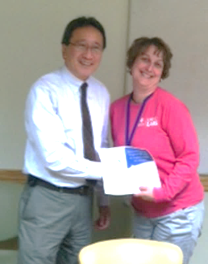
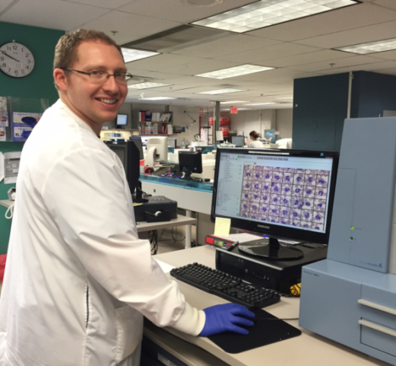
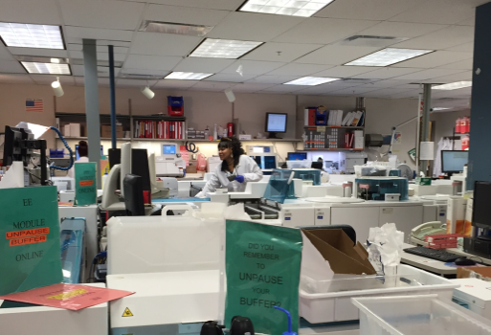
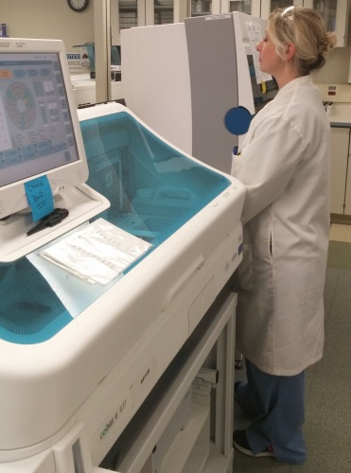
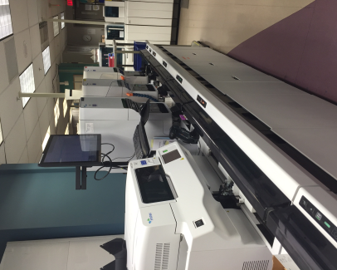
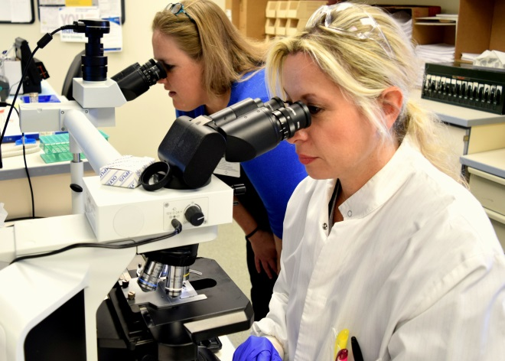
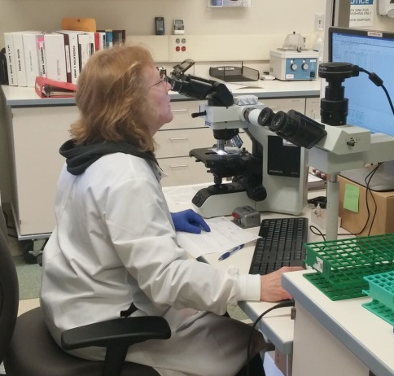
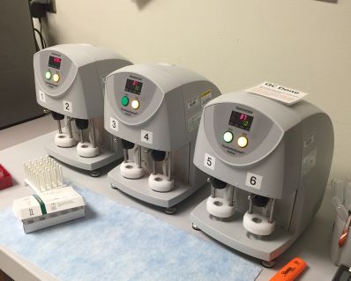
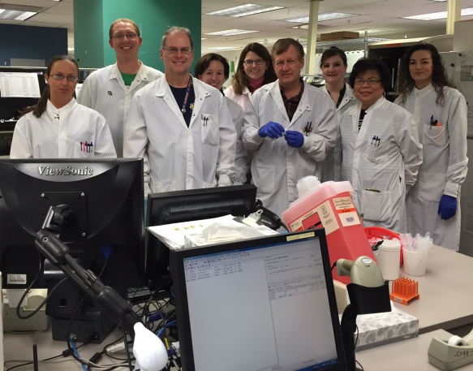
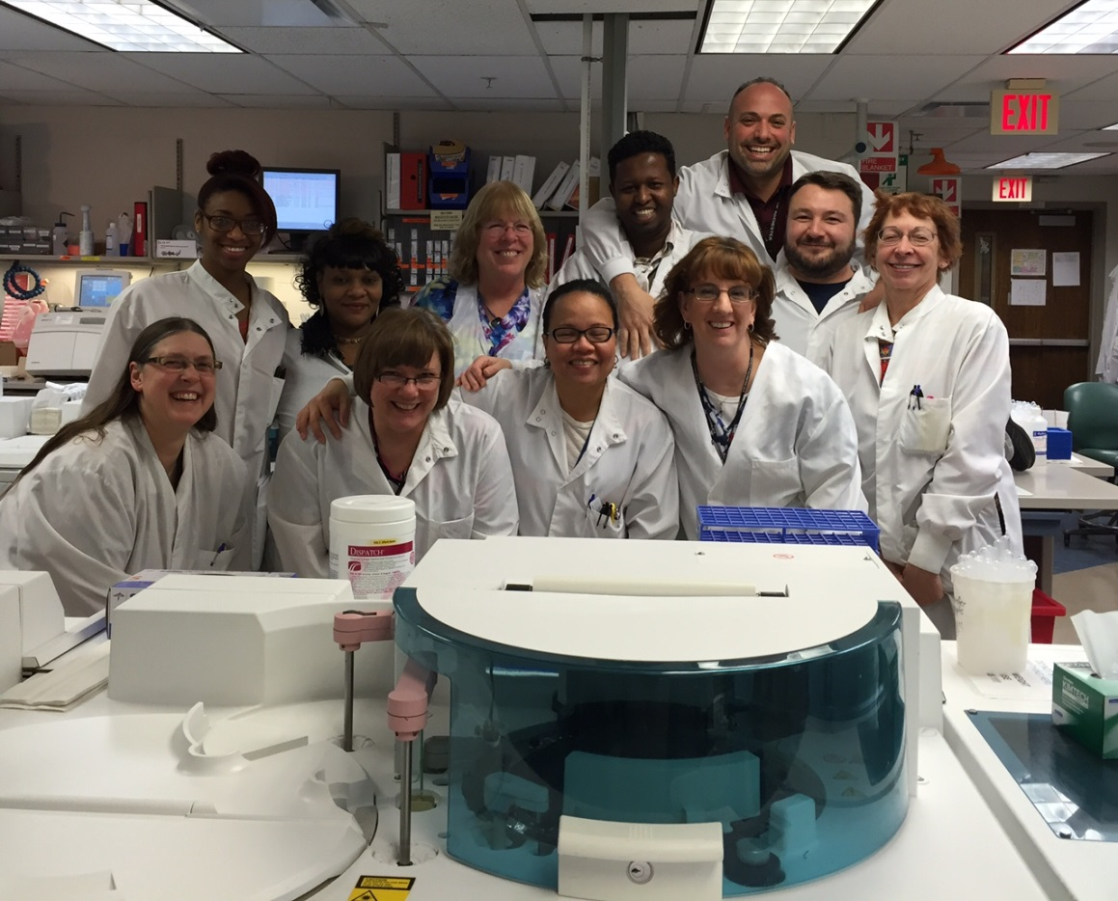
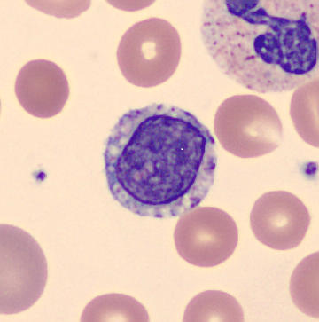
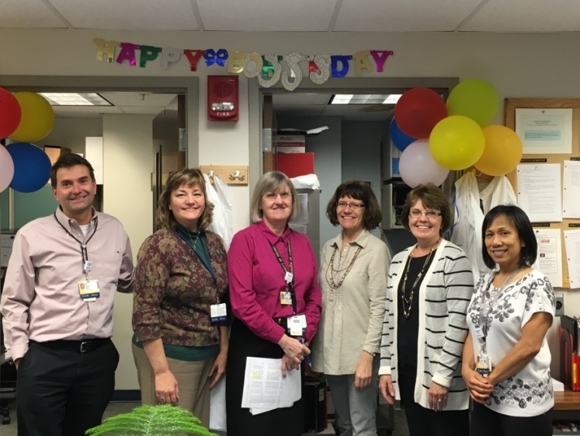

Hematology and Chemistry Laboratory
How We Help Our Patients
(Chemistry)
A patient was admitted to the ED presenting with eyesight trouble and cold blue extremities. Subsequent chemistry results and blood protein analysis contributed to an overall diagnosis of Waldenstrom’s Macroglobulinemia. This disease is a type of cancer that causes an increased amount of a specific protein in the blood. Thanks to the combined work of Chemistry’s main lab and the protein electrophoresis lab, providers were able to deliver the correct diagnosis in time for treatment.
 | Chemistry | Hematology | Strong West
Test types | 82 | 66 | 60
Night Staff | 6 | 7 | 2
Day Staff | 20 | 15 | 3
Evening Staff | 12 | 13 | 2
Lab Bench Assignments | 15 | 13 | 1
Supervisors | 6 | 3 | 1
Faculty | 6 |  | 1
Support Staff | 1
Students Per Year | 41 |  | -
Total Number of Tests Yearly | 6,725,827 | 929,821 | 58,448
(Protein Electrophoresis Gel)
(Special Hematology)
(Stacy Daley accepting
A Strong Star from
Dr. Kwong)
(Day Shift Hematology, Chemistry & Protein Staff)
(Cellavision software used for manual cell review)
(Chemistry analyzers)
(Hematology CBC analyzer)
(Strong West Analyzer)
(Strong West)
(Strong West)
(TEG clot analyzers)
How We Help Our Patients
(Hematology)
While performing a manual review of a blood sample, Geoffrey Harris MT made the careful observation that a young baby in the PICU had unusual white blood cells. The detection of those abnormal cells helped lead to the diagnosis of a rare genetic disorder that gave providers valuable insights to symptoms that would have otherwise been unexplained. Geoff's careful attention to detail in performing his duties in the Hematology Lab not only solved this medical mystery but gave the family answers and closure. This is only one example of the critical work that we do in our laboratories.
(Day and Evening Hematology Staff)
(Abnormal Lymphocyte)
Yearly Combined Test
Number
(Day and Evening Chemistry and Protein Electrophoresis Staff)
7,714,096
(Chemistry and Hematology Supervisory Staff)

