Slide 1
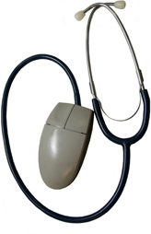
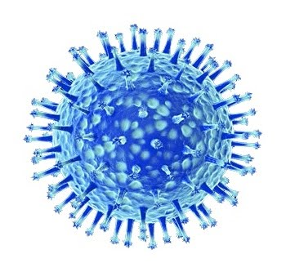
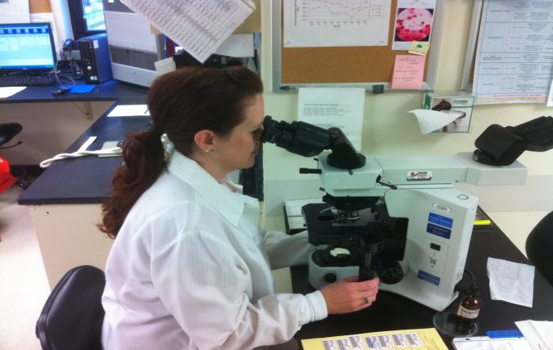
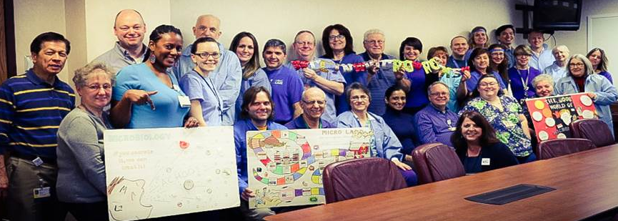
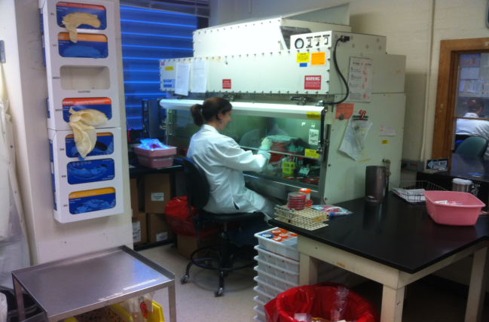
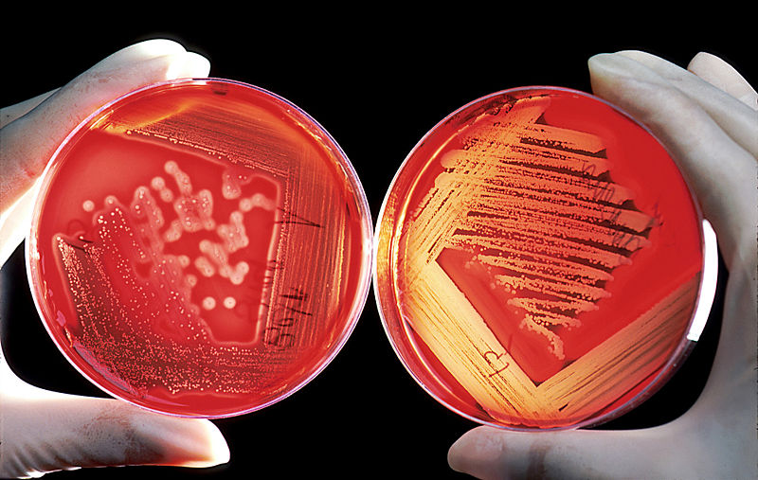
Pathology & Laboratory Medicine Clinical Microbiology
DIRECTORS:
Dr. Dwight J. Hardy & Dr. Marilyn Menegus
CHIEF SUPERVISOR:
Debra Jesien
Micro Specimen Receiving (MSR)
(covering 3 shifts)
16 Clinical Support Tech III
2 Clinical Support Tech IV
1 Supervisor
Bacteriology
(covering 3 shifts)
38 Medical Technologists
8 Tech Specialists
2 Assistant Supervisors
2 Supervisors
Molecular, Immunology & Serology
6 Medical Technologists
5 Transplant Technologists
1 Assistant Supervisor
1 Supervisor
Virology
9 Medical Technologists
1 Supervisor
Working behind the scenes
for patient care, 365 days a year!
How quickly results get to you (upon receipt)
Turn Around Time | Bacteriology | Virology | Molecular Virology | Immunology | Serology
<2 hours | Rapid Strept, C. difficile, Fecal Leukocytes, Fecal Lactoferrin, FLU/RSV & MRSA Amplifications, Antibiotic Levels, Gram Stain, etc. | ED/INPT Stat flu & RSV |  |  | Rapid HIV
24 -48 hours | PCR: Bordetella Pertussis, Mycoplasma & Pneumocystis | VIPER : GC, Chlamydia & Trichomonas HSV & VZV PCR | HCV and CMV Quantitative PCR | Anti-nuclear antibody (ANA) Screening & associated antibody testing (dsDNA, sm/RNP, etc.) Celiac Disease | Hepatitis A, B, & C, Peri-natal Syphilis with Confirmation, HIV with Confirmation, Routine Syphilis, Infectious Mononucleosis, Viral Antibody testing (EBV, CMV, Parvovirus B19), Lyme Disease with Confirmation
2-5 days | Bacterial Culture (Aerobic & Anaerobic) | BK/EBV PCR | HBV and HIV-1 Quantitative PCRs
3 days to 3 weeks | Fungal Culture | Virus Culture
6 weeks | AFB Culture
How we like to have FUN in Micro
Food and Fun Group
Laser Tag
Apple Pumpkin Food Fest
Chocolate and Wine
Bowling

