Slide 1
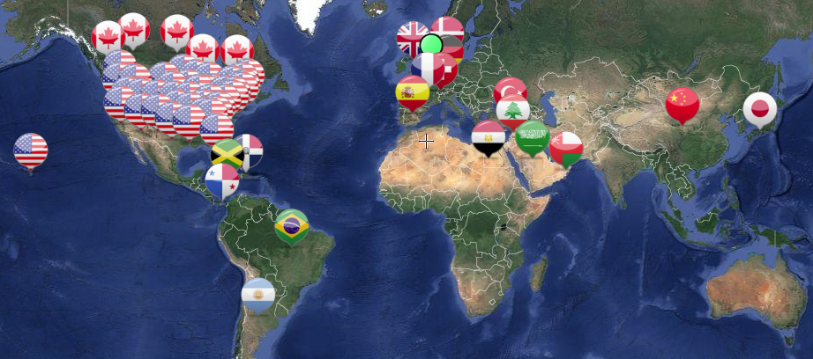
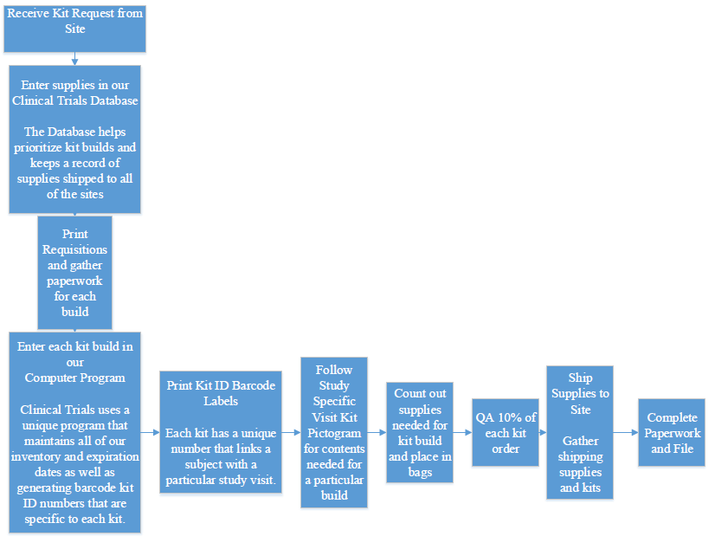
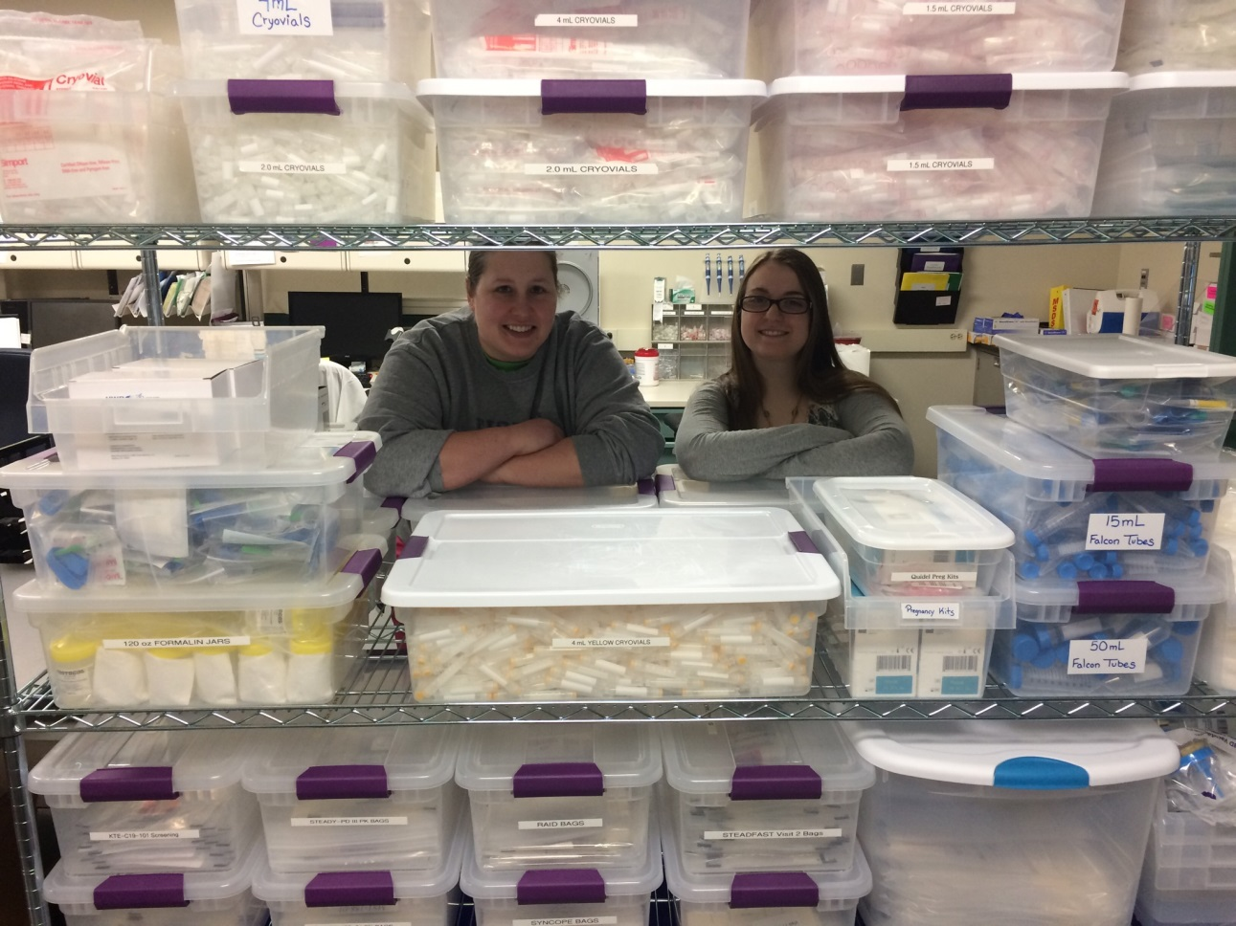
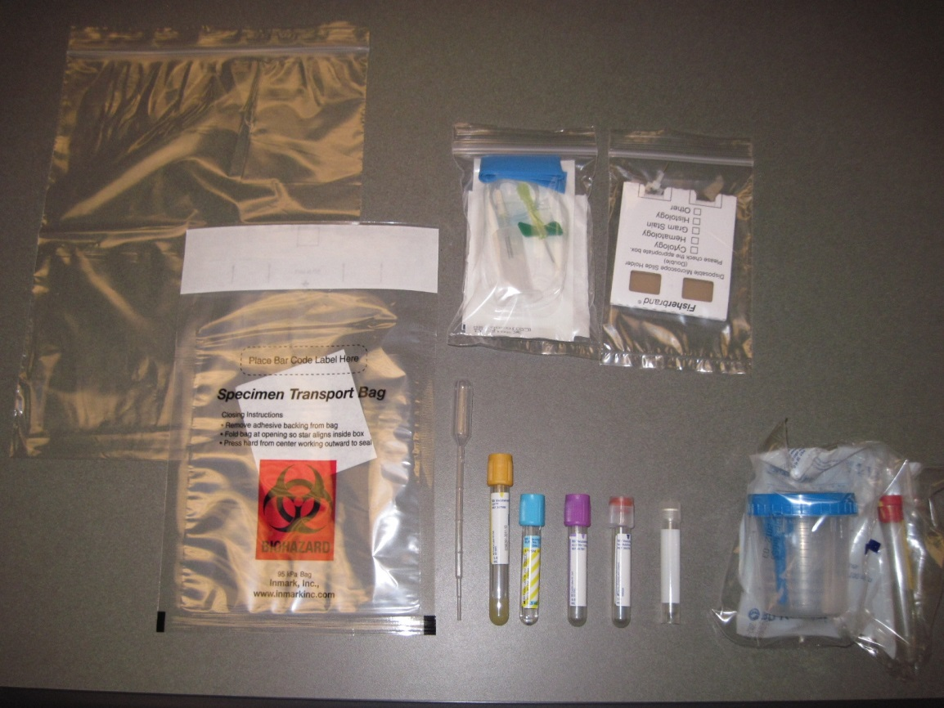
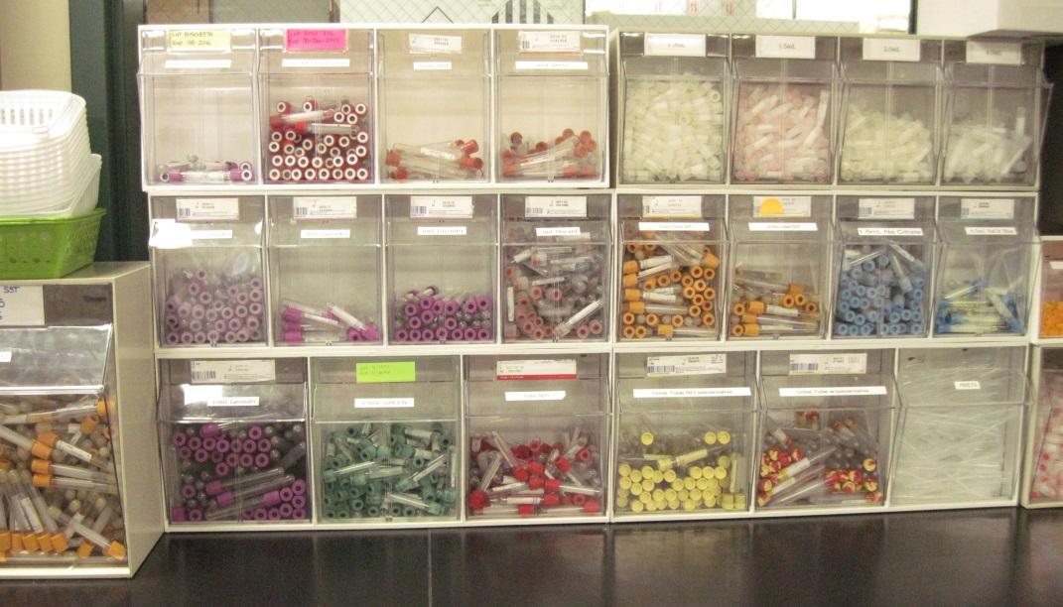
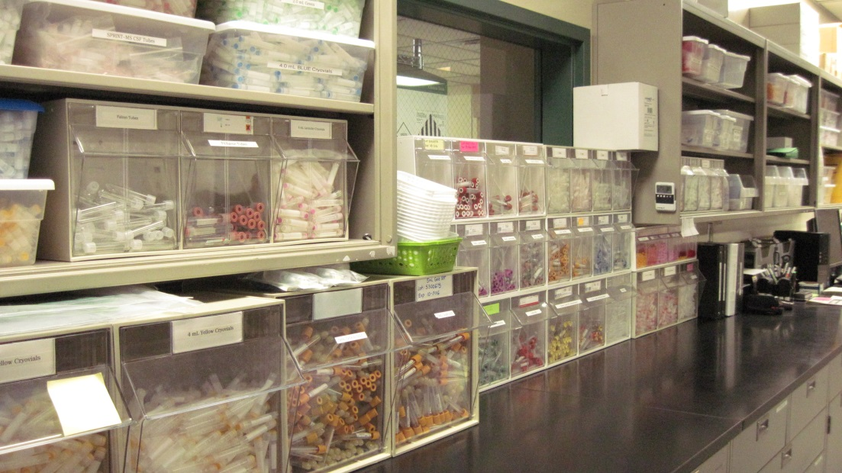
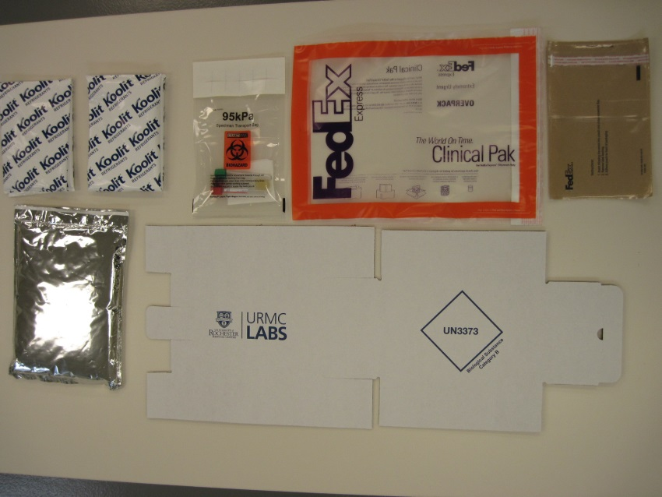
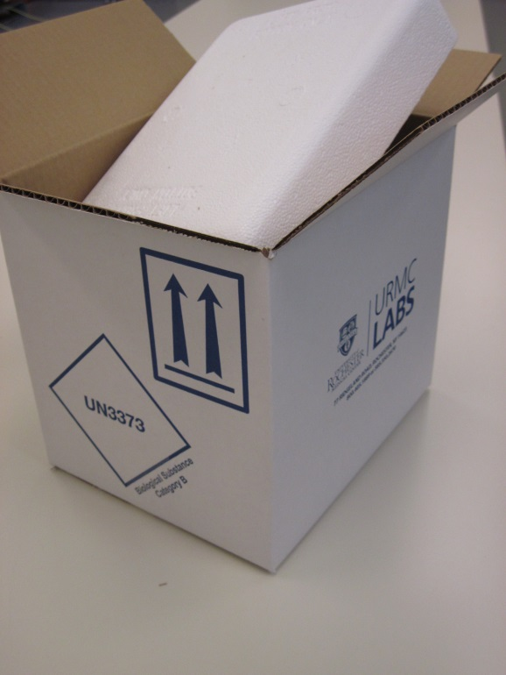

Department of Pathology and Laboratory Medicine
What We Do…
The Clinical Trials Kit Building Department is responsible for creating custom specimen collection kits for multiple research studies across the globe. Our department was created because of the growth of Clinical Trials. We currently have over 2 dozen studies that we manage and we continue to grow every year.
Clinical Trials Kit Building Department
Countries We Ship To…
Process Flow Chart for One Kit Build…
A Glance of supplies we provide…
Vacutainers with various additives
Urine Cups
Blood Draw Kits
Hematology Slide Kits
Pipets
Specimen transport bags
Various sizes of cryovials
Formalin Biopsy Jars
DNA Specialty tubes
Buccal Swabs
We also provide various shipping containers that our sites use to return samples that are either frozen, ambient, or refrigerated.
Canada
Jamaica
Brazil
China
Japan
United Kingdom
Germany
Spain
Argentina
Egypt
Lebanon
Oman
Belgium
France
Panama
Demark
Switzerland
Turkey
Saudi Arabia
Dominican Republic
Cooler
for
Samples
on
Dry Ice
Ambient Shipper Supplies

