Slide 1
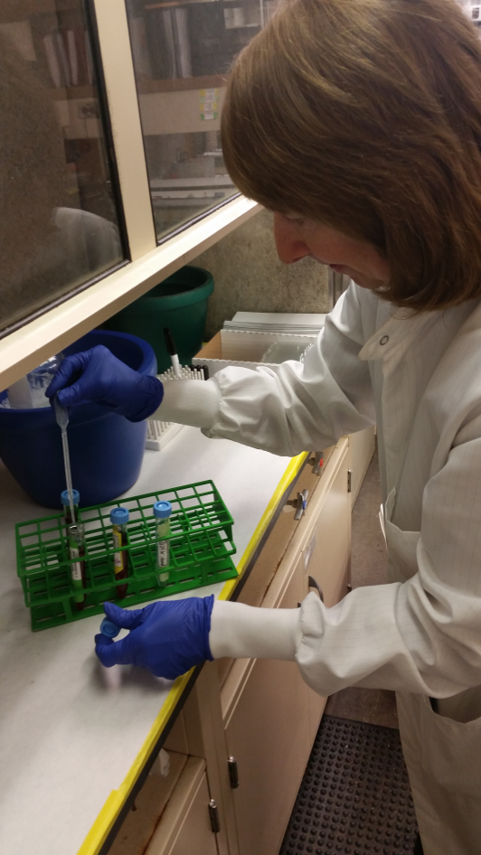
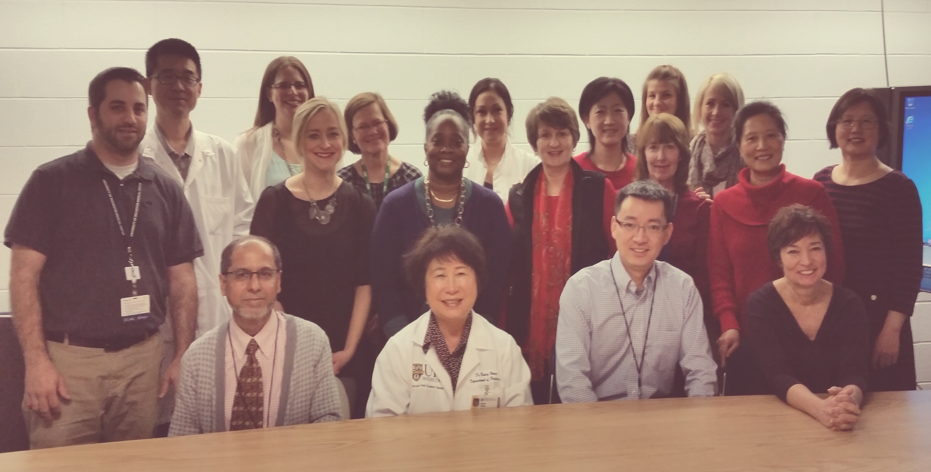
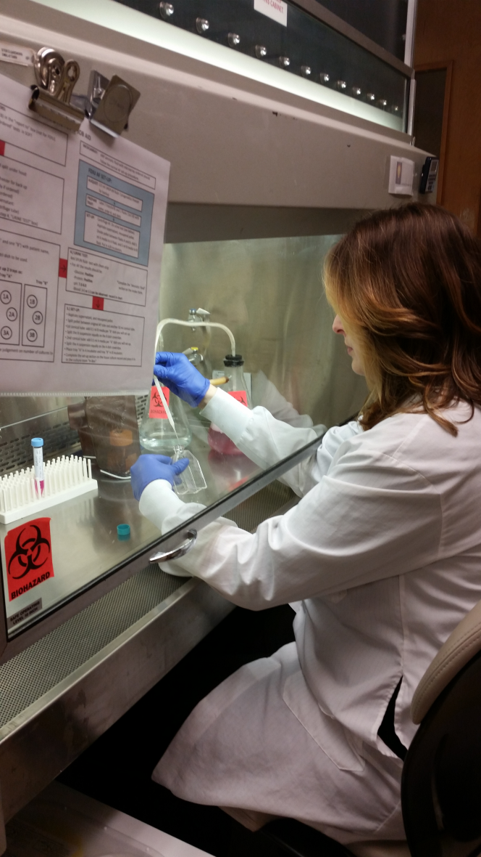
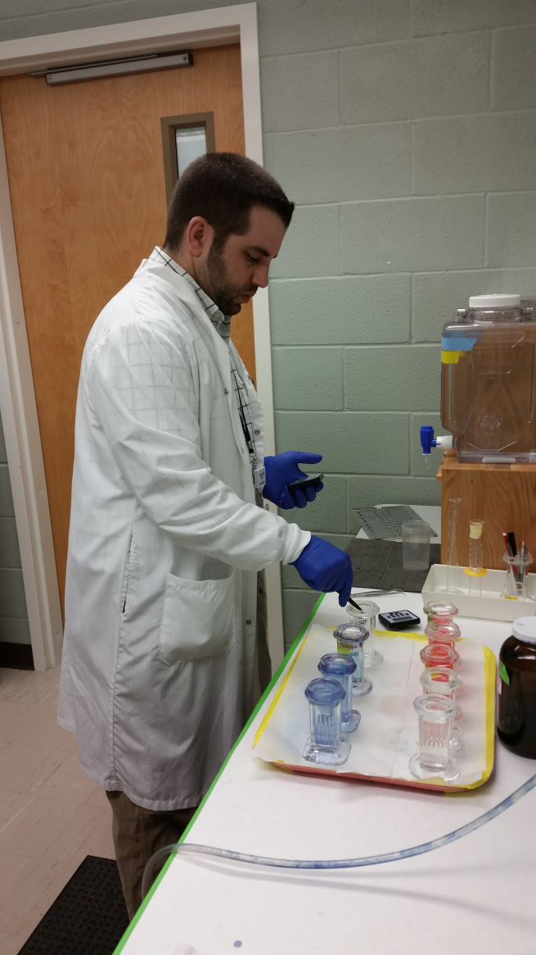
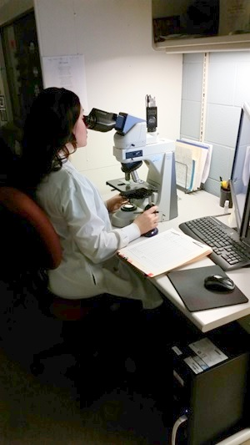
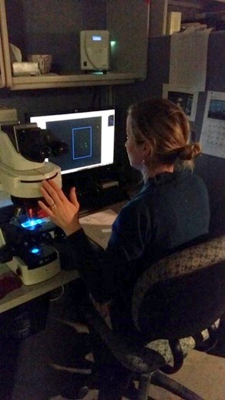
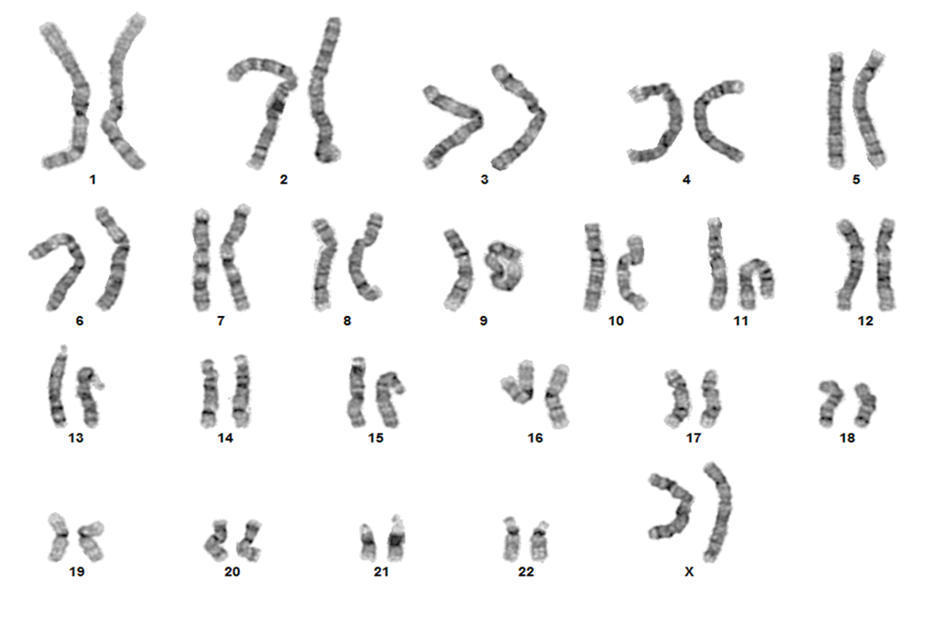
Department of Pathology and Laboratory Medicine Cytogenetics Laboratory
What are the types of samples that we process?
Inherited Bloods
Products of Conception
Amniotic Fluids
Chorionic Villus
Urines/Bladder washes
Bone Marrow/Leukemic Bloods
Formalin Fixed Paraffin Embedded (FFPE) tissue
Solid Tumors
Why is our testing requested?
The two tests that are processed here are G-Banding and FISH. With all of our samples we are looking to see if there is a genetically abnormal karyotype on all patients. A normal karyotype is 46, XX or 46, XY.
Common reasons for Cytogenetics to be ordered on inherited specimens are: infertility, developmental delay, history of spontaneous abortion, abnormal ultrasound, family history or positive non-invasive screening.
Common reasons for Cytogenetics to be ordered on an oncology specimens are: to see if we can find an abnormality that could help the Doctor place the patient on the right treatment regimen, help in diagnosis and prognosis for the patient, and identify clones that will be useful in follow-up as the patient is treated.
Urine is processed to detect bladder cancer.
An example of a normal female karyotype:
Examples of normal cells by FISH:
Left: Female Right: Male
An example of an ALK positive case by FISH:
What are our turnaround times
in 2015?
Products of Conception: 14-21 days
Bloods: Routine 7- 13 days
STATS:(baby blood/pregnant patient) 3 days
Bone Marrow/Leukemic Bloods: 4-14 days STATS:2-3 days
Amniotic Fluids: 6-13 days
Chorionic Villus: 5-10 days
Urines: 4-10 days
FFPE Slides: 2-7 days
Solid Tumors: 14-21 days
Acceptable turnaround times designated by New York State and CAP:
Amniotic Fluid samples: within 14 days
Routine Bloods: within 28 days
Bone Marrow/Leukemic Bloods: within 21 days
Preliminary report for STAT specimens: within 3 days
Final report for STAT specimens: within 7 days
Who are we?
1 Director
1 Associate Director
1 Assistant Director
1 Supervisor
2 Support Staff
12 Medical Technologists

