Slide 1
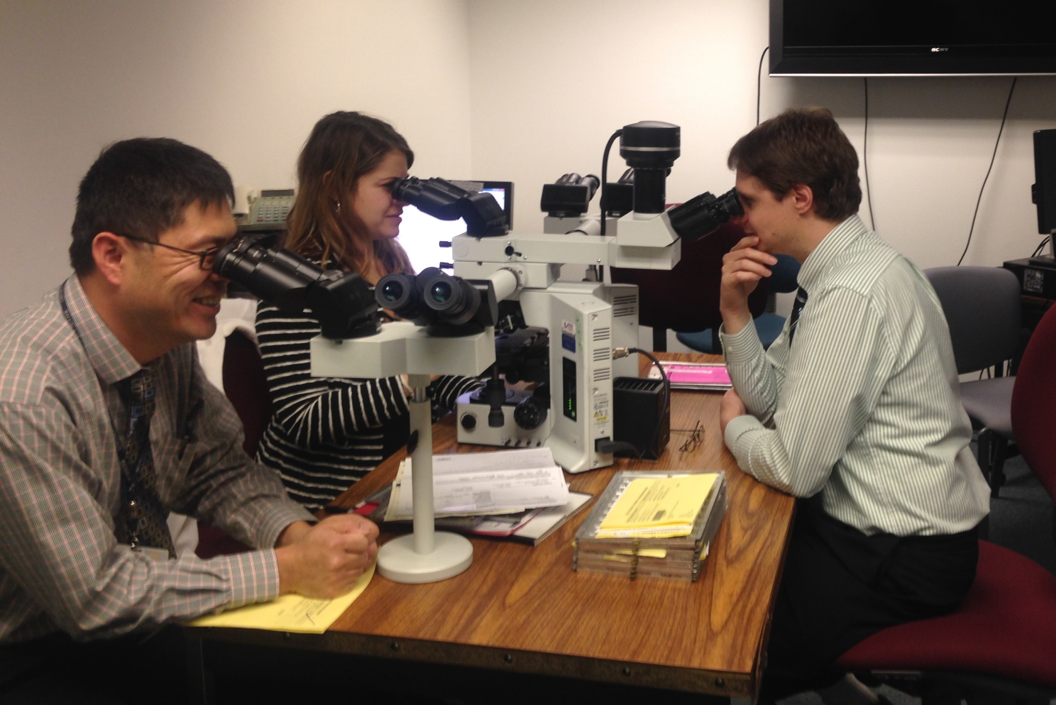
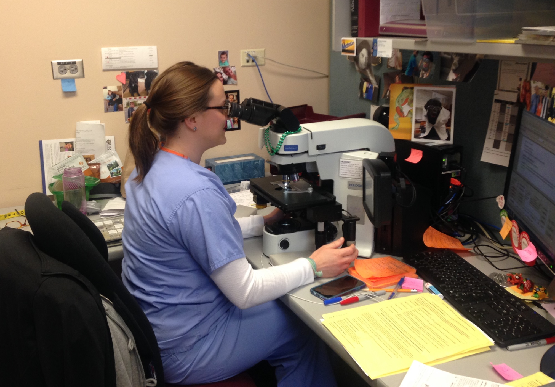
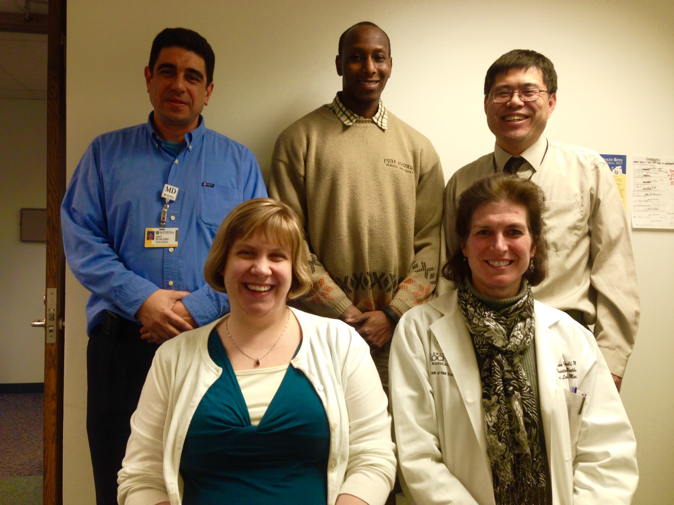
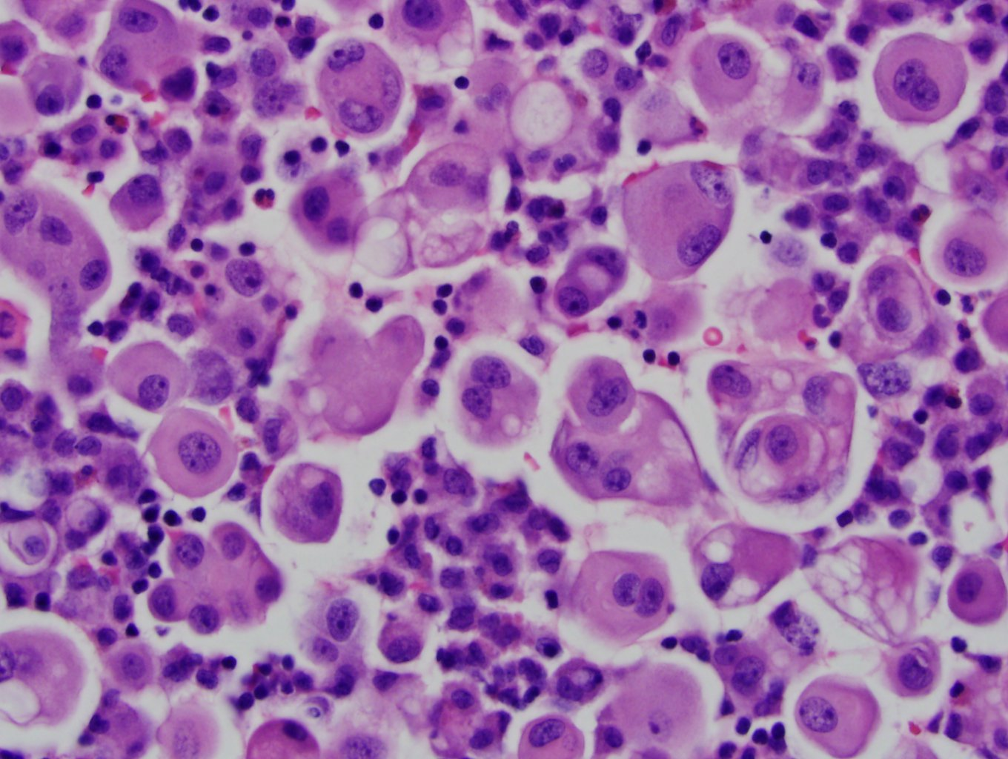
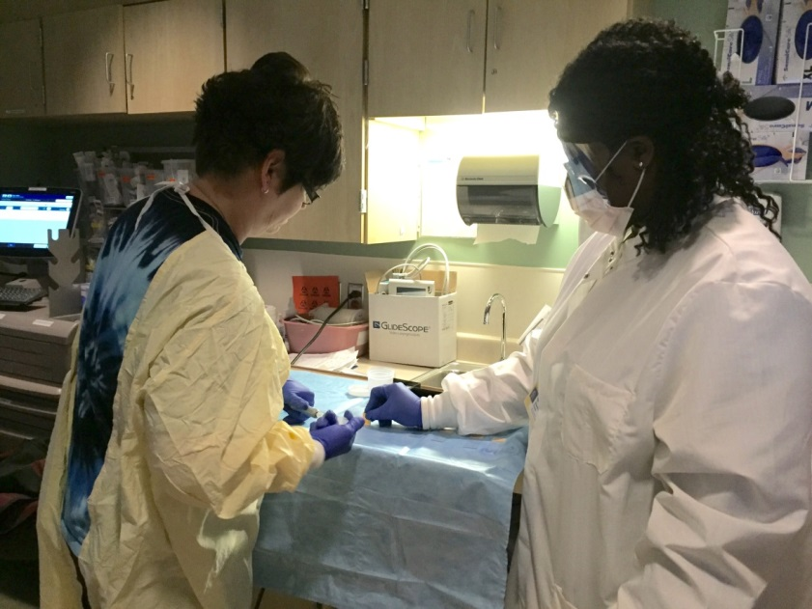
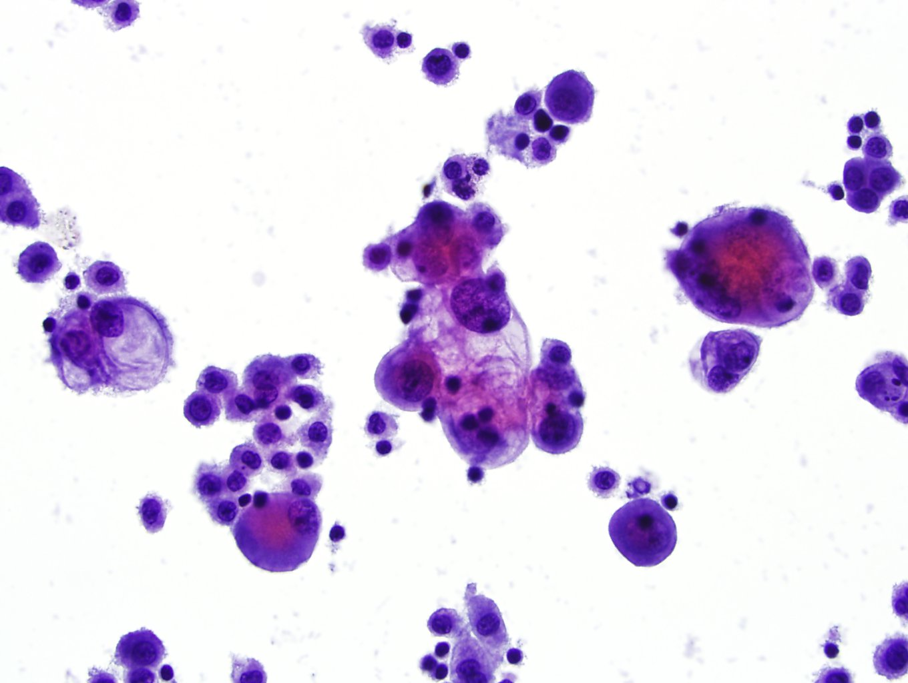
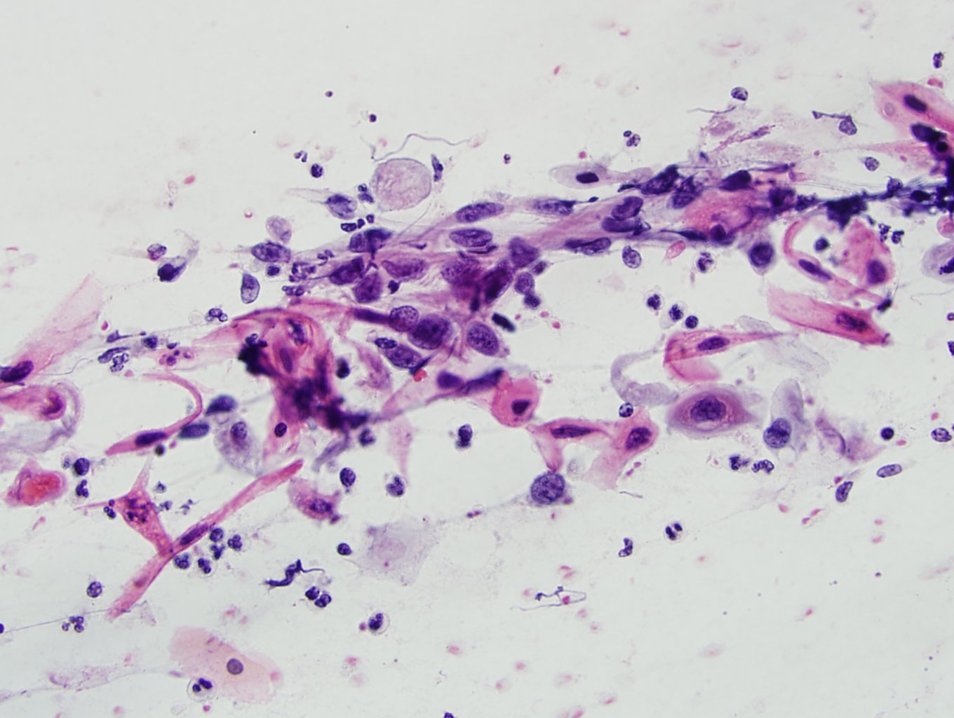
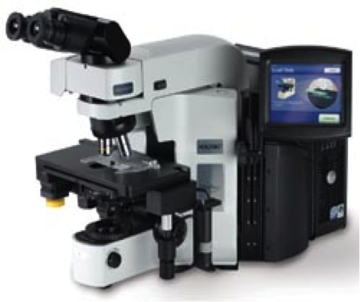
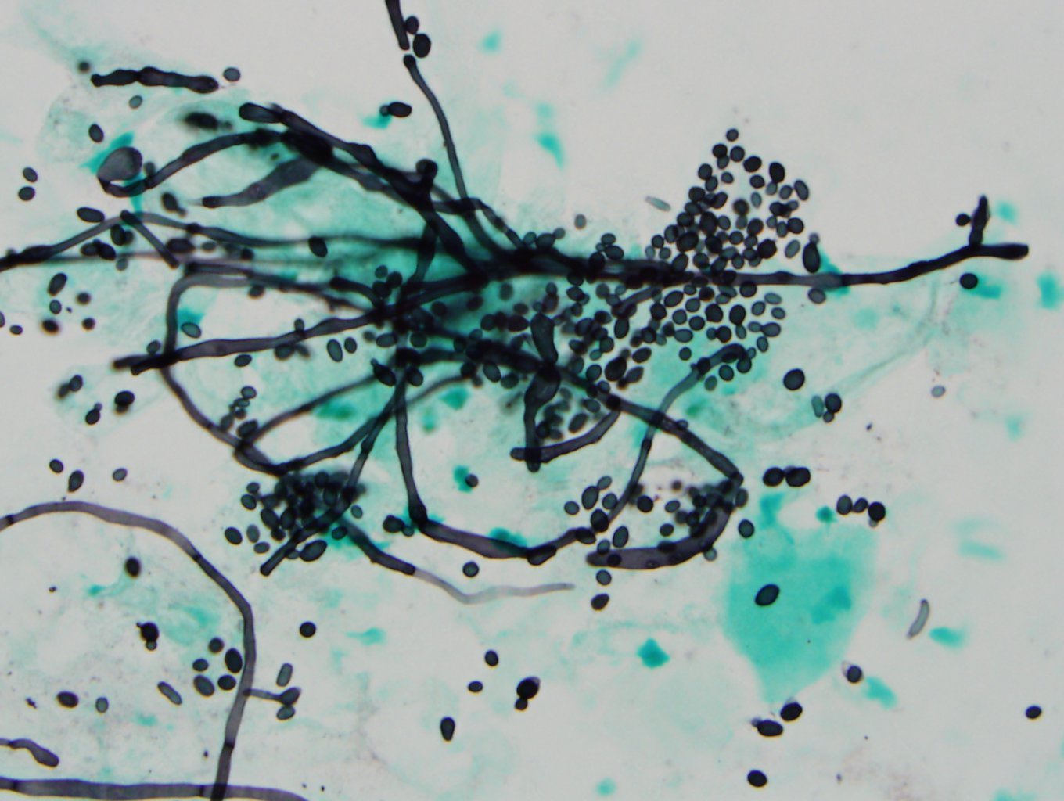
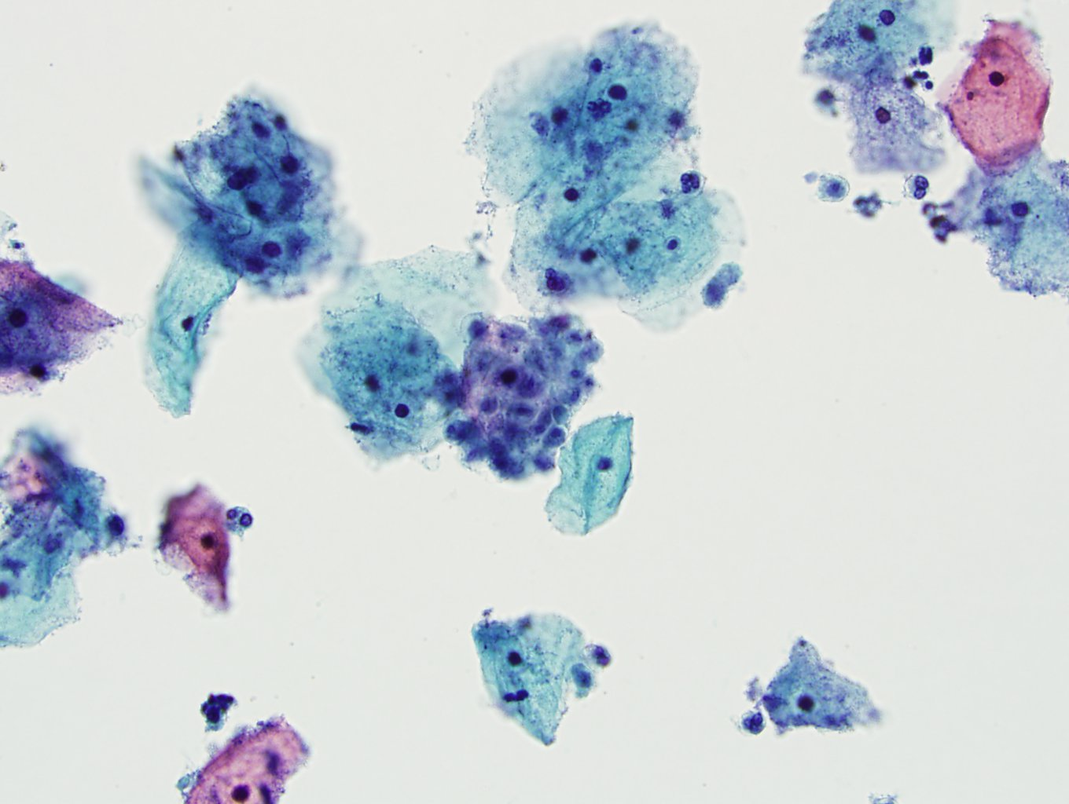
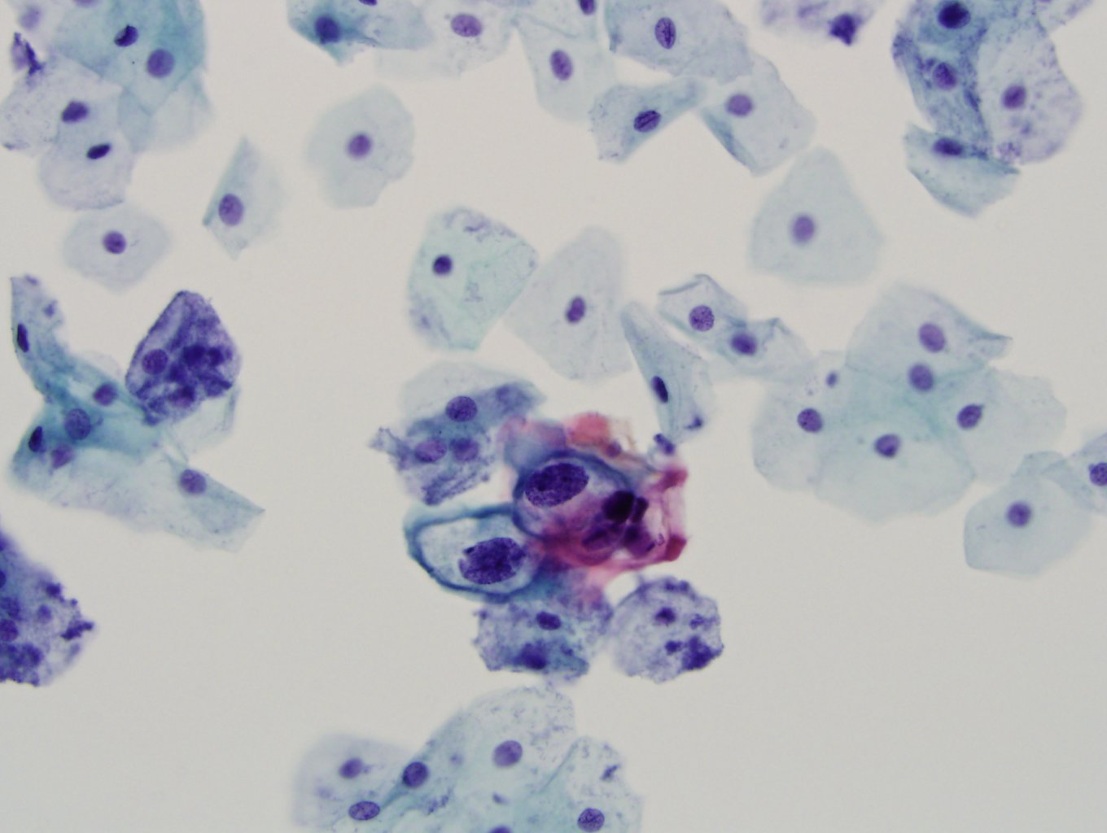
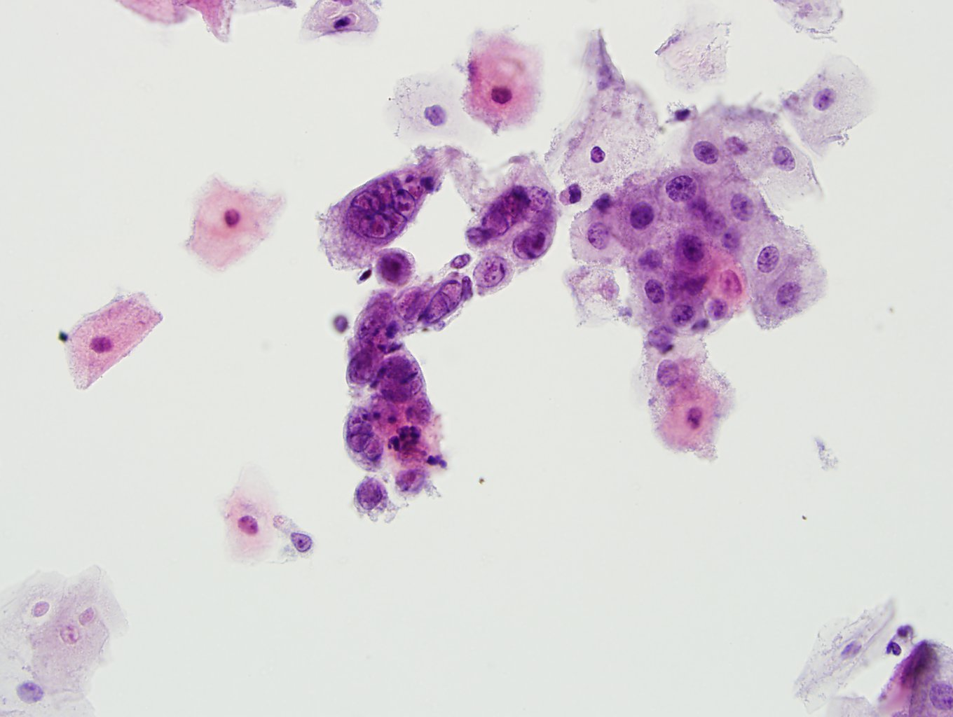
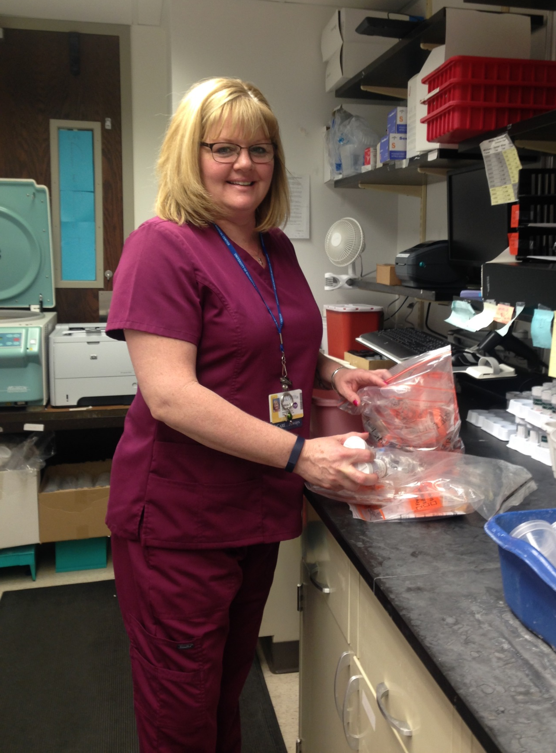
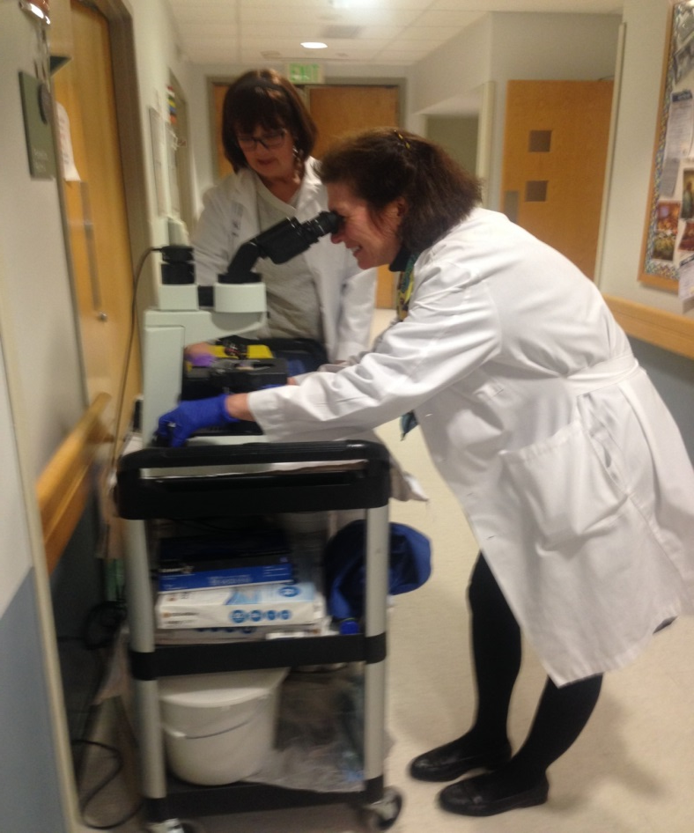
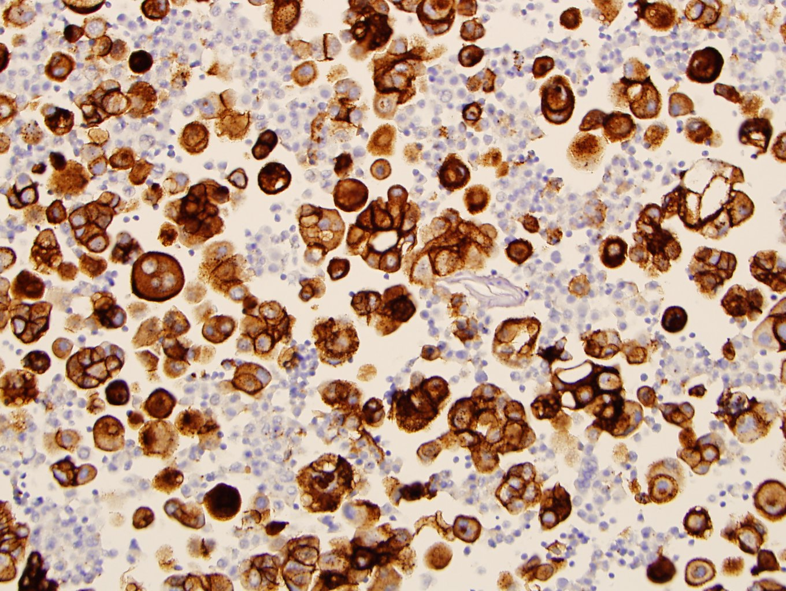
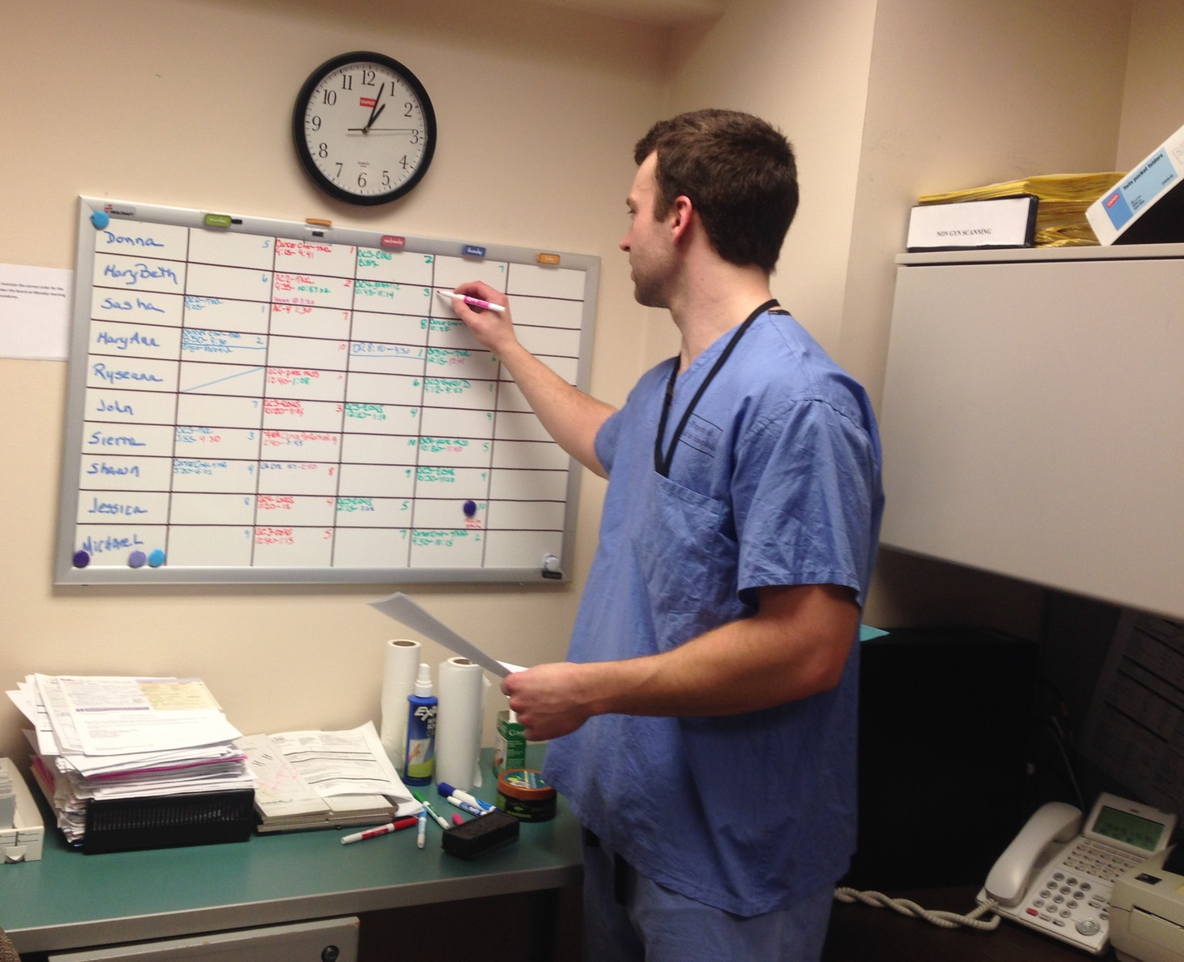
Cytopathology Laboratory
Specimen types we receive:
Pap tests
Anal paps
Cerebrospinal fluids
Pericardial and pleural effusions
Ascites and peritoneal fluids
Ovarian cyst fluids
Pancreatic cyst fluids
Common bile duct brushings
Various urine specimens
Bronchoalveolar lavages and bronchial washings
Breast cyst fluids and nipple discharges
Fine needle aspirations of:
Thyroid
Salivary gland
Lymph node
Lung
Pancreas
Liver
Stomach
Adrenal
Bone
Kidney
Soft tissue
Who we are:
We are a group of laboratory professionals that specialize in the microscopic analysis of cellular material. The laboratory employs 7 cytopathologists, 10 cytotechnologists, 3 preparatory technicians, 1 cytopathology fellow, and dedicated support staff members managed by SMS.
We can be reached:
Monday-Friday:8 A. M. - 5 P.M. at (585) 275-5656 (option 1)
Weekends: On-call cytotechnologist available via SMH pager system
What we do:
Our team is responsible for the preparation and diagnosis of Pap tests (GYN) and patient specimens from other body sites (NON-GYN). We screen all specimens for infections, disease processes, and malignancies. Negative Pap tests are signed out by cytotechnologists. Positive Pap tests and all NON-GYN specimens are signed out by cytopathologists.
Within the hospital, we offer immediate assessments for fine needle aspiration (FNA) procedures collected by our pathologists or from our clinical colleagues. Immediate assessments are performed for specimen adequacy and preliminary interpretation which often alleviates the need for surgery. Additionally, our FNA specimens are triaged to appropriate ancillary studies. Ancillary tests we can recommend:
Flow cytometry
Molecular testing (BRAF, EGFR and ALK-1)
Placement of fiducial markers for treatment purposes
FISH
IHC
Cytogenetics
Adenocarcinoma
(cancer / cell block)
Adenocarcinoma
(cancer)
Squamous Cell
Carcinoma
(cancer)
Trichomonas
Infection
Yeast
Infection
Our comprehensive triaging is important because it limits the number of procedures a patient undergoes for specimen collection, and it shortens the time between the patient’s specimen collection and initial treatment.
Human Papilloma Virus
(HPV)
Herpes Simplex II Virus
Immunohistochemical Stain
(cell block)
2015
Total Specimens
63,678

