Slide 1
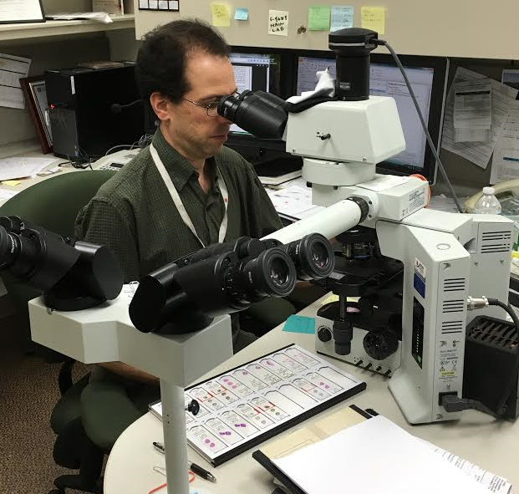
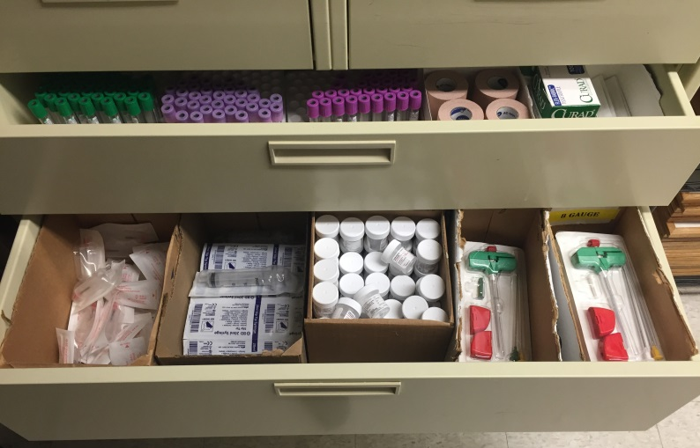
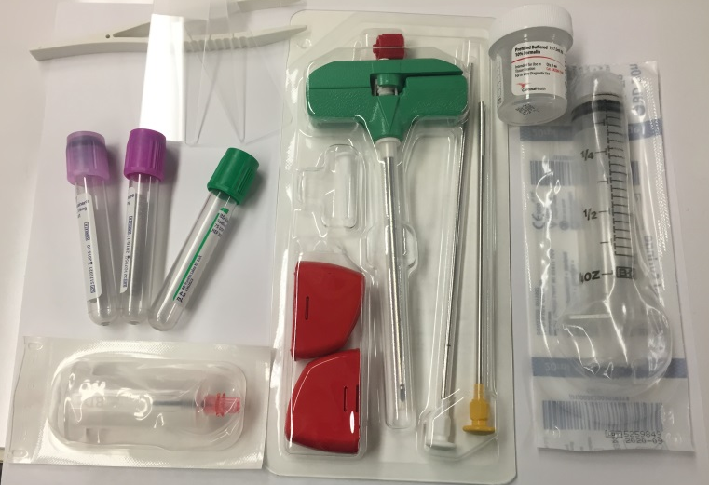
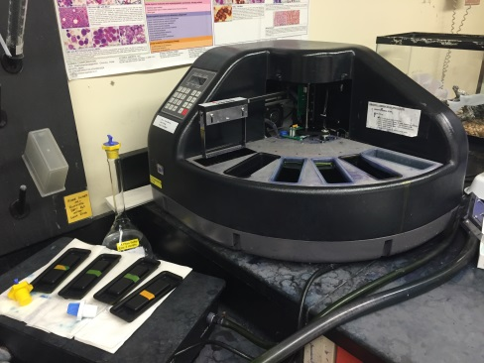
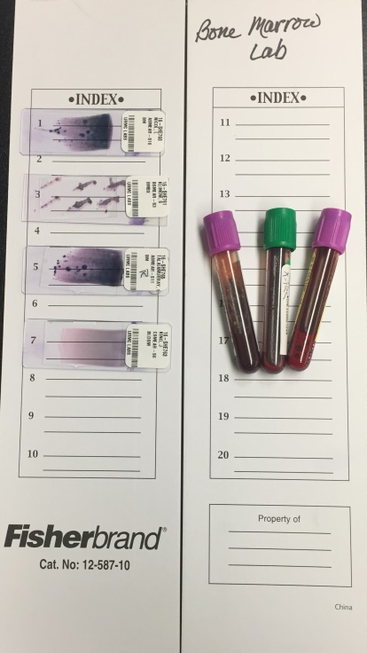
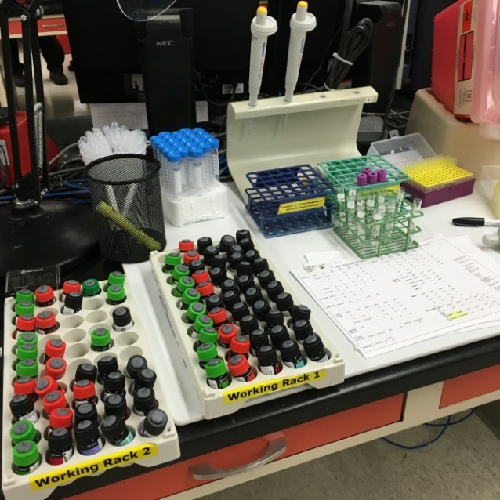
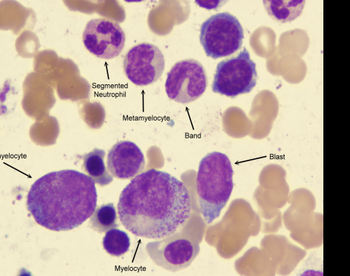
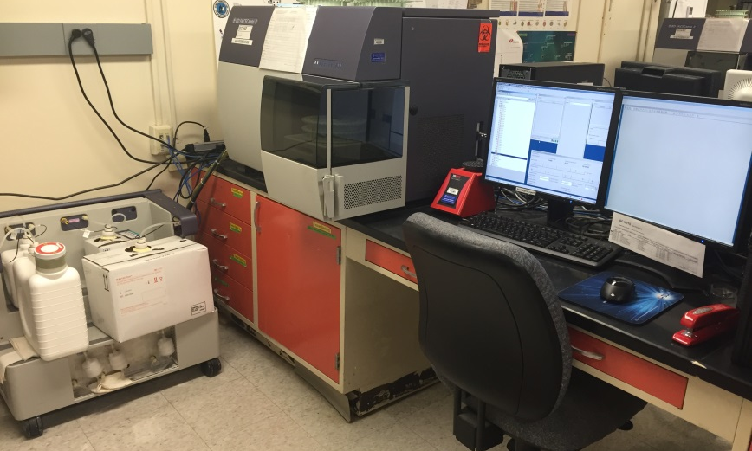
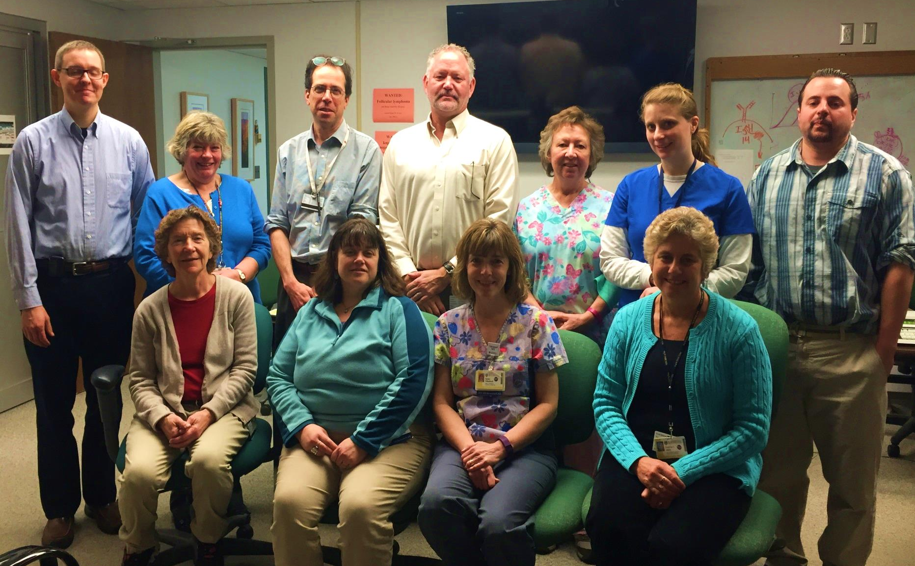
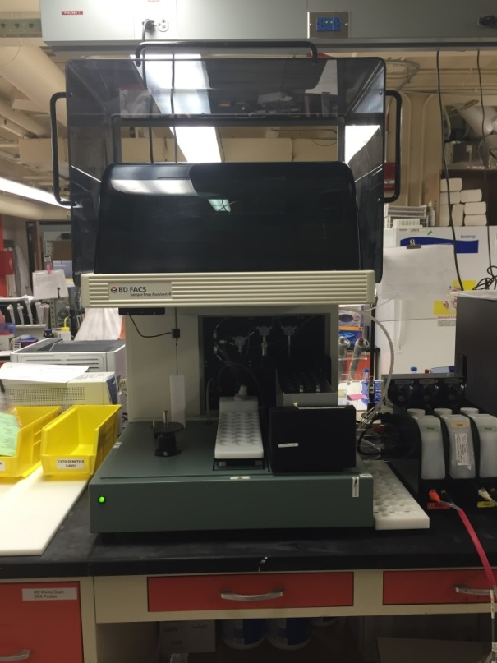
Follow a Bone Marrow from collection to diagnosis
After collection, the technologists return to the laboratory where they accession and process sample for review by the Hematopathologist.
The Medical technologists manually stain all flow cytometry samples. Flow Cytometry panels are created to help screen for a variety of hematopoietic diseases.
….of a flow cytometer. The Flow cytometer uses cell size and complexity to divide cells into different populations. The fluorescent stains allow for the identification of Lymphoma, Leukemia and other diseases.
The Hematopathologist , using slides and patient history orders appropriate flow cytometry testing on Bone Marrow samples. .
The red and blue lasers excite stained cells and direct them to the appropriate detector….
The staff of the Bone Marrow lab assist in most of the Bone Marrow biopsies performed at UR Medicine. The technologists travel to the site of the procedure and bring the majority of the supplies needed. They help ensure that a quality specimen has been collected and make slides at the bedside.
In addition to Bone Marrow, the laboratory also processes lymph nodes, spleen, blood, body fluids, solid tumor cells, fine needle aspirates and CSF. They also aid the Stem Cell Lab in work up of Hematopoietic Stem Cell collections from Bone Marrow Donors for Transplant .
Flow Cytometry and Bone Marrow Workload
January-December 2015
AML
(Acute Myelogenous Leukemia)
Laboratory Testing | Total tests
T&B cell Lymphocyte Subset | 4000
CD34 Stem Cell | 525
Bone Marrow biopsies | 1250
Lymphoma/Leukemia Workups (Flow Cytometry) | 2650
Consult Cases | 800
Top Row (L-R) Dr. Andrew Evans, Judy Miller, Dr. Richard Burack, Brian Smith, Roberta Thayer, Melissa Martin, Dr. Chad Hudson.
Bottom Row (L-R) Nancy Halstead, Libby Miller, Sue Polochock, Pat Leary.
Not pictured: Dr. Arch Perkins, Dr. John Bennett, and Sue Martin
CLL
(Chronic Lymphocytic Lymphoma/Leukemia)
SPA
The SPA (sample prep assistant) enables walkaway sample preparation of LMH3 samples for flow cytometry.
T&B cell subset testing (LMH3) aids in the treatment of HIV and post solid organ transplant patients.
The Flow Cytometry/Bone Marrow lab consists of an integrated team of 4 Hematopathologists,1 Supervisor, 2 Medical Technologist Specialists, 5 Medical Technologists, 1 Support Tech, and a rotation of Hematopathology Fellows and Pathology Residents. The Laboratory is highly interactive with the Wilmot Cancer Center, Adult and Pediatric Bone Marrow Transplant Services and Pediatric Hematology and Oncology.
Located 2-3655
Hours of Operation:
8am-6pm M-F
8am-5pm Saturday
Flow Cytometry/ Bone Marrow Laboratory
Department of Pathology and Laboratory Medicine

