Slide 1



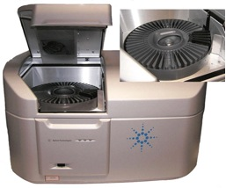
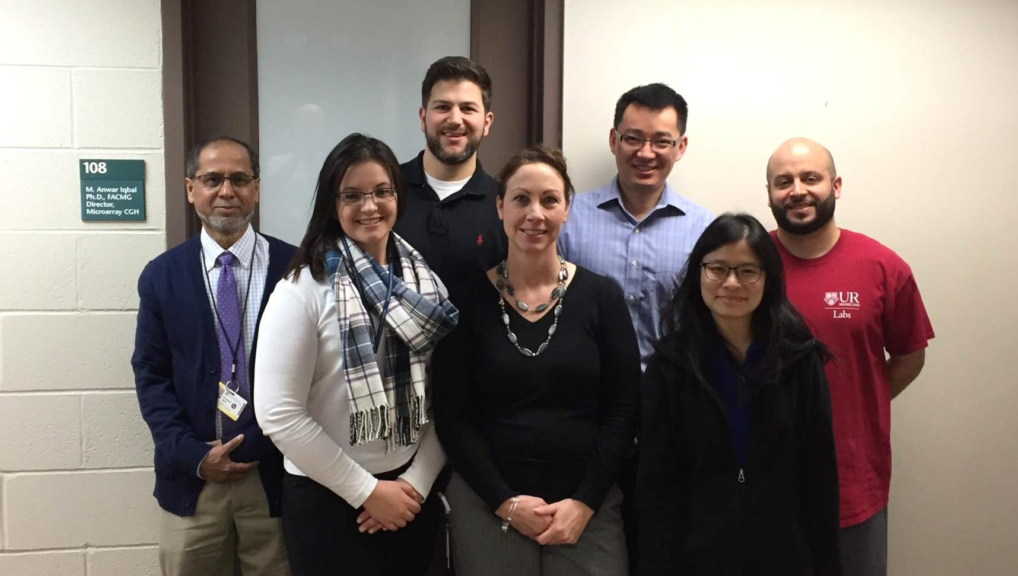
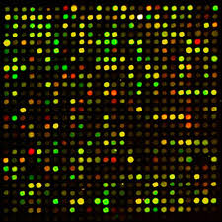
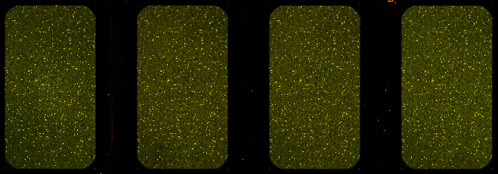



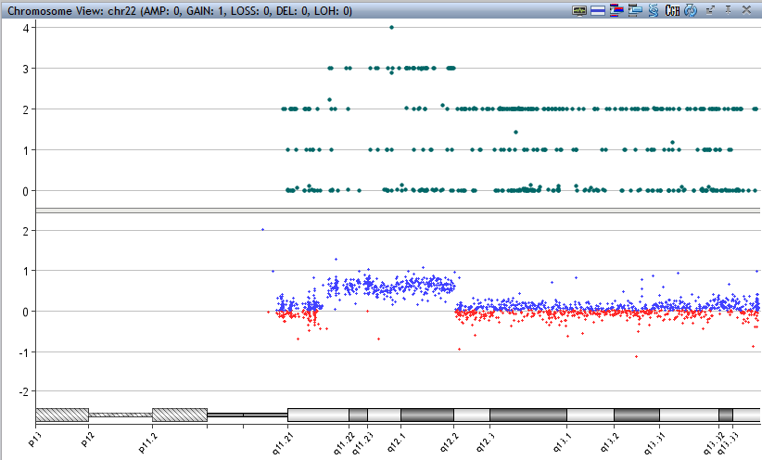
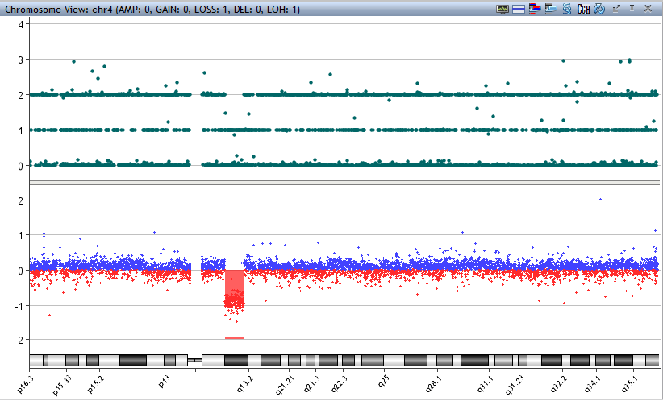
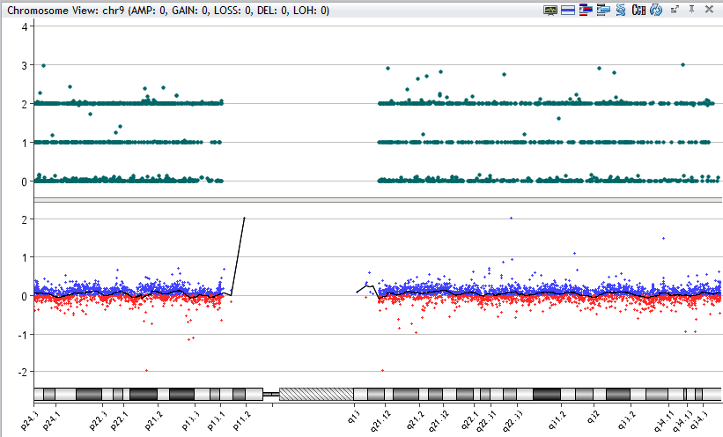
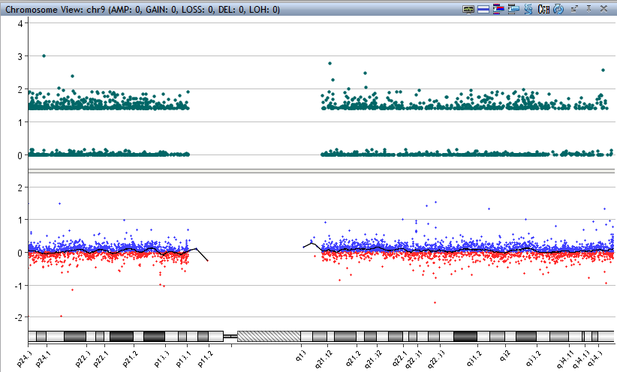
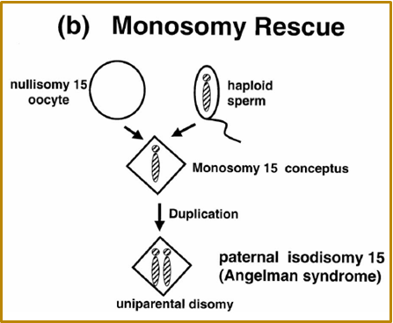
Microarray Laboratory
The Microarray Laboratory is the only NYS-certified clinical lab in the area that provides genetic testing in relation to prenatal, postnatal and cancer patients.
What is microarray : Testing patient DNA against control DNA to identify pathogenic microduplications and/or microdeletions in the patient’s genome.
Our Hours and TAT:
7.30am – 5.30pm M-F
Normal : 14 business days
Normal STAT : 7 business days
Abnormal : 28 business days
Abnormal STAT : 21 business days
What we need: A minimum of 1ml peripheral blood or bone marrow in EDTA at room temp. POC Tissue or cultured cells from tissue, CVS or AF which the Cytogenetics laboratory cultures for us. FFPE sections are also accepted.
Why it’s ordered:
Constitutional Cases: An abnormal prenatal screen, congenital anomalies, developmental delay or unknown clinical diagnosis in children.
Cancer Cases: MDS, Cytopenia and other cancer types
What is involved:
Extraction of 1 DNA – about 1.5 hours
DNA prepared for microarray chip – about 8 hours
*4 patients are needed per microarray chip
Hybridization of DNA on chip – 40 hours
Analysis of patients – about 1 day
Confirmatory testing – 2 – 4 weeks
Final review & sign out – about 0.5 day
When it’s ordered: Clinicians and genetic counselors send us samples to rule out genomic abnormalities
Who we are: A Laboratory Director, an Assistant Professor, and five NYS certified Medical Technologists.
What’s the outcome: Provide patients and families answers and a direction for treatment.
The following two figures have normal karyotypes.
Figure A is an example of normal genome.
Figure B exhibits Uniparental Disomy (UPD) with the utilization of SNP analysis.
Platform used: 4X180K SNP+CGH by Agilent Technologies.
Other things we do: Clean up for Earth Day,
supported fund raising for Golisano Children’s Hospital.
Where we’re located: Ridgeland Road
Microduplication
Microdeletion
A - Normal
B - UPD

