Slide 1
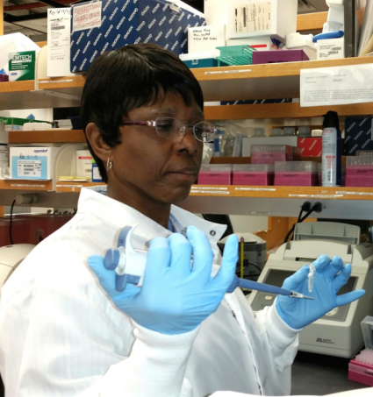
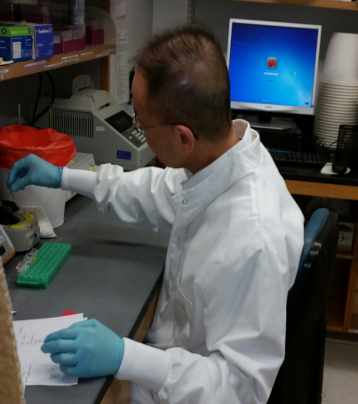
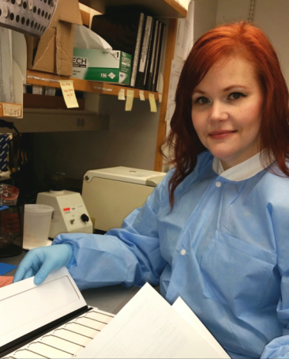
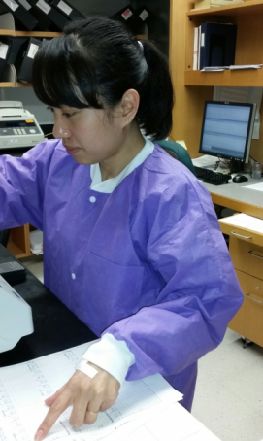
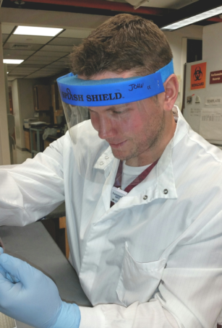
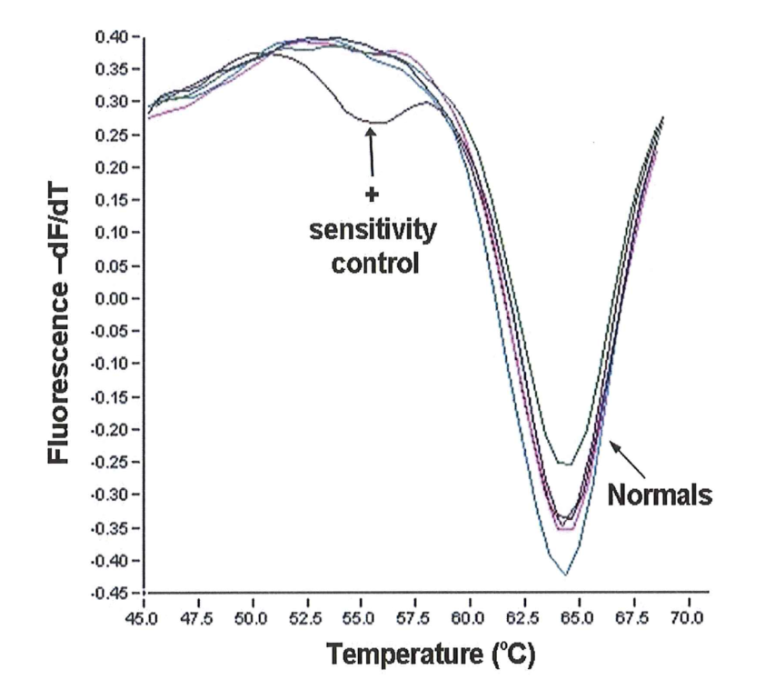
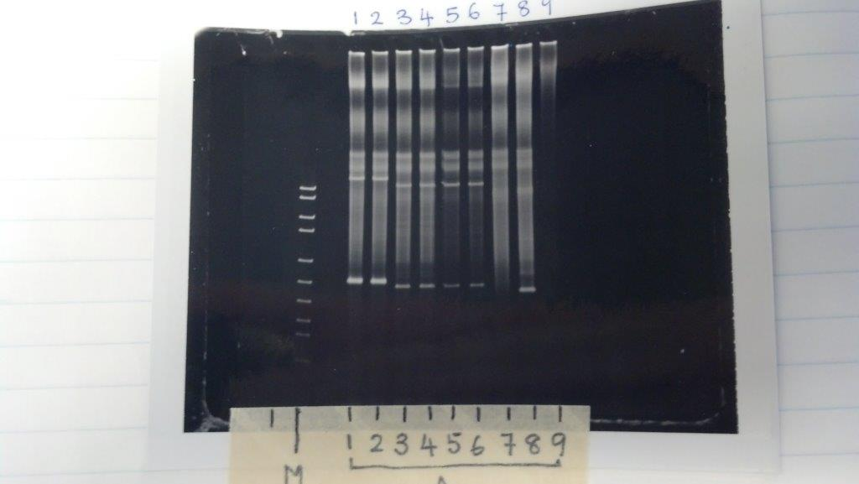
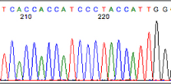
Molecular Diagnostics Laboratory Department of Pathology and Laboratory Medicine
What is Molecular Diagnostics?
How Do We Help Our Patients?
Molecular Team
Molecular diagnostic testing is used to diagnose and monitor oncological and genetic diseases. It helps determine risk and prognosis. By analyzing the individual's genetic code and how their cells express their genes as proteins, molecular diagnostics allows for personalized medicine .
Bone Marrow Transplants: Molecular diagnostics plays a large role in stem cell transplants by determining whose cells are populating the bone marrow post transplant (donor or recipient?) This difference helps the treatment team determine the next steps for a successful transplant.
Oncology: Molecular testing can diagnose and help guide therapy for patients with all varieties of cancer (lung, colon, brain, skin, blood, etc.)
Genetics: There are certain genetic mutations that are risk factors for bleeding and iron overload disorders. Molecular diagnostics can help determine if the patient has the mutation and the likelihood the patient will develop the disease.
How Is DNA Analyzed?
DNA is first extracted from the blood, bone marrow, or tissue samples. The polymerase chain reaction (PCR) is the technique used for the amplification of DNA to make millions of replicates of a target DNA sequence. Specific mutations which can be associated with certain diseases are detected once the DNA is amplified.
Top: Dr. Paul Rothberg, Bonnie Nuccie
Middle: Sharon, Todd, Nufatt, Paige
Bottom: Suni, Yanyun, Bill, John
Post PCR gel electrophoresis
Real time PCR of the KRAS gene
DNA sequencing analysis

