Slide 1
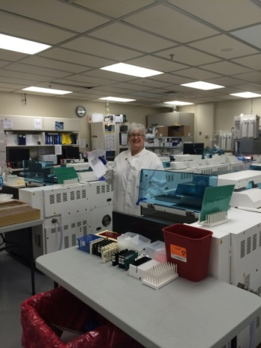
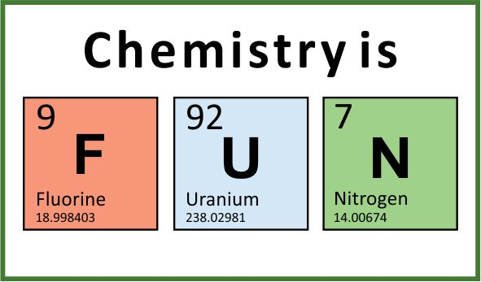
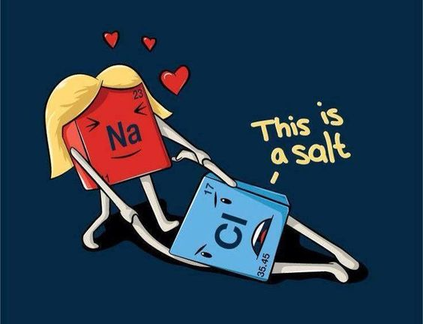
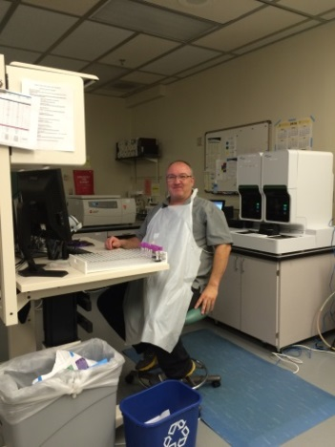
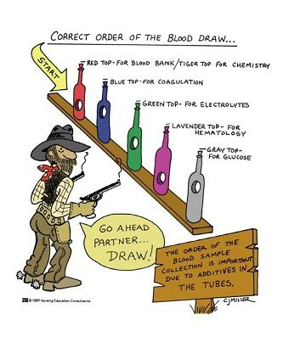
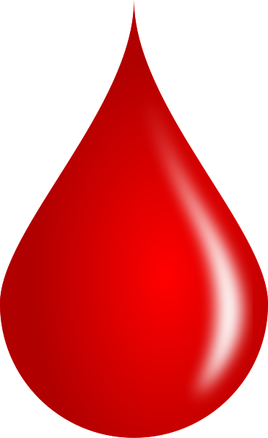
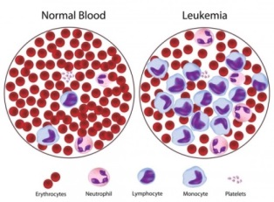
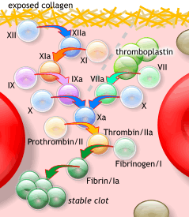
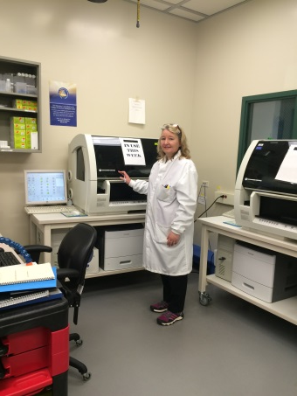
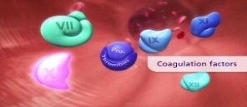
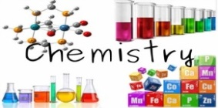
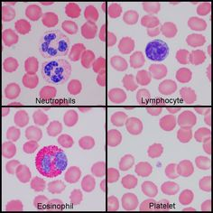
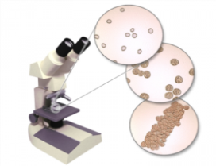
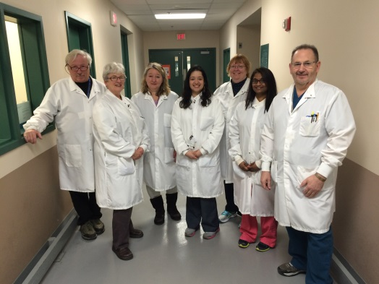
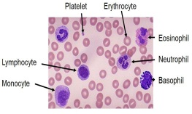

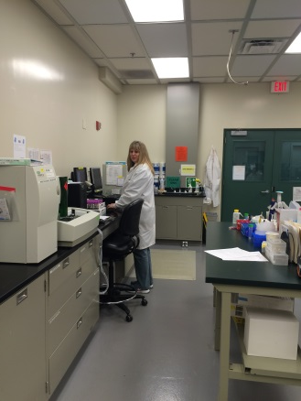

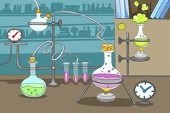
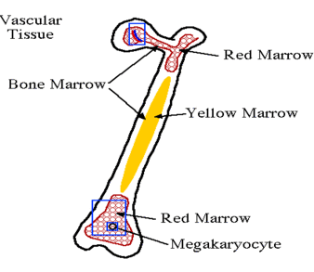
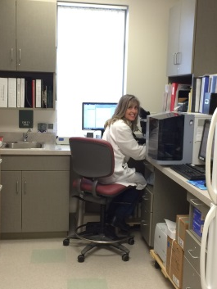

UR Medicine at Ridgeland Road Clinical Trials Central Laboratory
Our Team
14 staff members:
Medical Director, James Corsetti, MD, PhD
1 Secretary.
1 Administrator.
1 Asst. Supervisor .
11 Med. Technologists.
Chemistry
In the Chemistry section of the lab, blood and other body fluids are tested for chemical substances that are released from body tissues or are produced during the breakdown of certain substances. The laboratory is under the Associate Directorship of Tai Kwong, PhD.
Examples of Chemistry tests include cholesterol for risk of heart disease, glucose to monitor diabetes and thyroxine to monitor the thyroid gland.
Hematology &
Coagulation
Clinical Trials
The Hematology section of the lab analyzes the amount and function of blood cells and plasma. Examples of Hematology tests include the Complete Blood Count (CBC) that tells the doctor how many cells of each type are in your blood.
HbA1c is the test that helps to diagnose diabetes and prediabetes .
In the Coagulation section we run the prothrombin time (PT) test that is used to monitor patients on the drug Coumadin.
Activated Partial thromboplastin time (aPTT) is a test that measures the time it takes your blood to clot and also can be used to check for bleeding problems.
We provide Chemistry, Hematology, Coagulation, Urinalysis and specialized testing to support local, national, and international Clinical Trials studies.
Red Creek Laboratory
Accredited by College of American Pathologists (CAP)
Red Creek Laboratory is located right outside of the door of Pluta Cancer Center and it is ideal for the patients convenience. The lab provides patients a quick turn-around-time for Hematology and Chemistry. The time for blood transfusions from a type and cross is less than six hours. A Medical Laboratory Technologist assists physicians with bone marrow biopsies by preparing the slides. This laboratory is under the directorship of Neil Blumberg, MD.
Laboratory Hours: open 6 days a week 7 am – 11:30pm ( Days and Evening)
We are processing around 3,314,402 tests per year for 16 PSC (Patients Service Center)

