Slide 1
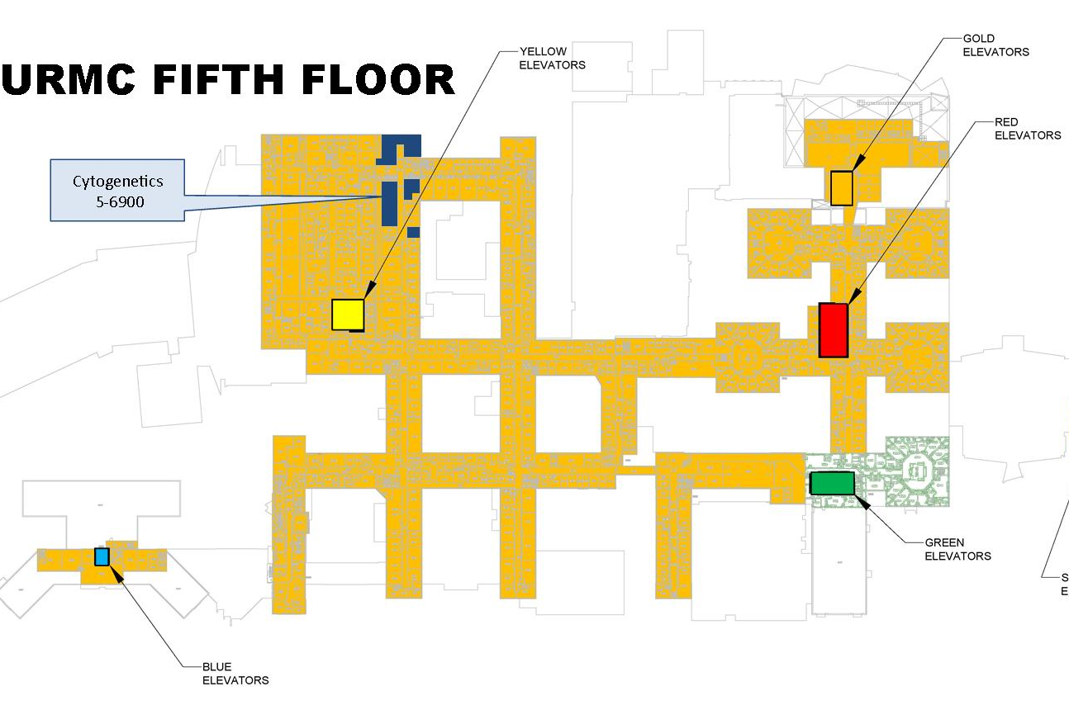
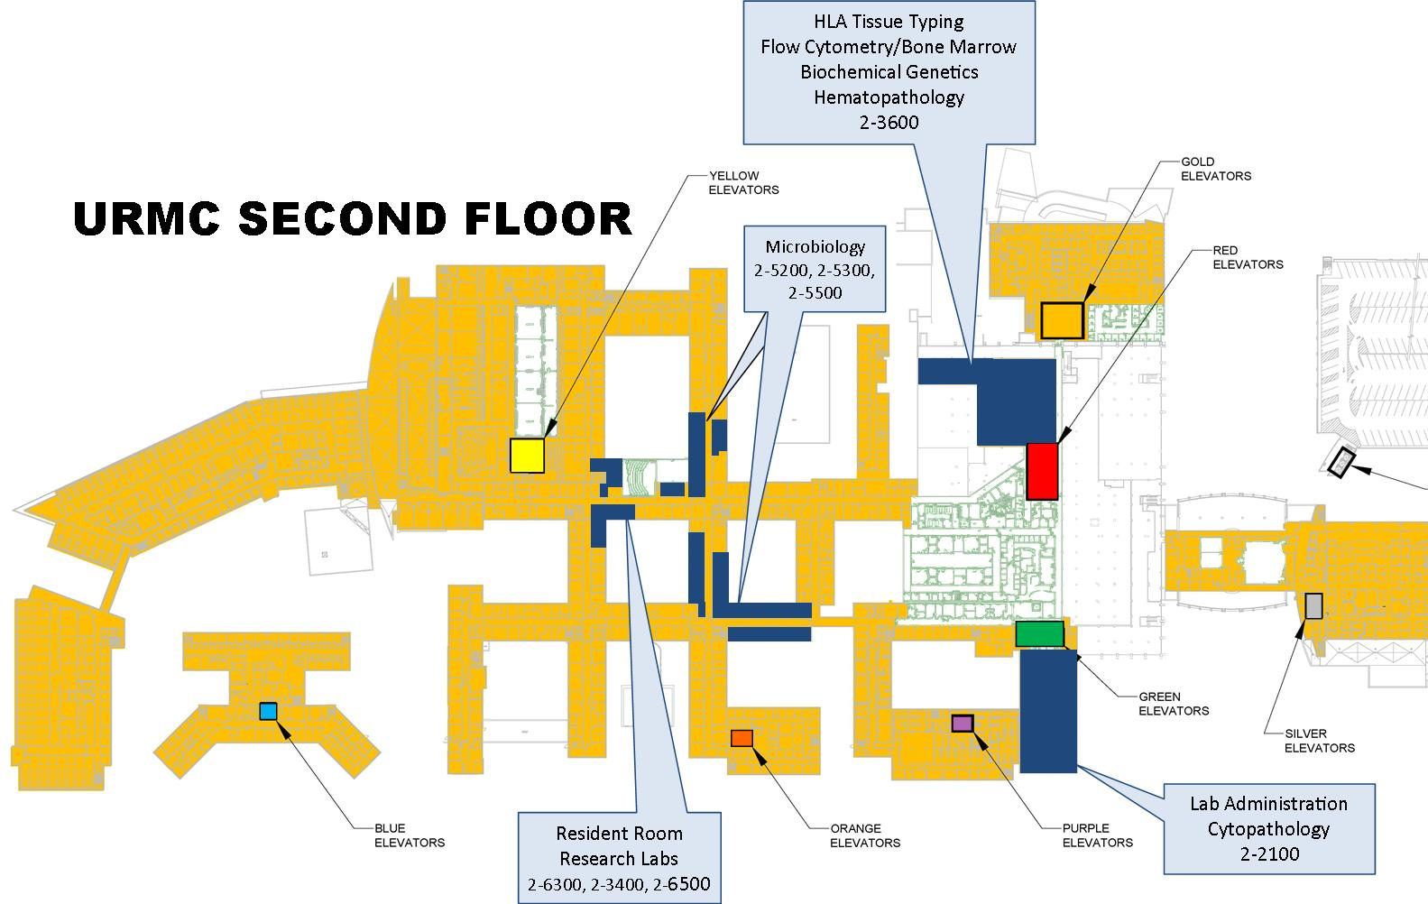
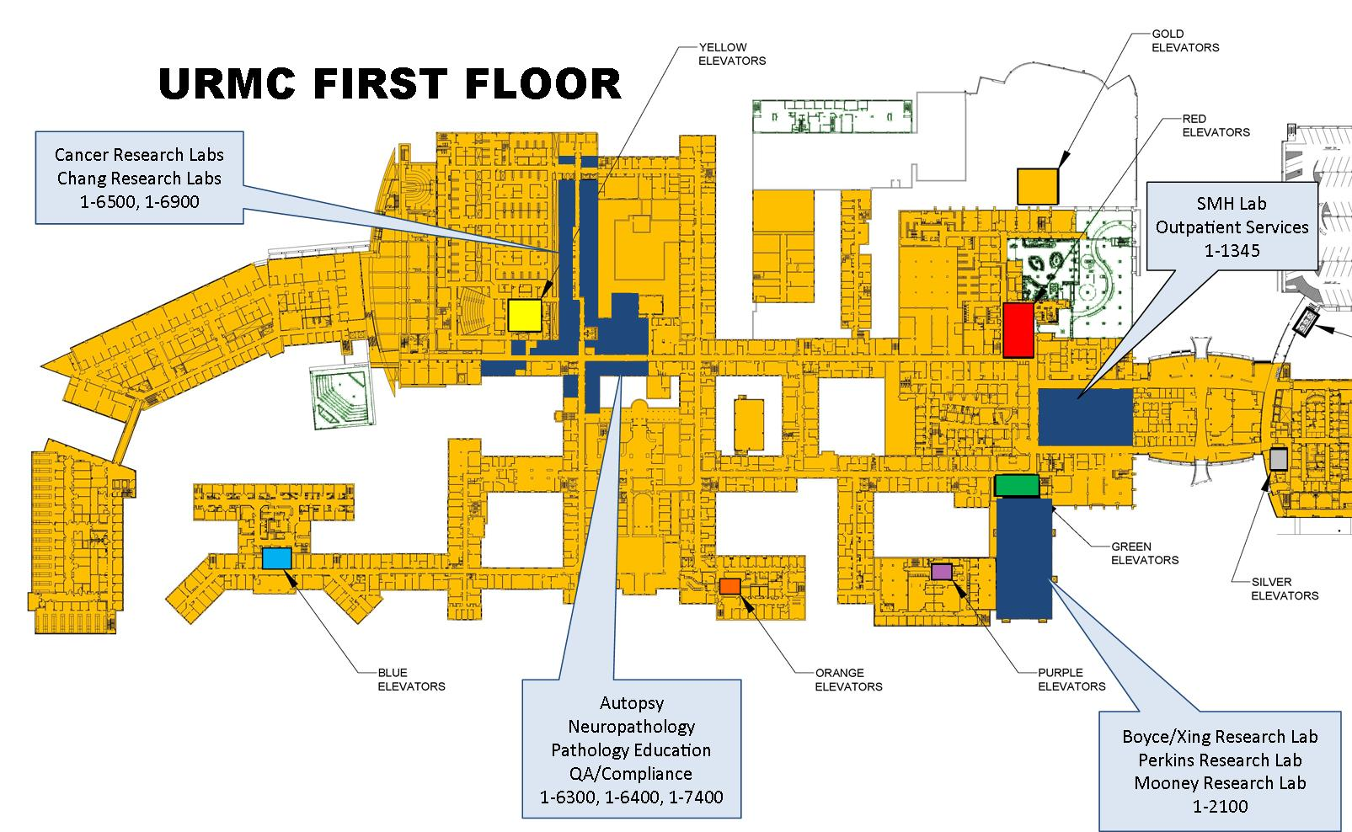
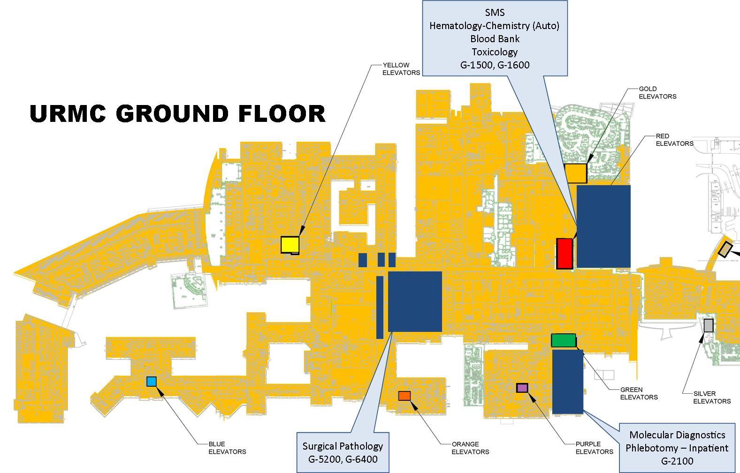
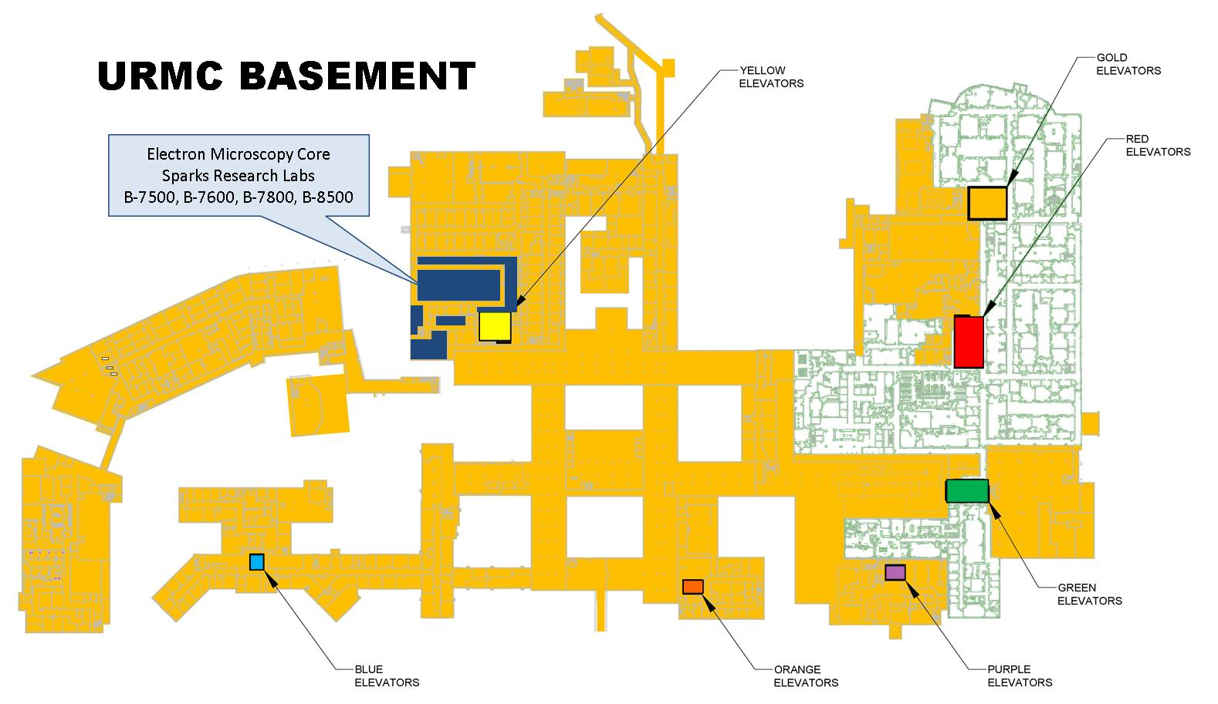
Strong West Lab
26 Miles from SMH
Patient Service Center Locations
Range from Rochester area to Southern Tier
Ridgeland Rd Labs
4 miles from SMH
Pathology & Lab Medicine Locations

