Slide 1

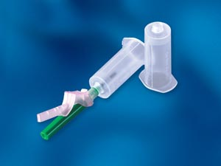

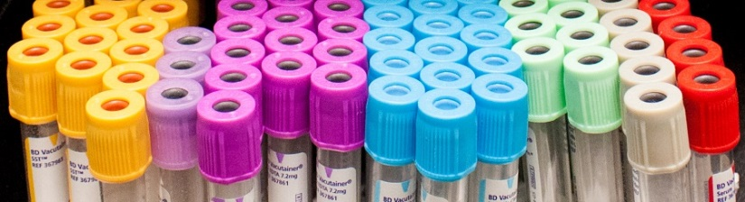
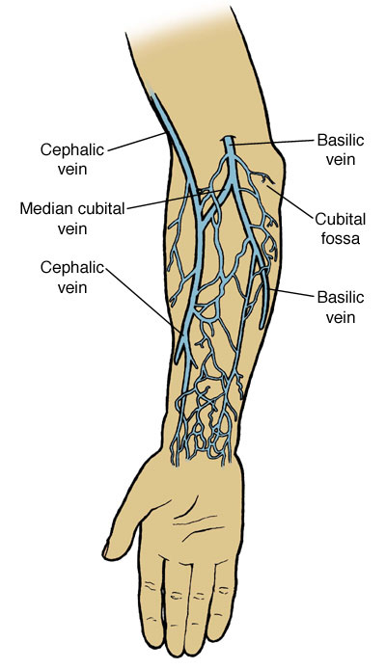


Phlebotomy
An integral part of the healthcare experience
TUBE | EXAMPLES OF COMMON TESTS | LABORATORY USE
GOLD | COMPREHENSIVE METABOLIC, LIPID, HEPATIC FUNCTION, PRENATAL, RENAL FUNCTION, TSH,IRON,HIV AG/AB, GTT, SYPHILIS SCREEN, PSA | FOR SERUM DETERMINATIONS IN CHEMISTRY. MAY BE USED FOR ROUTINE BLOOD DONOR SCREENING AND DIAGNOSTIC TESTING OF SERUM FOR INFECTIOUS DISEASE.
TAN | LEAD | FOR LEAD DETERMINATIONS
LAVENDER | CBC, HEMOGLOBIN A1C, SEDIMENTATION RATE, RETICULOCYTE COUNT, HIV VIRAL LOAD, VITAMIN B3, ABO GROUP & RH TYPE | FOR WHOLE BLOOD HEMATOLOGY, ROUTINE IMMUNOHEMATOLOGY TESTING, AND BLOOD DONOR SCREENING
GREEN | TROPONIN, VITAMIN C | FOR PLASMA DETERMINATIONS IN CHEMISTRY
BLUE | PT, PTT, FACTOR II ACTIVITY, FIBRINOGEN, D-DIMER | FOR COAGULATION DETERMINATIONS
Phlebotomy is the act of drawing or removing blood from the circulatory system through a cut (incision) or puncture in order to obtain a sample for analysis and diagnosis. Phlebotomy is also done as part of the patient's treatment for certain blood disorders.
Phlebotomy is comprised of 170 staff members spread out over 37 sites. We have inpatient settings, outpatient settings, nursing home, and home service , as well as stat nursing home service available 24/7.
We often help patients manage chronic conditions as well as routine bloodwork.

