Slide 1
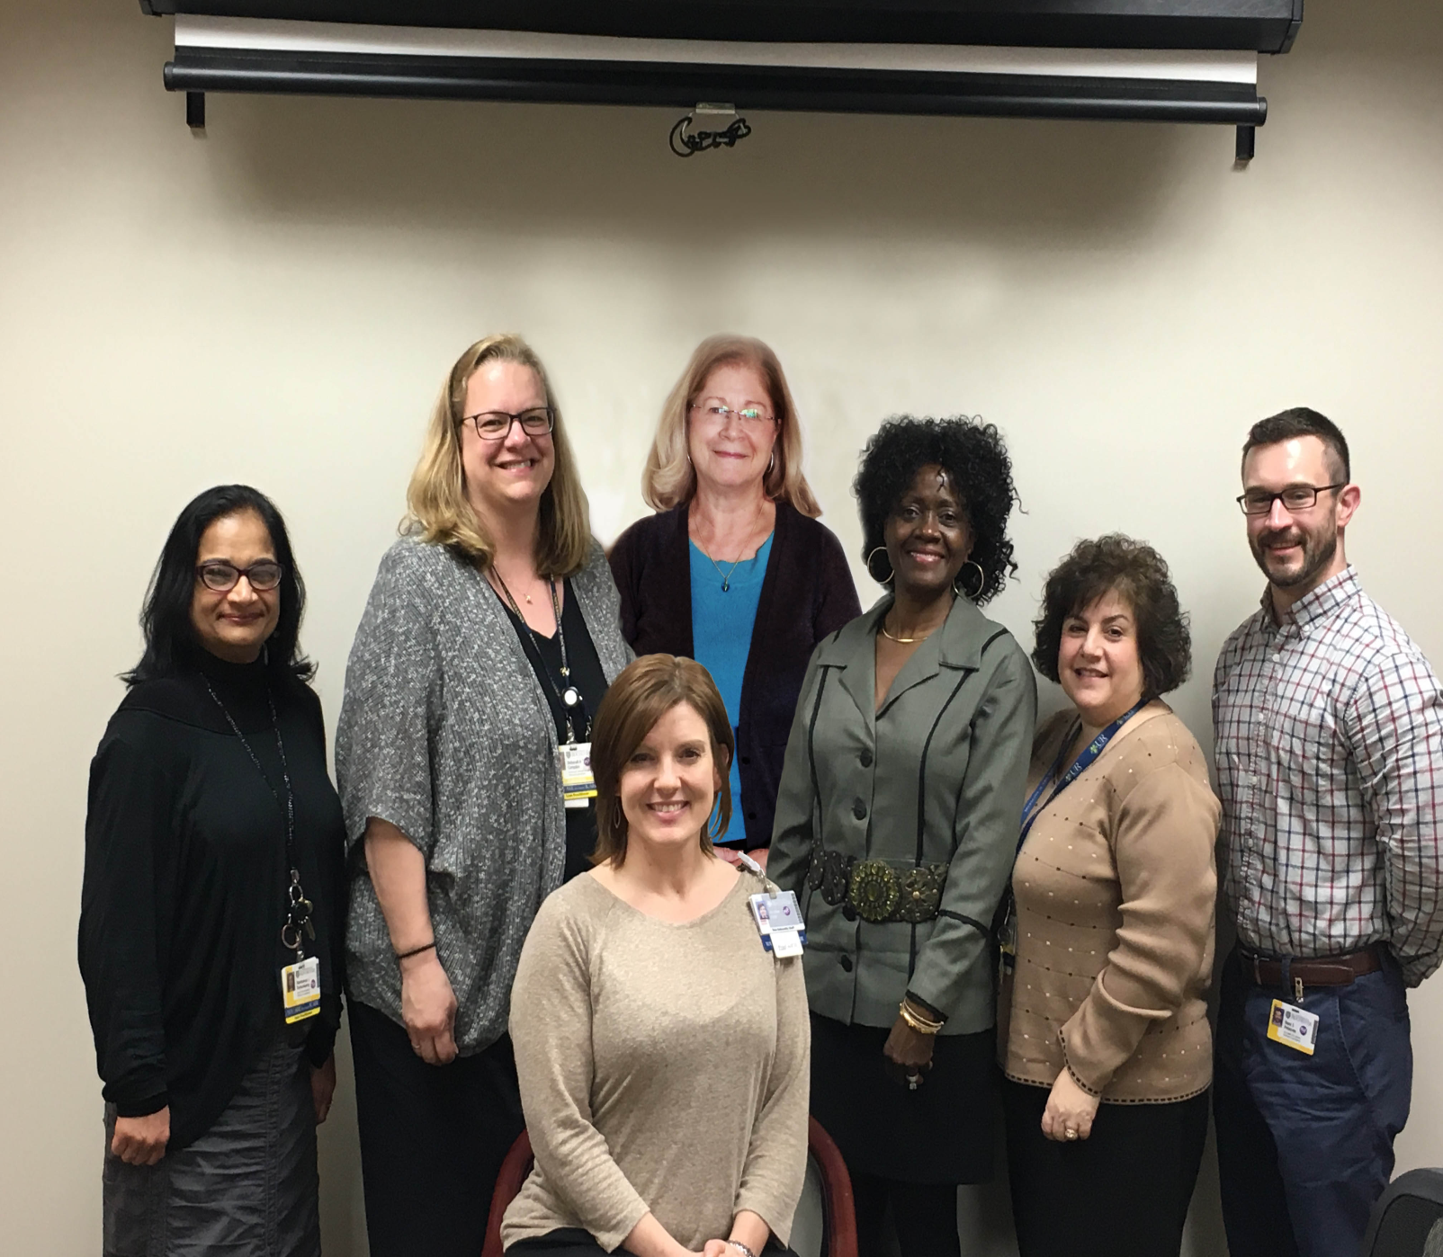
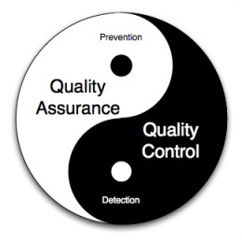
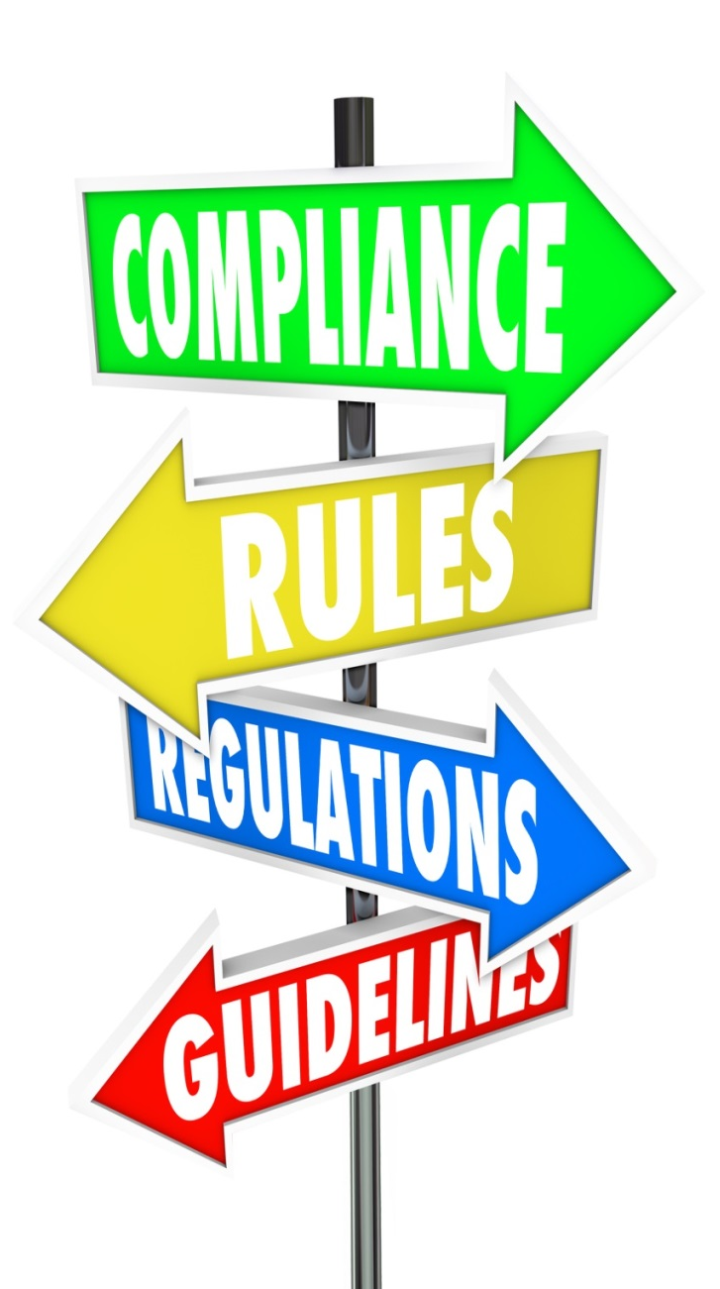
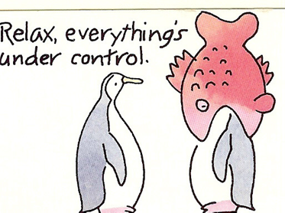
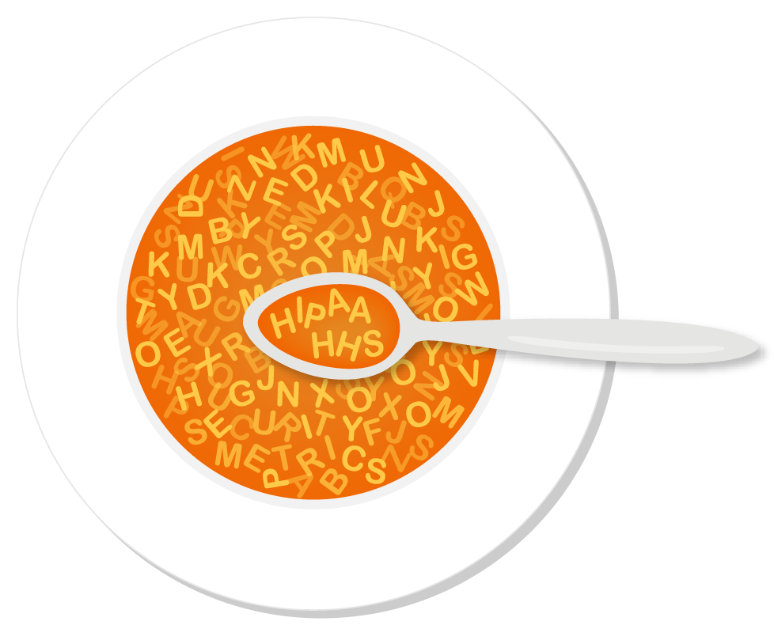
Department of Pathology and Laboratory Medicine
Quality Assurance and Compliance Department
Recipe For Success- Key Ingredients
9 pins
Hospitals and Laboratories supported by the Quality and Compliance Program:
Quality and Compliance Team Members:
Dr. Julietta Fiscella
Fran Gersonia
Maimoona Ramaswamy
Lois Thom
Debbie Congdon
Heather Cote
Ross Petersen
Quality is the best business plan. Our team is here to help you succeed.
Related Pins:
What is Compliance?
Compliance is to the business side of laboratories what the Clinical Laboratory Improvement Amendments (CLIA) of 1988 is to the analytical and regulatory side.
Compliance is all about doing the right thing: Pay the right amount to the right provider for the right beneficiary for the right reason for the right test.
The Quality Assurance Team is responsible and works with all labs to :
Continuously monitor data on a periodic, random basis
Provide ongoing training to personnel
Perform investigations if a problem is detected
Notify providers/clients and reissues reports if data/results are negatively impacted
QC vs. QA
QC – refers to the procedures for the measures that must be included during each assay run to verify that the test is working properly. This is a laboratory function.
QA – refers to the overall program that ensures the final results reported by the laboratory are correct. QA activities are performed by staff who are not directly involved with the analysis of clinical samples.
Compliance and Regulatory Soup
Ingredients:
Coding
Documentation
Medical Necessity
Internal
Auditing & Monitoring
All served with
a side of
alphabet soup:
External CT audit types:
pre-qualification, qualification, study specific & for-cause
Our Role:
Promote an environment of audit preparedness
Ongoing monitoring of CT study documents
Perform laboratory tracer audits
Perform “mock- audits” of study
Facilitate external audits
Encourage an “information sharing” approach with client auditor
Provide response to audit findings
Support resolution of audit finding resolution.
Clinical Trials sample is a “one time opportunity” to capture specific information contained in the specimen only at that specific time period.
CLIA CAP ICH E6 GCP GxP
In 2015:
The team performed approximately 65 internal audits
The team participated and prepared for 5 NYS Inspections and 3 CAP inspections.
The team participated and prepared for 6 external client audits for clinical trials.
Tips for Successful Audit:
Respond to the question asked with simple, honest, and complete answers.
Listen actively and ask for clarification if you are unsure of what is being asked.
Don’t rely on memory alone – review the documents yourself.
Deferring to and locating the correct person to answer the question asked within a specified
time window is acceptable.
It takes a village…Assemble and rely on a Team
ABN | MCD | CPI | NPI | HEAT | RAC | CMS
AKS | MCFU | CPT | OIG | HER | SCR | NGS
ALJ | MCR | CSP | OMIG | HHS | SMP | HCPCS
AO | MLN | DOJ | OPPS | ICD | SNF | PTAN
APG | NGS | DRG | PAO | IPPS | TOB
CERT | MPFS | EMR | PCS | LCD | UPIN
CLFS | NCCI | FCA | PQRS | LCSC | ZPIC
CMP | NCD | FI | PSC | MAC | NCCI
Clinical Laboratory Evaluation | NYS Department of Health (NYSDH)
CAP Inspection | College of American Pathologists
AABB inspection | American Association for Blood Banks (BB)
FDA Inspection (Blood Bank) | US Food and Drug Administration
FACT Inspection (Stem Cell/Blood Bank) | Foundation for Accreditation of Cellular Therapy
ASHI inspection (HLA Lab) | American Society of Histocompatibility & Immunogenetics

