Slide 1

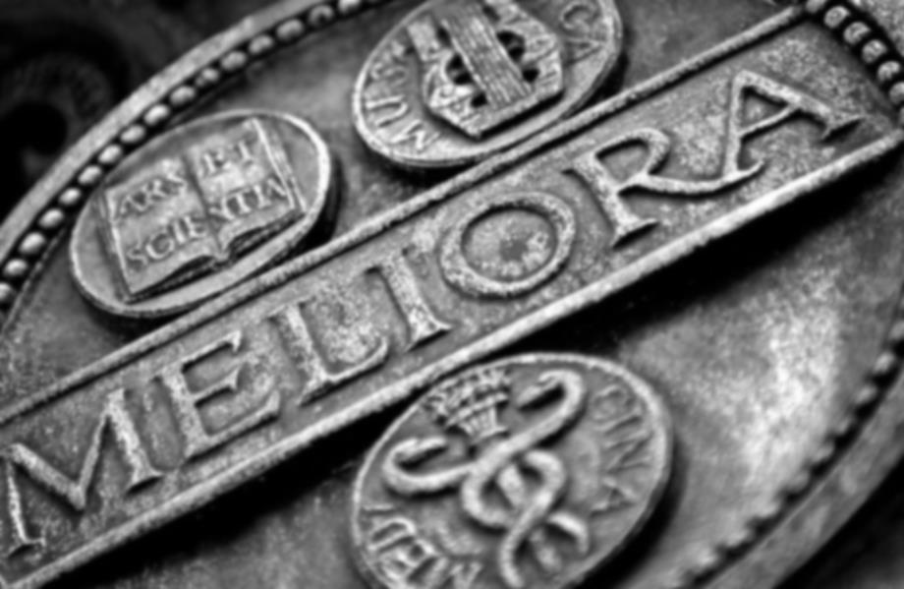
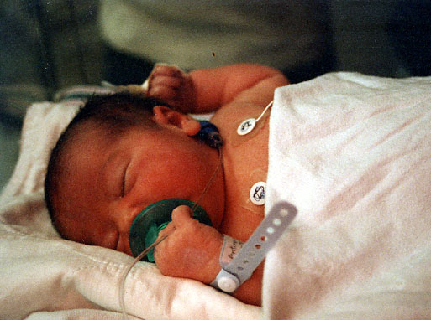
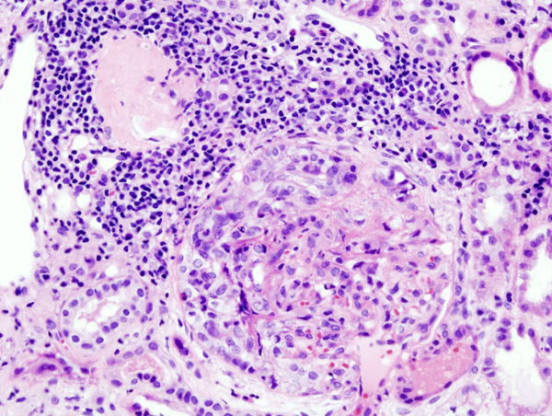
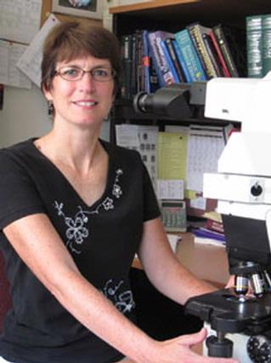
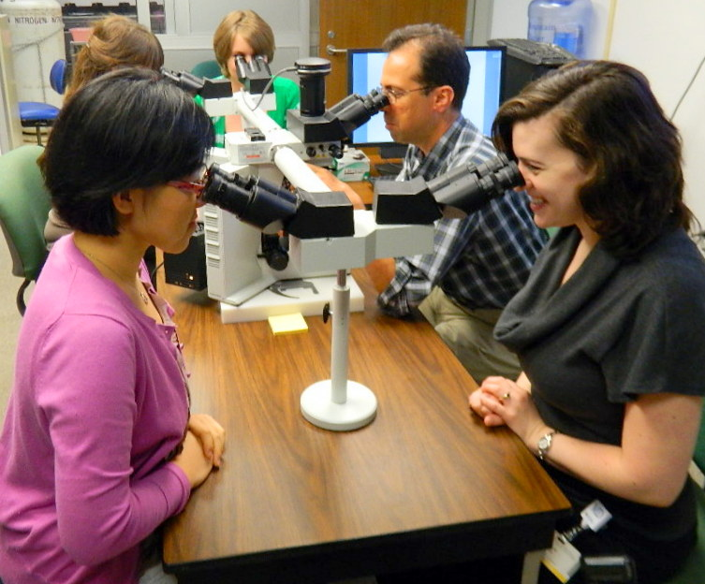
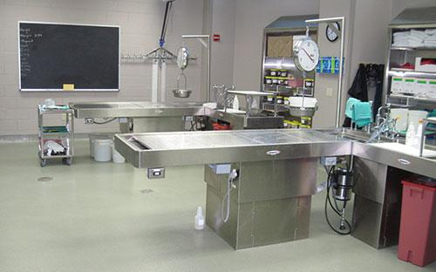
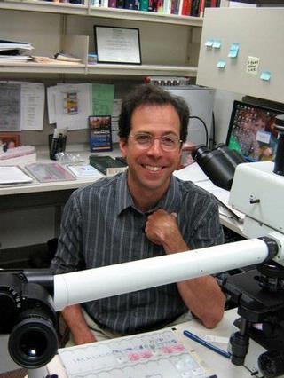
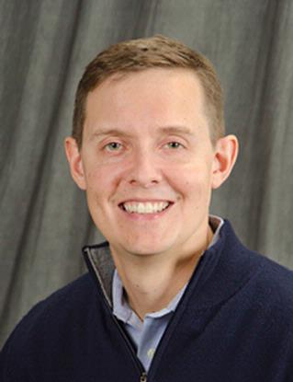
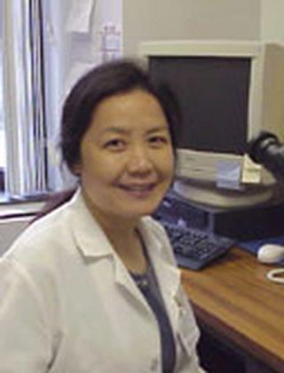

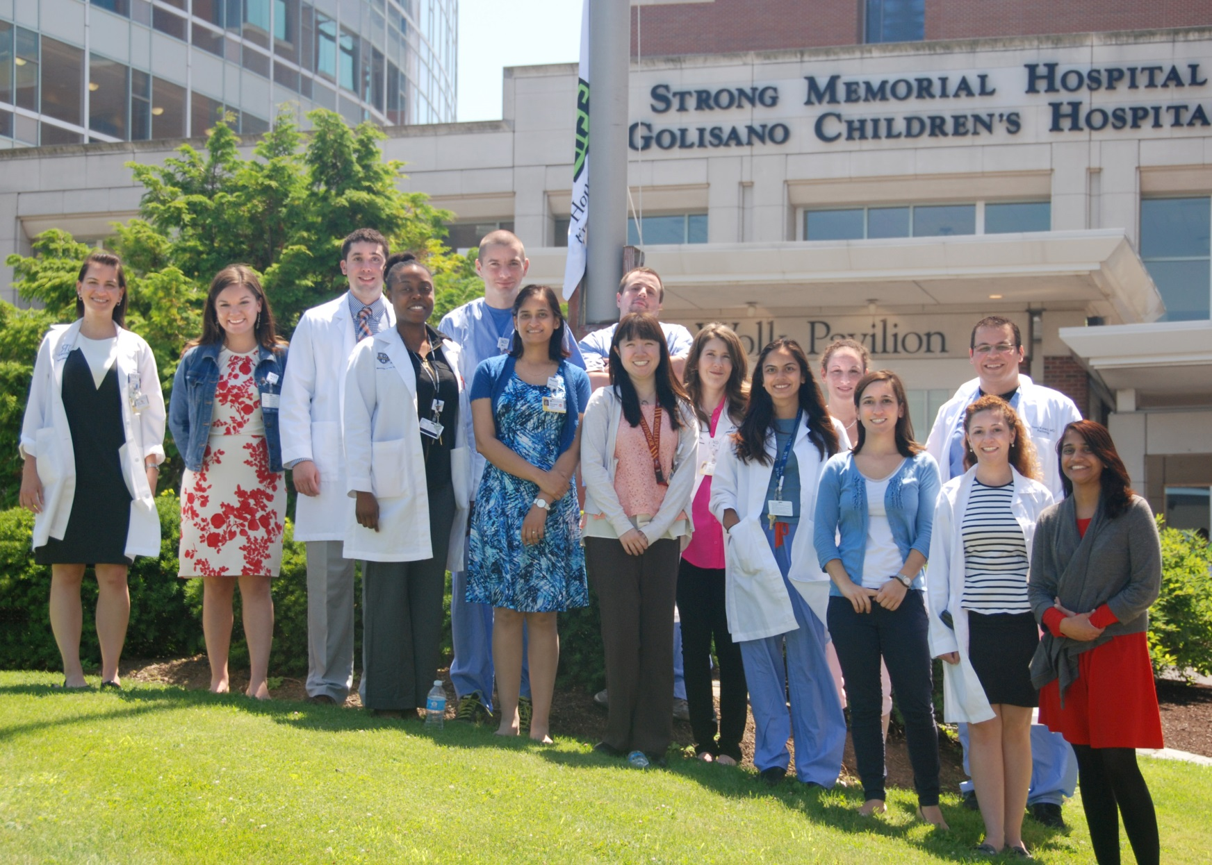
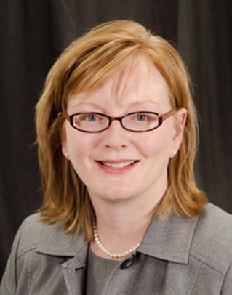
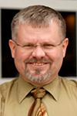
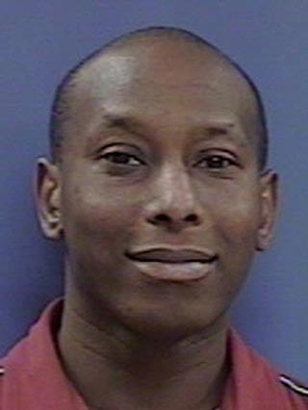
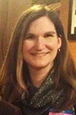
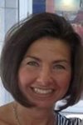
Graduate Medical Education
Pathology Residency Program & Pathology Fellowship Programs
WHAT ARE PATHOLOGISTS
Pathologists are medical doctors who have undergone additional specialist study, training and examinations in pathology. They study the cause of diseases and the ways diseases affect the body by examining changes in tissues, blood and other body fluids. Pathologists also provide expert clinical advice relating to the interpretation of pathology results to treating practitioners, such as explaining the significance of particular test results or how a disease should be managed based on test results. It takes a minimum of 13 years to become a pathologist.
DID YOU KNOW A PATHOLOGIST COULD...
PATHOLOGY FELLOWSHIPS
The Department of Pathology supports a variety of fellowship training. We prepare our fellows to become successful subspecialty pathologists. Training is provided through extensive clinical, research and teaching opportunities in one of the finest Departments of Pathology. Recognizing that the definition of future pathologists is broad, our subspecialty fellowships encompass a broad spectrum of programs. Using extensive clinical material and conferences, fellows are trained to be experts in their field.
URMC Fellowship Training Programs
URMC PATHOLOGY RESIDENCY TRAINING PROGRAM
The Pathology Residency Program at URMC provides residency training in both Anatomic and Clinical Pathology. Our program consists of 16 residents. Residents train for 48 months, then continue on to fellowship programs. There are over 45 faculty that contribute to our residents training. We allow URMC medical students who have completed at least two years of medical school to participate in our program as a Year Out Student Fellow. This gives medical students the opportunity to experience pathology training as a first year resident.
URMC Pathology Residents train in the following pathology laboratories:
Blood Bank / Transfusion Medicine
Chemistry
Cytogenetics / Microarray
Hematology
Laboratory Management
Microbiology
Molecular Diagnostics
Autopsy
Cytopathology
Forensics
Neuropathology
Surgical Pathology
Review blood tests of a pregnant woman to make sure her baby will be born healthy.
Look at kidney tissue under a microscope to determine if a patient needs a transplant.
Cytopathology Fellowship
Program Director
Dr. Ellen Giampoli
Hematopathology Fellowship
Program Director
(A) Dr. Richard Burack
Associate Program Director
(B) Dr. Andrew Evans
A
B
Help chart a patient's course to recovery by diagnosing their type of cancer from a surgical biopsy
Conduct an autopsy to determine if a person died of natural causes or because of foul play.
Surgical Pathology Breast Fellowship
Program Director
Dr. Ping Tang
PATHOLOGY RESIDENCY PROGRAM
Below are some OF our PATHOLOGY “Peeps” (Residents & Fellows)
Dr. Linda M. Schiffhauer,
Associate Director, Pathology Residency Program
Leslie R. Antinarella
Program Coordinator
Dr. Scott A. Kirkley,
Vice Chair, Pathology Education
Program Director, Pathology Residency Program
Gastrointesitnal Hepatobiliary (GI) Fellowship
Program Director
Dr. Christa Whitney-Miller
Genitourinary (GU) Fellowship
Program Director
Dr. Jerome Jean-Gilles
Dr. Linda Schiffhauer
Associate Director, Pathology Residency Program
Leslie R. Antinarella
Program Coordinator
Graduate Medical Education
Blood Bank / Transfusion Medicine Fellowship
Program Director
Dr. Amy Schmidt
Pictured: D. Agostini-Vulaj, L. Bratton, J. Blitman, S. Cheris, R. Baldzizhar, M. Bansal, C. Hudson, S. Straub, A. El-Halaby, S. Patel, S. Toth, S. Winters, H. Katerji, N. Patel. Not Pictured: M. Magguilli, S. Abu-Farsakh, M. Sharma, M. Barrett,
B. Steinbauer

