Slide 1





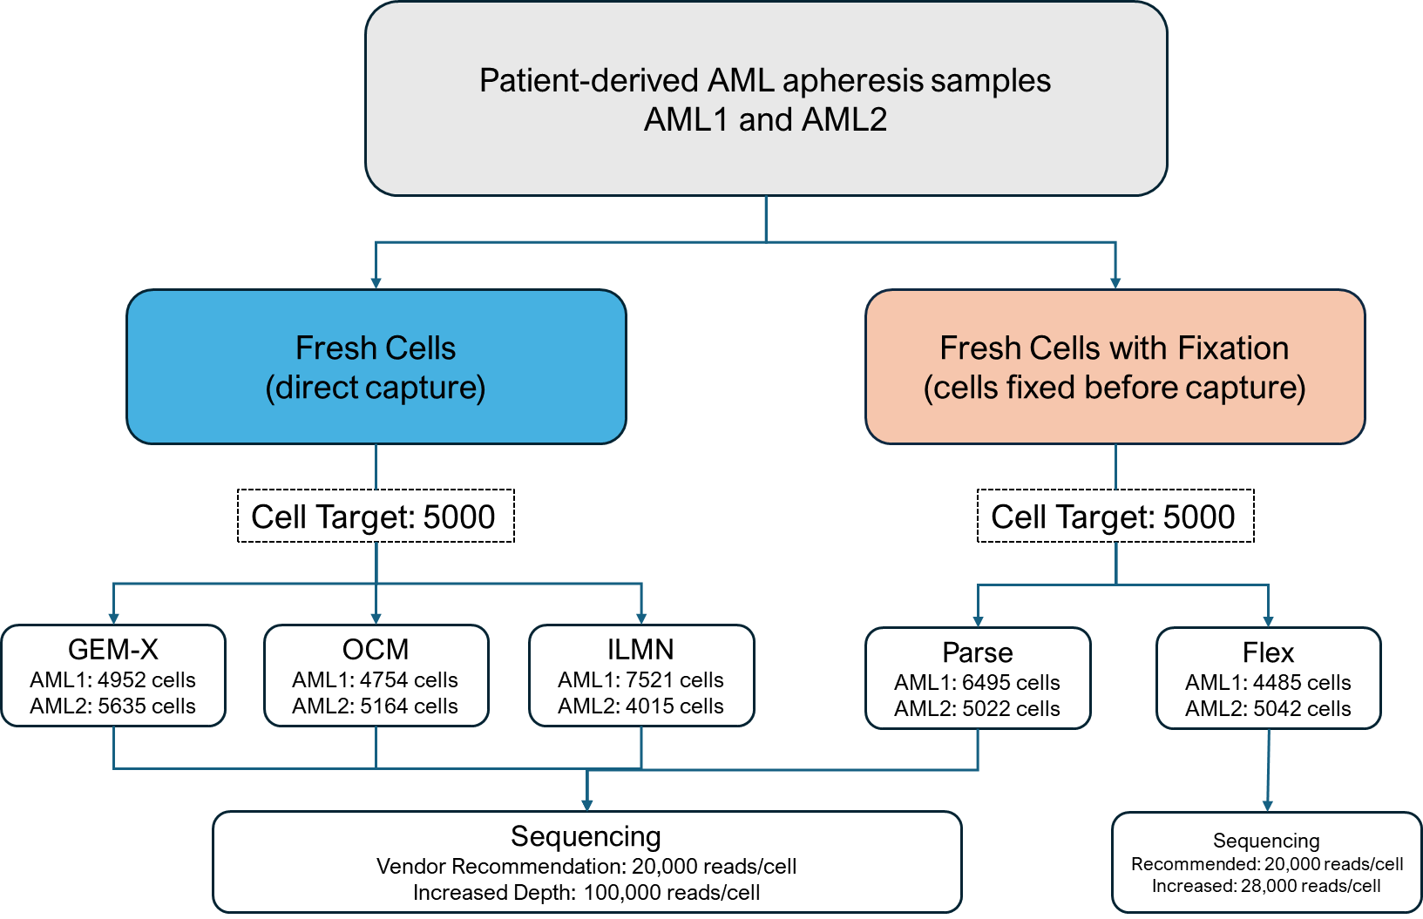
Supporting UR Science Series: Single Cell Platform Comparison Study (Part I) Genomics Research Center Written by: Elizabeth Pritchett, Jeffrey Malik Experiment Completed by: Marlene Rueby, Phil Spinelli Analysis Completed by: Cameron Baker, Hannah Aichelman, Jen Becker, Carter Long
Introduction
Single-cell RNA sequencing enables high-resolution profiling of complex tissues and has advanced our understanding of cellular heterogeneity. Many platforms are available, and selection of the appropriate methodology is essential for study design and outcomes. In this study, we benchmarked five singe-cell RNAseq platforms using patient derived samples: 10X Genomics GEM-X 10X Genomics Flex 10X Genomics On-Chip Multiplexing (OCM) Parse Biosciences Illumina Single Cell (ILMN)
Figure 1. Study design schematic. Using patient-derived AML apheresis samples.
Platform | Technology | Cell Fixation? | Type of Profiling | Capacity (cells) | UMI | Ease of Use (Lab) | Ease of Use (Analysis)
GEM-X | Droplet Encapsulation | No | 3’ + 5’ Expression | 20,000 | Yes | Easy | Easy
OCM | Droplet Encapsulation | No | 3’ + 5’ Expression | 5,000 | Yes | Easy | Easy
ILMN | PIP Formation | No | 3’ Expression | 10,000 | Yes | Moderate | Hard
Parse | Cell Compartments + Combinatorial Indexing | Yes | Full Transcript | 100,000 – 1 million | Yes | Moderate | Easy
Flex | Droplet Encapsulation | Yes | Probe-based Profiling | 25,000 – 10 million | Yes | Easy | Easy
Table 1. Summary of single-cell RNAseq platform key attributes. “Capacity (cells)” for Fixation based methods indicate number of cell required for fixation.

Slide 2
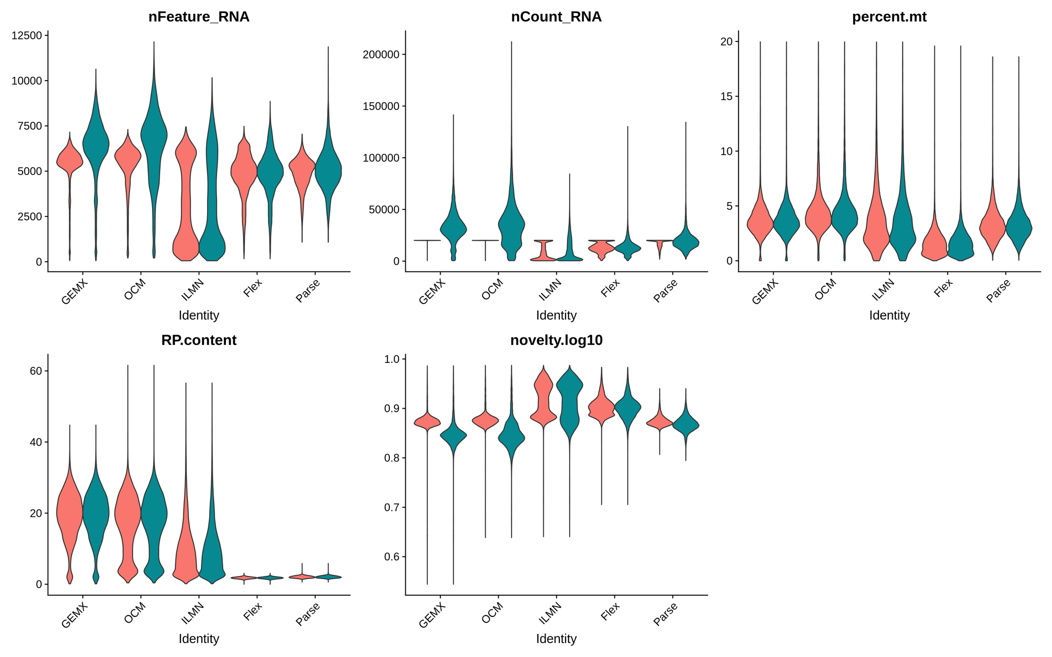
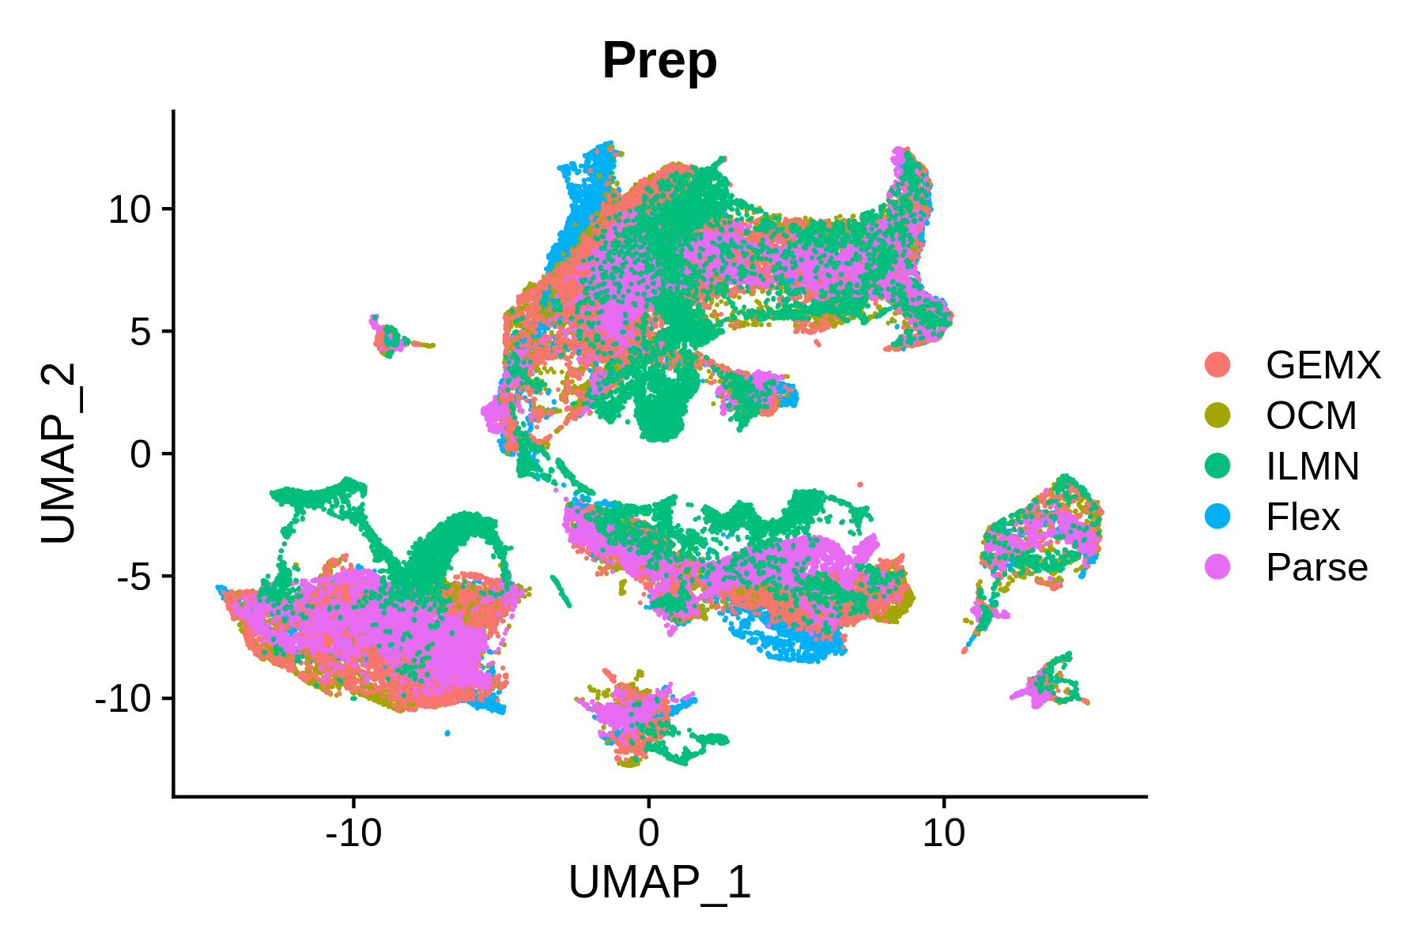
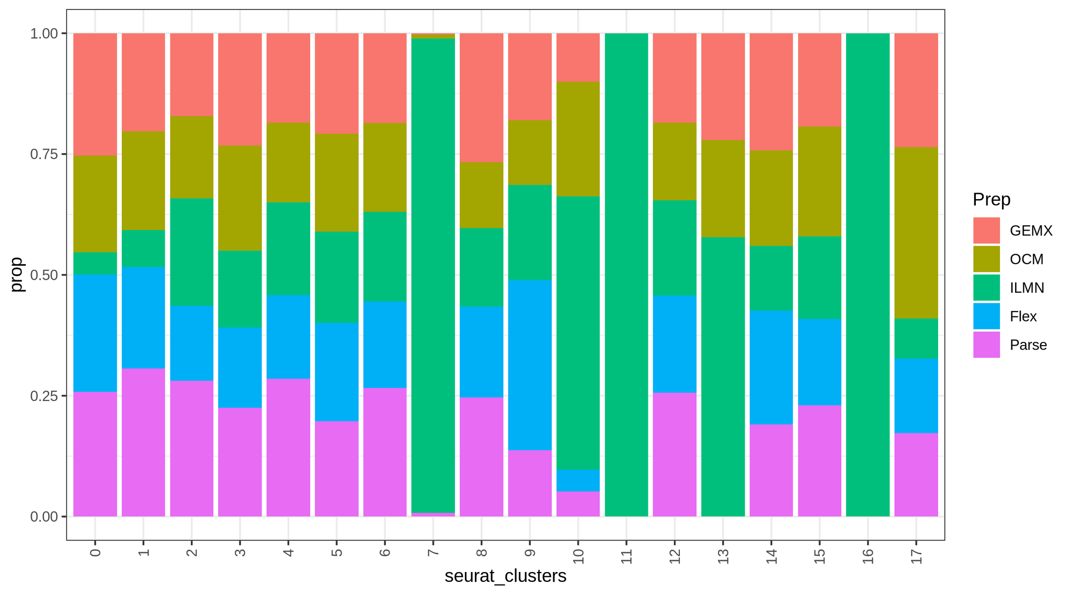
Supporting UR Science Series: Single Cell Platform Comparison Study (Part I) Genomics Research Center Written by: Elizabeth Pritchett
Genes Detected
Library Complexity
a.
Novelty Score
% Mitochondrial
% Ribosomal
b.
Proportion
Recommended
Increased Depth
Figure 2. Violin plots for Genes Detected (features), Library Complexity (novelty), % Mitochondrial, and % Ribosomal reads for all platforms at recommended and increased sequencing depth. Percentage ribosomal or mitochondrial content was generated using Seurat's PercentageFeatureSet with pattern matching corresponding to "RPS*|RPL*" and "MT-*" respectively. *Increased depth results will be presented in Part II
Figure 3a. Integrated dataset colored by platform. Figure 3b. Proportion of cells from each platform per cluster. Cells in clusters 7, 11, and 16 are predominantly from ILMN platform and have low gene detection.
Conclusion and Next Steps
Conclusion - Platforms performed similarly with some exceptions for Illumina Single Cell (ILMN) We suspect this is related to variability in sample preparation. Illumina expects SOP updates in early 2026 which may lead to improved results
- All platforms are viable options and final platform choice will depend on several factors outside of standard metrics Budget Multiplexing Capabilities (OCM, Flex, Parse) Experimental goals - Longitudinal studies with need for fixation, need for full transcript
Next Steps - Presentation of increased read depth - Perform and compare cell-type identification across platforms - Leverage Parse full-transcript coverage to investigate isoform expression

