Slide 1


Supporting UR Science Series: Lowering Costs at the Genomics Research Center
Written by: Elizabeth Pritchett, Anthony Gaca, Jeffrey Malik
Experiment Performed by: Phil Spinelli; Analysis by: Anthony Gaca
Introduction
Experimental Results
Library Prep and Volume | mRNA Full | mRNA Reduced | Total RNA Full | Total RNA Reduced
Avgerage Library Size (bp) | 340 | 341 | 391 | 383
Depth (M reads) | 30 | 30 | 50 | 50
Read Length (bp) | 2x150 | 2x150 | 2x150 | 2x150
*Genes Detected | 100ng: 27,246 25ng: 27,026 | 100ng: 27,442 25ng: 27,113 | 100ng: 31,599 25ng: 31,276 | 100ng: 31,020 25ng: 30,986
As part of our ongoing efforts to optimize workflows and reduce costs for our community, we conducted a study comparing our standard-input mRNA and Total RNA library construction methods to assess whether reducing reagent volumes would impact data quality.
Sequencing performed using the NovaSeq X PLUS. *A minimum of 3 reads mapped to each gene was required for detection.
Experimental Details
Conclusion
Library Preparation Kits:
Kit Type | Approach
Stranded mRNA | Coding Transcriptome
Stranded Total RNA | Coding and non-coding Transcriptome
Overall, all metrics are similar between full volume and reduced volume reactions for both mRNA and Total RNA Library preparations
  Genes detected
  Transcript Coverage
  Sample-to-sample correlation
  Reads assigned to transcripts
By implementing reduced reagent volumes, we achieve lower per-sample costs while adhering to the high-quality standards of the GRC
As part of our strategic goals for our community, we have more to come!
Sample Type:
Universal Human Reference (UHR) RNA.
Extracted from cell lines representing different human tissues
Pooled from 10 subjects
gDNA depleted
Includes low, medium, and high abundance gene transcripts
Input Concentrations:
25 ng
100 ng

Slide 2
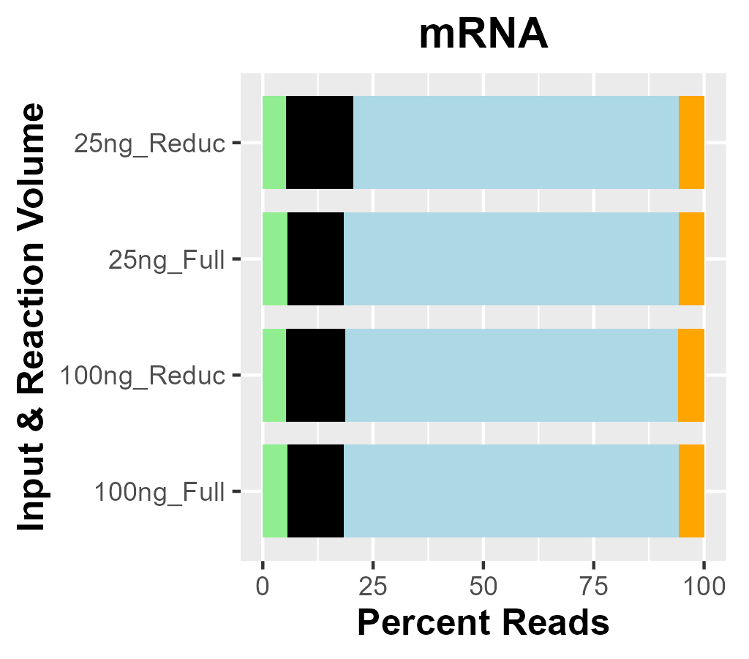
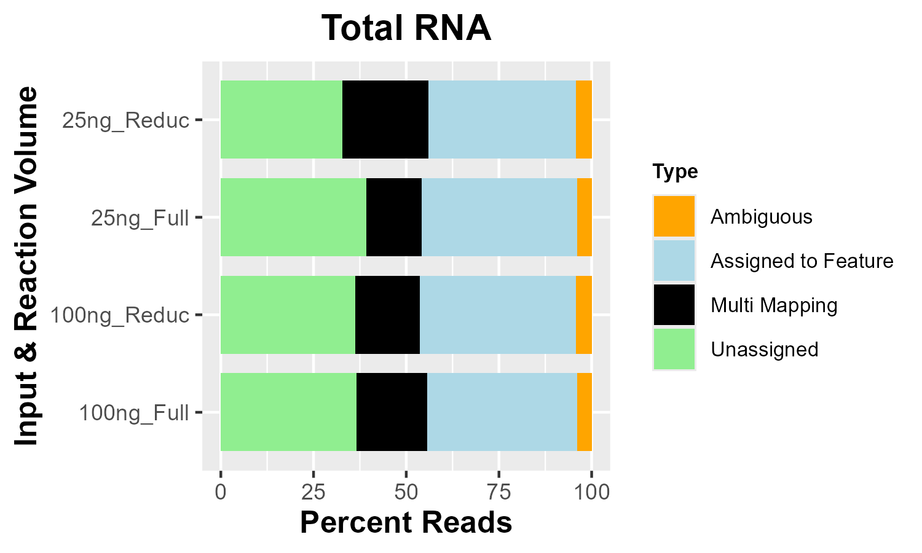
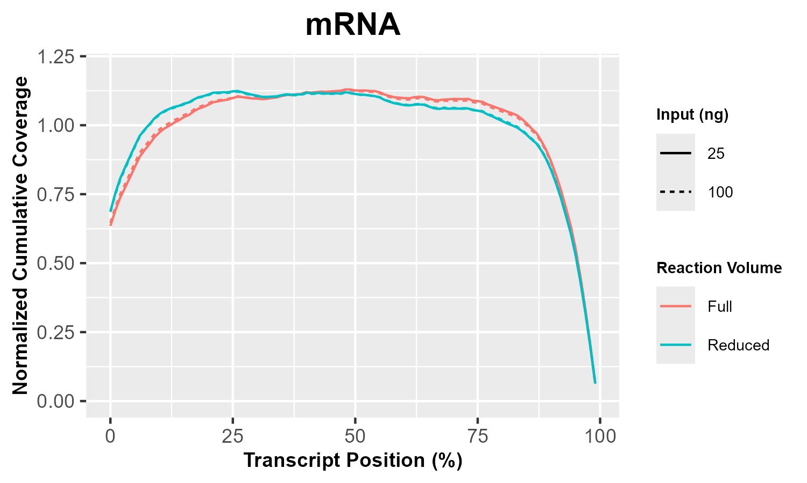
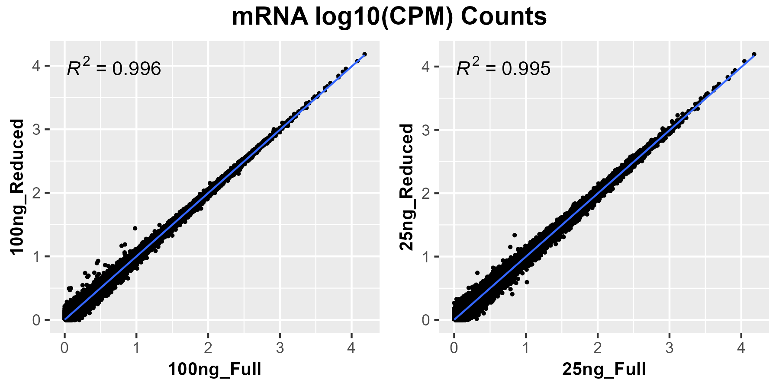
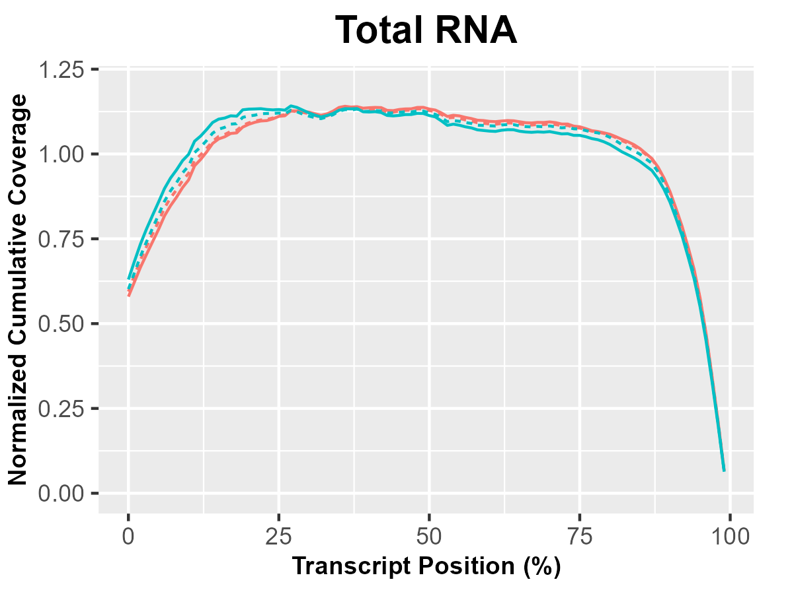
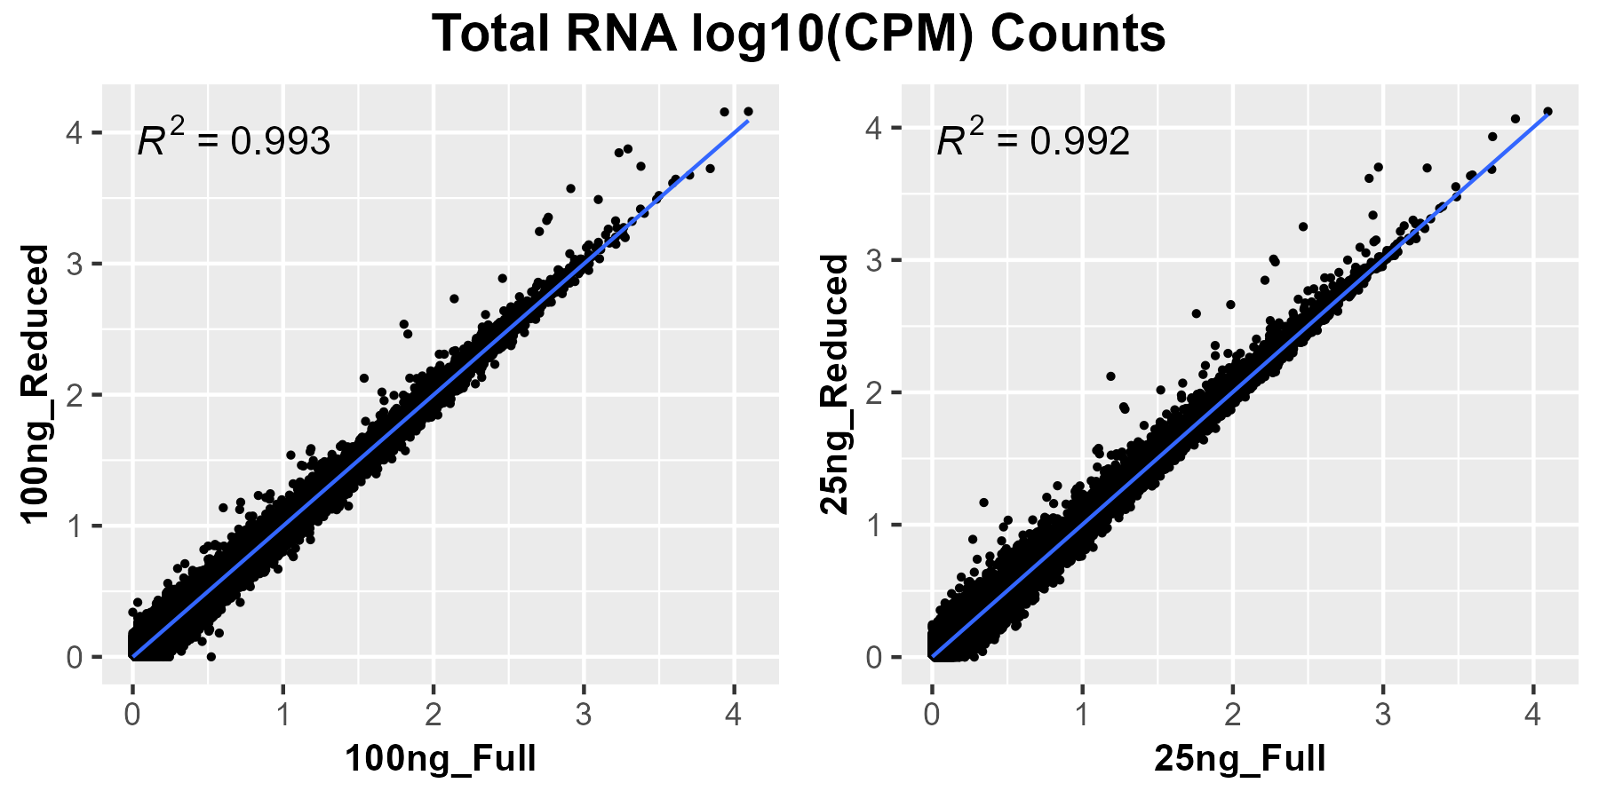
Supporting UR Science Series: Lowering Costs at the Genomics Research Center
Written by: Elizabeth Pritchett, Anthony Gaca, Jeffrey Malik
Experiment Performed by: Phil Spinelli; Analysis by: Anthony Gaca
Results
Assignment to Genomic Features:
Figure 1: Consistent mapping of reads to genomic features with reduced library preparation volumes. Percent mapped reads assigned to each featureCounts category. Ambiguous indicates that a mapped read is associated with a region of transcript overlap. Unassigned indicates that a mapped read is not associated with a protein-coding region. Total RNA libraries capture non-coding transcripts leading to higher unassigned read levels.
Transcript Read Coverage:
Sample Correlation by Reaction Volume:
Figure 2: Reduced volume library preparations have even transcript coverage. Cumulative mapped-read depth at relative transcript positions as determined by QualiMap. Values are normalized to the overall number of mapped reads for each sample to account for varying sequencing depth.
Figure 3: Reduced volume library preparations maintain near perfect transcript abundance correlation. Correlation plots of log₁₀(CPM) normalized transcript count values between full and reduced volume library preparations. Regression lines and R² values are derived using a standard linear model.

