Slide 1
"Reducing Racial Inequities in Health: The Fierce Urgency of Now" "Reducing Racial Inequities in Health: The Fierce Urgency of Now"
David R. Williams, PhD, MPH
Florence & Laura Norman Professor of Public Health
Chair, Department of Social and Behavioral Sciences
Professor of African & African American Studies and of Sociology
Harvard University

Slide 2
Racial Inequities In Health Have Existed for a Long Time

Slide 3
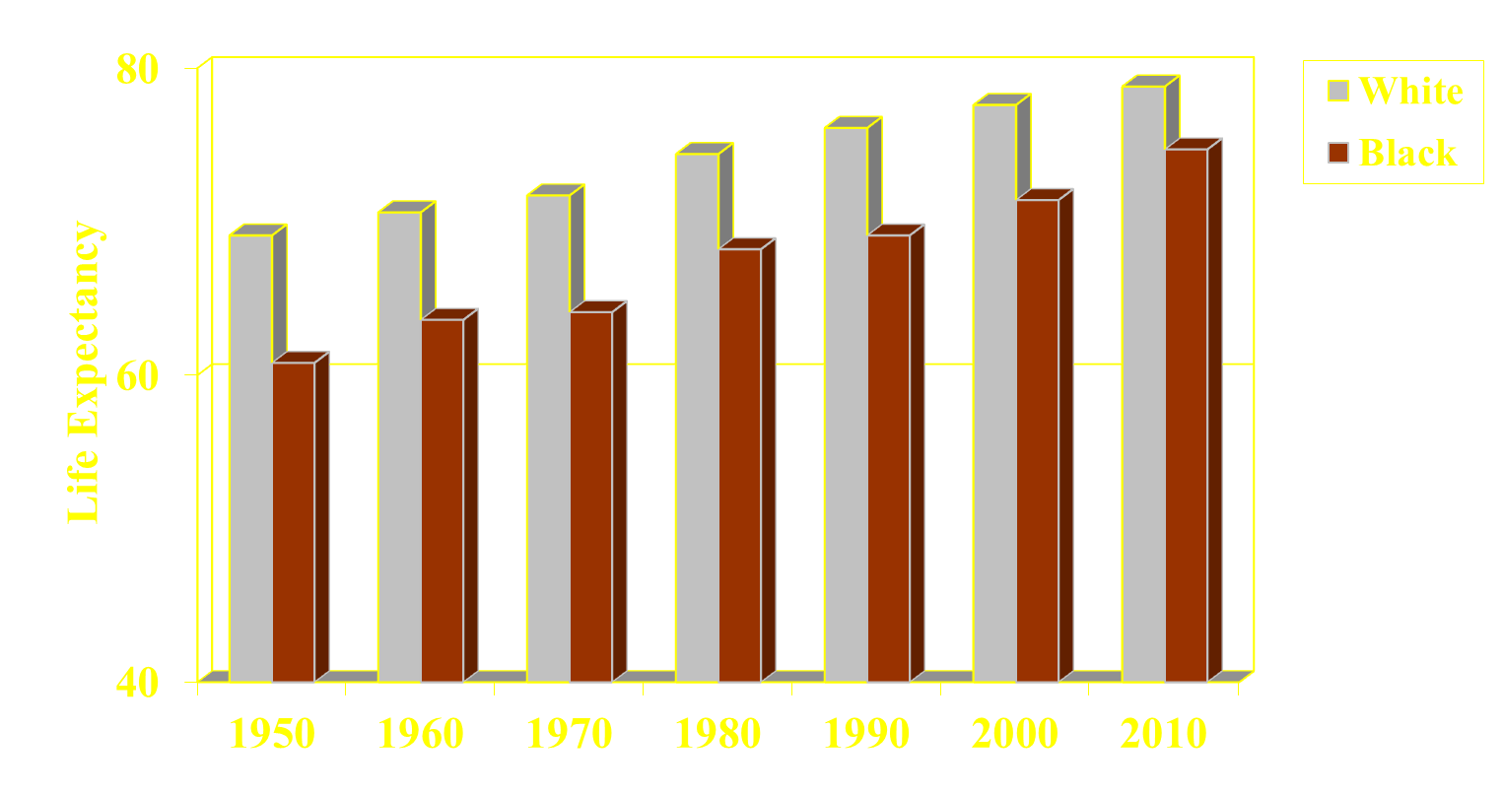
Life Expectancy Lags, 1950-2010
77.6
78.8
76.1
74.7
74.4
69.1
70.6
71.7
71.4
68.2
69.1
63.6
64.1
60.8
Source: NCHS, Health United States, 2013

Slide 4
Decline: Life Expectancy at Birth, 2019-2020
Changes (Years)
Hispanic Male
Black Male
Black Female
Hispanic Female
White Male
White Female
Arias et al, NVSS July 2021

Slide 5
Life Expectancy by Race, 1950-2020
78.8
77.6
76.1
77.3
74.4
74.7
69.1
70.6
71.7
71.8
71.8
69.1
68.1
63.6
64.1
60.8
NCHS, Health United States Chartbook, 2019; Arias et al, NVSS July 2021

Slide 6
What Drives these Large Racial Inequities
in Health?

Slide 7
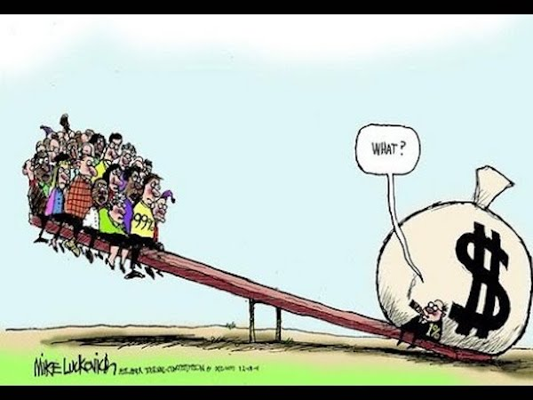
Socioeconomic Status
Socioeconomic Status (SES), (whether measured by income, education, occupation, poverty or wealth) is a central determinant of the distribution of valuable resources in society
This Photo by Unknown Author is licensed under CC BY-NC-ND

Slide 8
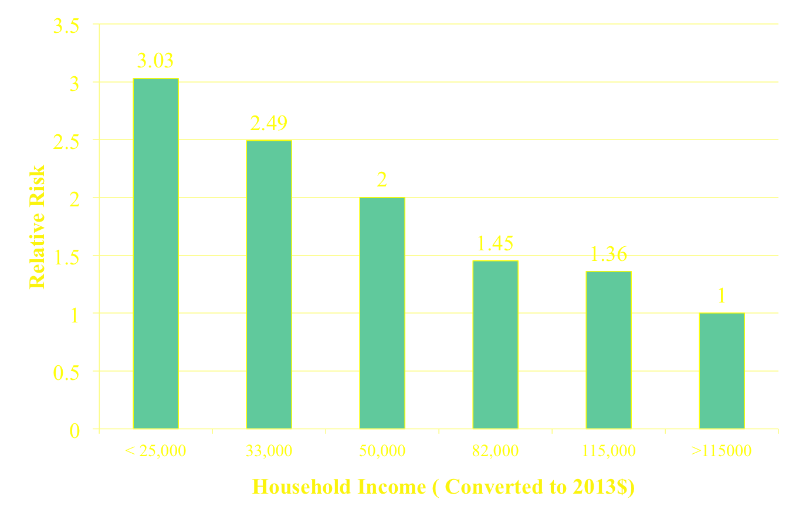
Relative Risks of All-Cause Mortality by Household
Income Level: U.S. Panel Study of Income Dynamics
P. McDonough, Duncan, Williams, & House, AJPH, 1997

Slide 9
Race/Ethnicity is strongly related to SES

Slide 10
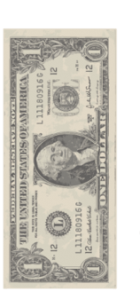











Median Household Income and Race, 2018
Racial Differences in Income are Substantial:
1 dollar
1.23 dollar
73 cents
59 cents
59 cents
Whites
Asians
Hispanics
Am Indians*
Blacks
U.S. Census Bureau, Semega et al., 2019; * For 2017; US Census Bureau, ACS, 2017
Notes:
Add American Indians American Indian Report 2-014
Slide 2: home ownership slide… **** ( homeownershP0

Slide 11

Reducing Racial Inequity in Income is on a Treadmill: A Lot of Talk: Little Progress
In 1978, Black households
earned 59 cents for every dollar of income that White households earned
In 2018, the gap is still 59 cents to the dollar
This Photo by Unknown is licensed under CC BY-NC

Slide 12
Large racial gaps in income markedly understate the racial gap in economic status

Slide 13




Median Wealth and Race, 2016
For every dollar of wealth that Whites have,
Blacks have 10 cents
Latinos have 12 cents
Other Races have 38 cents
Dettling et al., FEDS Notes, Federal Reserve Board (SCF), 2017

Slide 14
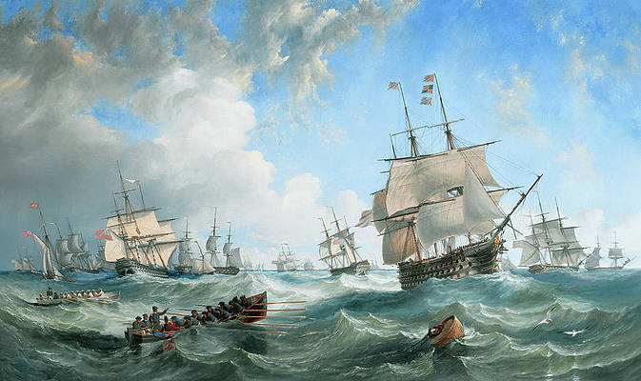
What Low Economic Status Means
We are in the same storm but in different Boats
Pixels

Slide 15
Added Burden of Race

Slide 16
Life Expectancy at Age 25 Based on Level of Education
6.4-year gap
White
70
75
80
85
Age
5-year gap overall
Black
5.3-year gap
Overall
0-12 years
College graduate
Murphy, NVSS 2000; Braveman, Cubbin, Egerter, Williams, Pamuk, AJPH, 2010; NLMS 1988-1998

Slide 17
Life Expectancy at Age 25 Race Still Matters
White
3.1-year gap between HS dropouts
4.2-year gap between college grads
Age
70
75
80
85
Black
Blacks with a college degree have a lower life expectancy than Whites with only a high school degree
0-12 years
12 years
Some college
College graduate
Murphy, NVSS 2000; Braveman, Cubbin, Egerter, Williams, Pamuk, AJPH, 2010; NLMS 1988-1998

Slide 18
What does Scientific Research Clearly Say?
Why Does Racial Inequality Exist?
Racism and Racial Discrimination are alive, well, pervasive and thriving in America

Slide 19
The House that Racism Built
Racism as a societal system
Social Forces
Political
Legal
Economic
Religious
Cultural
Historical Events
Williams, Lawrence, Davis, Vu, ‘Understanding how Discrimination Can Affect Health,’ HSR, 2019

Slide 20
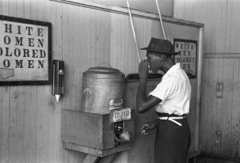
Racism Defined
Racism: an organized system that,
-- categorizes and ranks
-- devalues, disempowers, and
-- differentially allocates opportunities/resources
The development of racism is typically undergirded by an ideology of inferiority in which some population groups are regarded as being inferior to others
This leads to the development of
-- negative attitudes/beliefs (prejudice and stereotypes) to out-groups, and
-- differential treatment (discrimination) by individuals and social institutions
Bonilla-Silva, 1996; Williams 2004

Slide 21
The House that Racism Built
Racism as a societal system
Structural or Institutional Racism (e.g. Segregation))
Social Forces
Political
Legal
Economic
Religious
Cultural
Historical Events
Williams, Lawrence, Davis, Vu, ‘Understanding how Discrimination Can Affect Health,’ HSR, 2019

Slide 22
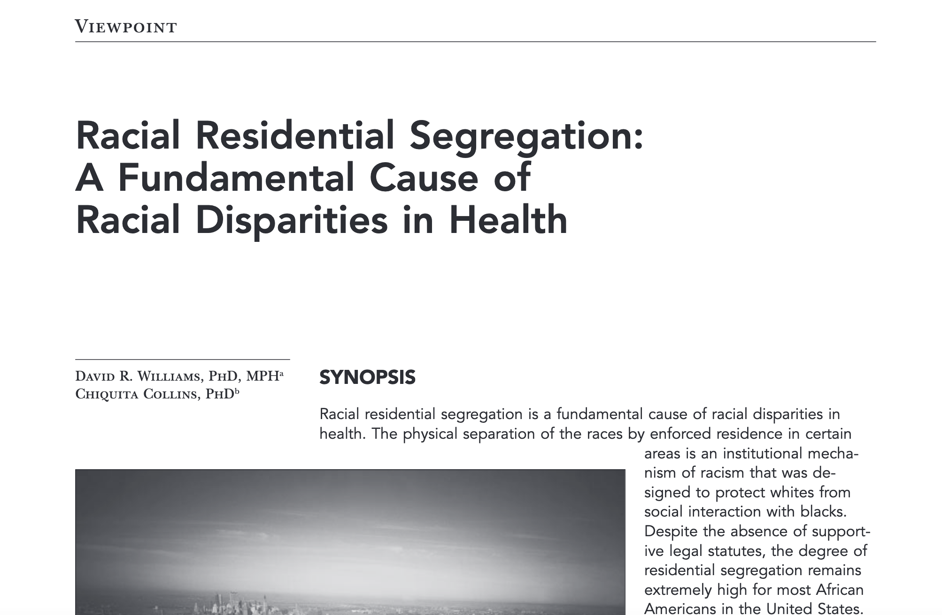
US: Centrality of Segregation in Creating Racial Inequities
Segregation refers to restricted residence to particular areas based on race
It includes the forced removal and relocation of indigenous peoples
Reflects institutionalized isolation & marginalization of racial populations
David R Williams & Chiquita Collins, Public Health Reports, 2001 Google Scholar Citations: 3,190

Slide 23
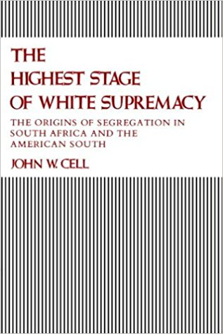
Racial Segregation Is …
One of the most successful domestic policies of the 20th century
"the dominant system of racial regulation and control" in the U.S
John Cell, 1982

Slide 24

How Segregation Works
Segregation is like a burglar at mid-night. It slips into the community, awakens no one, but once it shows up, valuables disappear:
Quality Schools
Safe playgrounds
Good jobs
Healthy environment
Safe housing
Transportation
Healthcare
Pixabay.com

Slide 25
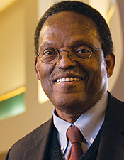
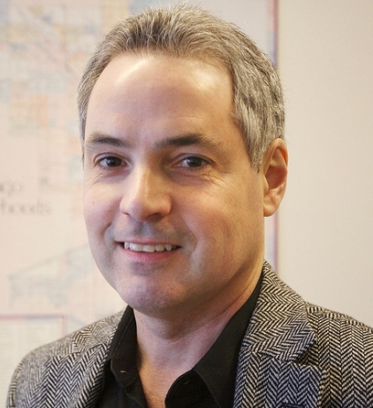
Racial Differences in Residential Environment
In the 171 largest cities in the U.S., there is not even one city where whites live in equal conditions to those of blacks
“The worst urban context in which whites reside is considerably better than the average context of black communities.”
Sampson & Wilson 1995

Slide 26

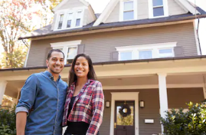
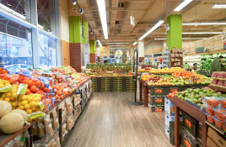
Neighborhood Opportunity Index
Institutions: number & quality of schools, early childhood centers
Influences shaping norms and expectations: (high school graduation rate, adults with high skill jobs)
Economic Resources: income, home ownership, employment, public assistance
Environmental Quality: air, water, soil pollution, hazardous waste sites
Resources for health: green space, healthy food outlets, walkability
Acevedo-Garcia, Health Affairs, 2020, Diversitydatakids.org
Shutterstock.com

Slide 27
Percentage of Children at Neighborhood Opportunity Level
100 largest Metropolitan areas
D. Acevedo-Garcia et al, Health Affairs, 2020, Diversitydatakids.org

Slide 28
Segregation is the central driver of the Large Racial/Ethnic Differences in SES

Slide 29
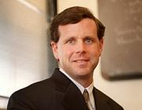
Residential Segregation and SES
A study of the effects of
segregation on young
African American adults
found that the elimination
of segregation would erase
black-white differences in:
Earnings
High School Graduation Rate
Unemployment
And reduce racial differences in single motherhood by two-thirds
David Cutler & EL Glaeser, Quarterly J Economics, 1997

Slide 30
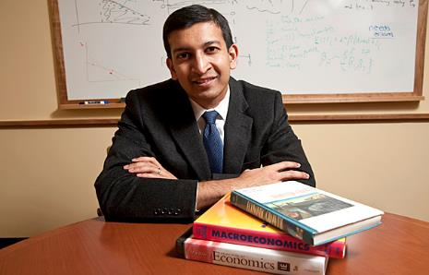
An Intergenerational Study
Inequity usu. studied in one generation
Intergenerational analysis, linking parents & kids, US pop,1989-2015
Black boys have lower earnings than white boys in 99% of Census tracts in America (controlling for parental income)
Why? They live in neighborhoods that differ in access to opportunity
Black boys do well in neighborhoods with good resources (low poverty) and good race-specific factors (high father presence, less racial bias)
The problem: there are essentially no such neighborhoods in America
Raj Chetty et al, “Race & Econ Opportunity” NBER Working Paper, 2018

Slide 31
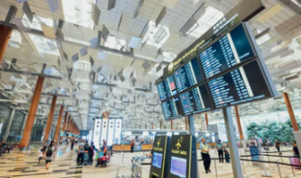
Inequities by Design
Racial inequities in SES that matter for life & health do not reflect a do reflect broken system
Instead, they reflect a carefully crafted system, functioning as planned – successfully implementing social policies, many of which are rooted in racism
They are not accidents, random events or acts of God
They are not caused just by the bad choices of individuals
Racism has produced a truly “rigged system”

Slide 32
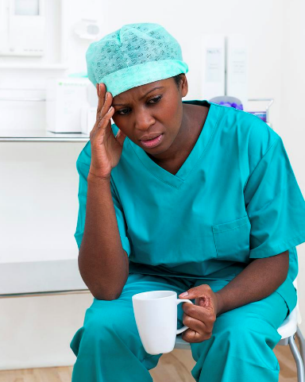
Segregation, SES, Stress and Health
Lower economic status, living in disadvantaged, segregated, neighborhoods leads to to higher levels of exposure and greater clustering of: 1. Economic Stressors 2. Psychosocial Stressors 3. Physical & Chemical Stressors
Williams, J Health and Social Behavior, 2016 photo from pixels.com

Slide 33
The House that Racism Built
Racism as a societal system
Structural/ Institutional Racism (e.g. Segregation))
Social Forces
Political
Legal
Economic
Religious
Cultural
Historical Events
Individual Discrimination
Williams, Lawrence, Davis, Vu, ‘Understanding how Discrimination Can Affect Health,’ HSR, 2019

Slide 34
Individual Discrimination Experiences of discrimination are an added source of Toxic Stress

Slide 35

Every Day Discrimination
In your day-to-day life how often do these happen to you?
You are treated with less courtesy than other people.
You are treated with less respect than other people.
You receive poorer service than other people at restaurants or stores.
People act as if they think you are not smart.
People act as if they are afraid of you.
People act as if they think you are dishonest.
People act as if they’re better than you are.
You are called names or insulted.
You are threatened or harassed.
What do you think was the main reason for these experiences?
Williams, Yu, Jackson, Anderson, J Health Psychology, 1997
This Photo by Unknown Author is licensed under CC BY-SA-NC

Slide 36
Everyday Discrimination and Health
Incident
-Metabolic
Syndrome
-CVD outcomes
-Breast cancer
-Type 2 diabetes
Nicotine dependence
Binge eating
Smoking & drug use
At-risk drinking
CAC (coronary artery calcification)
IMT (intima media thickness)
Visceral fat
HRV
Atrial fibrillation
Adult onset asthma
Nocturnal amb. BP
Cognitive function
Increases in SBP, DBP
Inflammation (CRP, IL-6, e-selectin)
Cortisol
Telomere length
Allostatic load
Sleep duration
Sleep quality
Breast cancer screening
Cervical cancer screening
Lower adherence
Delays in seeking treatment
DSM Disorders
Emotional Distress
Well-being
Changes in personality
Waist circumference
Obesity
Weight gain
Williams, Lawrence, Davis & Vu, Health Services Research, 2019

Slide 37
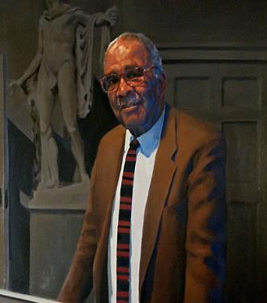
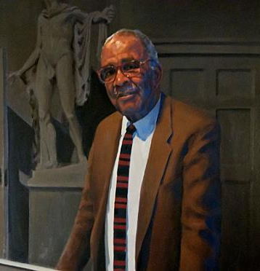
Concept of Microaggressions
“What the reader must bear in mind is that these assaults to black dignity and black hope are incessant and cumulative. Any single one may not be gross. In fact, the major vehicle for racism in this country is offenses done to blacks by whites in this sort of gratuitous, never-ending way. These offenses are microaggressions.”
Prof Chester M. Pierce
Pierce CM. Psychiatric problems of the black minority. In American Handbook of Psychiatry, Vol 2 edited by G Caplan; Basic Books 1974.)This paper references his earlier work (1970) on this topic

Slide 38
Hidden Ways in which Stressors linked to Race and Racism Adversely affect Health

Slide 39
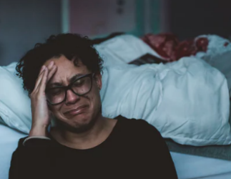
Worry About Safety of Children
Study of black women found that most live with a heavy burden of stress due to concern about the racism their children might experience
Over 70% were very concerned:
-- that their children might be harmed by
the police
-- that their children might get stopped in
a predominantly white neighborhood
A.Vines & D. Baird Journal National Med Assoc, 2009
Unsplash.com

Slide 40

Police Stops and Mother’s Health
A study of over 3,000 mothers in 20 cities (Fragile Families Study)
23% of urban youth are stopped by the police by the age of 15
Mothers of youth who were stopped by the police are more than twice as likely to report both depression- and anxiety-related sleep difficulties.
Unsplash.com
Dylan Jackson & Kristin Turney, Journal of Urban Health, 2021

Slide 41

Police Violence and Health
Frequent media reports of incidents of police violence directed to black, Latino, and Native American communities
These are stressors that negatively affect health of larger community
Recent national, quasi-experimental study:
Police killings of unarmed blacks lead to declines in mental health among blacks
in general population for
3 months after event
No effect on whites
Bor, Venkataramani, Williams & Tsai, The Lancet, 2018

Slide 42
The House that Racism Built
Cultural Racism
(e.g. Stereotypes, Stigma, Implicit & Explicit biases)
Racism as a societal system
Social Forces
Political
Legal
Economic
Religious
Cultural
Historical Events
Institutional/ Structural Racism (e.g. Segregation))
Individual Discrimination
Williams, Lawrence, Davis, Vu, ‘Understanding how Discrimination Can Affect Health,’ HSR, 2019

Slide 43
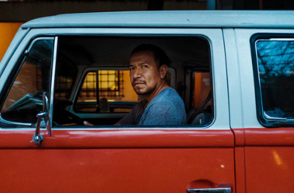
Negative stereotypes about race remain deeply embedded in our culture These Stereotypes Trigger Racial Discrimination that Reduces Access to Societal Resources

Slide 44
Where do Negative Racial Stereotypes come from?

Slide 45

Racial Stereotypes in Our Culture
BEAGLE Project
10 million words
Sample of books, newspapers, magazine articles, etc. that average college-level student would read in lifetime
Allows us to assess how often Americans have seen or heard words paired together over their lifetime
Verhaeghen et al. British J Psychology, 2011
This Photo by Unknown Author is licensed under CC BY-SA

Slide 46
Stereotypes in Our Culture
BLACK poor .64
BLACK violent .43
BLACK religious .42
BLACK lazy .40
BLACK cheerful .40
BLACK dangerous .33
WHITE wealthy .48
WHITE progressive .41
WHITE conventional .37
WHITE stubborn .32
WHITE successful .30
WHITE educated .30
FEMALE distant .37
FEMALE warm .35
FEMALE gentle .34
FEMALE passive .34
MALE dominant .46
MALE leader .31
MALE logical .31
MALE strong .31
Verhaeghen et al. British J Psychology, 2011

Slide 47
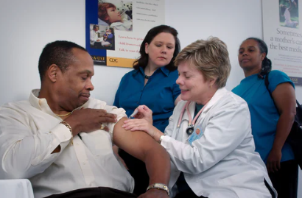
Implicit Bias Exists in Medical Care

Slide 48
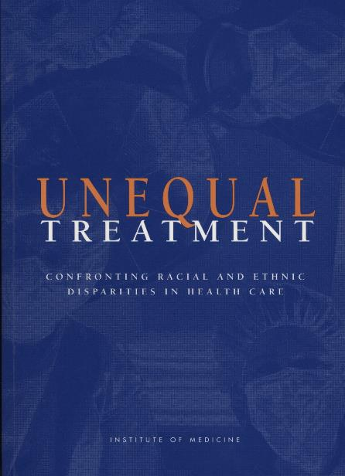
Populations of color receive poorer quality medical Care

Slide 49
Recent Studies

Slide 50

Physician Race and Newborn Survival
Study of 1.8 million hospital births in in Florida from 1992 to 2015
When cared for by white doctors, black babies are 3 times more likely than white newborns to die in the hospital
Disparity cut in half when black babies are cared for by a black doctor
Biggest drop in deaths in complex births and in hospitals that deliver more black babies
No difference between MD race & maternal mortality
Brad Greenwood, et al. PNAS, 2020

Slide 51
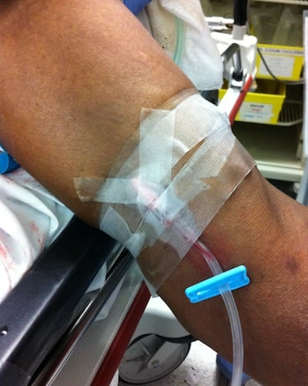
Fewer Prescriptions for Cancer Patients
Study of 318, 549 Medicare Patients
Older Black and Hispanic patients with advanced cancer are less likely than white patients to get opioid medications for pain in the last weeks of life
When Black and Hispanic patients received
opioids, they tended to receive lower doses
Black patients were also more likely to undergo
urine drug screening
Black men experienced the greatest inequality for both opioid access and urine drug testing
ANN Enzinger at al, J of Clinical Oncology, 2023
Free online MS photos

Slide 52
And What Our Society and most Institutions are Doing is not Working
In Isolation, Diversity Training is Not Effective

Slide 53
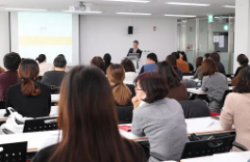
Our Diversity Training Programs Don’t Work
Research studies reveal little positive effects of diversity training programs on the careers of women and minorities
In a review of over 900 studies of antibias interventions, Paluck & Green found little evidence that diversity training reduces bias
Yes, training can increase knowledge about diversity and attitudes toward diversity, but to the extent that it triggers positive changes, they are small and short-term
Pixabay.com
Dobbin & Kalev, Anthropology Now, 2018

Slide 54
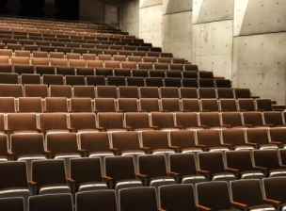
Limits of Implicit Bias Training
Before and after scores on the IAT test from over 400 studies found:
Observed effects of the IAT on reducing implicit bias were small
There were even weaker effects on reducing explicit bias
Other evidence also suggests that some participants learn to game the test
Unsplash.com
Dobbin & Kalev, Anthropology Now, 2018

Slide 55
Implicit (unconscious) Bias
Can be reduced under certain conditions

Slide 56
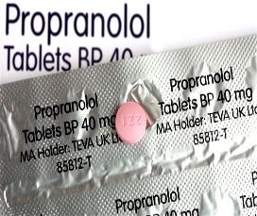
Propranolol Intervention?
Propranolol is a beta blocker that
reduces emotional conditioning and
amygdala responses to visual emotional
stimuli (e.g. facial expressions)
Randomized double blind, parallel group, placebo controlled design of a single oral dose of Propranolol (40mg) of 36 whites in the U.K.
Compared to placebo, propranolol eliminated implicit bias and reduced heart rate, but had no effect on explicit bias (measured by feeling thermometer: warmth to blacks, whites, homosexuals, Muslims, Christians, drug addicts)
Terbeck et al, Psychopharmacology, 2012

Slide 57
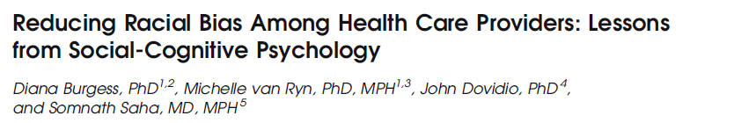
Multiple Prejudice-reducing Strategies:
Stereotype replacement
Counter-stereotype imaging
Individuation
Perspective taking
Increasing interracial contact

Slide 58
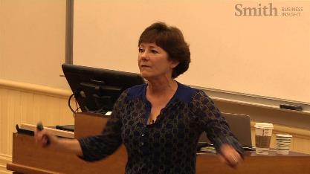
The Devine Solution
Implicit biases viewed as deeply engrained habits that can be replaced by learning multiple new prejudice-reducing strategies
Non-black adults were motivated to:
Increase their awareness of bias against blacks
Increase their concerns about the effects of bias
Implement multiple strategies
These were effective in producing substantial reductions in bias that remained evident three months later
Devine, P. G., Forscher, P. S., Austin, A. J., & Cox, W. T. L. 2012 J Exp Soc Psych

Slide 59
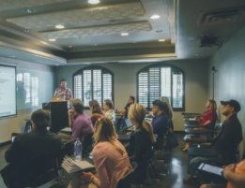
Model Program
Patricia Devine’s Model
Extensive 12-week curriculum
Homework exercises to complete
Observed effects were stronger for persons concerned about discrimination
Effects stronger for those who completed the homework exercises
Unsplash.com
Devine, P. G., Forscher, P. S., Austin, A. J., & Cox, W. T. L. 2012 J Exp Soc Psych

Slide 60
What Else Can We Do?

Slide 61
Strategy Number 1
Building More Health into the Delivery of Medical Care

Slide 62
Building More Health into the Delivery of Medical Care
Ensuring Access to Care for All

Slide 63

Colorectal Cancer (CRC) Intervention
State of Delaware fully funds a CRC screening program promoting colonoscopy in 2002
Provides reimbursement for uninsured residents up to 250% of Federal poverty level (FPL)
Other state residents eligible through other insurance
Cancer screening nurse navigator system added in 2004, at each of the 5 acute care hospital sites
Cancer treatment program added in 2004: covers costs of cancer care for 2 years for newly diagnosed uninsured if income under 650% FPL
Special outreach efforts for African Americans
S Grubbs et al. J Clin Oncology, 2013
This Photo by Unknown Author is licensed under CC BY-SA
This Photo by Unknown Author is licensed under CC BY-SA

Slide 64
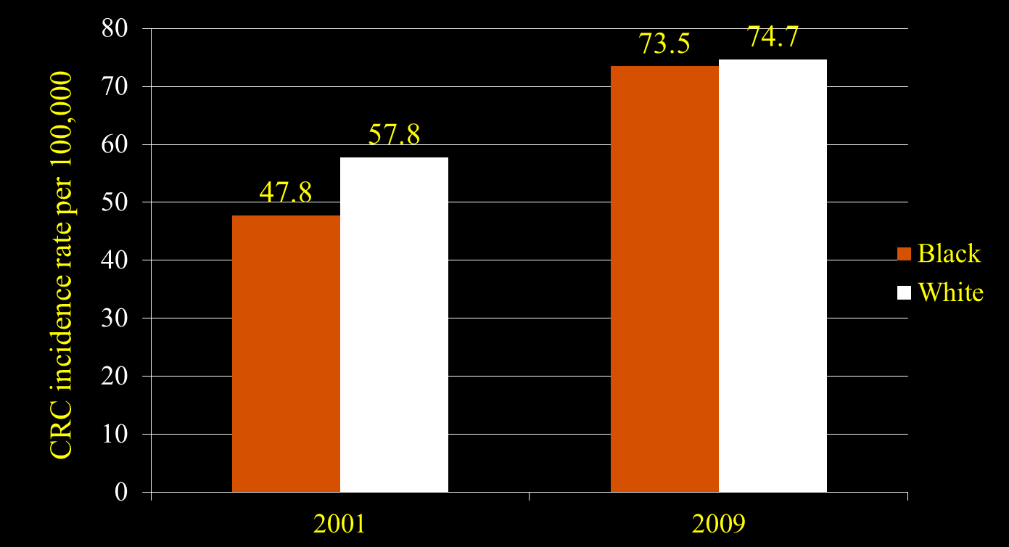
Eliminated screening disparities
3 – year average, age adjusted
S Grubbs et al. J Clin Oncology, 2013

Slide 65
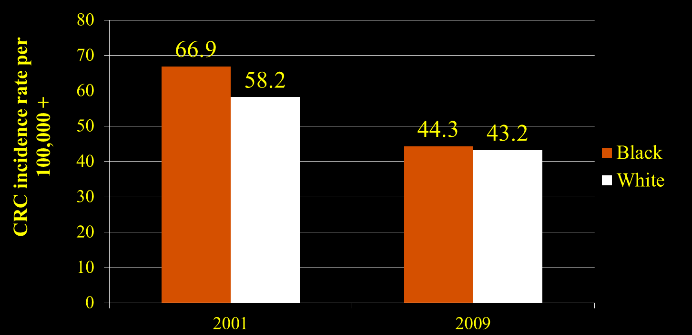
Equalized Incidence rates
3 – year average, age adjusted
S Grubbs et al. J Clin Oncology, 2013

Slide 66
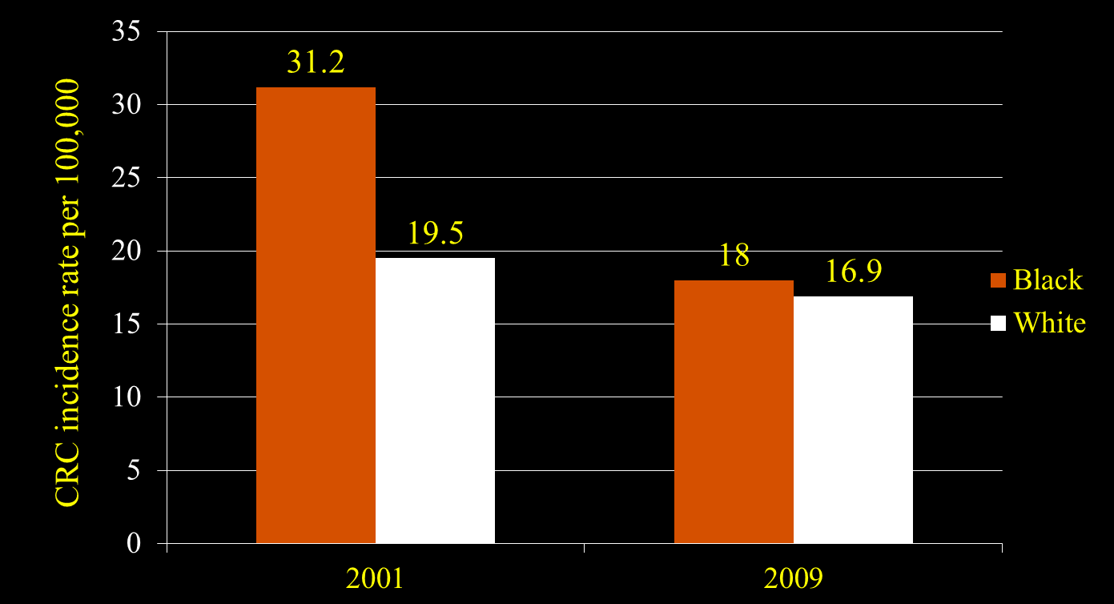
Near Elimination of Mortality Difference
3 – year average, age adjusted
S Grubbs et al. J Clin Oncology, 2013

Slide 67

Lessons from Delaware
Full access to care, with outreach and patient navigation can reduce some disparities
If done nationally, 4,200 fewer blacks would get CRC each year, and 2,700 fewer would die
The annual cost of screening ($1M) and treatment ($6M) was $7 million
Annual savings (due to reduced incidence & earlier diagnosis): $8.5M
Net Savings from the program: $1.5M per year
S Grubbs et al. J Clin Oncology, 2013 wikipedia

Slide 68
Building More Health into the Delivery of Medical Care
Diversifying the Workforce to meet the Needs of all Patients

Slide 69
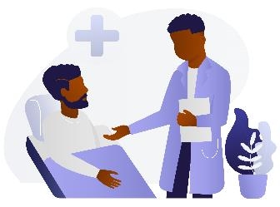
Physician Race & Health Care
A RCT of 1,300 Black men
Recruited from barbershops and flea markets
Given a coupon for a free health care screening at a Saturday clinic for
-- blood pressure,
-- body mass index,
-- cholesterol,
-- diabetes
Men randomized to see black doctors or not
$50 incentive for clinic attendance
Free Uber rides if need for transportation
Alsan, Garrick, Graziani, American Economic Review, 2019 Black Illustrations

Slide 70

Black Doctors and Black Health
Men who saw a Black Doctor
29% more likely to talk about other health problems
47% more likely to do screening for diabetes
56% more likely to get a flu vaccine
72% more likely to do screening for cholesterol
Alsan, Garrick, Graziani, American Economic Review, 2019
MS Online Pictures; Photo by Unknown Author

Slide 71
Huge Shortage of URMs in the Health Professions
AAMC, HRSA, 2020

Slide 72
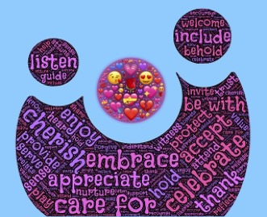
Provider Cultural Competence
Study of 437 people living with HIV/AIDS and 45 providers
Created 20-item scale, self-rated cultural competence
Racial disparities were found in the receipt of ARVs, self-efficacy and viral suppression among patients of low cultural competence providers
Minority patients whose providers were high (vs low) on cultural competence, more likely to be on ARVs, have high self-efficacy and report complete ARV adherence
When cultural competence was high, no racial disparities
Somath Saha et al., Journal General Internal Medicine, 2013 pixabay

Slide 73
Cultural Competence Scale (Selected)
Family & friends as important to health as doctors
Social history contributes to how I care for patients
I am familiar with lay beliefs my patients have
I ask my patients about alternative therapies they use
I find out what patients think is cause of their illness
I involve patients in decisions about their health care
S. Saha et al., Journal General Internal Medicine, 2013

Slide 74
Building More Health into the Delivery of Medical Care
Provide Care that Addresses the Social context

Slide 75
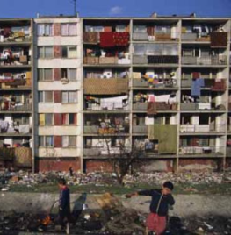
Care that Addresses the Social context
Why treat illness and send people back to live in the same conditions that made them sick in the first place?

Slide 76

Medical Legal Partnership
Enables MDs to refer to unique specialists:
on-site attorneys
Most low-income persons face legal issues
that affect their quality of life and their
management of disease
Adding lawyers to medical team can screen and assist families for these social problems that affect care
Stressors addressed: unhealthy housing, immigration, income, food, education access, disability, family law
Child with asthma, in moldy apartment, will not get well, regardless of meds, if conditions not improved
Zuckerman et al. Pediatrics, 2004

Slide 77
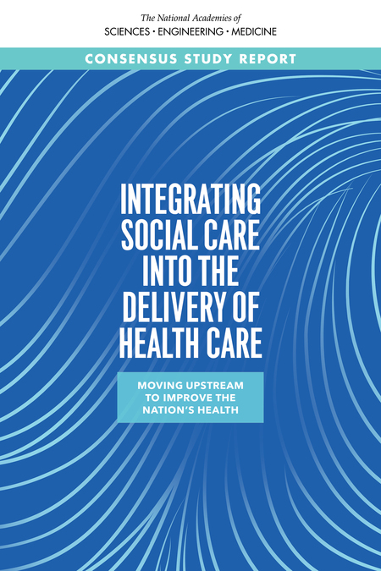
Recent Report: National Academy of Medicine
Many opportunities for health care systems and professionals to address the social needs of patients

Slide 78
Moving Further Upstream: Implementing Policies to Reduce Social Inequities in Health

Slide 79

Strategy Number 2
Create Communities of Opportunity to minimize, neutralize and dismantle the systems of racism that create inequities in health
MS Online Pictures; Photo by Unknown Author

Slide 80

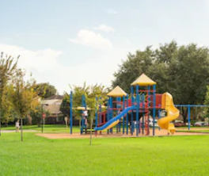
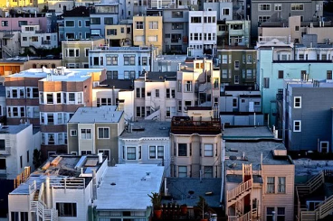
Reducing Inequities Address Place-Linked Determinants of Health
Enrich the quality of neighborhood environments
Increase economic development in poor areas
Improve housing quality and the safety of neighborhood environments
Shutterstock; Pixabay

Slide 81

Communities of Opportunity
Invest in early Childhood
Reduce Childhood Poverty
Enhance Income and Employment Opportunities for Youth and Adults
Improve Neighborhood and Housing Conditions
Enhance economic opportunities to build strong families/reduce disparities in marriage
Raise Awareness levels of Racial Inequities and Build Political Will to Address them
David R Williams & Lisa Cooper, Int J Environmental Res & Public Health, 2019
Shutterstock

Slide 82
Communities of Opportunity
Improve Neighborhood and Housing Conditions

Slide 83
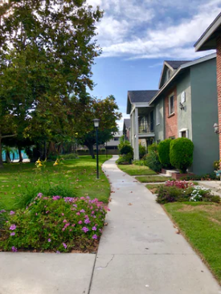
Moving to Opportunity
The Moving to Opportunity Program randomized families with children in high poverty neighborhoods to move to less poor neighborhoods.
10 to 15 years later, movers had lower levels of obesity, severe obesity & diabetes risk (HbA1c)
Unsplash.com
Ludwig et al. NEJM, 2011

Slide 84
Innovative Initiatives from Healthcare Institutions

Slide 85
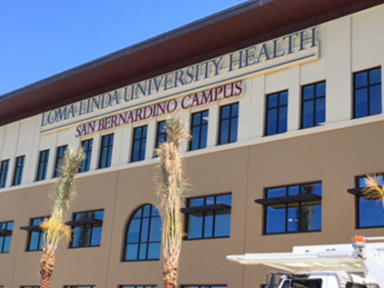
Loma Linda U Health: Addressing Community Needs
San Bernardino, CA, - one of the most disadvantaged cities in U.S.
Nearby Loma Linda University Medical Center intervenes
It builds a $68 Million, 157,000 sq. ft. clinic and education space
It has 124 exam and procedure rooms, 24 dental operatories
It is the largest specialty-based & teaching health center (THC) FQHC in the nation
Richard Hart, myll.llu.edu/news of the week July 2016

Slide 86
Loma Linda U Health: Addressing Unemployment
It also addresses a social determinant in the community
Only ~20% of high school graduates obtain any additional education
So the top floor is a “Gateway College”, to lower unemployment & provide job skills for high school graduates
The Gateway College offers certificate Programs: Certified Nurse’s Assistant, Pharmacy Tech, Surgical Tech, Community Health Worker
Richard Hart, myllu.llu.edu/news of the week July 2016

Slide 87
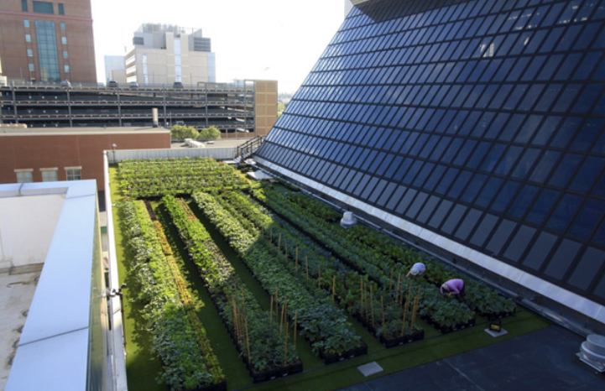
Rooftop Farm
Boston Medical Center implements rooftop farm to distribute high-quality produce to patients and their families, employees and visitors
Musicus et al, Am J Pub Hlth, 2019

Slide 88
Rooftop Farm
Farm contributes produce to hospital cafeterias, inpatient meal services, teaching kitchen, and preventive food pantry
Installation and roof modification cost $300,000
2,243 milk crate planters, growing more than 25 crop varieties and two beehives
One fulltime farmer, part-time assistant and hospital employee volunteers
Musicus et al, AJPH, 2019

Slide 89

Dignity Health: Addressing Access to Affordable Housing
Housing is an economic and social stressor for many families
Addressing housing is a priority for improving health and supporting neighborhood stability
Dignity Health (a health care system) invested $90 Million (low interest loans) to organizations that develop affordable housing from abandoned buildings
Pablo Bravo Vial, J of Catholic Hlth Association, September-October, 2019

Slide 90
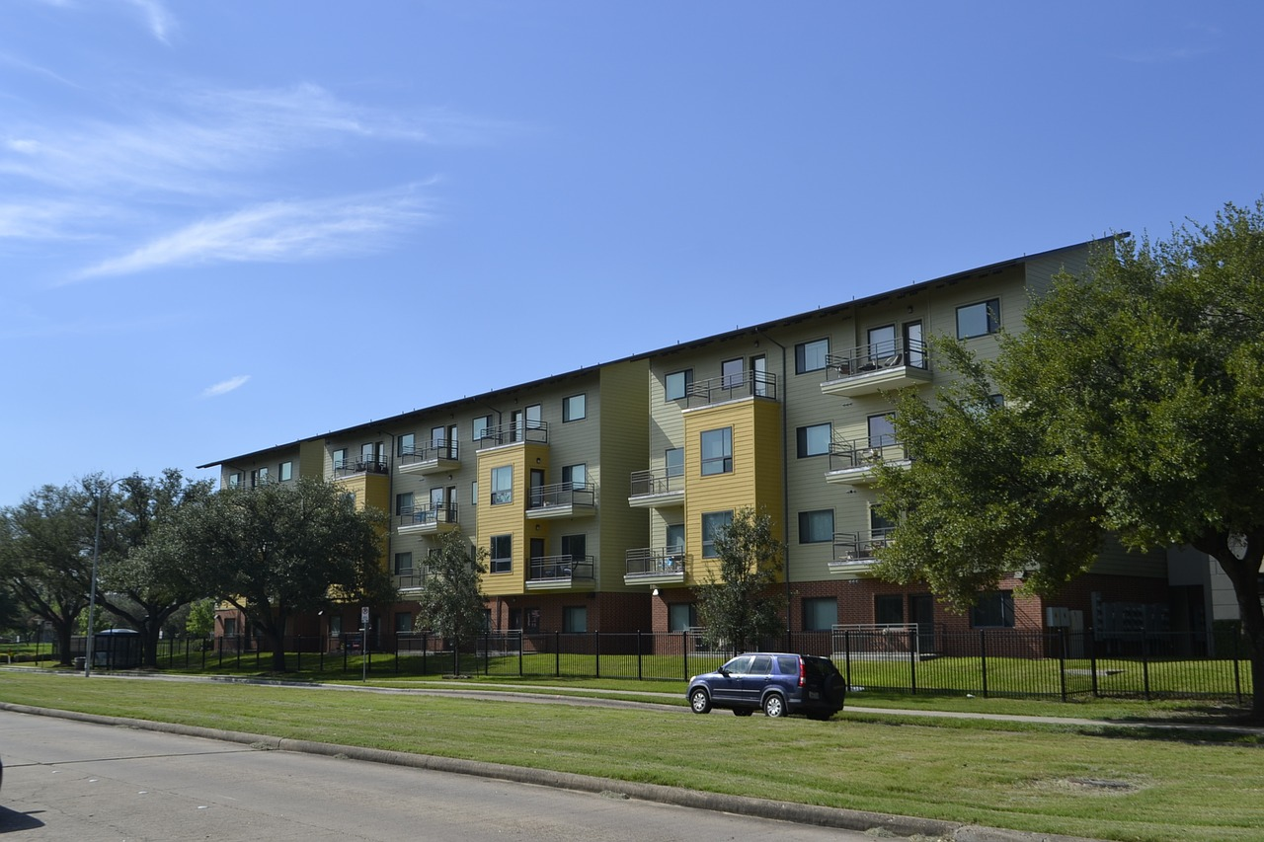
Dignity Health: Addressing Access to Affordable Housing
Partnered with more than 30 housing development projects
In Stockton, CA, 131 foreclosed homes & 3 apartment buildings refurbished
In Los Angeles, 600 housing units created or preserved
Pablo Bravo Vial, J of Catholic Hlth Association, September-October, 2019

Slide 91

Rush University Medical Center Equity Framework
Example of a Comprehensive Approach to Reducing Health Inequities in Race & SES by an Academic Medical Center
MS Free Photo: Photo by Unknown Author
David Ansell et al. NEJM Catalyst, May, 2021

Slide 92
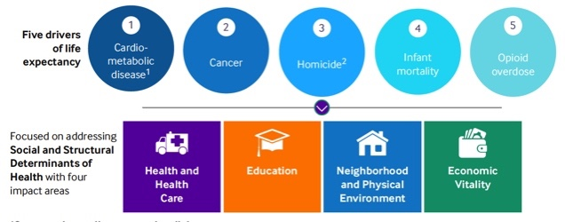
Goal: Cut Life Expectancy Gap by 50% (in Primary Service Area) by 2030
David Ansell et al, NEJM Catalyst, May, 2021

Slide 93

Rush Anchor Mission Initiative: Increase Local Hiring
Hire locally and develop talent
Employment Preference Initiative
Career ladder development
David Ansell et al. NEJM Catalyst, May, 2021

Slide 94

Rush Anchor Mission Initiative: Use Local Labor
Utilize local labor
Local labor for capital projects
Apprenticeship
Diversity hiring and contracts
David Ansell et al. NEJM Catalyst, May, 2021

Slide 95

Rush Anchor Mission Initiative: Buying Local
Buy and source locally
Local purchasing program
Prime vendor engagement
David Ansell et al. NEJM Catalyst, May, 2021

Slide 96

Rush Anchor Mission Initiative: Increase Local Investments
Invest locally and retirement readiness
Impact investing in local communities
403(b) plan auto-escalation and enrollment
Working credit
Payroll card
Fifth Third eBus (financial education)
David Ansell et al. NEJM Catalyst, May, 2021

Slide 97

Rush Anchor Mission Initiative: Employees Volunteering Locally
Volunteer
Employee engagement in local communities
Leveraging employee expertise (e.g., teaching skills class)
David Ansell et al. NEJM Catalyst, May, 2021

Slide 98
Why We Need to Act Now
We cannot Afford to Pay the MULTIPLE COSTS caused by Societal Racism and Health Inequities

Slide 99

‘Excess Deaths’: Racial Inequities in Health Equals A Massive Loss of Lives
Over 200 Black People, Dying Too Soon, Every Single Day
Levine et al., Health Affairs, 2001
MS Online Pictures; Photo by Unknown Author

Slide 100
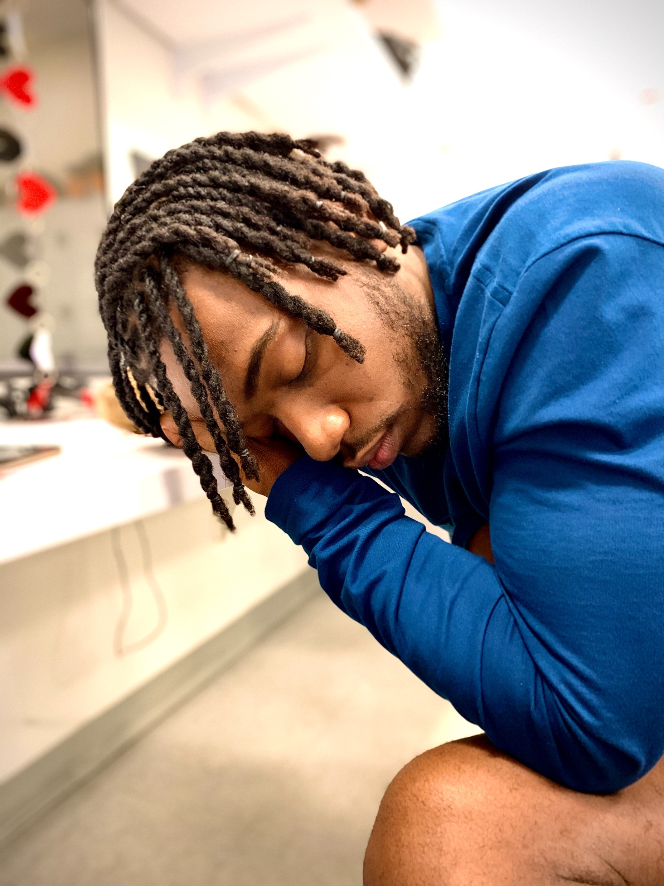
Poor Health = Large Economic Burden
As much as 50% of company profits go towards health care costs
Indirect costs (absenteeism, presenteeism) of poor health can be two to three times the direct medical costs
Productivity losses due to personal & family health problems cost US employers $225.8 billion/year ($1,685 per employee per year)
Institute of Medicine Roundtable, 2014; Partnership for Prevention, 2013
MS Free Online Photo

Slide 101

Annual Additional Economic Benefits
If US eliminated Racial Inequities by 2050, it would lead to:
Additional $8 trillion U.S. GDP (more than GDP of every country, except US & China)
Additional $3.3 trillion in earnings (by closing gaps in productivity & opportunity)
Additional $2.6 trillion in consumer spending ($330B on food, $860B on housing, $440B on cars & transportation and $90B on clothes & services)
Additional $1.4 trillion federal tax revenues and $325B state/local tax revenues
Increase of 0.5% in long-term annual growth rate
of the US economy
Business Case for Racial Equity, Altarum Institute, WK Kellogg Foundation, 2018
Unsplash.com

Slide 102

Ominous Storm Clouds
Racism is exacting a heavy toll on the health and lives, of young children
Pixabay

Slide 103
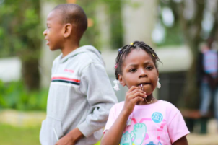
Suicide in Elementary School Children
National data reveal that between 1993 and 2012, the suicide rate for children, aged 5 to 11, was stable overall
Stable for Hispanic and Asian children
Marked decline in suicide among white children
Doubling of suicide for black children
Update: from ages 5 to 13, for black boys and girls, the suicide rate is twice as high compared with white children, up through 2015
Unsplash.com
These data beg the question: What does it feel like to be a Black child growing up in America today?
Jeffrey Bridge et al., JAMA Pediatrics, 2015; Jeffrey Bridge et al, JAMA Pediatrics, 2018

Slide 104
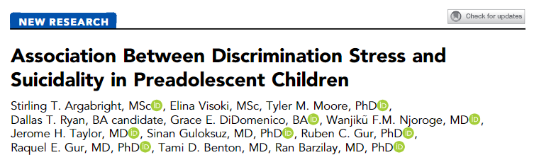
Racial Discrimination: A Driver of Suicidal Ideation
The ABCD Study of 11,235 of children (mean age: 11 years)
Black youth reported more discrimination and higher suicidality than other youth
High racial/ethnic discrimination was positively associated with suicidality (even after adjustment for other types of discrimination and suicide risk factors)
In matched analyses, high racial/ethnic discrimination was associated with increased risk of suicidality (RR = 2.7; 95% CI =2.0 -3.5) while Black race was not
Stirling Argarbright et al. J of the American Academy of Child & Adolescent Psychiatry, May, 2022
Notes:
Racial/ethnic discrimination is disproportionately experienced by Black children, and is associated with preadolescent suicidality, over and above other adversities.
Add the titles
Broaden the measures
Dylan Jackson – must broaden conceptualization

Slide 105
What Is Holding Us Back? What are the Barriers we have to Address?

Slide 106
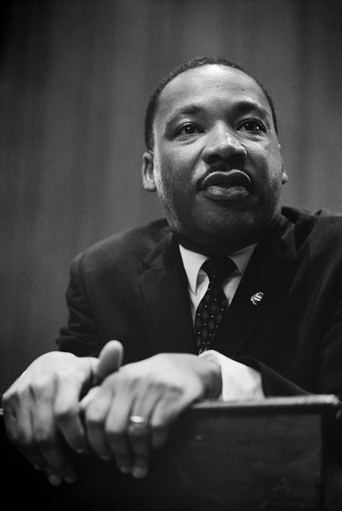
Self-Deception on a Large Scale
“The majority of white Americans consider themselves sincerely committed to justice for the Negro. They believe that American Society is essentially hospitable to fair play and to steady growth toward a middle-class utopia, embodying racial harmony. But unfortunately, this is a fantasy of self-deception and comfortable vanity. Overwhelmingly, America is still struggling with irresolution and contradictions. It has been sincere and even ardent in welcoming some change. But too quickly apathy and disinterest rise to the surface when the next logical steps are to be taken.”
Martin Luther King, Where Do We Go From Here: Chaos or Community?, 1967

Slide 107

--We need to raise awareness levels of the challenges (health and social) faced by disadvantaged racial/ethnic populations -- We need to build the science base that will guide us in developing the political will to address racial and other social inequities in health -- We need to build empathy, that is, identify how to tell the story of the challenges of the disadvantaged in ways that resonates with the public
3 Challenges linked to Communication
Unsplash.com

Slide 108
The Need to Build Empathy

Slide 109
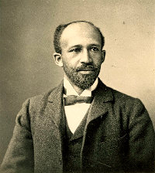
The Real Challenge
An Empathy Gap?
“The most difficult social problem in the matter of Negro health is the peculiar attitude of the nation toward the well-being of the race. There have… been few other cases in the history of civilized peoples where human suffering has been viewed with such peculiar indifference” W.E. B. Du Bois, 1899 [1967] p.163
https://www.phila.gov/personnel/Jobs/NonCivilServiceJobOpps.html

Slide 110

Review of Global Research on Empathy Gap
Studies of empathic responses in brain activity when viewing suffering of persons of one’s own race vs. members of another race
Racial ingroup bias consistently found in brain imagery studies in Europe, Africa, Asia, and the U.S.
Stronger empathic neural response to the pain of same race versus other race individuals, using a variety of stimuli
This racial bias in neural responses more consistent than self-reports of empathy
Han, S. Trends Cogn. Sci. 2018

Slide 111

Lack of Empathy, Evident Early in Life
Mainly white 5-, 7- and 10-year
olds rate pain of black and white
children
No racial bias at age 5
Children show weak bias (blacks feel less pain) at age 7
At age 10 children rate pain of black child less than white one (strong, reliable racial bias)
Unrelated to social preference (would like to be friends with)
We may need to start empathy training very young
R. Dore et al, Br J Dev Psych, 2014
http://www.huffingtonpost.com/2013/10/17/racial-empathy-gap_n_4118252.html

Slide 112


Benefits of Inclusive Policies
The creation of communities of opportunity to reverse racial injustice will be beneficial to people of all races
Policies that benefit communities of color will improve conditions for everyone, including many poor and working class whites
MS Online Pictures
R Godsil & S. Waldeck, The New Tipping Point, Emory Law Journal, 2021.

Slide 113
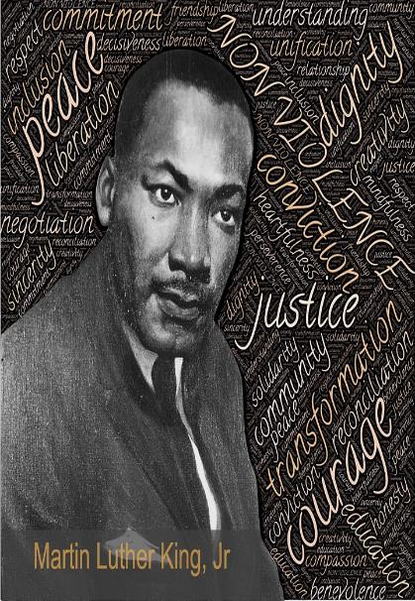
"True compassion is more than flinging a coin to a beggar; it understands that an edifice which produces beggars needs restructuring.”

Slide 114
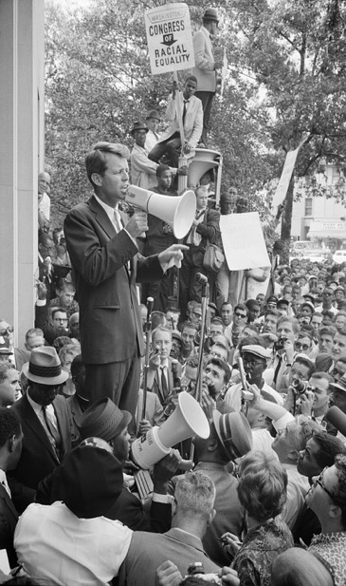
A Call to Action “Each time a man stands up for an ideal, or acts to improve the lot of others, or strikes out against injustice, he sends forth a tiny ripple of hope, and those ripples build a current which can sweep down the mightiest walls of oppression and resistance.”
- Robert F. Kennedy

