Slide 2
Part 1
What kinds of ticks are present in the ecosystem?

Slide 3
Part 1: What kinds of ticks are present in the ecosystem?
1. Use the photograph of the tick found on Max and the Tick Identification Key to identify the tick found on Max. What type of tick was found on Max?
2. Support your identification by checking the characteristics the tick had that helped in identification. You can also type “x” next to your selection.
____ Festoons
____ Long mouth parts
____ Several silvery markings
____ One single white spot
3. Use the Human Diseases Transmitted by Ticks reference page to determine what diseases, if any, this kind of tick is likely to be carrying.

Slide 4
Part 1: What kinds of ticks are present in the ecosystem?
4. Use the Tick Identification Key to identify the tick found on Lainey. What type of tick was found on Lainey?
5. Support your identification by checking the characteristics the tick had that helped in identification. You can also type “x” next to your selection.
____ Festoons
____ Long mouth parts
____ Several silvery markings
____ One single white spot
6. Use the Human Diseases Transmitted by Ticks reference page to determine what diseases, if any, this kind of tick are likely to be transmitted to humans.

Slide 5
Part 1: What kinds of ticks are present in the ecosystem?
7. Use the Tick Identification Key to identify the tick found on Daisy. What type of tick was found on Daisy?
8. Support your identification by checking the characteristics the tick had that helped in identification. You can also type “x” next to your selection.
____ Festoons
____ Long mouth parts
____ Several silvery markings
____ One single white spot
9. Use the Human Diseases Transmitted by Ticks reference page to determine what diseases, if any, this kind of tick are likely to be transmitted to humans.

Slide 6
Part 2
What pathogens can ticks carry?

Slide 7
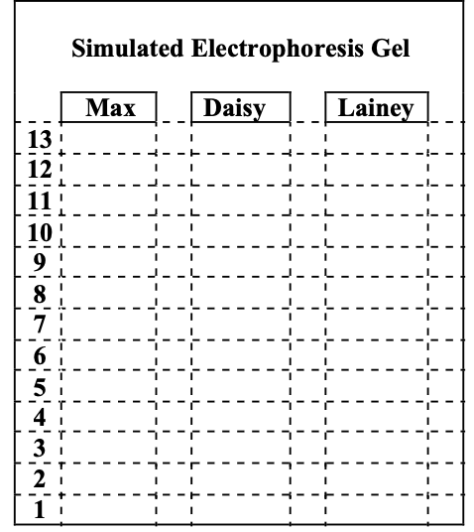
Part 2: What pathogens can ticks carry?
1. Use the Tick Pathogen Detection video to determine if any of the ticks removed from Dr. Louis’ patients were carrying pathogens. To record the banding pattern on the diagram on the right, move the pink DNA bands to the corresponding line where you observed a pink color change in the video for the simulated electrophoresis gel.
Select a pink DNA band from here
to drag it to the diagram on the right.

Slide 8
Part 2: What pathogens can ticks carry?
The Tick Pathogen Standard Key displays banding patterns for common tick-borne pathogens. Compare the banding patterns in the tick samples to the Tick Pathogen Standard Key.
2. Complete the laboratory form to return the results to Dr. Louis by placing an in the box where pathogens were detected.
X
DRAG THESE TO THE TABLE BELOW
X
X
X
X
X
X
X
 | Type of Pathogen Detected
Patient’s Name | Borrelia burgdorferi (Lyme Disease) | Ehrlichia chaffeensis (Ehrlichiosis ) | Francisella tularensis (Tularemia) | Anaplasma phagocytophilum (Anaplasmosis)
Max
Daisy
Lainey

Slide 9
Part 2: What pathogens can ticks carry?
3. Which pet’s owners should be notified of possible pathogen transmission to their dog?
4. During a follow up visit with Daisy, Dr. Louis was informed that Daisy’s owner was walking through the woods with Daisy when she was bitten by the tick. Dr. Louis was concerned that Daisy’s owner may also have been exposed to the pathogen through a tick bite. List some of the symptoms that Daisy’s owner might exhibit if he was exposed to this pathogen.

Slide 10
Part 3a
Analyzing patterns in tick-borne diseases
(Distribution)

Slide 11
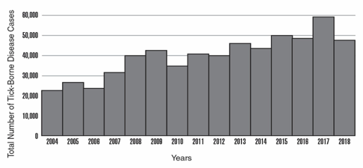
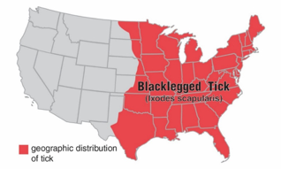
Part 3a: Analyzing patterns in tick-borne diseases
(Distribution)
Total number of reported tick-borne diseases in humans from 2004-2018
1. Use the graph provided to describe the overall trend in the incidence of tick-borne diseases in the United States.
Modified from CDC https://www.cdc.gov/ticks/data-summary/index.html
Map of Blacklegged Tick Distribution
2. What part of the United States would you most likely find blacklegged ticks?
Modified from CDC https://www.cdc.gov/ticks/geographic_distribution.html

Slide 12
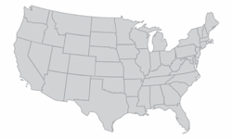
Part 3a: Analyzing patterns in tick-borne diseases
(Distribution)
3. On the map to the right, Drag the circle below to identify the region of the country researchers focus on because blacklegged tick-borne diseases are prevalent there.
DRAG this circle to the map. You can make the circle larger or smaller to cover the region you identify.
DRAG ME
to the Region
4. Does the incidence of these diseases correlate with the entire geographic range of the blacklegged tick? Support your answer.

Slide 13
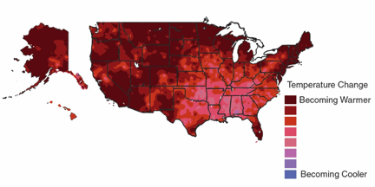
Part 3a: Analyzing patterns in tick-borne diseases
(Distribution)
5. What is the trend in annual temperature in the region you identified as important to tick-borne diseases?
Change in Average Annual Temperature
Modified from Climate Science Special Report https://science2017.globalchange.gov/chapter/6/
6. Can this pattern in temperature change provide an explanation for the increase in tick-borne diseases in this entire region? Support your answer with information from the Change in Average Annual Temperature map and the previous maps.

Slide 14
Part 3b
Analyzing patterns in tick-borne diseases
(Environmental Factors)

Slide 15
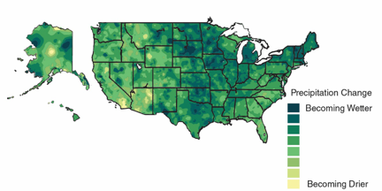
Part 3b: Analyzing patterns in tick-borne diseases
(Environmental Factors)
7. What is the trend in annual precipitation in the region you identified as important to tick-borne disease?
Change in Average Annual Precipitation
Modified from Climate Science Special report https://science2017.globalchange.gov/chapter/7/
8. Can this pattern in precipitation change provide an explanation for the increase in tick-borne diseases in this entire region? Support your answer with information from the Change in Average Annual Precipitation map and the previous maps.

Slide 16
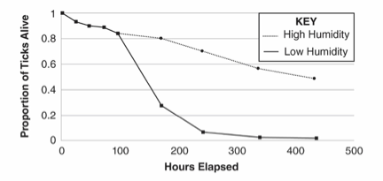
Part 3b: Analyzing patterns in tick-borne diseases
(Environmental Factors)
9. What effect does relative humidity have on the proportion of ticks alive after 200 hours?
This graph represents the data that the scientists collected:
Modified from PLoS ONE https://www.ncbi.nlm.nih.gov/pmc/articles/PMC5226345/
10. Does the data support the scientists’ hypothesis? Why or why not?
11. Explain how this difference in behavior could lead to more tick-borne pathogens spreading to humans in the Northeast.

Slide 17
Part 4a
Do living things influence
the pattern of tick-borne diseases?

Slide 18
Part 4a: Do living things influence the pattern of tick-borne diseases?
1. According to the Complex Interactions Model model, what organism is eaten by immature ticks?
2. What effect would an increase in acorns have on the number of ticks in the environment? Explain.
3. What effect would an increase in the number of small mammal predators have on the number of ticks?

Slide 19
Part 4a: Do living things influence the pattern of tick-borne diseases?
If you did not do so yet, Click Here to see if you found where the bacteria that causes Lyme disease is transferred to the tick, then answer questions 4-5.
4. Use the information from the two diagrams to explain how Daisy and her owner were most likely exposed to Borrelia burgdorferi, the bacteria that causes Lyme disease.Move the numbers (2-8) to the lines to place the events in the correct order.
2
3
4
5
6
7
8
____ Immature tick feeds on chipmunk.
____ Ticks bite Daisey and her owner.
1 Adult ticks mate on deer.
____ Immature ticks leave deer to find a small mammal host.
____ Tick leaves small mammal host, waits for new host on plants.
____ Bacteria is transferred from chipmunk to tick.
____ Immature ticks hatch from eggs on deer.
____ Ticks leave the plant for a dog or human host.
9 Tick bites transfer bacteria to Daisy and her owner.
5. People often read in the newspaper that when deer populations are high, there is an increased risk for tick-borne diseases. Explain why a large deer population may increase the transmission of tick-borne diseases.

Slide 20
Part 4b
Predicting
Incidence of Disease

Slide 21
Part 4b: Predicting Incidence of Disease
6. Use the information from the two diagrams to explain how Daisy and her owner were most likely exposed to Borrelia burgdorferi, the bacteria that causes Lyme disease.
DRAG and move this letter A in the box on the timeline corresponding to each year there was a peak in the number of acorns.
DRAG and move this letter C in the box on the timeline corresponding to each year there was a peak in the number of chipmunks.
DRAG and move this letter T in the box on the timeline corresponding to each year there was a peak in the number of immature ticks.
A
C
T
Timeline
1993 | 1994 | 1995 | 1996 | 1997 | 1998 | 1999 | 2000 | 2001
7. Describe how the pattern of peaks in the chipmunk population compares to the pattern of peaks in the acorn population.

Slide 22
Part 4b: Predicting Incidence of Disease
8. Provide an explanation for this pattern.
9. Describe how the pattern of peaks in the chipmunk population compares to the pattern of peaks in the tick population.
10. Provide an explanation for this pattern.

Slide 23
Part 4b: Predicting Incidence of Disease
11. In what 2 years would you expect to see an increase in tick-borne diseases? Why?
12. Assume that 2001 is a peak in the acorn population. What year, following this peak would you warn people about a potential increase in tick-borne diseases? Why?
13. Would environmental scientists worried about tick-borne diseases recommend an increase or a decrease in the population of apex predators?

Slide 24
Part 4b: Predicting Incidence of Disease
14. Explain why environmental scientists would make this recommendation.
15. Provide at least two actions an environmental scientist might suggest to decrease the number of tick-borne diseases that are transmitted to humans, based on the complex interactions in this ecosystem.

Slide 25
Part 5
What should pet owners know about tick-borne diseases?

Slide 26
Part 5: What should pet owners know about tick-borne diseases?
Use the internet resources provided to develop well-written responses to the questions that can be included in the FAQ sheet for Dr. Louis.

Slide 27
Part 5: What should pet owners know about tick-borne diseases?
What should I do if I see a tick on my pet?
Link: https://www.cdc.gov/ticks/removing_a_tick.html

Slide 28
Part 5: What should pet owners know about tick-borne diseases?
If my pet is diagnosed with a tick-borne disease,
why should I contact my own doctor?
Link: https://www.avma.org/resources/pet-owners/petcare/lyme-disease-pet-owners-guide

Slide 29
Part 5: What should pet owners know about tick-borne diseases?
What kind of precautions can I take to prevent tick bites on my pet?
Link: https://www.cdc.gov/ticks/avoid/on_pets.html

Slide 30
Part 5: What should pet owners know about tick-borne diseases?
What kind of precautions can I take to prevent tick bites on me?
Link: https://www.cdc.gov/ticks/avoid/on_people.html

Slide 31
FAQs…
(Use this page to organize the four questions and responses)

Slide 32
Part 6
One Health and tick-borne diseases

Slide 33
Part 6: One Health and tick-borne diseases
1. Use the information in the first text box to explain what must be involved in a complex problem for it to be considered a One Health problem.
2. Use the information in the second text box and what you learned about ticks and tick-borne diseases to develop your digital slide. The Online Resources and Template slides on the next set of page may help you organize your digital slide.

Slide 34
Online Resources:
Click titles below for tick -related One Health Resources:
Ticks and Lyme Disease: Symptoms, Treatment, and Prevention | FDA
Safe Use of Flea and Tick Products in Pets | FDA
PUBLIC WORKSHOP: EMERGING TICK-BORNE DISEASES & BLOOD SAFETY
Tick-Borne Encephalitis Vaccine for humans (TICOVAC)
Package Insert - TICOVAC
Scientific Article about Ticks in the USA
Click titles below for General One Health Resources:
One Health in Action
One Health | USDA
One Health: It's for All of Us | FDA
Continue to next slide for your Digital Slide Template

Slide 35
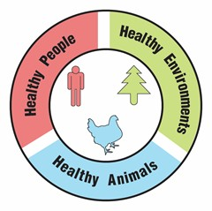
Part 6: One Health and tick-borne diseases
Why is an increase in tick-borne diseases a One Health problem?
1-2 sentences that answer the question | Picture with brief caption
Picture with brief caption | Picture with brief caption

Slide 36
Ticks, Biodiversity, and Climate
Digital Lab Student Evaluation Form.
CLICK HERE
To complete and submit your feedback
Notes:
Now that you have finished, discuss your responses to Part 6 with your teacher(s), classmates, and others who may be learning about One Health concepts. Perhaps others have thought of similar ideas to the ones you shared. Alternatively, you could learn new things that you had not thought of before. Continue learning and enjoying investigating your responses more using the resources from this field trip.
Also if you want to help provide input on the next Virtual Field Trip, return to the virtual field trip website (use the CLICK HERE on the slide) and complete the survey questions . We value your feedback.

Slide 37
Extension Activity
1. Identify your own One Health Problem: Brainstorm ideas using the table below. Be sure to include issue(s) related to humans, animals, and the environment.
One Health Problem
Environment | Animals | People

Slide 38
Extension Activity
2. Identify your own One Health Solutions: Brainstorm ideas for actions that could be taken to “solve” parts of problem that you describe. Be sure to include actions that would improve the health of humans, animals, and the environment.
One Health Problem
Environment | Animals | People

Slide 39
Extension Activity
3. Which One Health solution would be easiest for you to implement? Explain why you chose that solution.
4. Which One Health solution would be easiest for local communities to implement? Explain why you chose that solution.
5. Which One Health solution would have the greatest impact on solving the One Health problem caused by the invasion of ticks? Explain why you chose that solution.

Slide 40
Additional Notes

Slide 41
Additional Notes

Slide 42
Additional Notes

