Slide 1

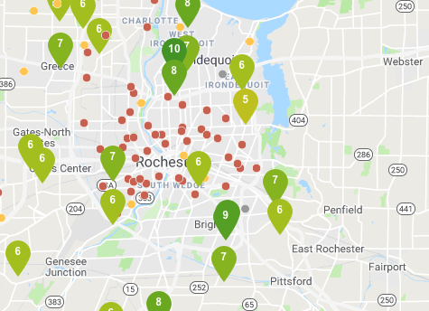
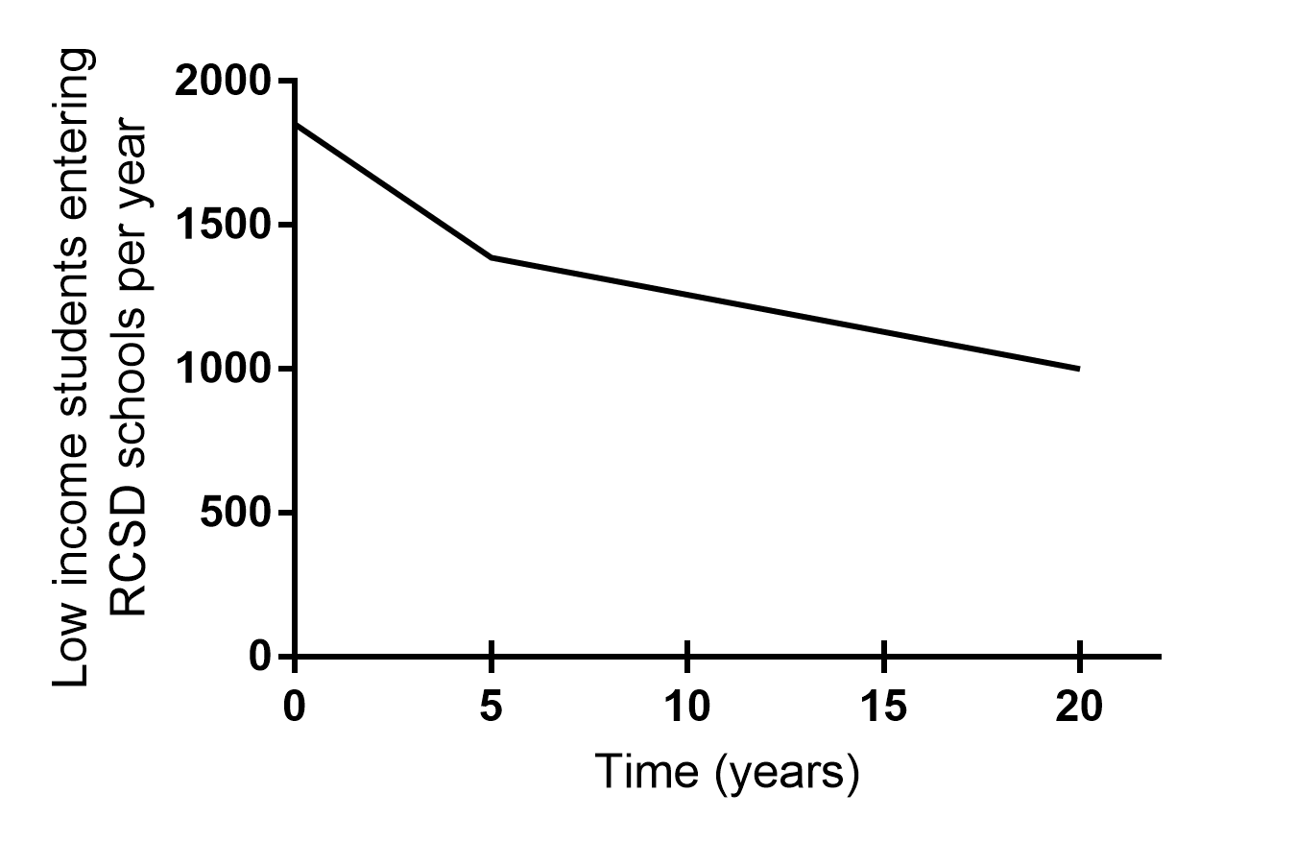
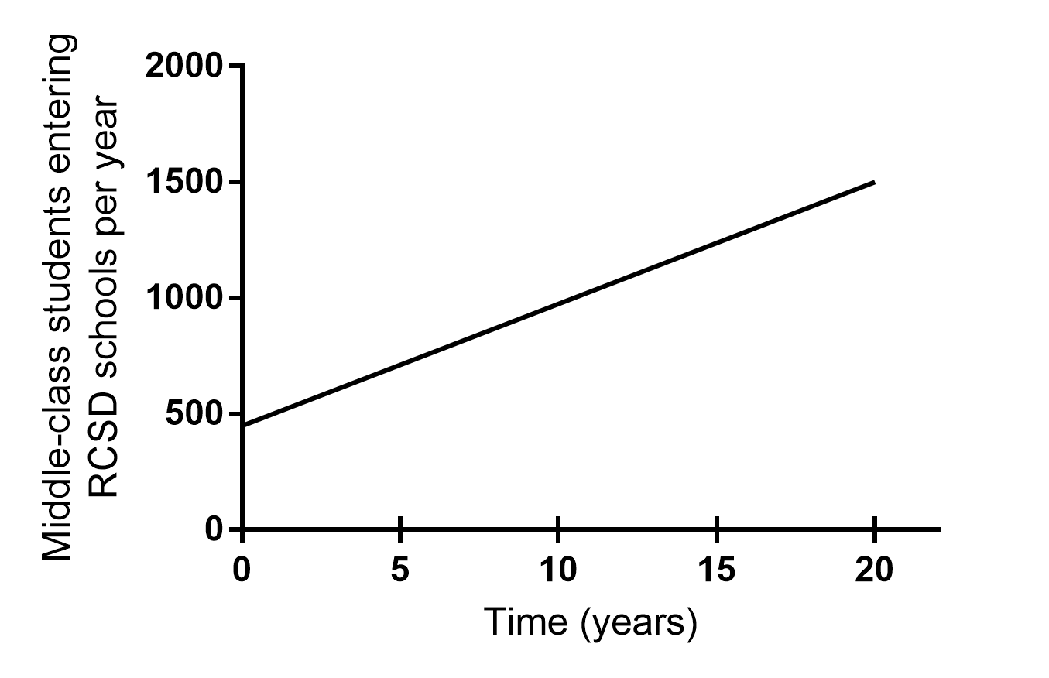
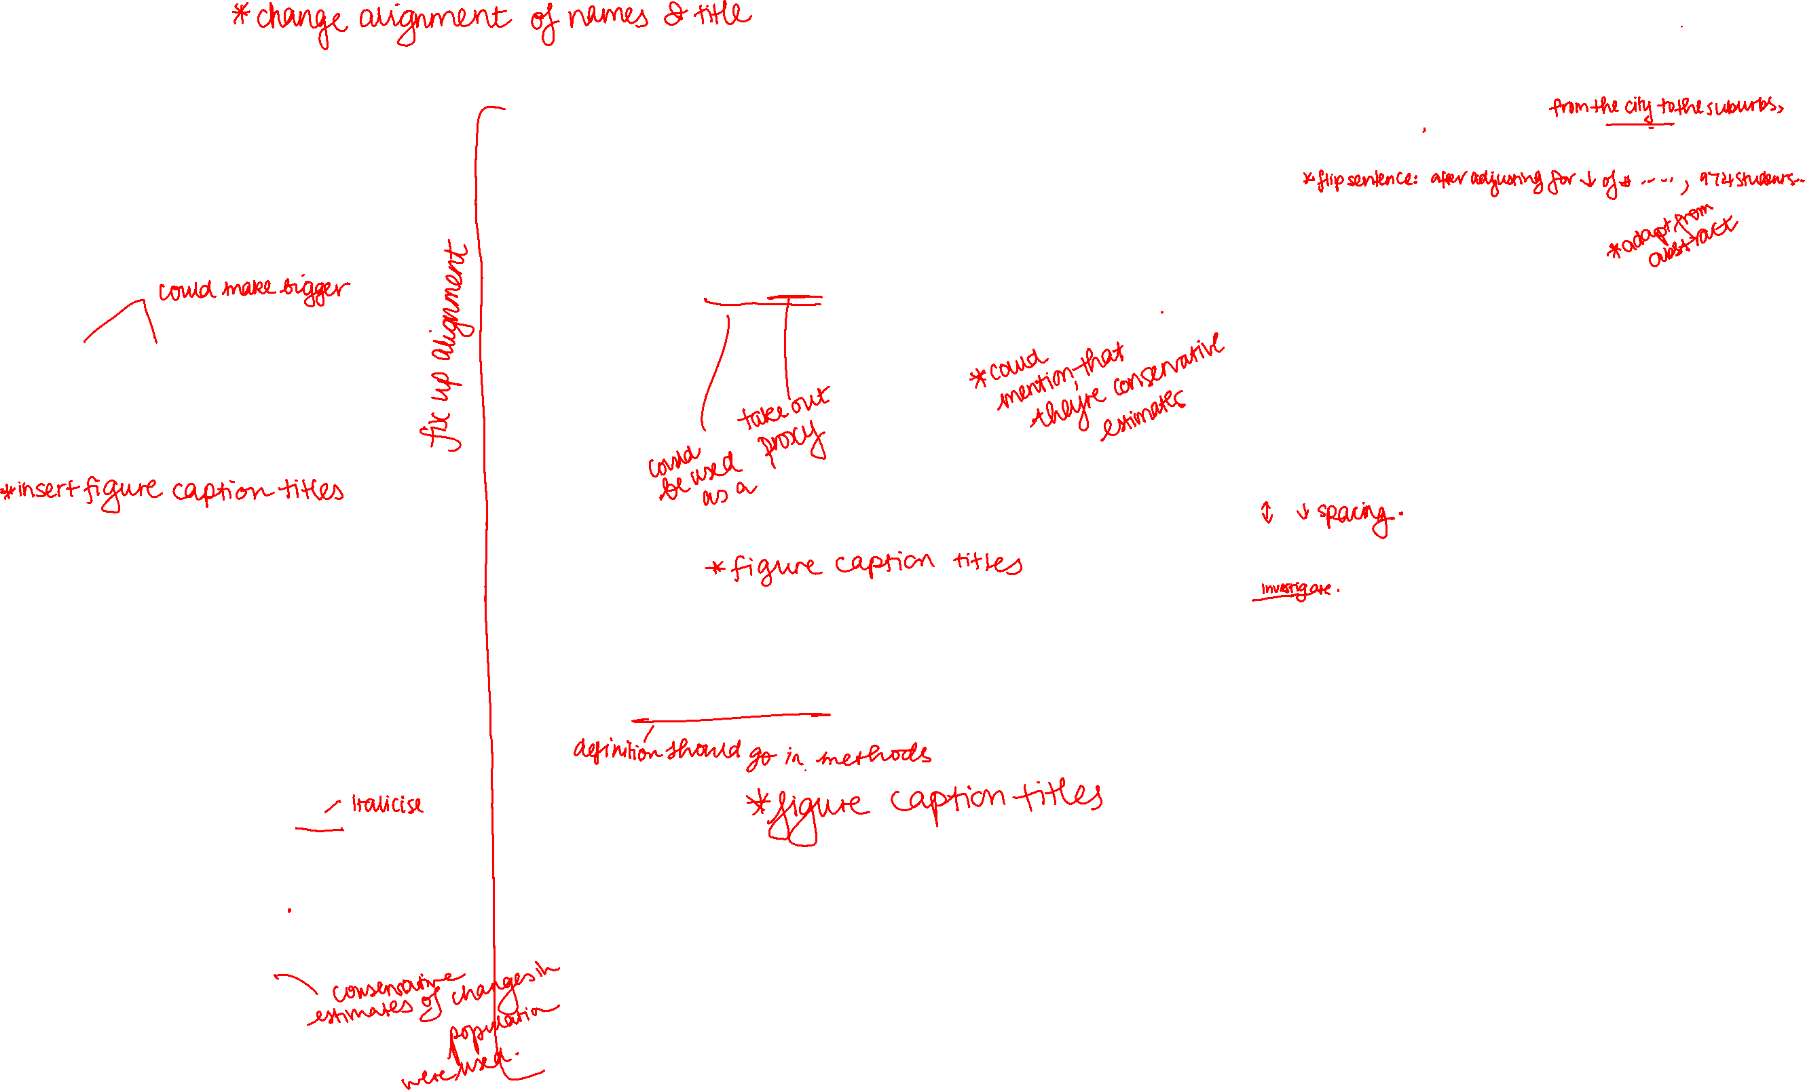
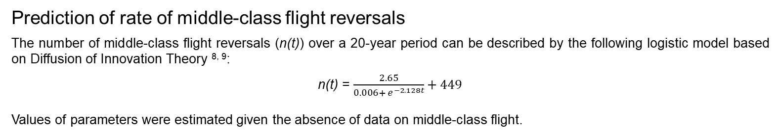
Assessment of Feasibility of Socioeconomic Integration of Rochester City School District Schools through Reversal of Middle-Class Flight
D. Vitharana¹, Morehouse School of Medicine¹, A. Aligne, MD, MPH², University of Rochester Medical Center, The Hoekelman Center, Department of Pediatrics², SCRC Summer Program³
Introduction
Results
Rochester City School District (RCSD) schools, with a total enrollment of 26, 687 students, are considered to be high-poverty (86%), low-achieving schools. ^{1, 2}
Poor educational attainment is associated with an increased risk of intergenerational poverty and health problems. ³
Students in schools integrated by socioeconomic status (SES) with a 60 to 40 percent ratio of middle-class to low-income students (eligible for free or reduced-price lunches (FRL)), perform better academically. ^{4, 5}
Genesee Community Charter School (GCCS) is integrated by SES and is the only high-achieving school in the city.
A major barrier to SES integration is the perceived lack of middle-class students to integrate RCSD’s high-poverty schools. ⁶
Estimation of number of middle-class students necessary to integrate RCSD schools through prevention of middle-class flight alone
2474 middle-class students per year for 20 years.
Prediction of trends in low-income and middle-class students entering kindergarten in RCSD schools
Anti-poverty initiatives in Rochester e.g. The LARC Initiative and the Rochester-Monroe Anti-Poverty Initiative are believed to be decreasing the number of children born into, or currently in, poverty in Rochester.
  In Colorado, long-acting reversible contraception (LARC) use led to a 25 percent decrease in use of Special Supplemental Nutrition Program for Women, Infants, and Children (WIC; utilization of WIC could be used as a measure of the number of children being born into poverty). ⁷
Decreases in child poverty increase the number of middle-class students entering kindergarten in RCSD schools each year.
  As a result, fewer middle-class students would need to stay in the city (who would otherwise move to the suburbs) and be enrolled in RCSD schools to achieve SES integration.
After adjusting for decreases in the number of low-income students entering the district each year, 974 middle-class students who would otherwise move from the city to the suburbs would need to be introduced each year for 20 years to achieve complete SES integration of RCSD.
Conclusions
Increased school quality
Decreased resident out-migration
Increased SES integration of school
Integration of RCSD schools by SES would not be feasible by solely relying on the prevention of middle-class flight to increase the number of middle-class students in the district.
Efforts to decrease child poverty would decrease the number of low-income students entering RCSD.
The number of middle-class students entering the district each year is also predicted to increase.
This in turn would decrease the extent to which middle-class flight would need to be reversed.
Our analysis suggests that decreasing child poverty and reducing middle-class flight would make SES integration of RCSD schools over a 20-year period attainable.
Figure 1. School quality, resident out-migration, and socioeconomic integration are inherently linked.
Figure 2. Map of school quality in Rochester, NY. GCCS (denoted by the arrow) is the only high-achieving school in the City of Rochester. Retrieved from greatschools!.org
Future Directions
Objectives
Determine the number of middle-class students leaving the city of Rochester each year from property sales.
Validate the applicability of Diffusion of Innovation Theory for modeling middle-class flight reversals.
Compare the predicted number of middle-class flight reversals necessary to achieve SES integration to the actual value determined from property sales.
Investigate and identify evidence-based strategies that improve school quality in order to further supplement efforts to integrate RCSD schools by SES.
Investigate the feasibility of achieving socioeconomic integration of RCSD, with a 60 to 40 percent ratio of middle-class to low-income students, through the introduction of middle-class students over a 20-year time period.
Determine of the number of middle-class households leaving the City of Rochester for the suburbs of Rochester each year.
Figure 3. Predicted change in the number of low-income students entering kindergarten in RCSD each year. The number of low-income students entering RCSD is predicted to decrease by 25 percent over the first five years, and then by 28 percent over the next 15 years, from 1851 students to 1000 students.
Figure 4. Predicted change in the number of middle-class students entering kindergarten in RCSD each year. The number of middle-class students entering RCSD schools in kindergarten each year is predicted to increase almost three-fold over 20 years from 449 students to 1500 students.
Methods
Prediction of rate of middle-class flight reversals
The number of middle-class flight reversals (n(t)) over a 20-year period can be described by the following logistic model based on Diffusion of Innovation Theory ^{8, 9}:
n(t) = $\frac{2.65}{{0.006+ e}^{−2.128t}}+449$
Values of parameters were estimated given the absence of data on middle-class flight.
References
1. Determine of number of households moving from the city to the suburbs of Rochester each year
2017 property sales for Monroe County, NY and Victor, NY were obtained from The New York State Office of Real Property Tax Services (NYSORPTS) SalesWeb to quantify out-migration from the City to the suburbs of Rochester.
  Previous addresses of buyers were determined using The White Pages, and the number of households moving from the City of Rochester was counted.
  Each household was assumed to have two children.
2. Estimate the number of middle-class families that would need to stay in city to completely integrate the district by SES
Estimated based on RCSD school poverty rate and kindergarten enrollment.
3. Predict changes in numbers of low-income and middle-class kindergarten students entering RCSD schools each year over 20 years
Predictive models were created to determine the numbers of low-income and middle-class students entering kindergarten in RCSD schools each year.
4. Predict the rate of reversal of middle-class flight from the city to the suburbs of Rochester based on Diffusion of Innovation Theory
Modeled the change in the number of middle-class households living in the City of Rochester that would have otherwise moved to the suburbs of Rochester (middle-class flight reversals).
Modeled as a logistic model using diffusion of innovation theory.
New York State Education Department. (n.d.). School Report Card Data [2016 – 17] Retrieved from https://data.nysed.gov/reportcard.php?instid=800000050065&year=2017&createreport=1&freelunch=1.
New York State Education Department. (n.d.). Rochester City School District Enrollment (2016 – 17). Retrieved from https://data.nysed.gov/enrollment.php?year=2017&instid=800000050065.
Ross, C. E., & Wu, C. (1995, October). The Links Between Education and Health. American Sociological Review, 60(5), 719-745.
McFarland, J., Hussar, B., Wang, X., Zhang, J., Wang, K., Rathbun, A., Barmer, A., Forrest Cataldi, E., & Bullock Mann, F. (2018, May). Characteristics of Traditional Public Schools and Public Charter Schools. The Condition of Education 2018. Retrieved from https://nces.ed.gov/pubs2018/2018144.pdf.
Grant, G. (2011). Hope and despair in the American city, 104.
Kahlenberg, R. D. (2012). The Future of School Integration, Socioeconomic Diversity as an Education Reform Strategy, 186.
LARC4CO. (n. d.). Poverty. Retrieved from http://www.larc4co.com/poverty/.
Voit, E. O. (2013). A First Course in Systems Biology.
Kumar, Naresh. (2015, June). Review of Innovation Diffusion Models. Retrieved from https://www.researchgate.net/publication/279099570_Review_of_Innovation_Diffusion_Models.
Aligne, A. (2018). LARC Initiative for 2WB 2018 [PowerPoint slide].
Orr, G. (2003, March). Diffusion of Innovations, by Everett Rogers (1995). Retrieved from https://web.stanford.edu/class/symbsys205/Diffusion%20of%20Innovations.htm.
Figure 5. Model of Diffusion of Innovation Theory. ¹⁰ Diffusion of Innovation Theory describes how an innovation is disseminated in a social system over time, and can be modeled as a logistic model. ^{9, 11} At the tipping point, the rate of adoption increases dramatically. ¹¹
Figure 6. Predicted number of middle-class flight reversals over 20 years. The number of middle-class flight reversals is predicted to increase from 449 students to 974 students over a 20-year period. The rate of change of middle-class reversals is predicted to increase most dramatically approximately two to four years after middle-class flight reversal occurs.
Notes:
Reduce amount of text, more pictures, stats

